Slide 1
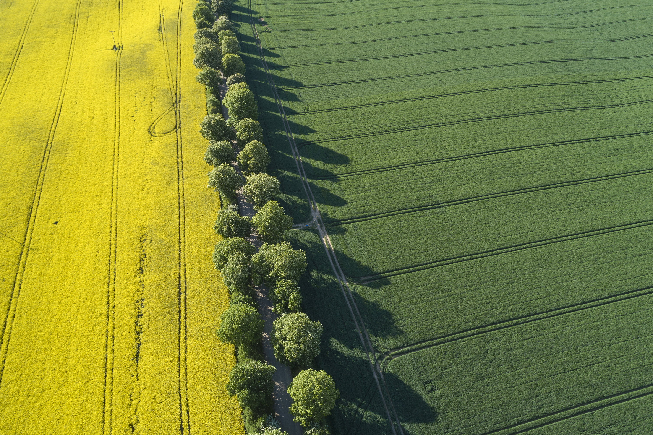

Select Agriculture...
Subject selection could be…
Agricultural Technology Years 7–10
Agriculture Years 11 - 12
Primary Industries HSC VET Years 11-12

Slide 2
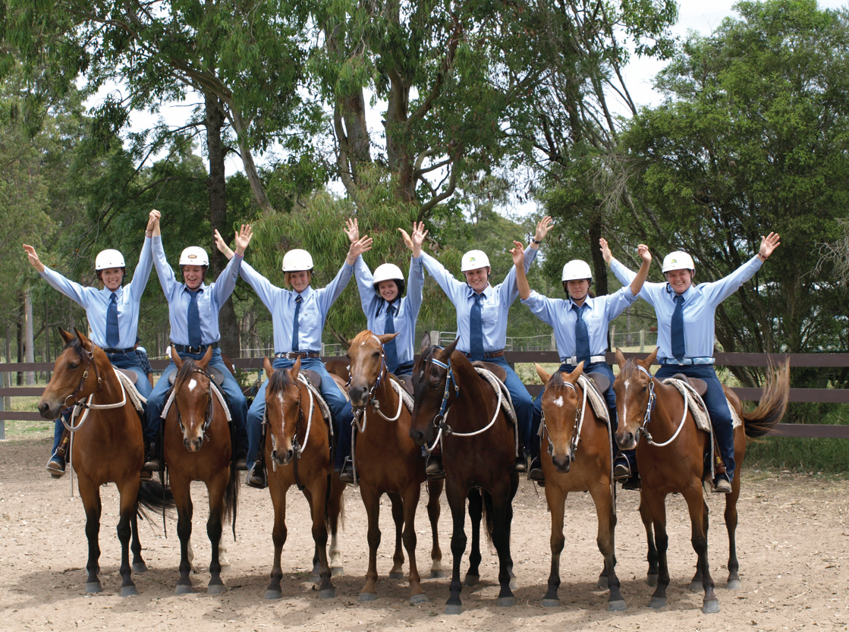
Course Description
Work with plants and animals using the appropriate agricultural technologies
Explore careers in agriculture
Investigate the sustainability of agricultural systems
Agricultural supply chain: production, processing and consumption.
What students learn
Study the interactions, management and sustainability of plants, animals or integrated plant/animal agricultural systems (intensive and extensive) in your local environment.
Conduct fieldwork, small plot activities, laboratory work, and visits to commercial farms and other parts of the production and marketing chain.
Learn about Work Health and Safety issues, develop skills in designing, investigating and managing farms.
Agricultural Technology Years 7–10
Select Agriculture...
Course Requirements (100 or 200 hour course)
You will undertake a range of practical experiences that occupy the majority of course time.
Introduction to Agriculture AND/OR Agricultural Systems and Management
Plant Production
Animal Production
Step into Agriculture
https://educationstandards.nsw.edu.au/wps/portal/nesa/k-10/learning-areas/tas/course-descriptions-7-10

Slide 3
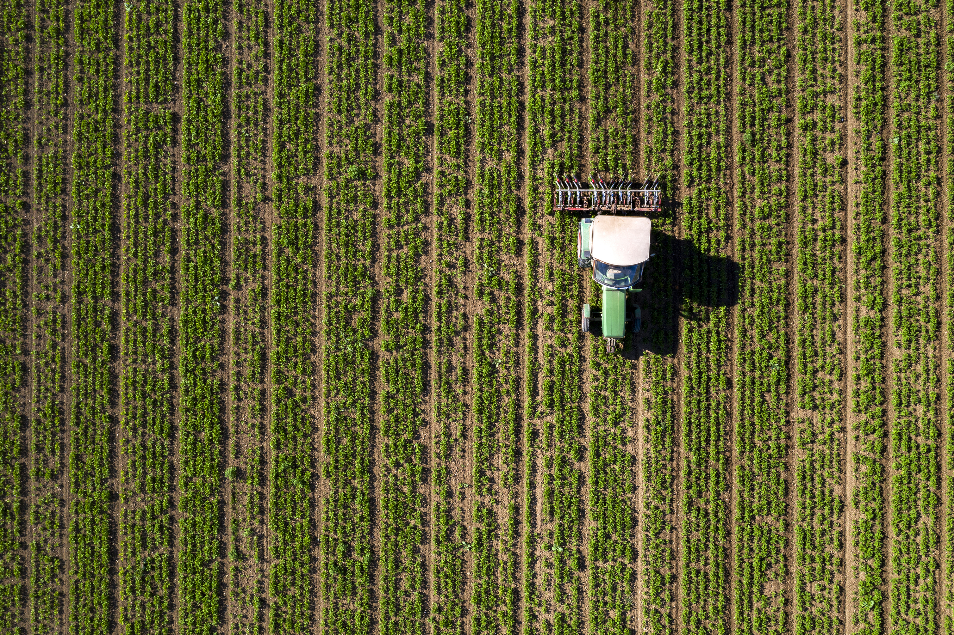
Stage 6
Dual accreditation – 2 units HSC and AQF AHC20116 or AHC20416 Certificate 2 qualification.
Demonstrates extensive knowledge and understanding of the HSC mandatory focus areas including Chemicals; Safety; Sustainability; Weather and Working in the industry
Demonstrates extensive knowledge and understanding of one HSC stream focus area – Livestock health and welfare (Agriculture stream) or Plant pests, diseases and disorders (Horticulture stream)
Communicates in a coherent, succinct and logical manner
Uses industry terminology accurately and appropriately with relevant workplace examples
Primary Industries
HSC VET
Select Agriculture...
Step into Agriculture
https://educationstandards.nsw.edu.au/wps/portal/nesa/11-12/stage-6-learning-areas/vet/primary-industries-syllabus/pbd

Slide 4
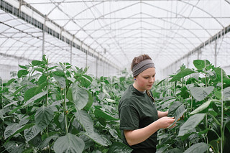
Course Description
Preliminary
Study of the interactions between agricultural production, marketing and management whilst considering sustainability
On-farm environment orientated course
HSC
Examines the scientific principles of the components of agricultural production
Emphasis on farm management to maximise productivity and environmental sustainability
The Farm Product Study is used for analysing social, environmental and economic issues as they relate to sustainability.
What students learn
Preliminary course
Overview (15%)
The Farm Case Study (25%)
Plant Production (30%)
Animal Production (30%)
HSC course
Core (80%)
Plant/Animal Production (50%)
Farm Product Study (30%)
Elective (20%)
Choose ONE of the following electives to study:
Agri-food, Fibre and Fuel Technologies
Climate Challenge
Farming for the 21st Century
Agriculture Stage 6
Select Agriculture...
Step into Agriculture
Course requirements
Practical experiences should occupy a minimum of 30% of both Preliminary and HSC course time.
https://educationstandards.nsw.edu.au/wps/portal/nesa/11-12/stage-6-learning-areas/tas/course-descriptions

Slide 5
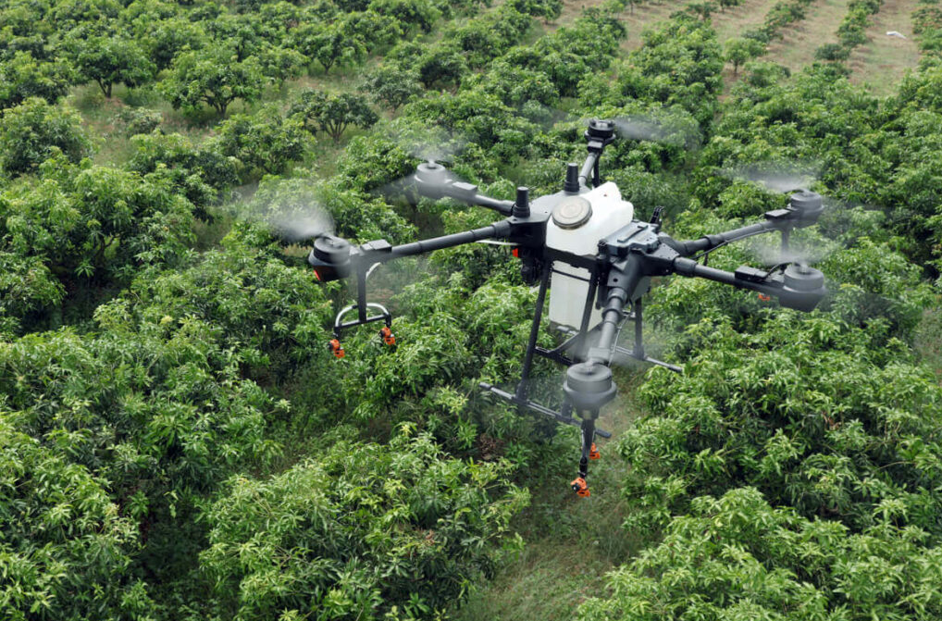

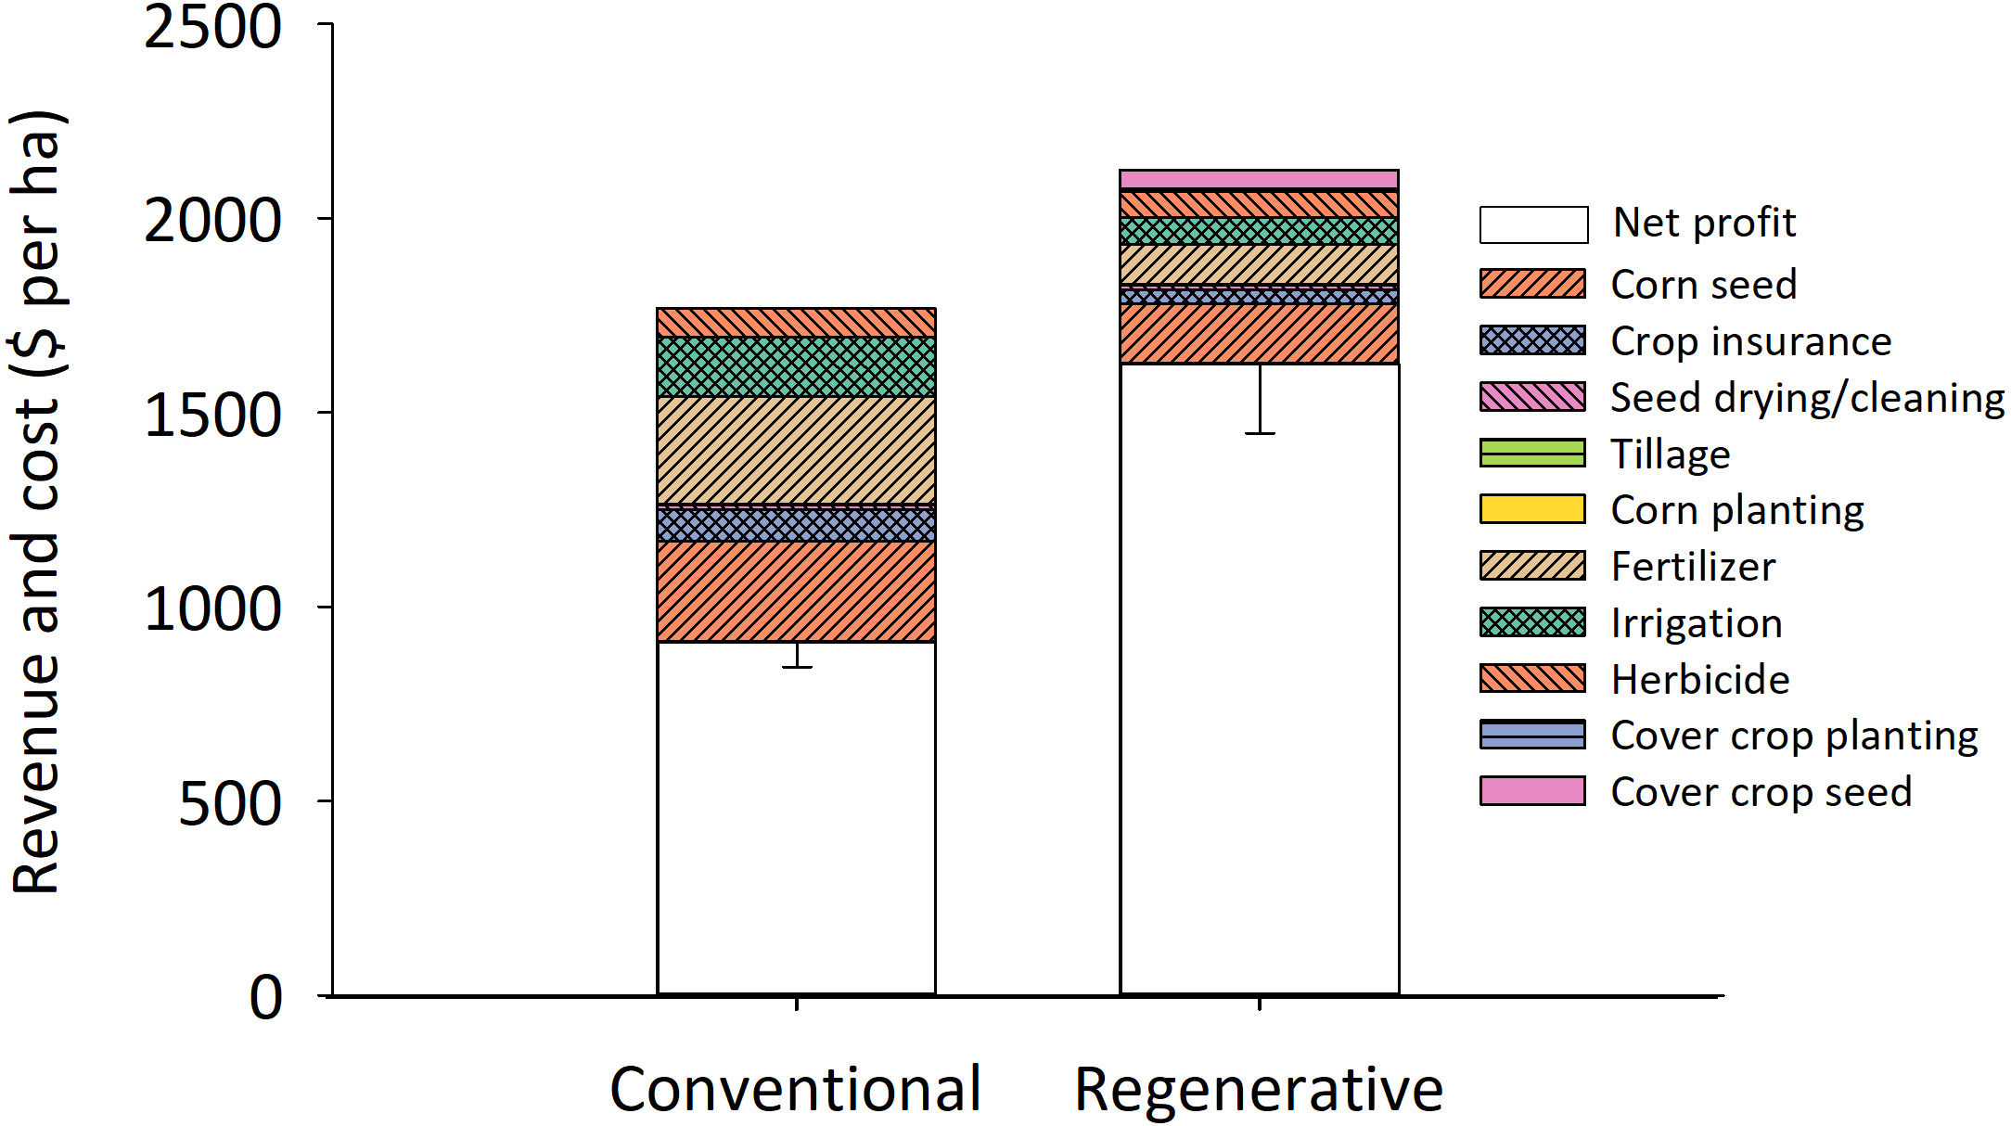
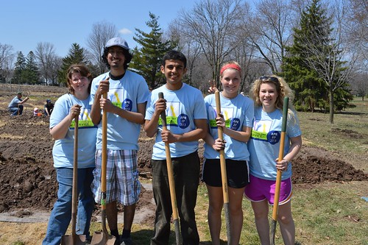
You will learn new skills
Designing experiments
Analysing data
Communicate ideas
Teamwork
Adoption of technology
Select Agriculture...
Step into Agriculture

Slide 6
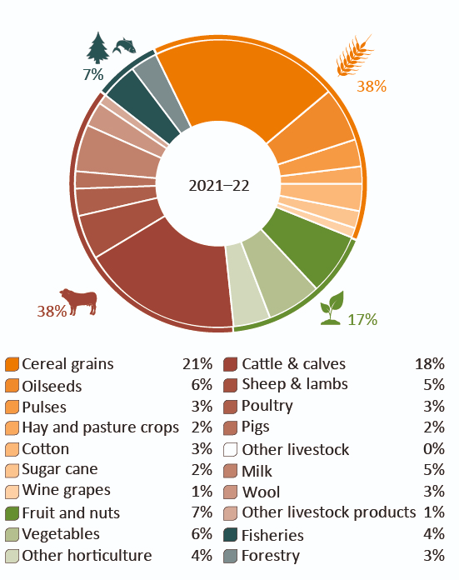
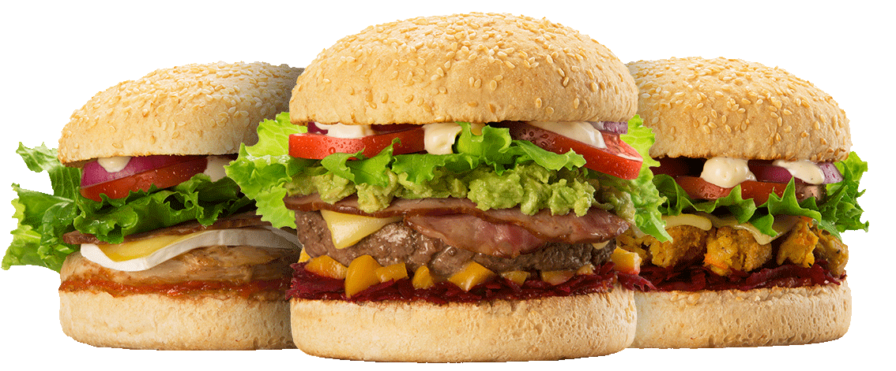
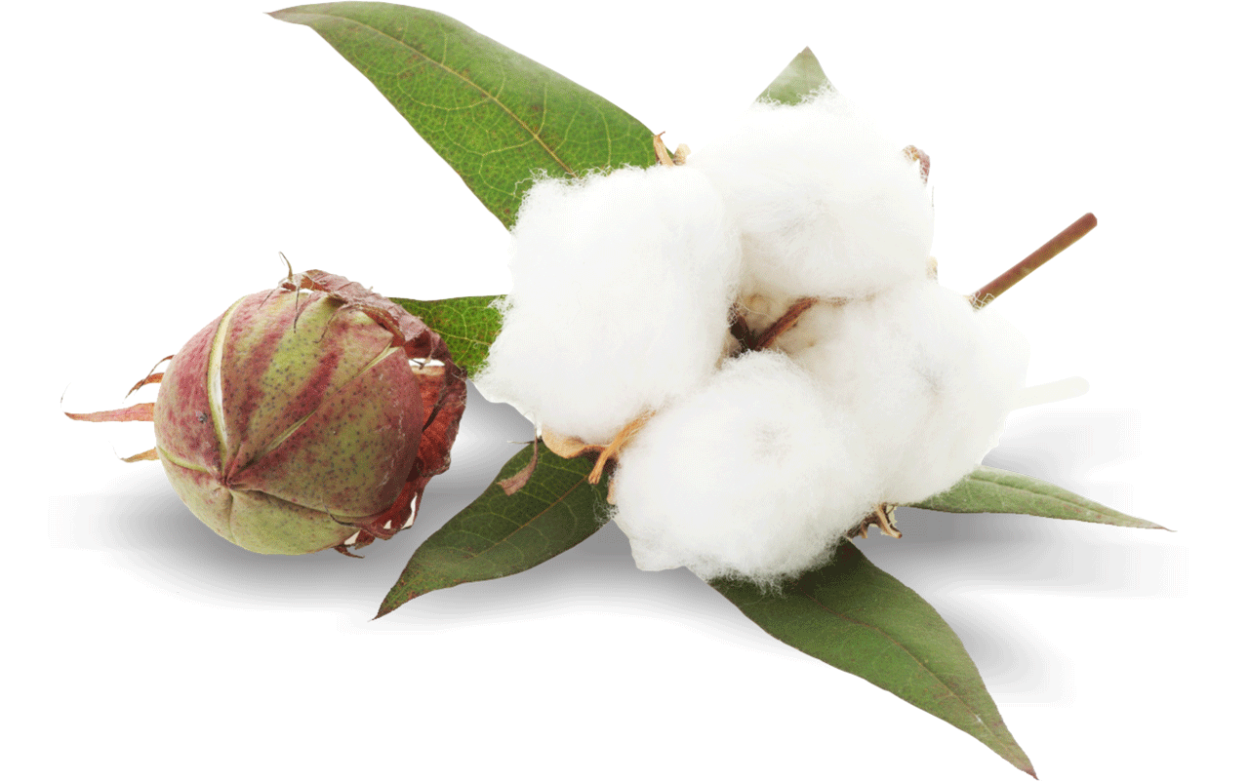
Agriculture, fisheries and forestry value of production, by commodity, 2021–22
Produce food and fibre for Australia and the world
Select Agriculture...
Step into Agriculture
Brown, A, De Costa, C & Guo, F 2020, Our food future: trends and opportunities, ABARES, Research Report 20.1, Canberra, January, DOI: 10.25814/5d9165cf4241d. CC BY 4.0.

Slide 7
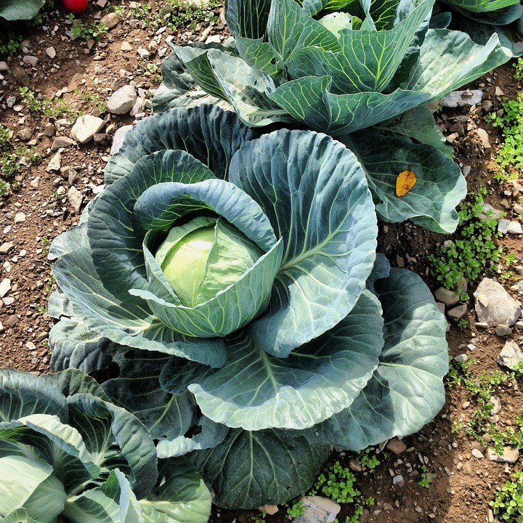
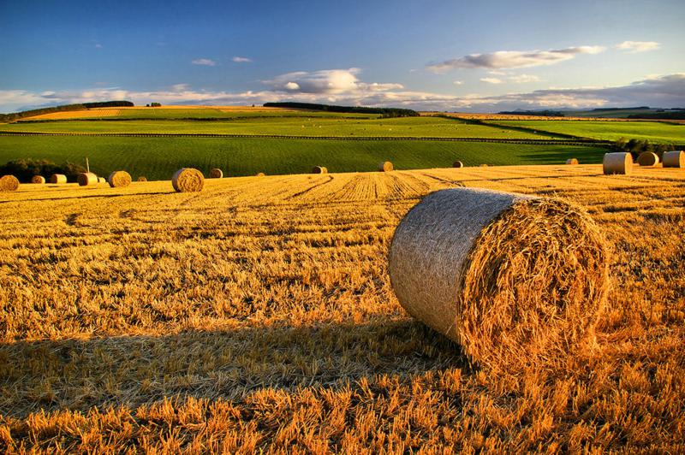
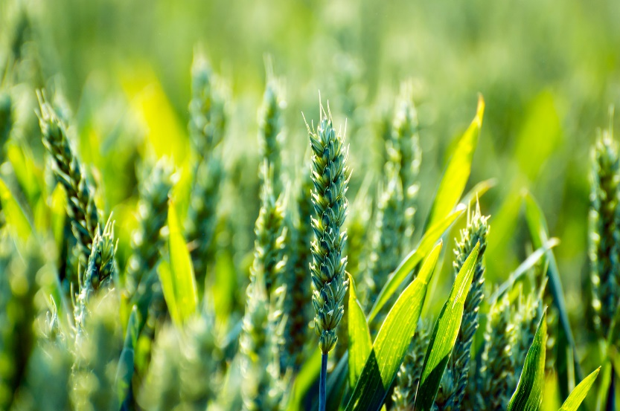
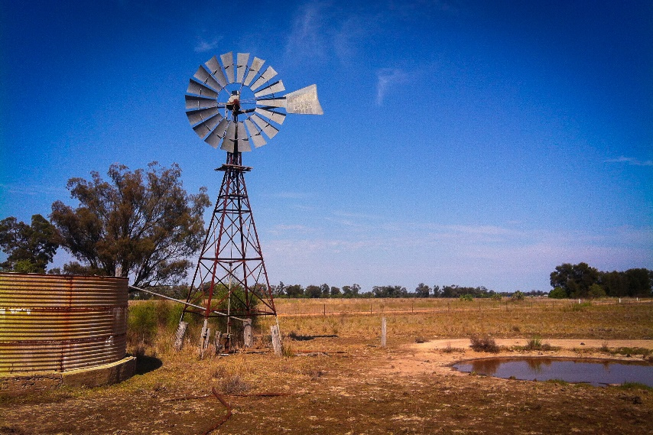
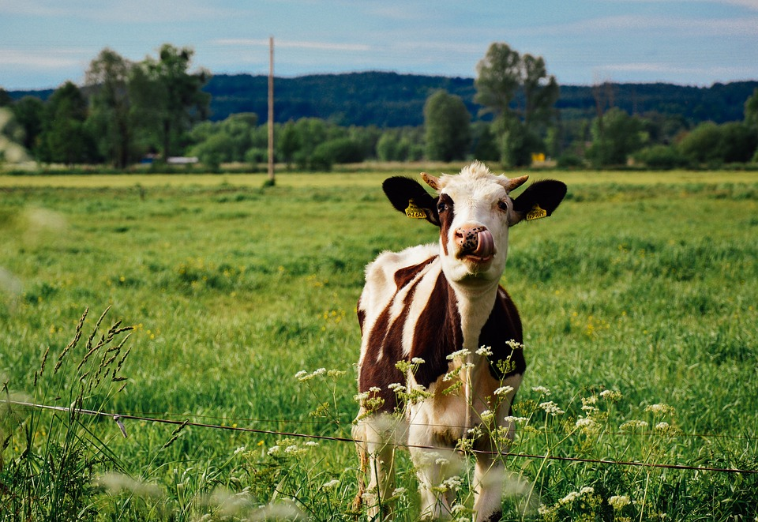
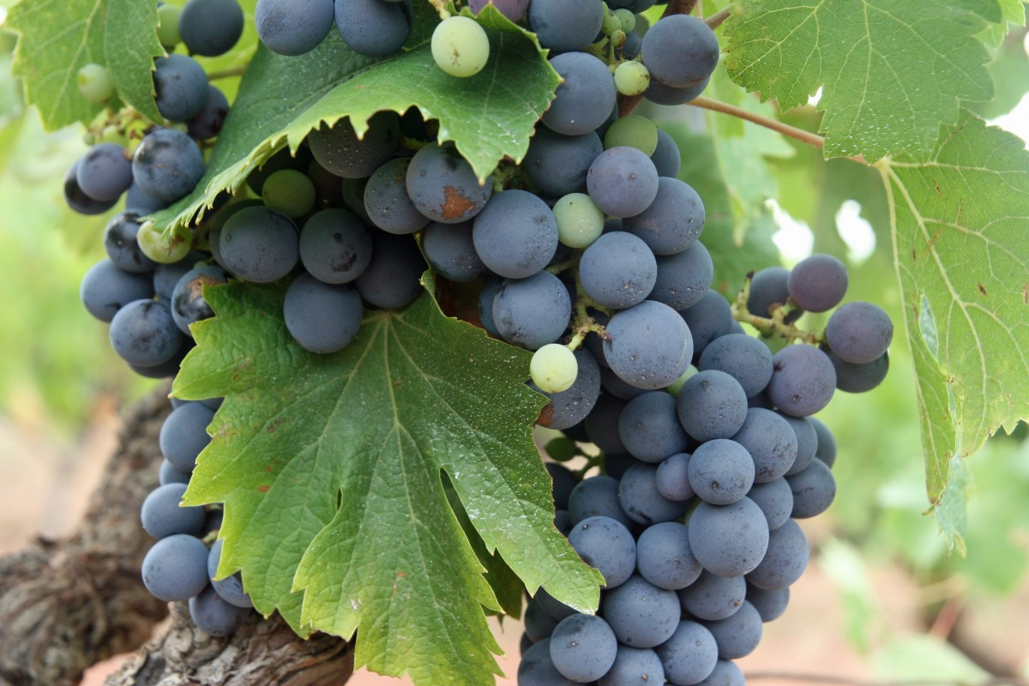
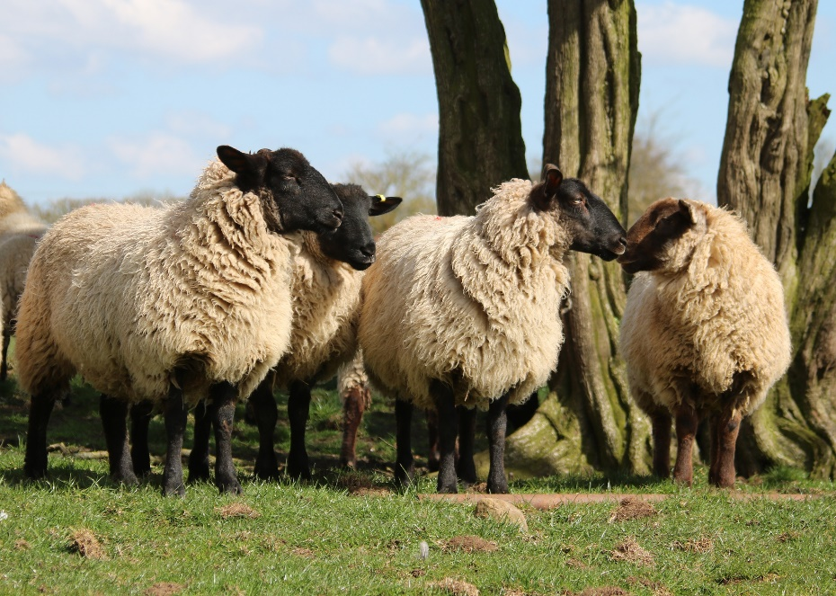
Understand how your food and fibre is produced in Australia
Select Agriculture...
Step into Agriculture

Slide 8
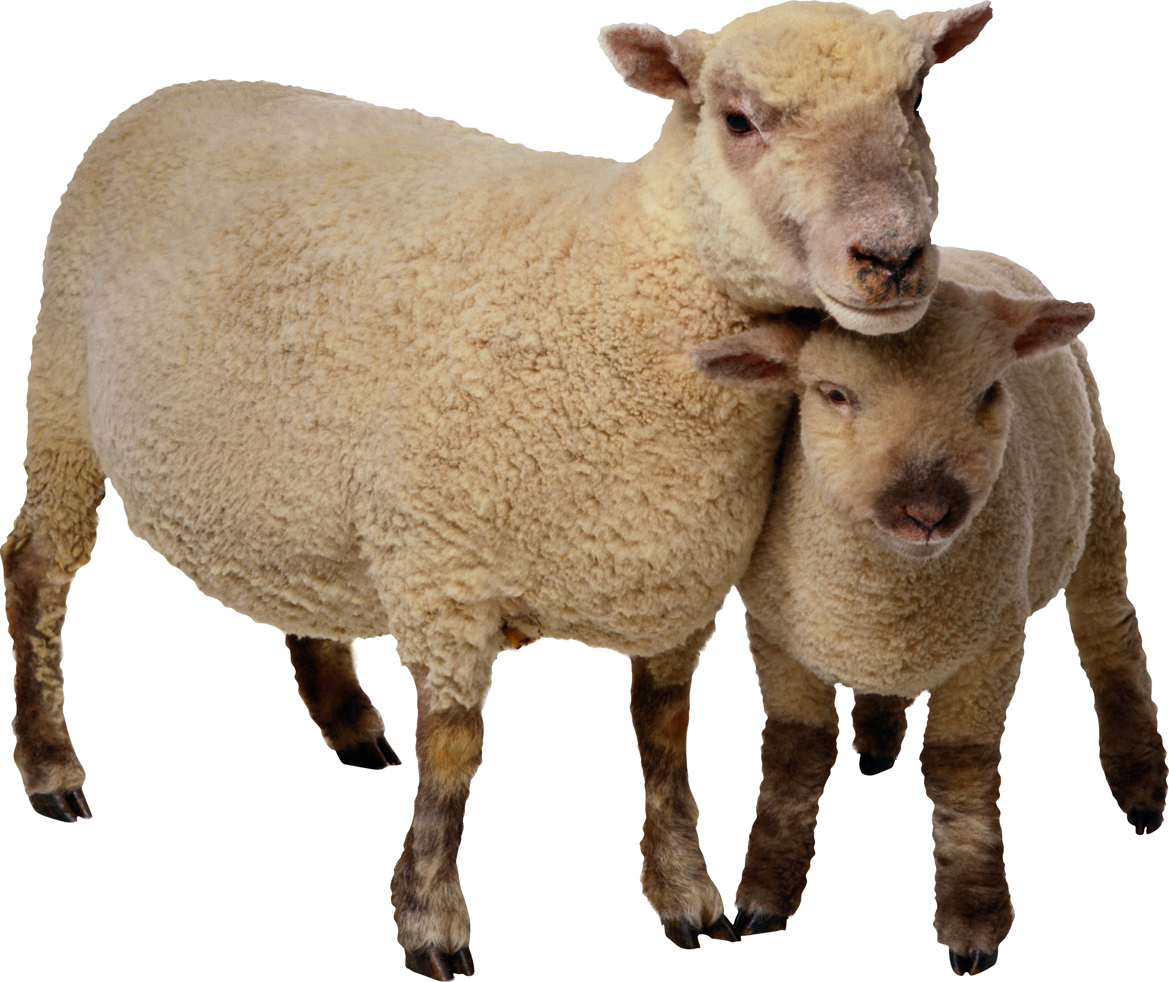
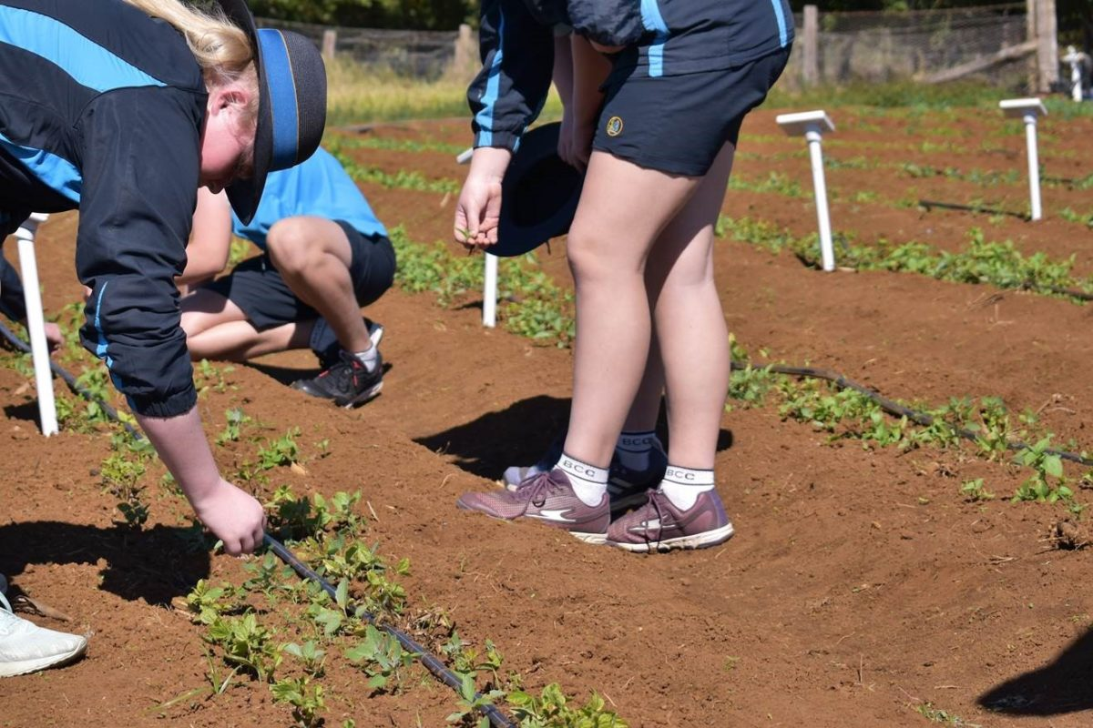
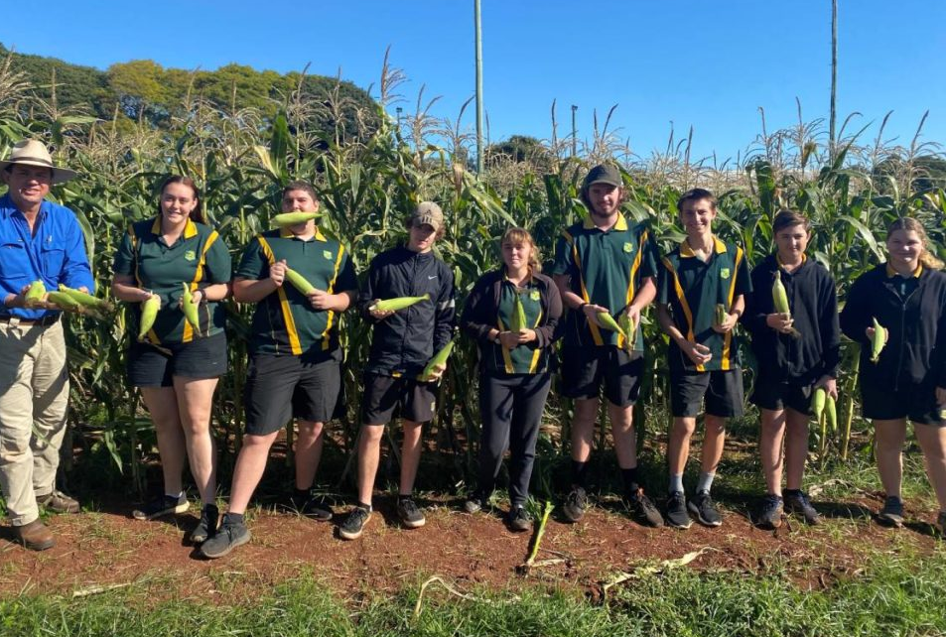

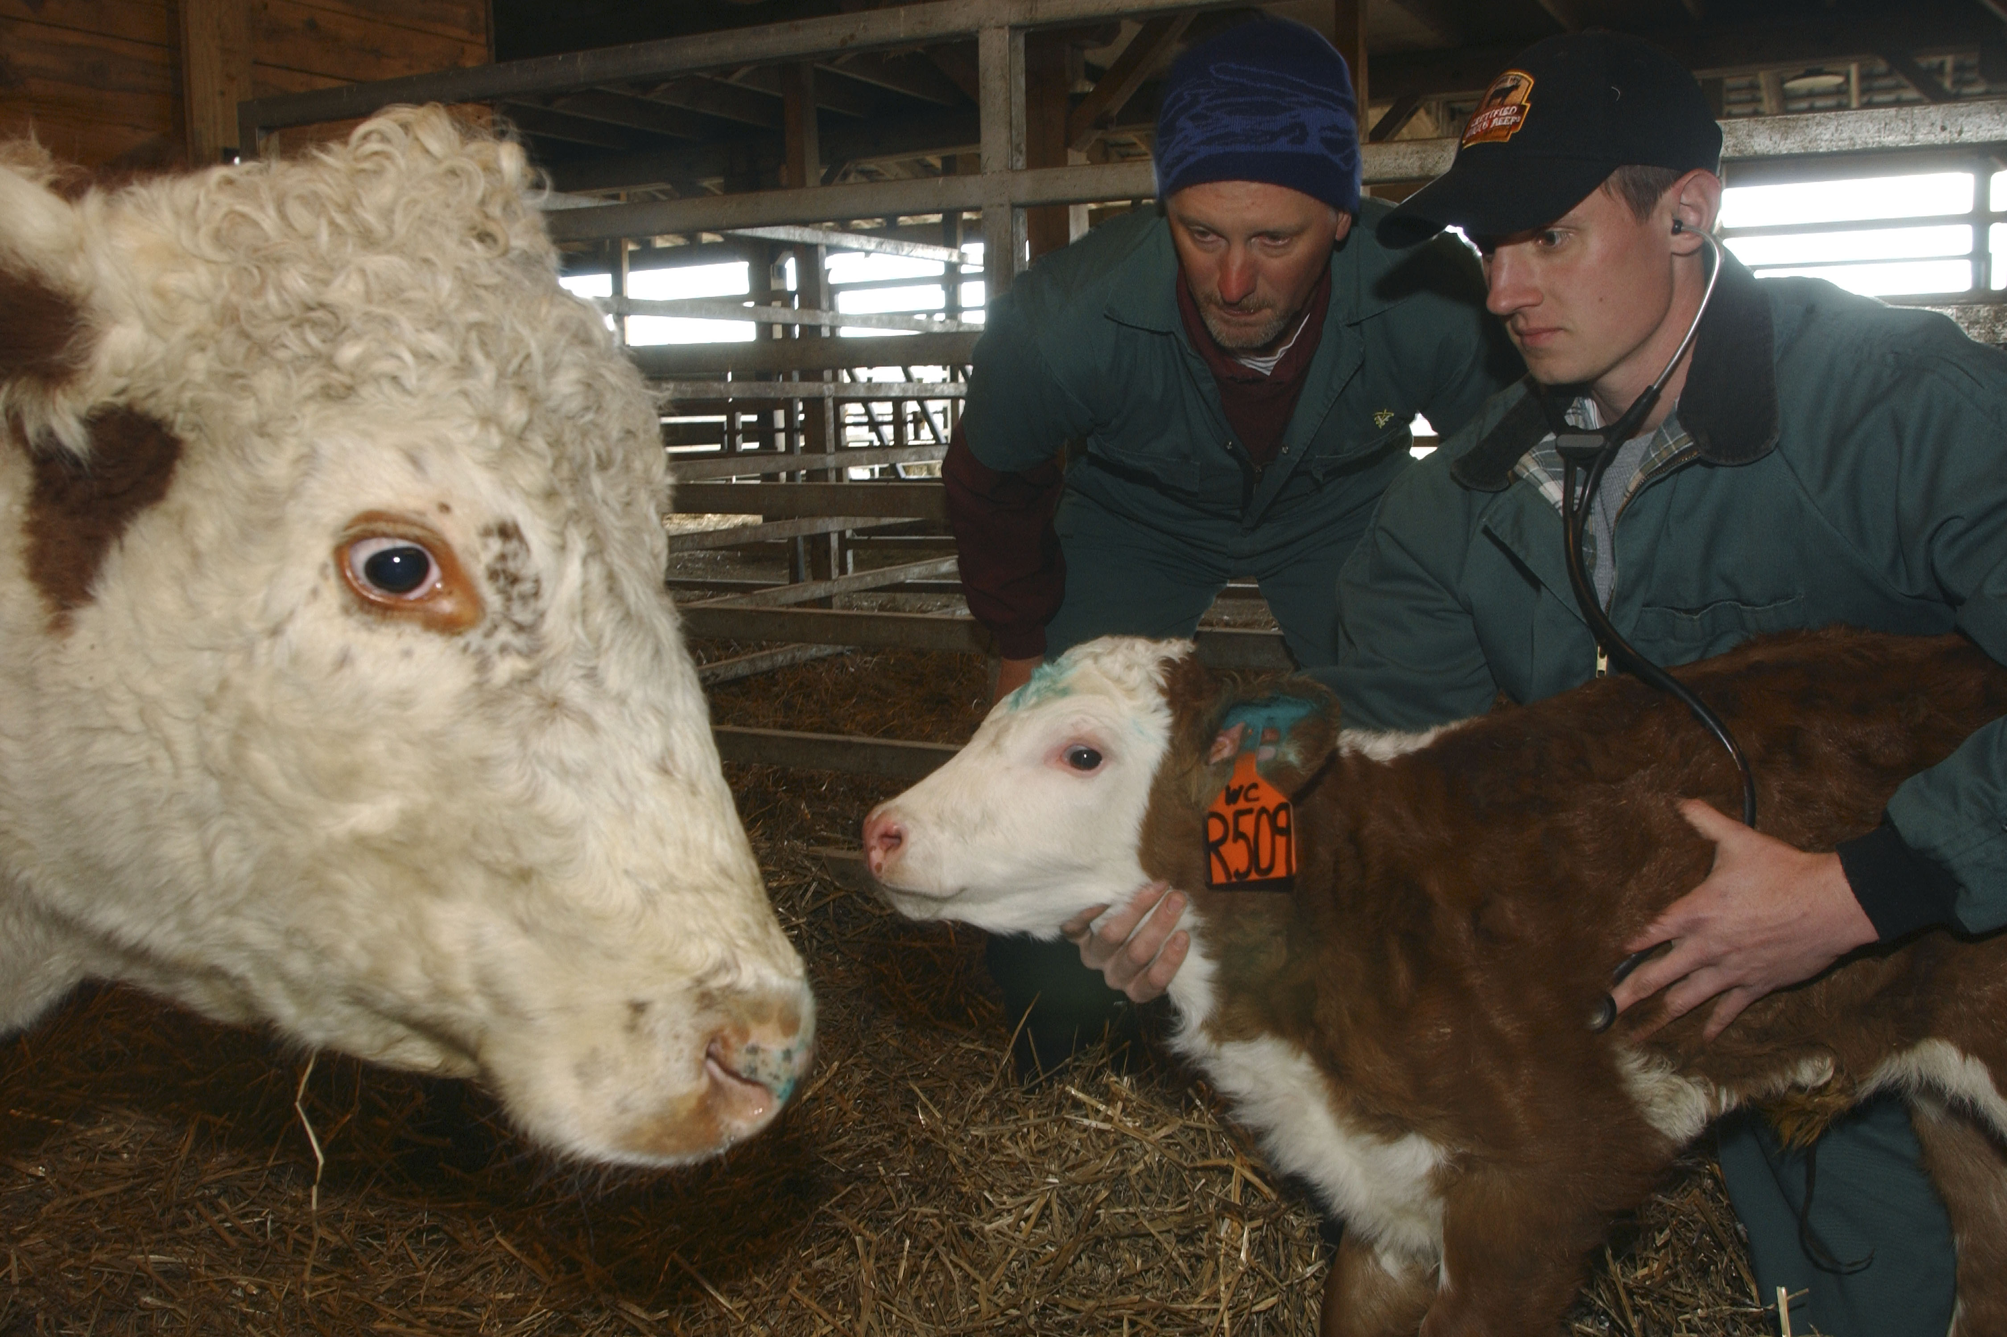
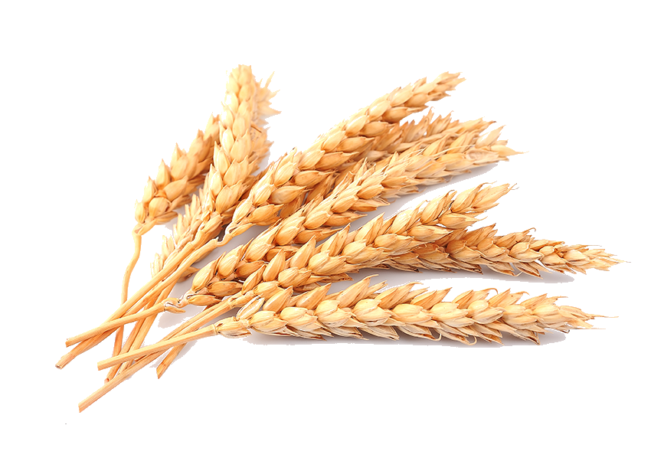
It's hands on
30%-50% practical application
You learn by doing
Work with animals and plants
Select Agriculture...
Step into Agriculture

Slide 9




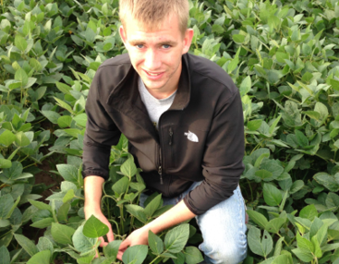
It combines well with
Investigating Science
Biology
Chemistry
Earth and Environmental Science
Select Agriculture...
Step into Agriculture

Slide 10


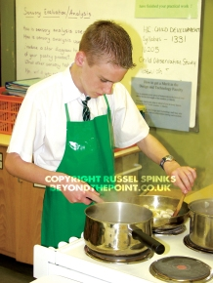
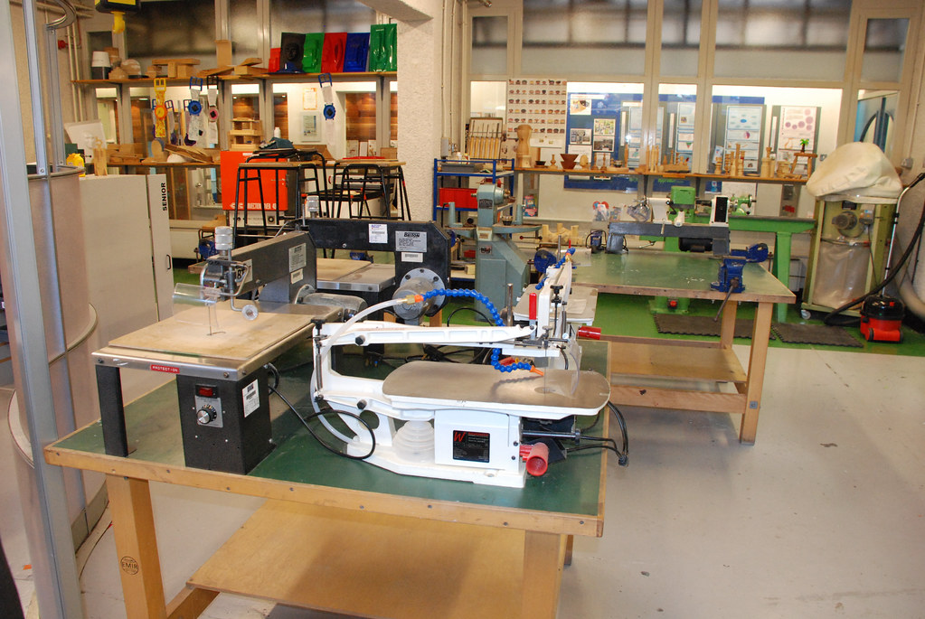
It combines well with
Business studies
Geography
Design and Technology
Engineering
Food technology
Select Agriculture...
Step into Agriculture

Slide 11
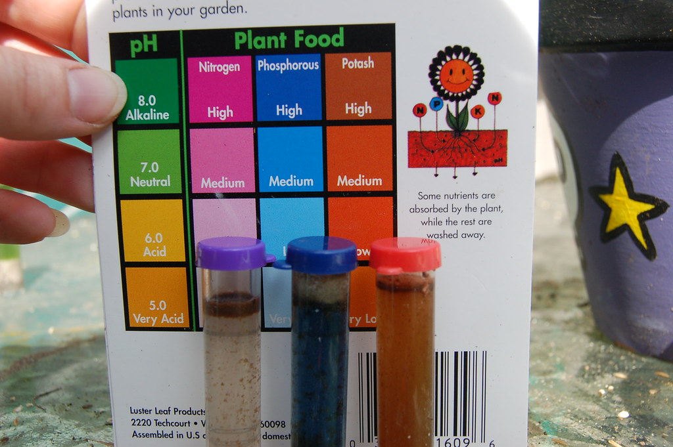

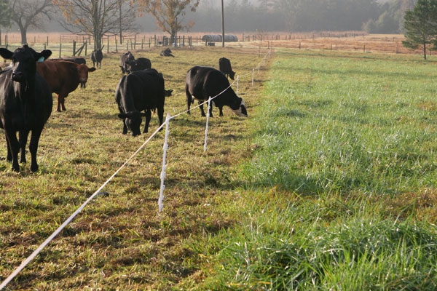
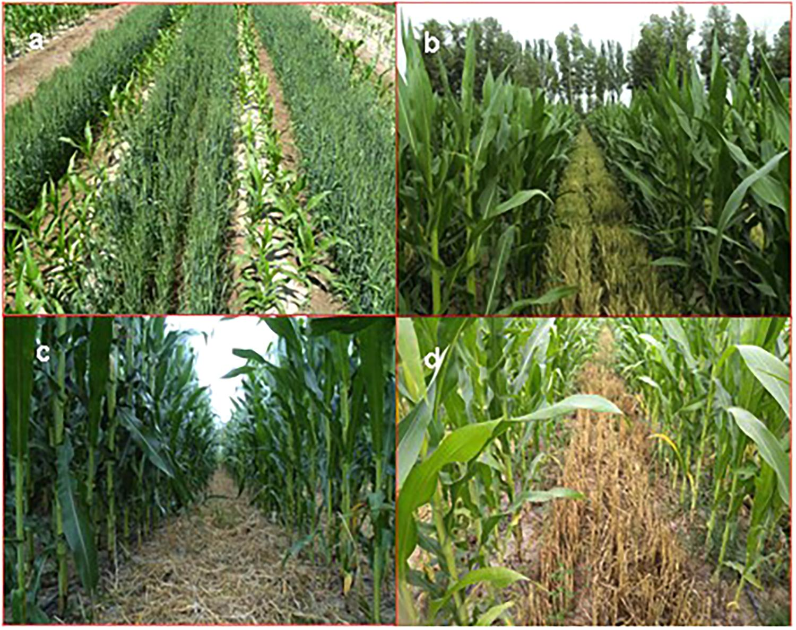
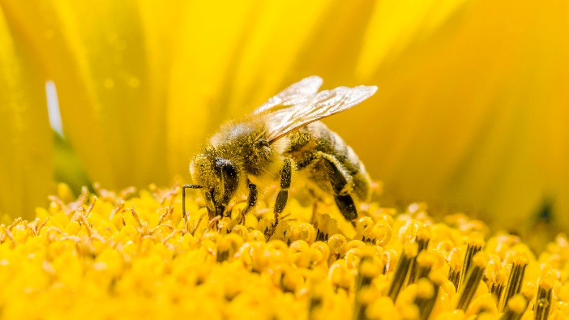

It provides real world solutions to
Relatable science problems
Practical production problems
Farming with the environment
Future farming
Select Agriculture...
Step into Agriculture

Slide 12

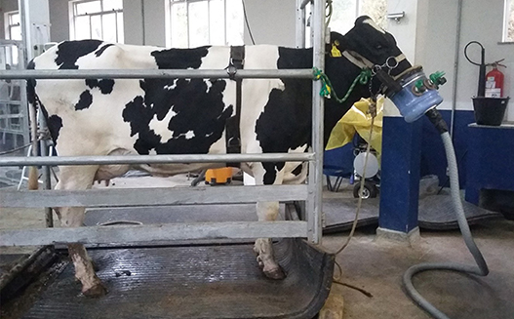
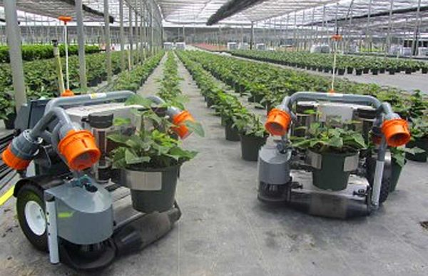
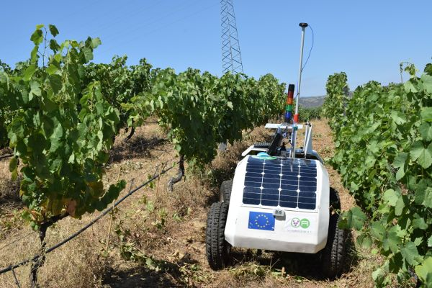
It embraces technology to
Farm more efficiently
Reduce water usage
Increase productivity
Collect data
Improve decision making
Select Agriculture...
Step into Agriculture

Slide 13
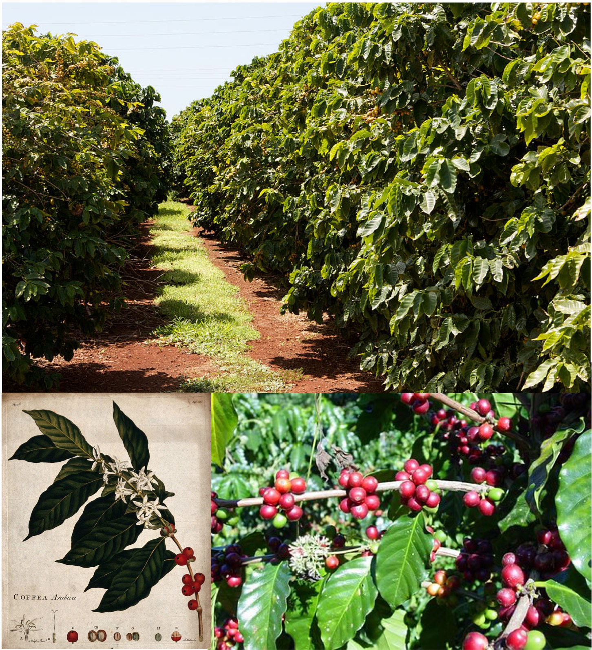
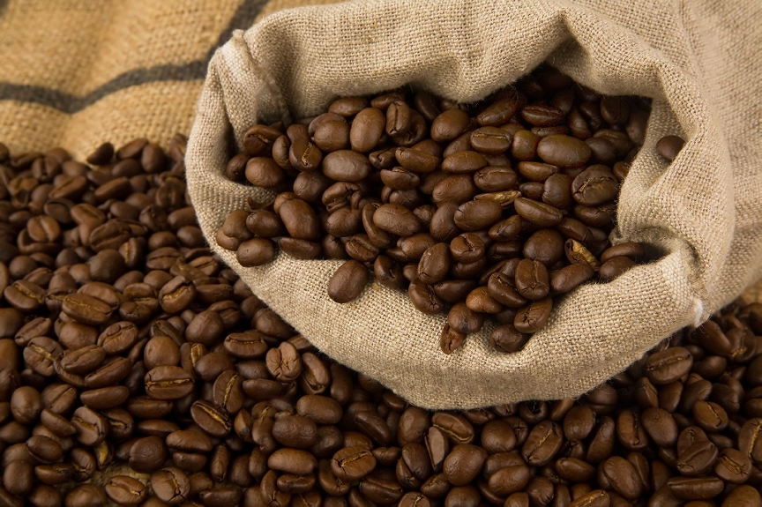


Learn how to run a business
From growing the product
Management strategies
Decision making
Marketing the product
Select Agriculture...
Step into Agriculture

Slide 14




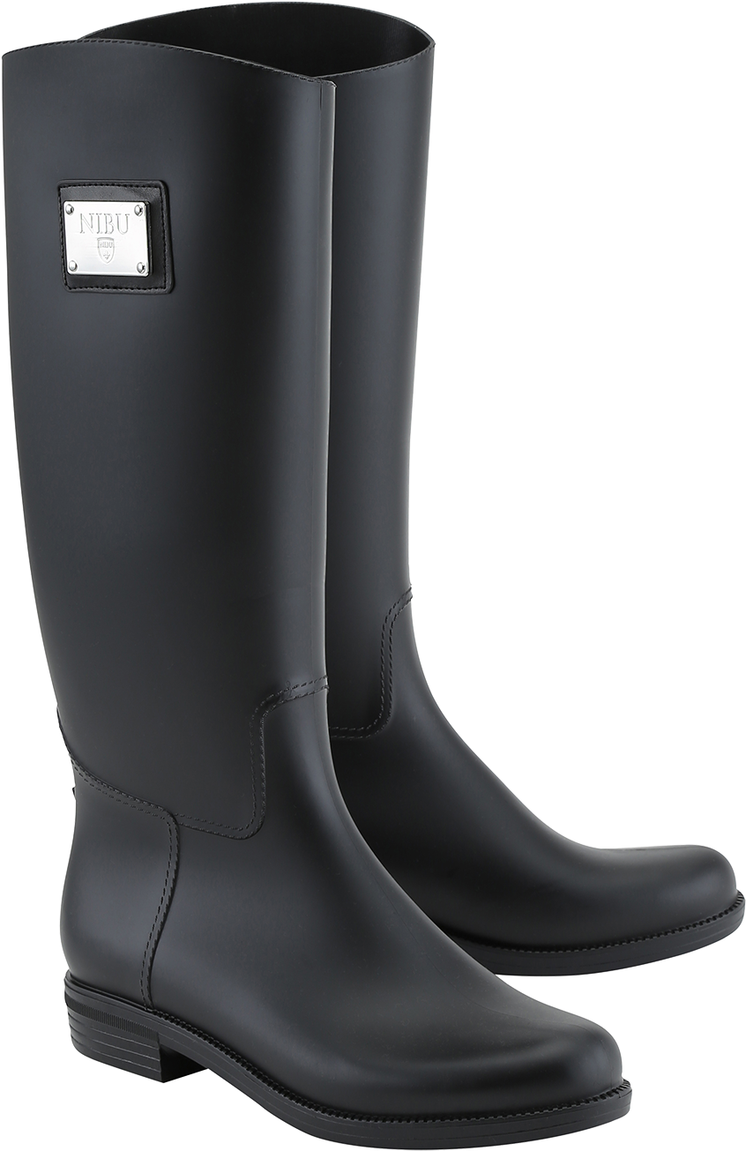
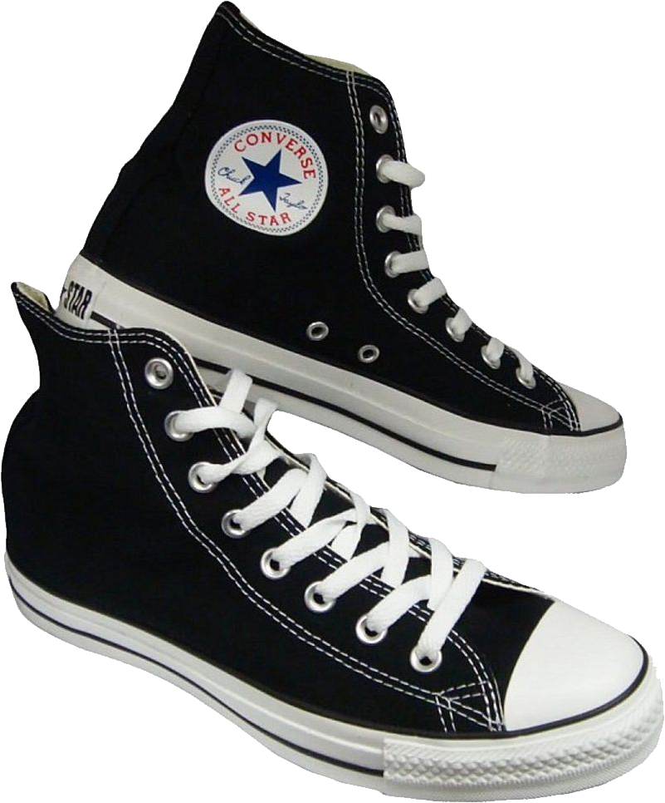


Agricultural economist
GIS Officer
Rural sociologist
Ichthyologist
Commodity trader
University lecturer
Logistics coordinator
Toxicologist
Underwater technician
Research scientist
Extension officer
There are so many opportunities
60% of ag jobs are in the cities
There are 6 jobs for every graduate
Many diverse career paths
Select Agriculture...
Step into Agriculture

Slide 15

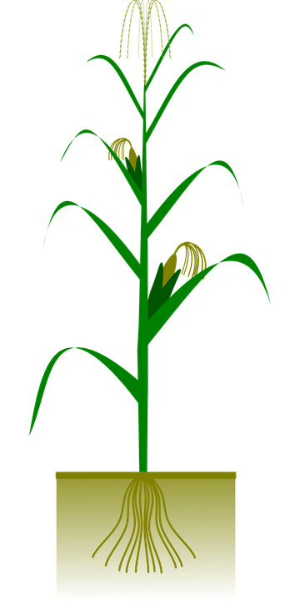
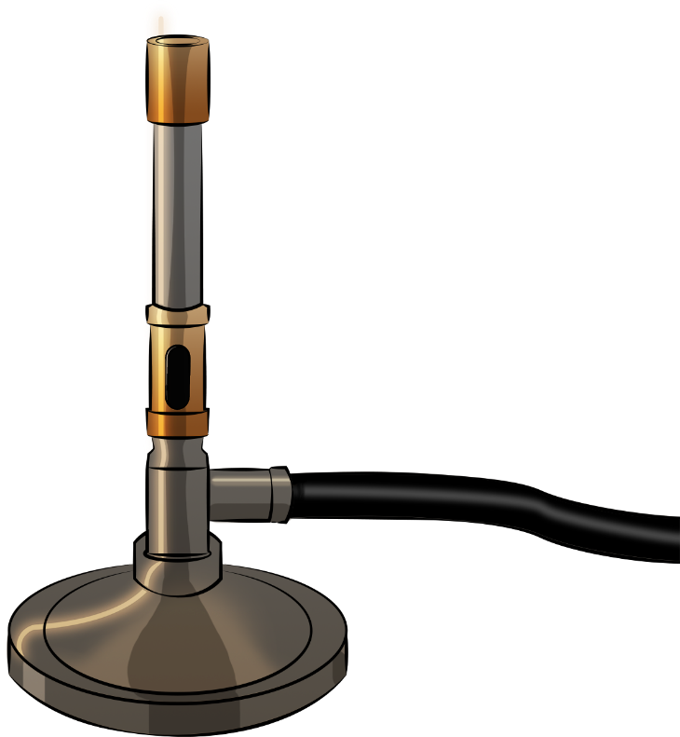

You could work in a
Laboratory
Field
Film set
Office
Select Agriculture...
Step into Agriculture
This Photo by Unknown Author is licensed under CC BY-NC

Slide 16

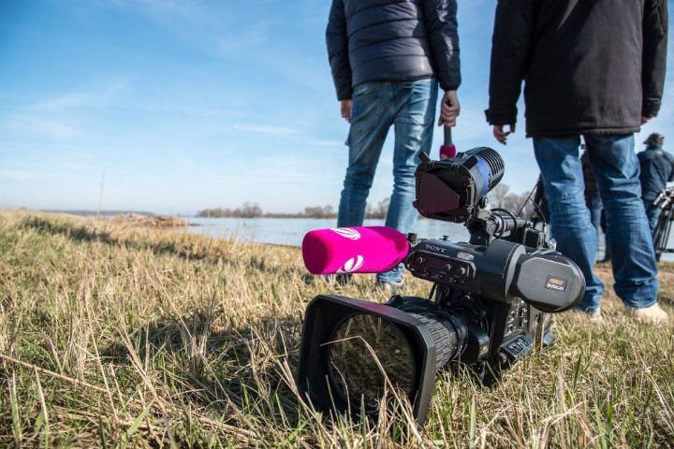

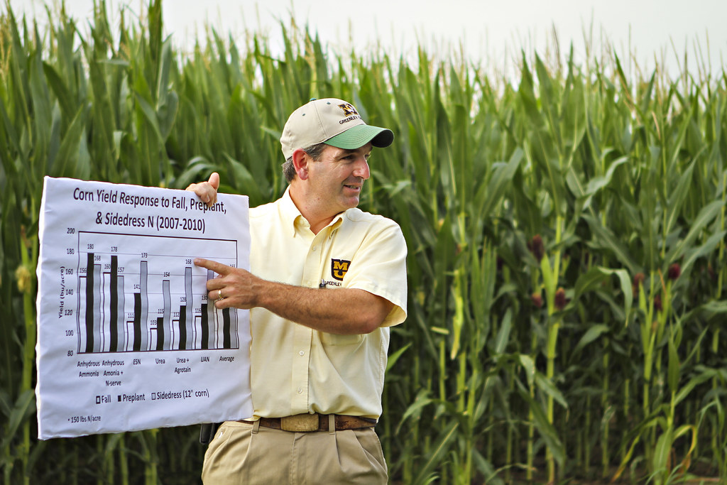
Select Agriculture...
The places you could go!
This Photo by Unknown Author is licensed under CC BY

Slide 17


As Australia's national science agency, CSIRO is solving the greatest challenges through innovative science and technology.
You could work for
CSIRO
Department of Agriculture
15 Research and development corporations
Professional agricultural support services
Private consulting firm
There are 15 Rural RDCs across agriculture, fisheries and forestry industries in Australia. Each one is tasked with delivering tangible and practical improvements for their industries in terms of productivity and profitability, sustainability, and the community.
Select Agriculture...
Step into Agriculture
Building stronger and more sustainable agriculture, fisheries, forestry and land care.

Slide 18












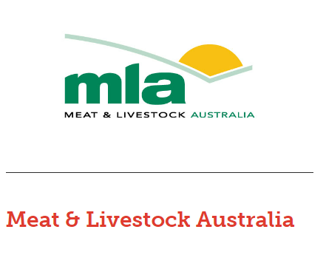


Select Agriculture...
Could one of these Rural RDCs be your next employer?

Slide 19
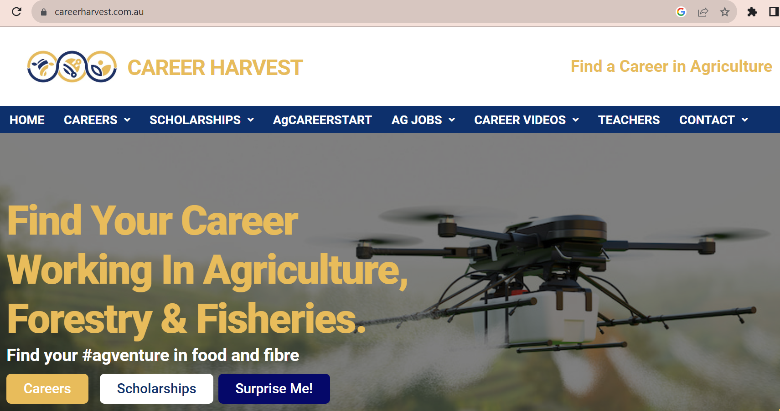
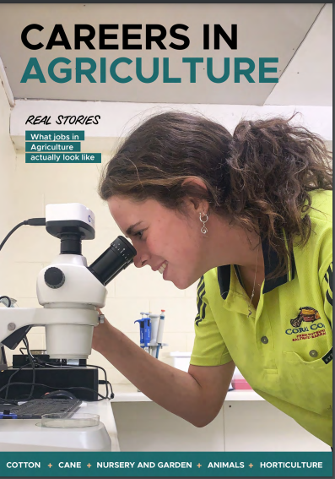
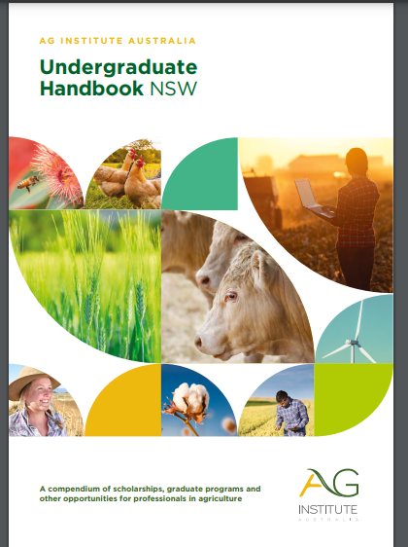


There are so
many organisations that want to help you find career and scholarship
opportunities​
Select Agriculture...
Step into Agriculture

Slide 20
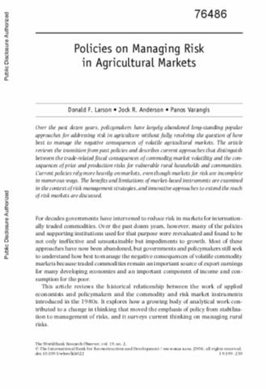
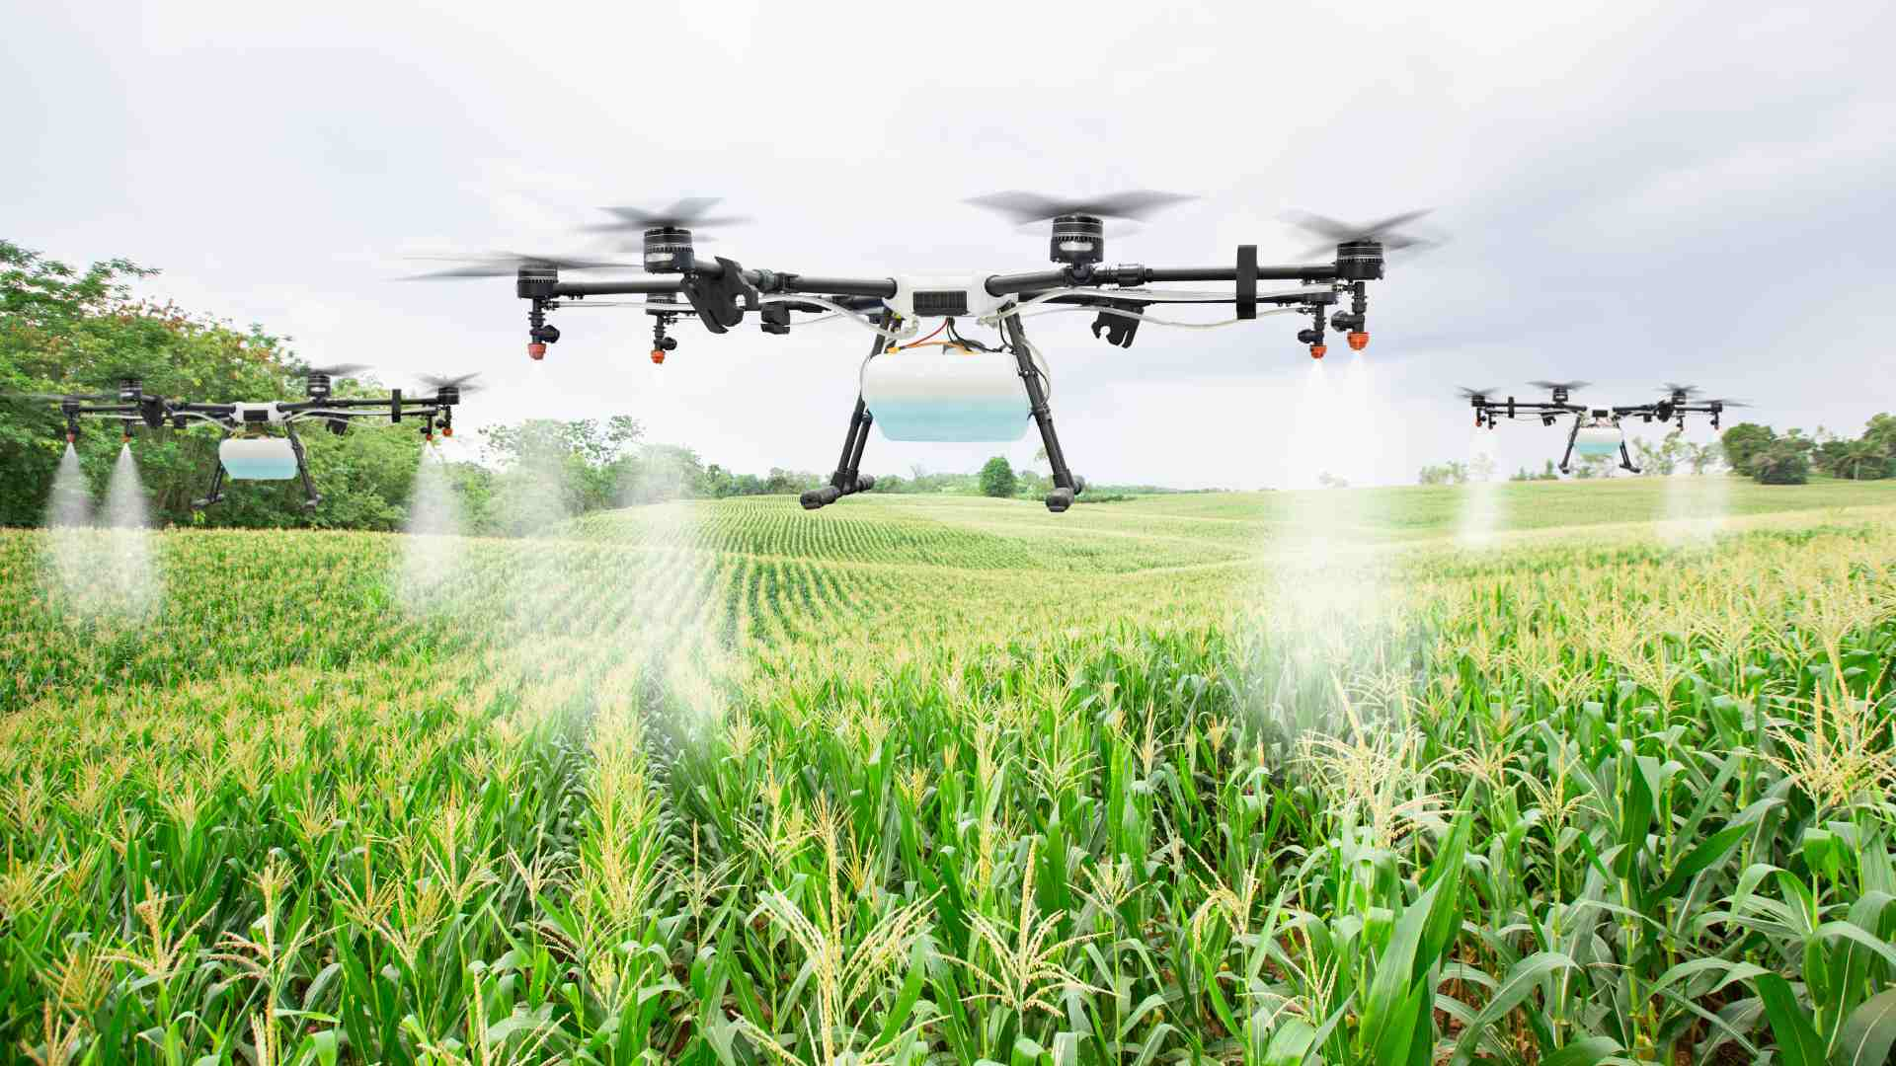
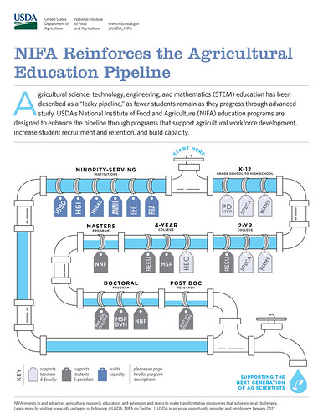
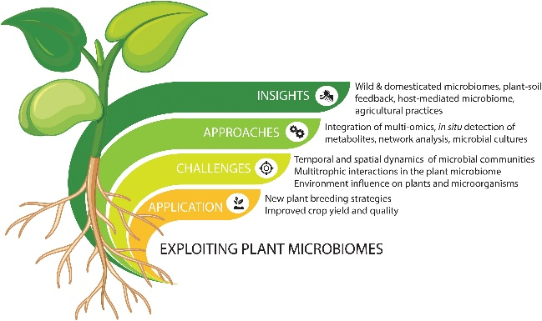


It is….PERFECT
P Policies
E Education and training
R Research
F Finance and Farming
E Extension and advisory services
C Communication
T Technologies and Trade
There are careers in so many different fields
Select Agriculture...
Step into Agriculture

Slide 21
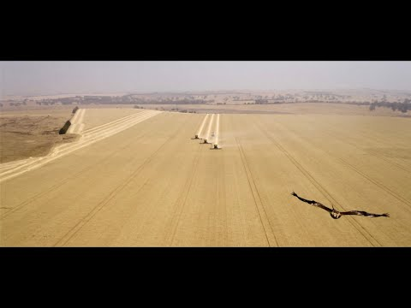
Some of the most beautiful offices in the world...
Select Agriculture...
Select Agriculture...

Slide 22



ATTRIBUTION, CREDIT & SHARING
This resource was produced by Primary Industries Education Foundation Australia (PIEFA). Primary Industries Education Foundation Australia’s resources support and facilitate effective teaching and learning about Australia’s food and food industries. We are grateful for the support of our industry and member organisations for assisting in our research efforts and providing industry-specific information and imagery to benefit the development and accuracy of this educational resource.
While reasonable efforts have been made to ensure that the contents of this educational resource are factually correct, PIEFA does not accept responsibility for the accuracy or completeness of the contents and shall not be liable for any loss or damage that may be occasioned directly or indirectly from using, or reliance on, the contents of this educational resource.
Schools and users of this resource are responsible for generating their own risk assessments and for their own compliance, procedures and reporting related to the use of animals, equipment and other materials for educational purposes.
This work is licensed under Creative Commons BY-NC 4.0.
To view a copy of this license, visit: http://creativecommons.org/licenses/by-nc/4.0/
PIEFA’s SFIRP Program is funded by the Australian and NSW Government’s Storm and Flood Industry Recovery Program. However, the material contained herein does not necessarily represent the views of either Government.

