Slide 1
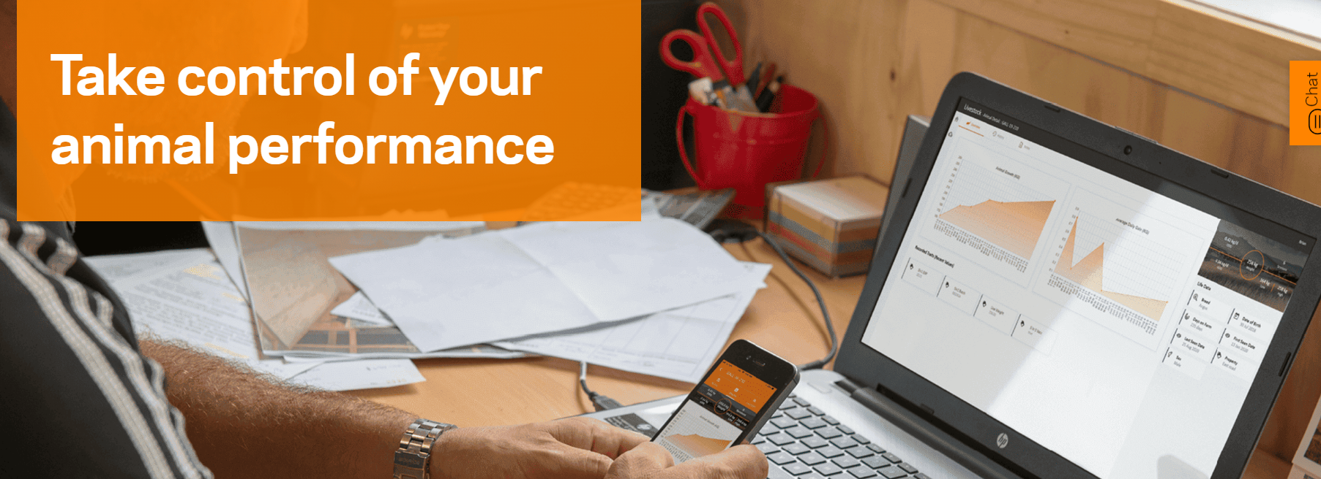
Animal Performance & Traceability
Josie Perrett – Territory Manager Tamworth North

Slide 2
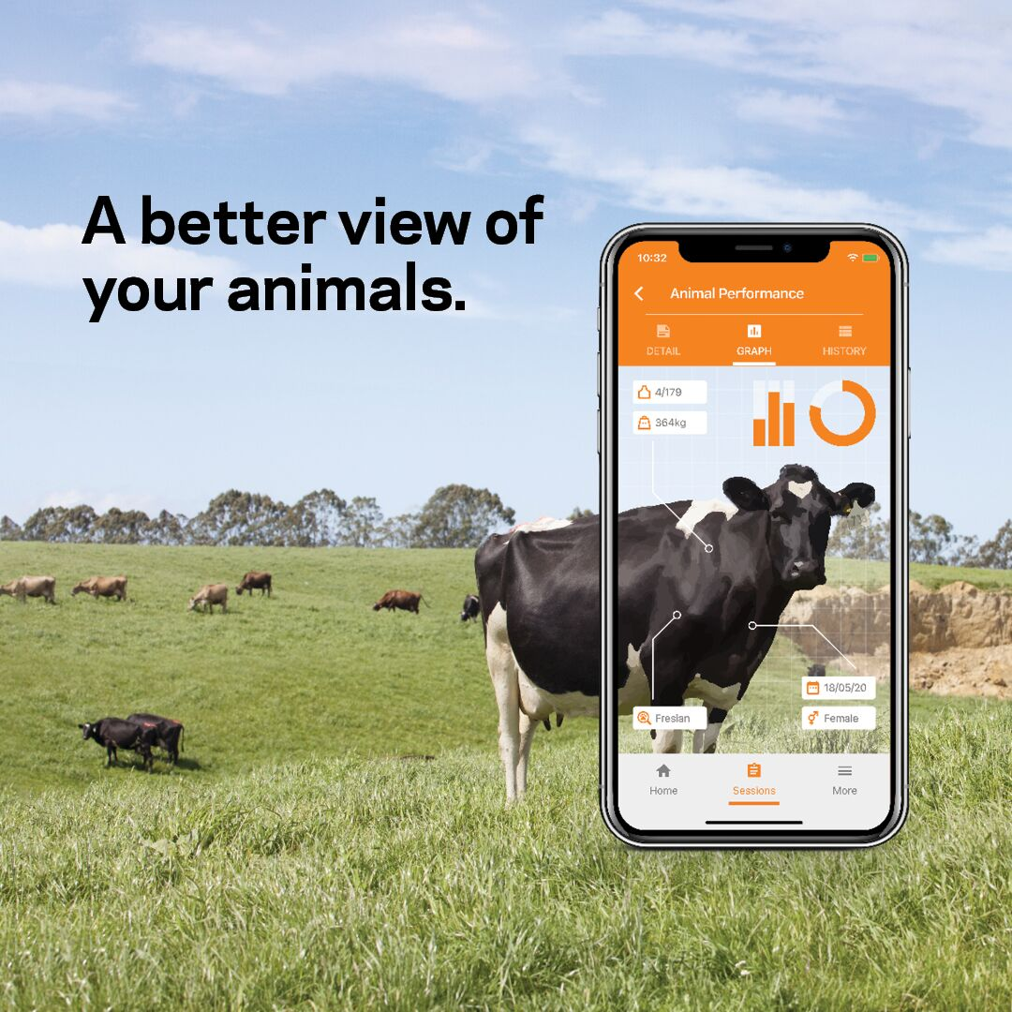
Data in Livestock
There is so much useable data available in livestock
It is up to us to collect, analyse and use this data to increase productivity and profitability
“If you don’t measure it, you can’t manage it”

Slide 3
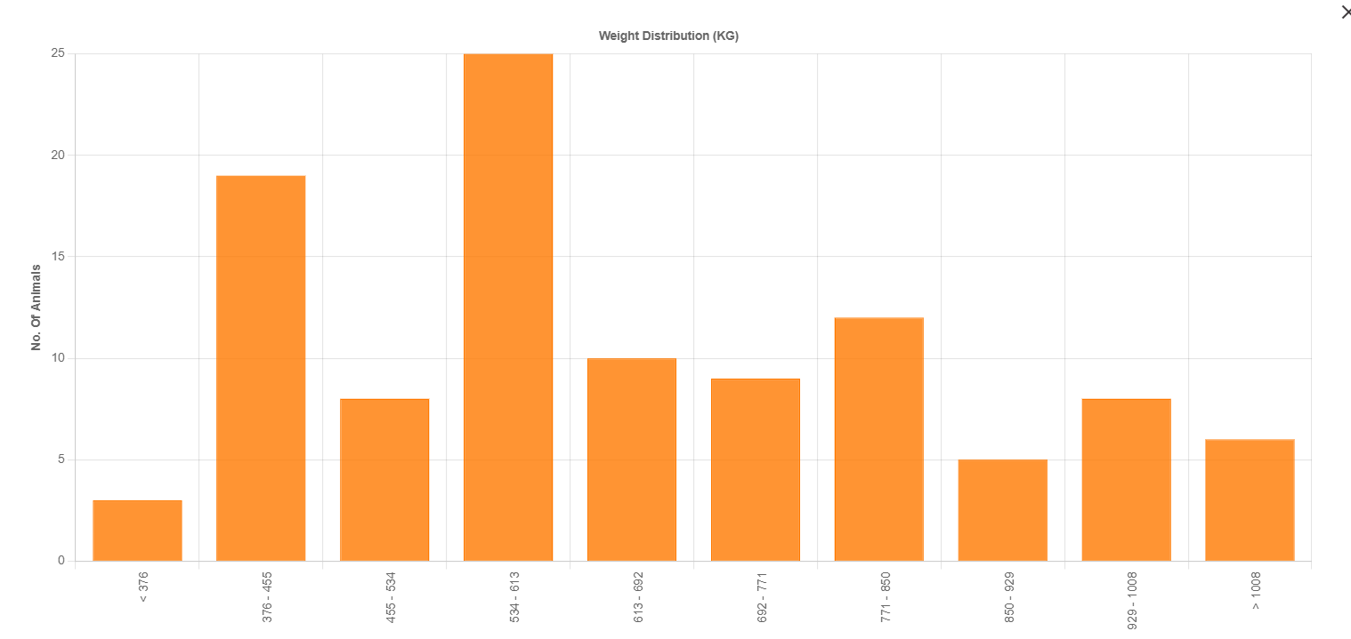
THE VALUE IN DATA
What can data collection provide my farm?
Informed decision making
Manage crops and pastures by weight gains
Manage efficiency of added minerals e.g. Multimin
Identify over and under performers
Lower input costs

Slide 4
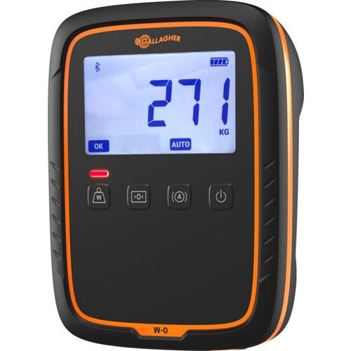
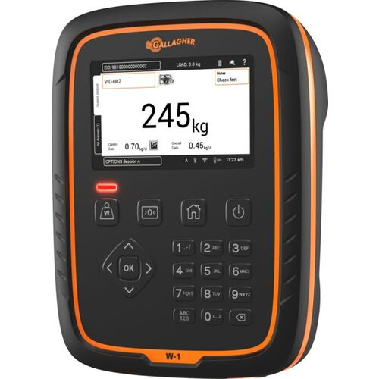
Weigh Only Indicators

Slide 5
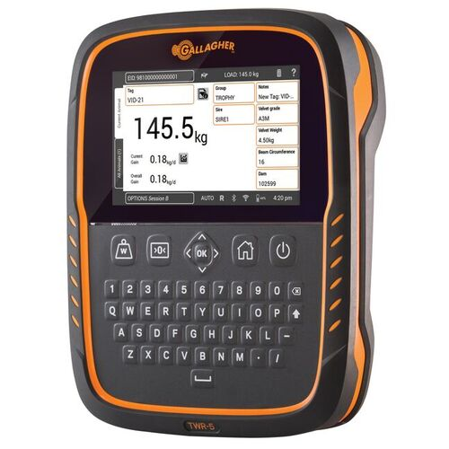
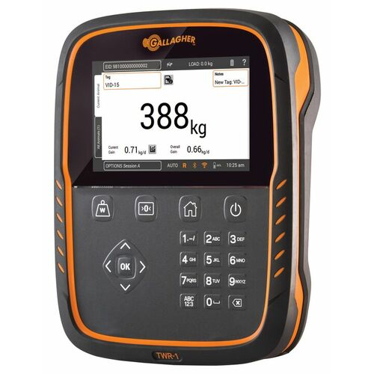
Data Collector Indicators
Weigh Scale and Tag Reader
Record Animal Life Data and traits every session
Gender, Breed, Vaccinations, Preg Status
Wifi connection – Syncs to cloud
Animal History – Average Daily Gains, Vaccination dates

Slide 6
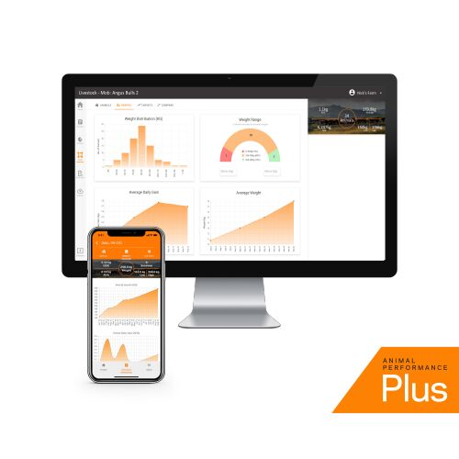
Animal Performance PLUS Software
A more in-depth look at data collection
Direct NLIS transfer
Manage animals within Mobs and Groups
Set target weights
Filter search
Import data from other programs
Compare mob and group performance
Create draft lists and send to indicator
Syncs directly with scales/indicators

Slide 7
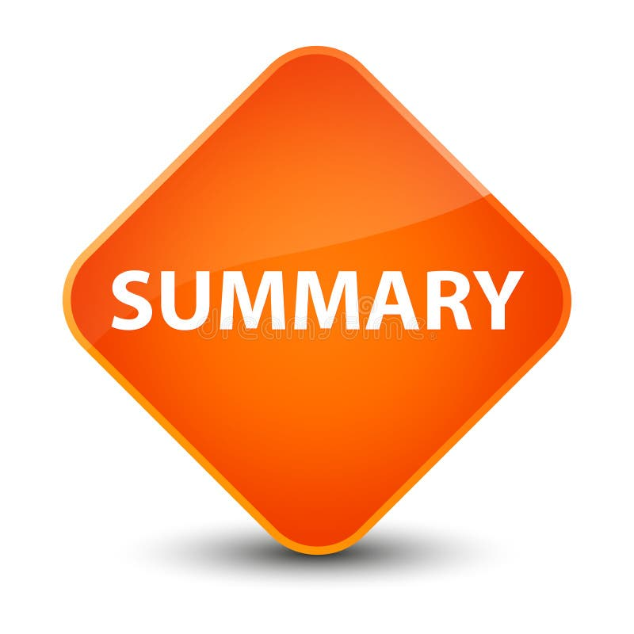
SUMMARY
Taking control of your farm
Data at your fingertips – use it!
Monitor performance
Informed decision making
Minimal cost maximum benefit
Data Doesn’t Lie
Future Proof your farm
Range of products to suit different operations

