Slide 1

Farming the Future
3. Supporting industry development in dairy

Slide 2
About me – Who am I and what do I do in the dairy industry?
Dairy Australia
    Dairy Australia are the national service body for the Australian dairy industry.
    We are funded through a combination of levies paid by farmers and matching payments from the Commonwealth Government.
    Our purpose is to support the profitability and sustainability of dairy farming.
    We deliver research and development activities including:
      Practical tools directly to farmers including online courses, workshops and 1:1 support
      Activities to attract people to the industry
      Investments in innovation focused on increasing farm productivity and global competitiveness
      Provide insight and inform policy
      Promote the benefits of dairy to consumers
      Meeting community expectations on issues such as animal welfare and environmental impact
My Role – NSW Workforce Attraction and Retention

Slide 3
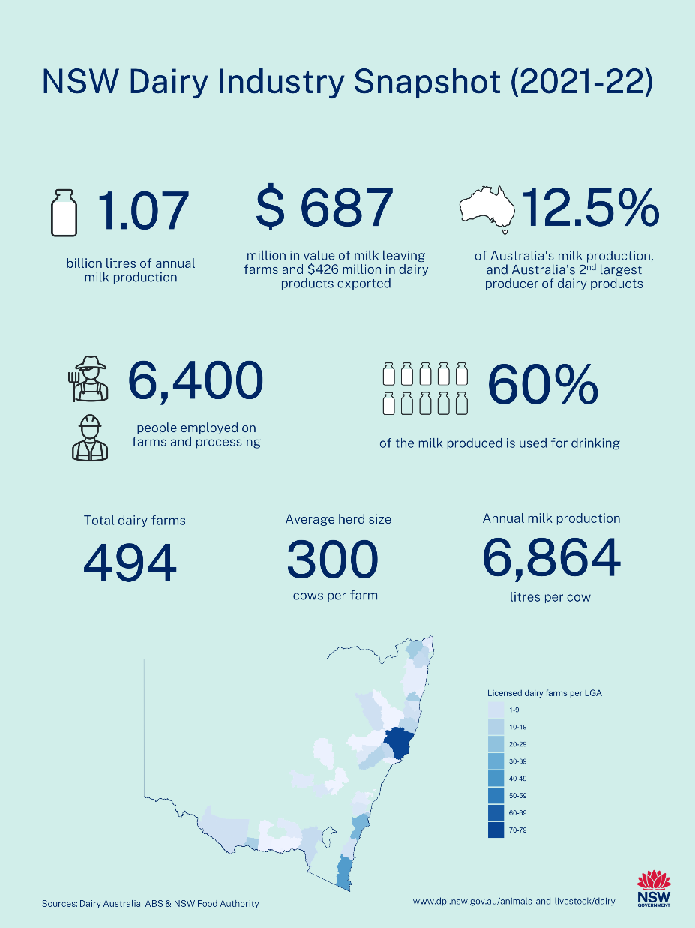
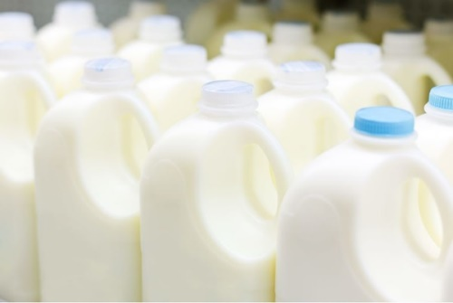
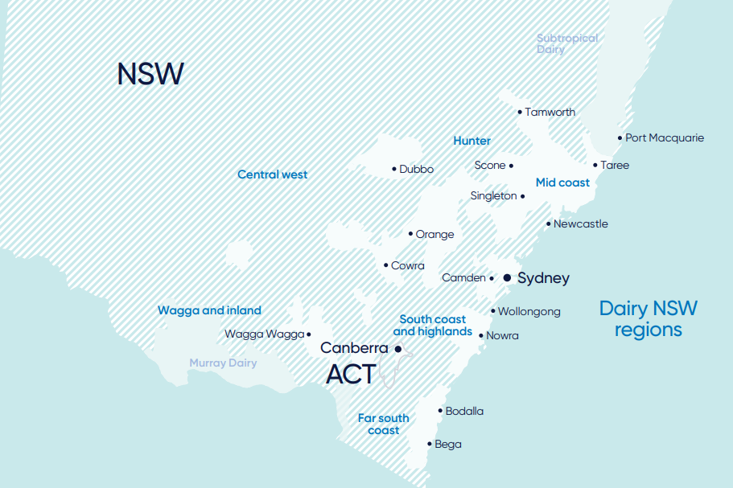
Dairy in NSW
That is over 500 million 2lt milk bottles!
Notes:
1.07 billion litres of milk - that is more than 500 million 2lt bottles of milk!! Just in NSW!
In Australia there are over 4000 dairy farms and approximately 1.3 million cows (Jan 2023).
Total annual milk production in Australia is 8.5 billion litres (Jan2023)
In Australia – 40% for cheese, 30% for drinking, 19% for skim milk powder and butter, 3% whole milk powder, 8% other (Jan2023).
36% of milk is exported, most of this is to China (Jan 2023).
In Tamworth area there are 8 farms
Hunter valley around 65 farms

Slide 4
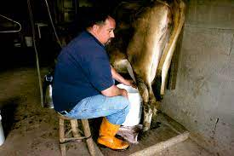
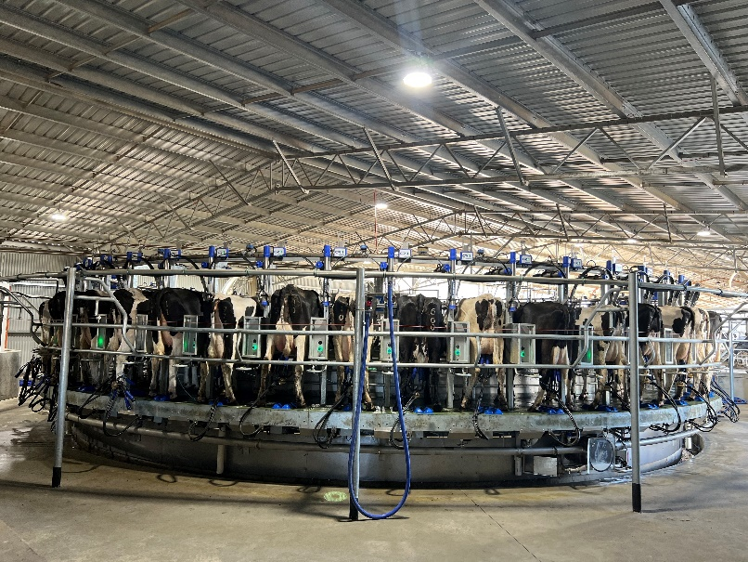
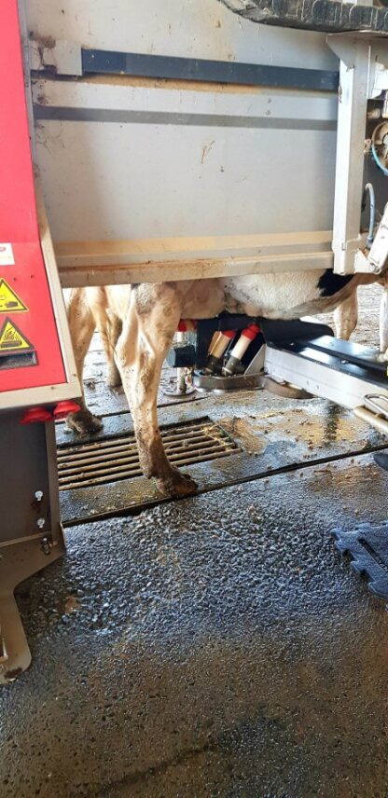
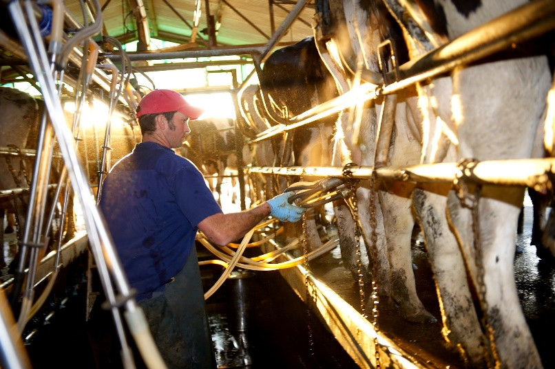
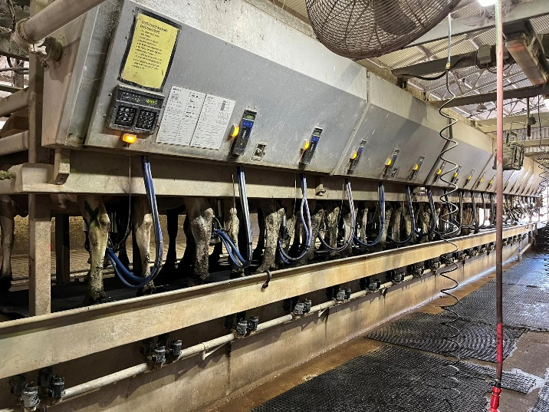
The Dairy Industry is an innovative
industry always developing

Slide 5
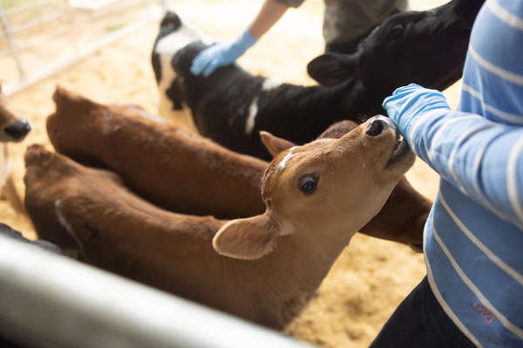
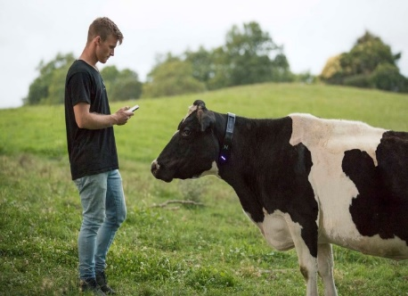
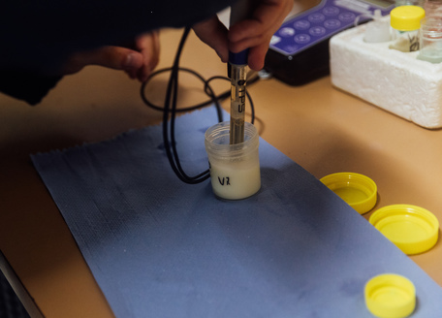
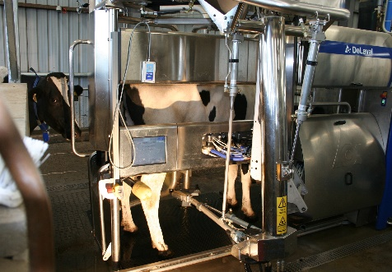
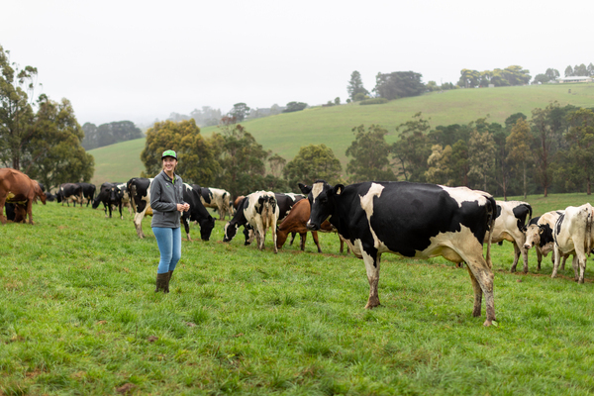
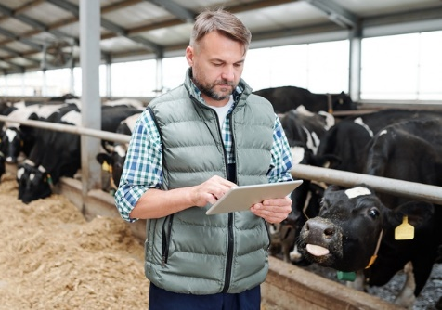
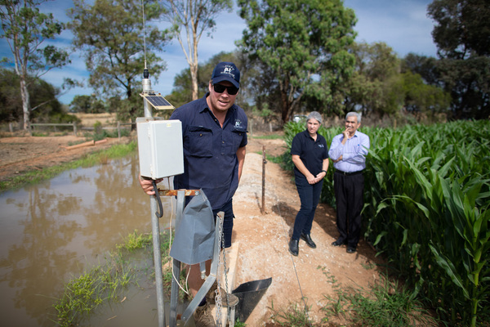
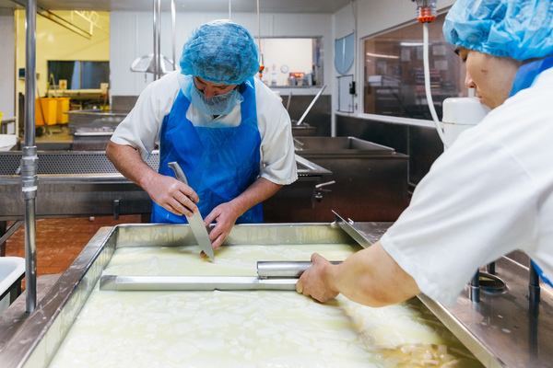
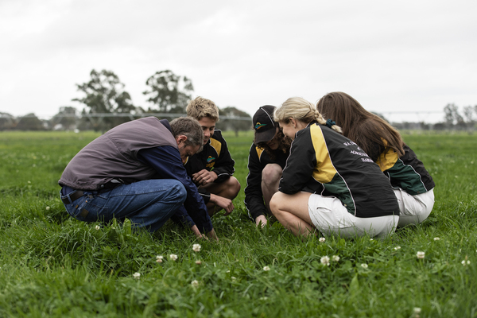
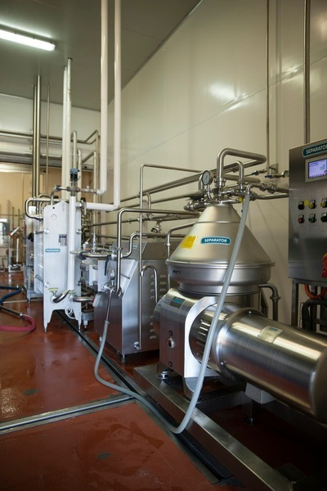
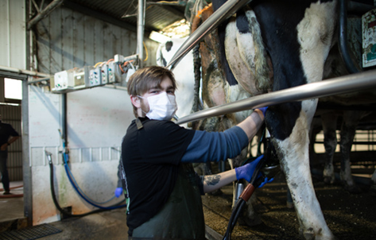
Just some of the career opportunities in the Dairy Industry
Calf Rearing
Computer Technology
Science and Research
Dairy Robotics
Genetics, Genomics and Biotechnology
Farm Management
Environmental Management
Food Technology and Manufacturing
Agronomy and Pasture Care
Engineering, Shed Design and Trades
Veterinary and Animal Nutritionist
5

Slide 6




Reasons to Explore a Career in Dairy
STABILITY AND OPPORTUNITY
WORK WITH ANIMALS IN THE GREAT OUTDOORS
CONTRIBUTE TO A HEALTHIER WORLD
TURN YOUR DAIRY JOB INTO A DAIRY CAREER
A job on a dairy farm provides stability, a reliable source of income and a level of job security that not all industries can offer. It’s a career that will always be there.
Providing best care for animals is a key part of any role in the dairy industry. Technological advances continues to improve the treatment, care and health of dairy cows.
The dairy industry makes a positive contribution to local communities and is part of a collective effort to provide nutritious food for a healthier world.
Work in the dairy industry can lead to a rewarding career. Agriculture is one of the most rapidly changing fields of study, there is high demand for skills professionals.
Notes:
Australia’s dairy farmers are skilled, innovative professionals who are passionate about their industry.
They are committed to the health and wellbeing of their animals, land and communities.
The Dairy industry is progressive and technologically advanced with world leading practices.
There is no gender bias in the agricultural industry , both genders are widely represented.

Slide 7
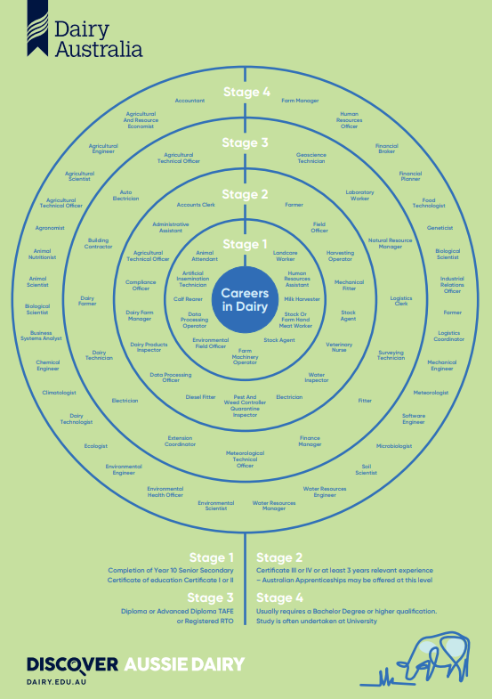
How to start a career in Dairy
There's more to dairy that just milking cows.
Accredited training is available to prepare people and excel careers in the dairy industry.
A massive shortage of skilled professionals exists in a range of agriculture positions.
Agriculture is one of the most rapidly changing fields of study in the 21st century.
Entry level jobs
Milker, Farm Hand, Calf Rearer
Certificate II, III or IV
Agriculture, Agriculture Dairy Production,
Diplomas
Traineeships including SBAT
University Degrees
Agriculture, Agriculture Science, Agriculture Business, Veterinary Sciences
Trades
Diesel Mechanics, Plumbers, Fitters
Ag Career Start
Gap Year Program that offers the opportunity to work in the Agriculture industry

Slide 8
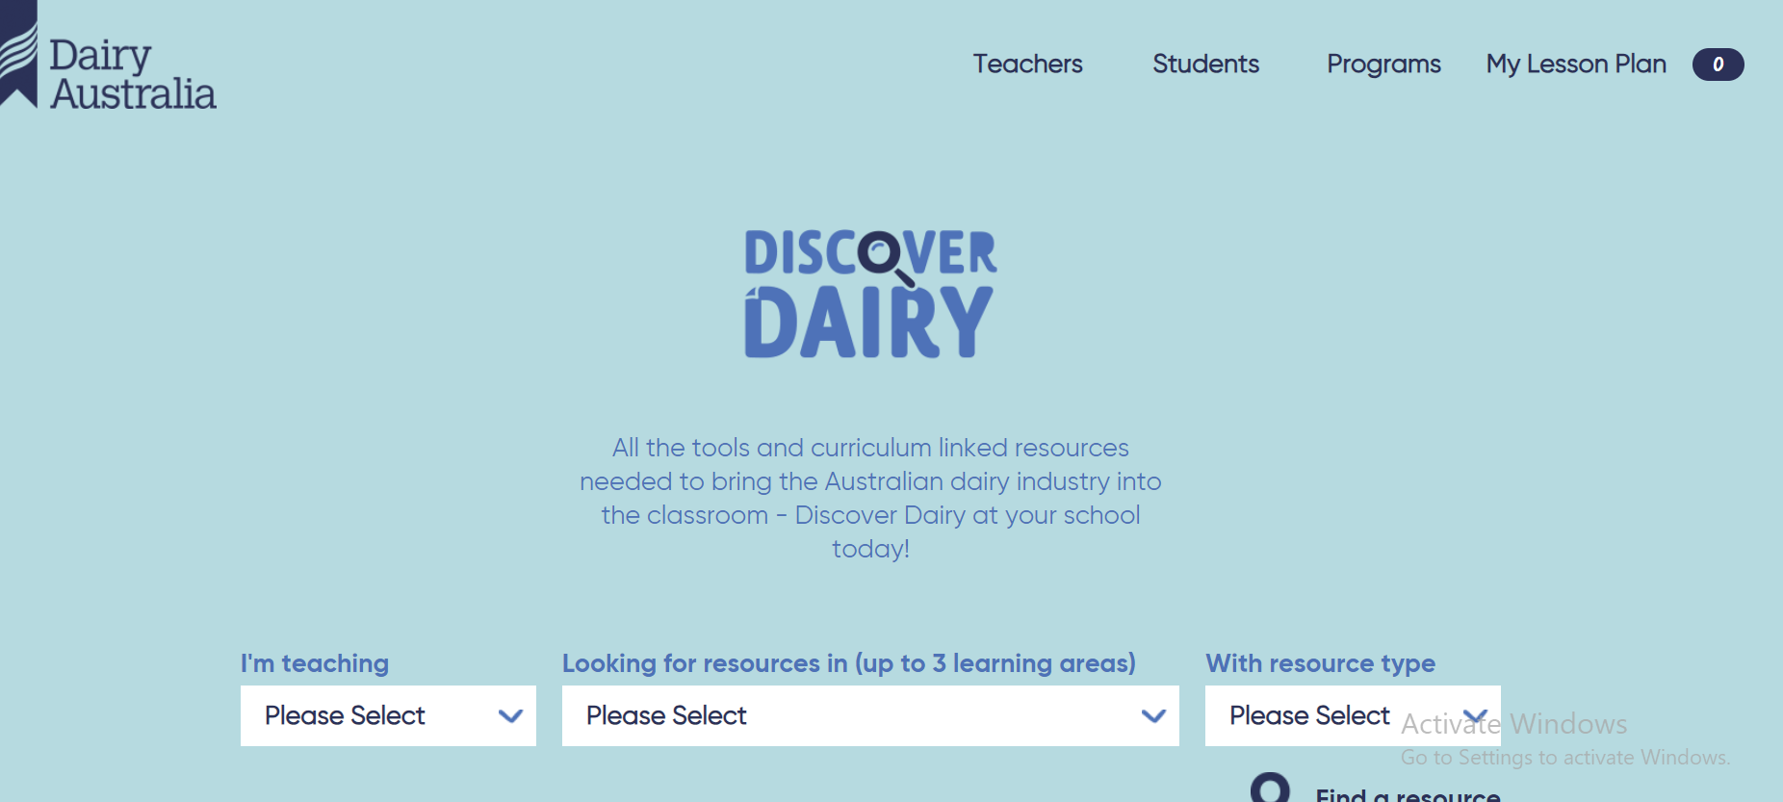
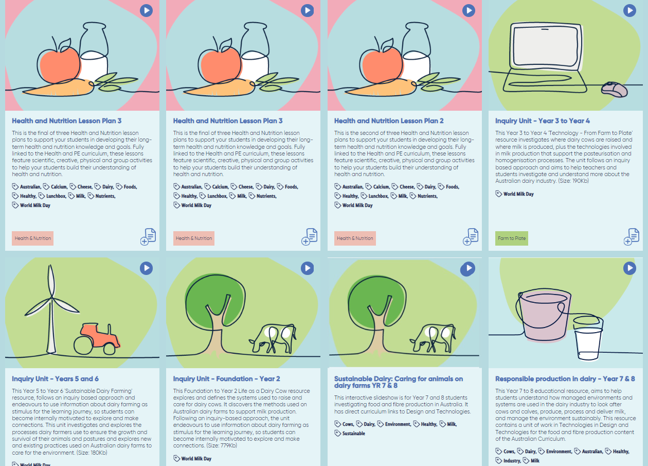
Discover Dairy
https://www.dairy.edu.au/ - also is linked on primezone
8
Notes:
This website is great it shows how you can link the curriculum to the dairy industry, more resources are being added to this

Slide 9
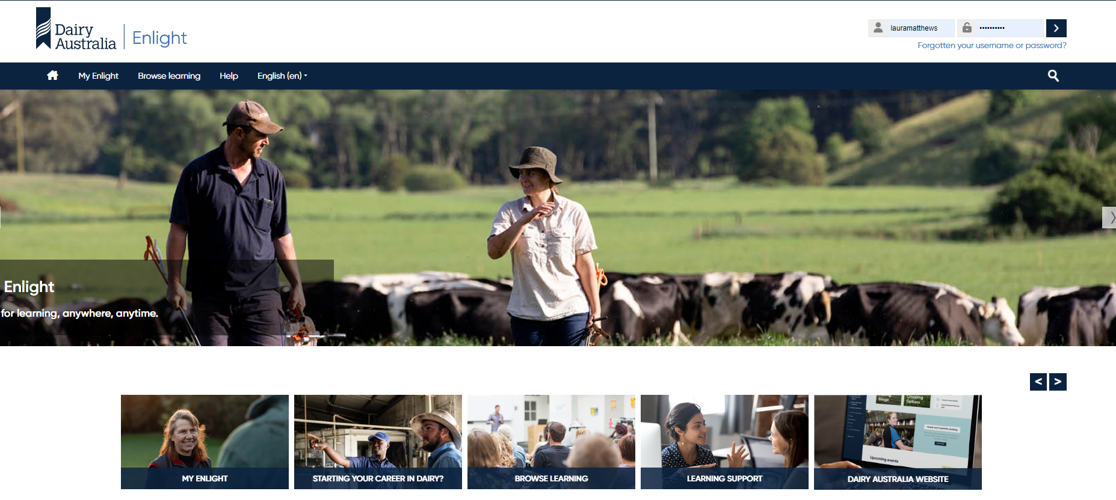
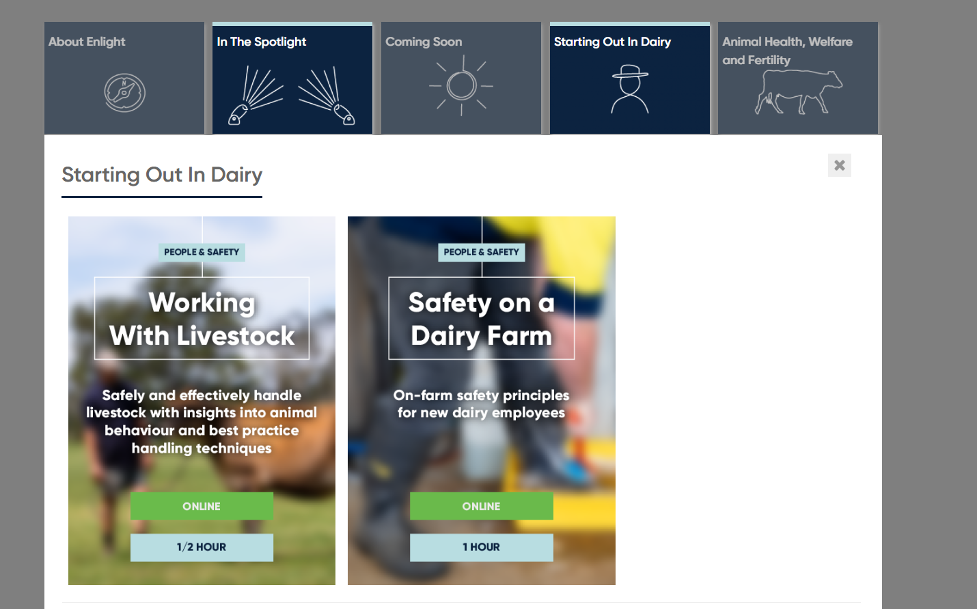
Enlight Online Learning Platform
https://enlight.dairyaustralia.com.au/
9
Notes:
Enlight is Dairy Australia online learning platform.

Slide 10
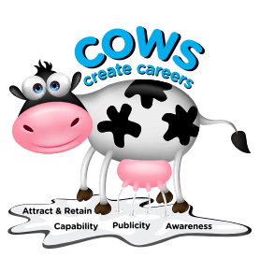
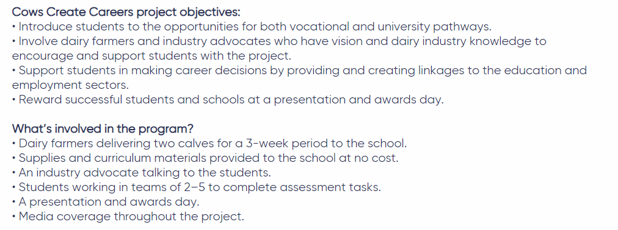
Cows Create Careers

Slide 11
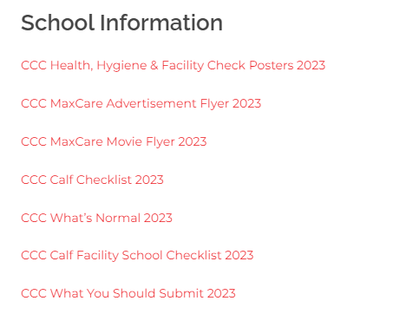
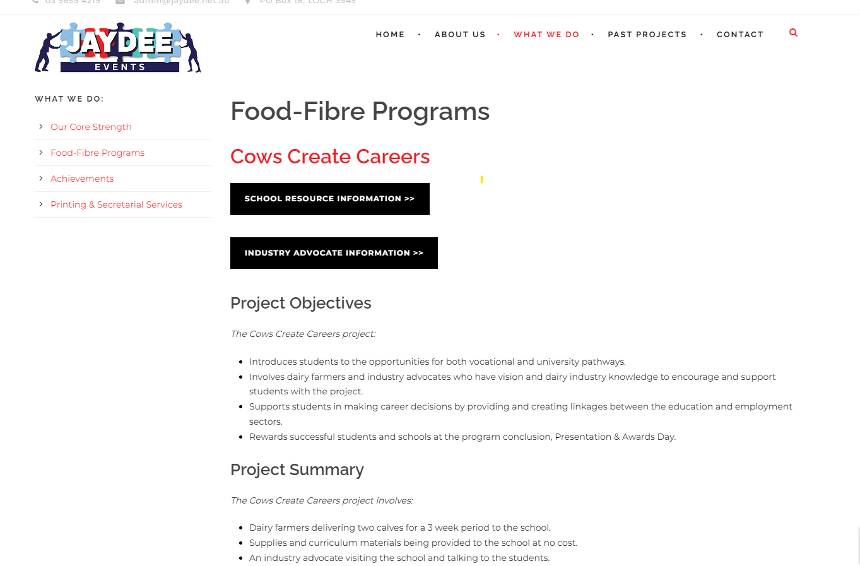
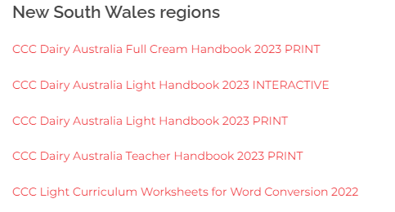
Cows Create Careers - Jaydee events
https://www.jaydee.net.au/food-fibre-programs/
11

Slide 12
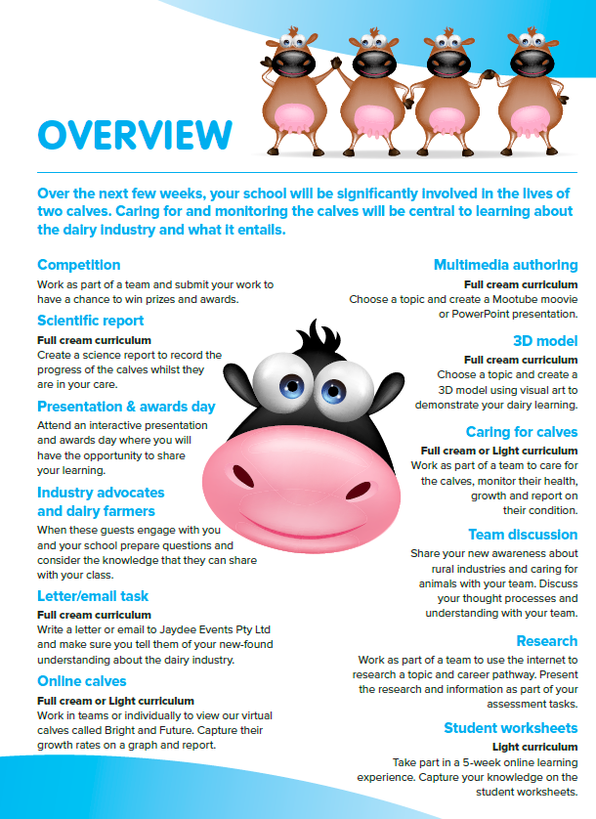
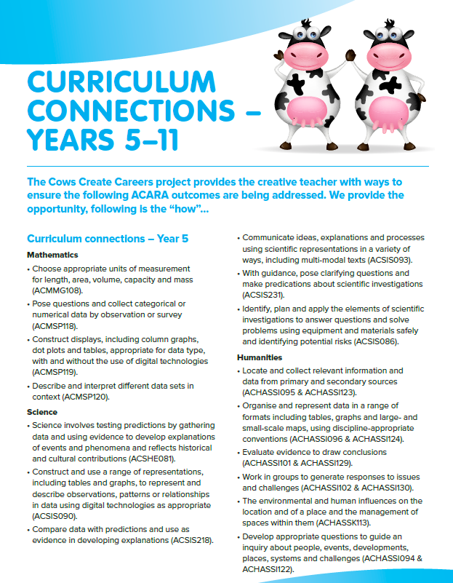

Slide 13
Any questions?
Please feel free to contact me:
Laura Matthews
Workforce Attraction and Retention Officer Northern NSW
laura@dairynsw.com.au
0493452640

