Slide 1
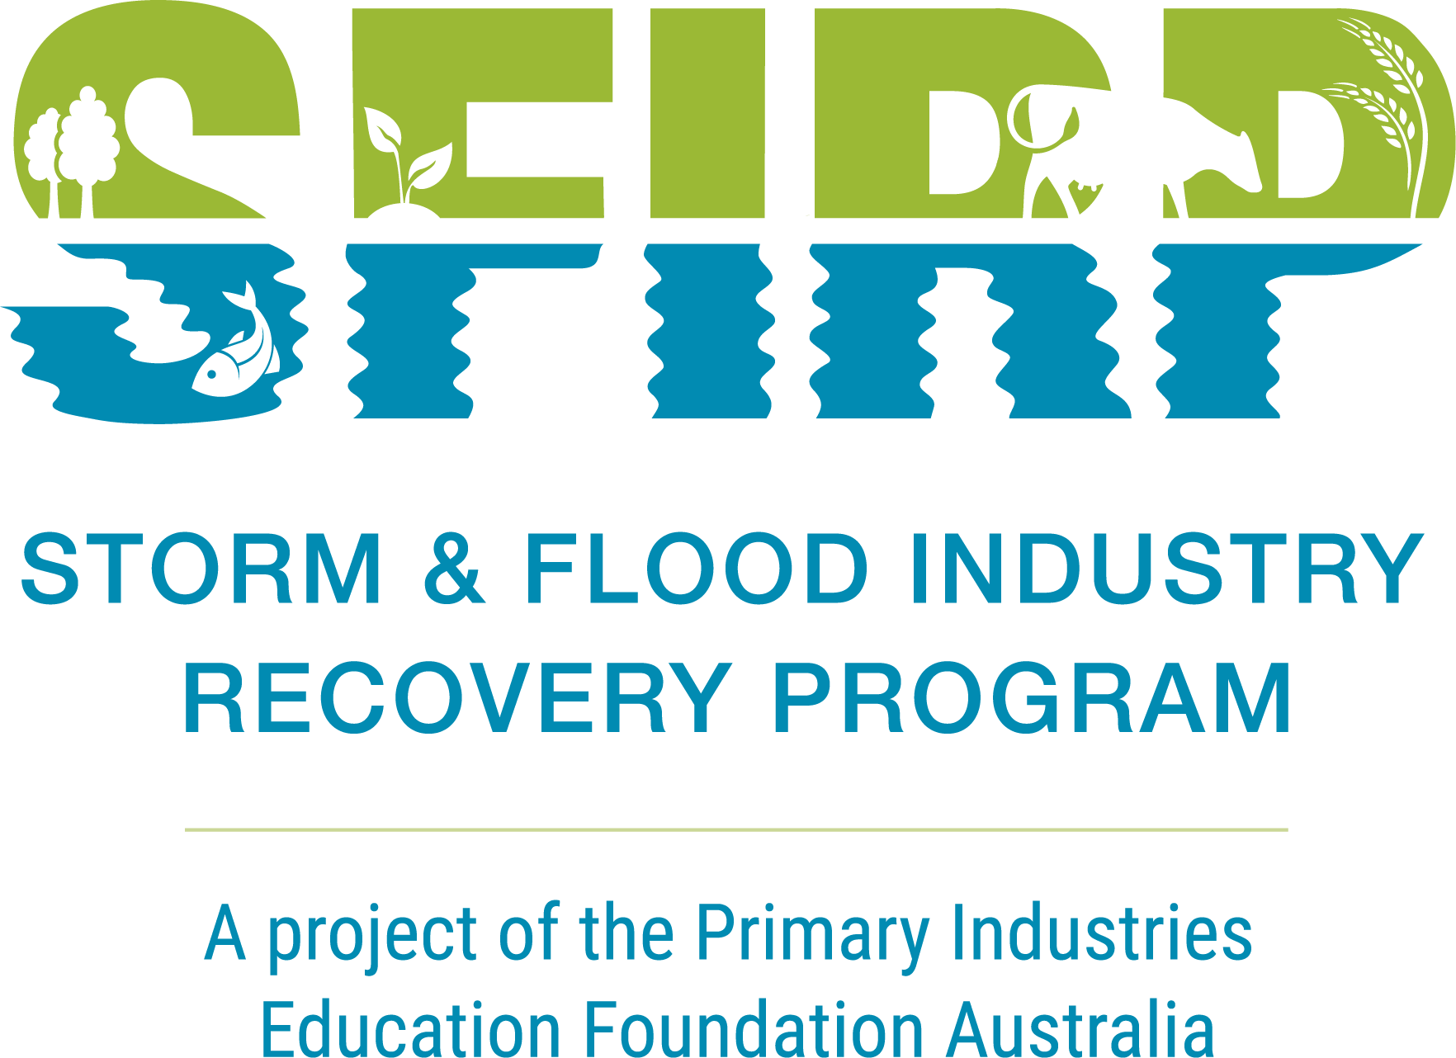
PIEFA/ SFIRP
Exploring Drones In Agriculture!
Storm & Flood Industry Recovery Program
Farming for Climate Resilience
& Productivity

Slide 2
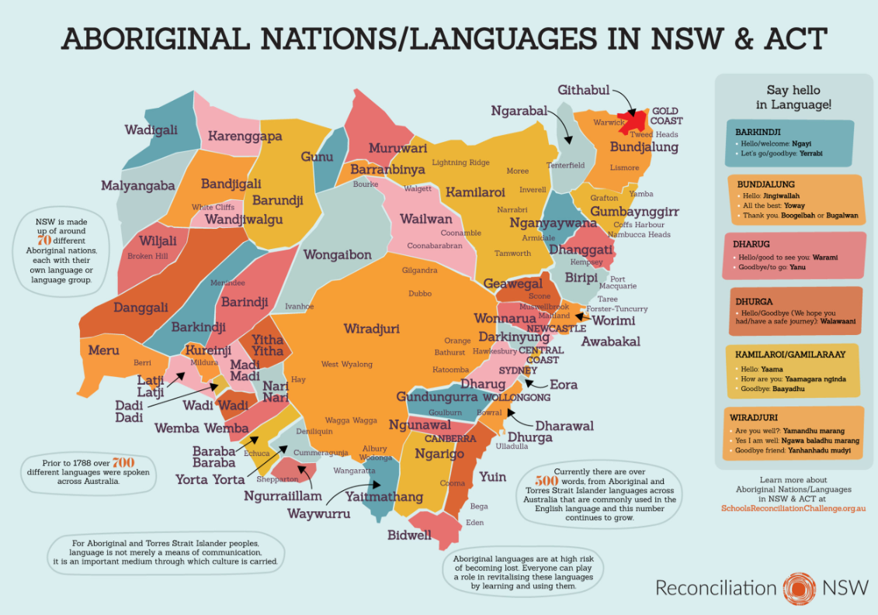
Bundjalung
Banyula
Darkinyung
Central Coast
Ngunawal
Canberra
Acknowledgment of Country
https://reconciliationnsw.org.au/product/a3-language-map/

Slide 3
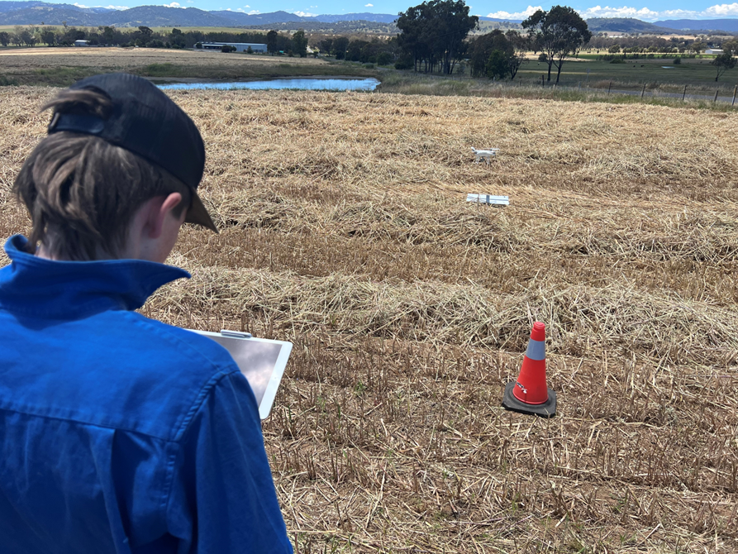
Farmer Time! ‘Exploring Drones In Agriculture’
National Science Week
12-20 August, 2023
Innovation: Powering Future Industries
PIEFA/ SFIRP would like to engage as many students, teachers and schools to take part in our unique Farmer Time opportunity.
Presenters include two inspiring Drone Pilots from Shepparton, Victoria and Molong NSW.

Slide 4
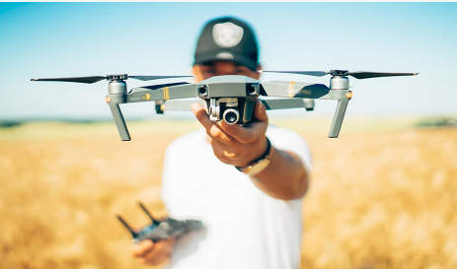
Why Drones?
Future Farming
Australian Agricultural practices are rapidly changing, due to the incredible speed and rate that digital technology is advancing. Using drone technology in primary industries are more effective, safe and an efficient way of production than traditional farming practices.
Drone Applications
managing assets
resources
land management
boundary & fencing
dam levels
livestock monitoring
Diverse Environments
large and small properties
differing environments
vast open paddocks
steep rocky outcrops
dams, rivers and creeks
reforestation of native trees,
shrubs and canopies

Slide 5
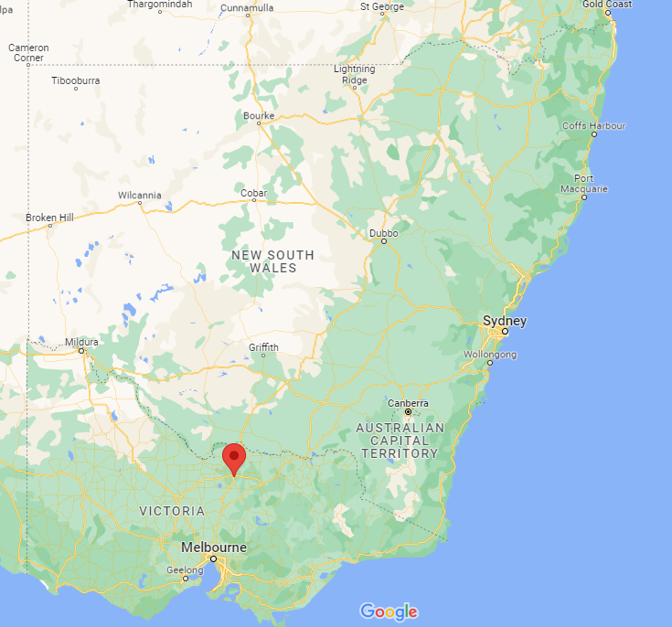
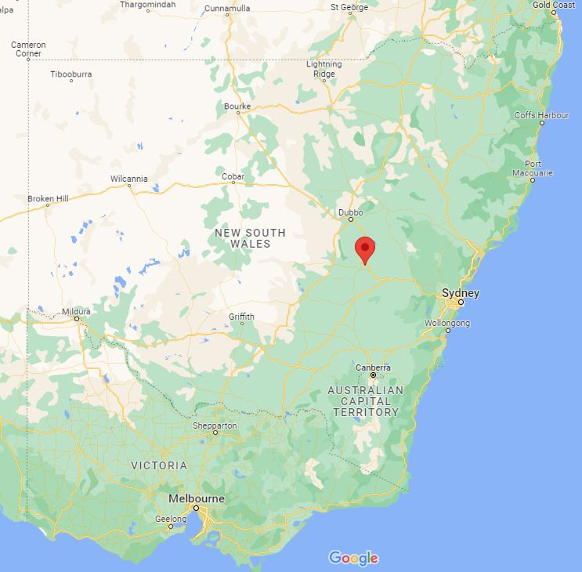
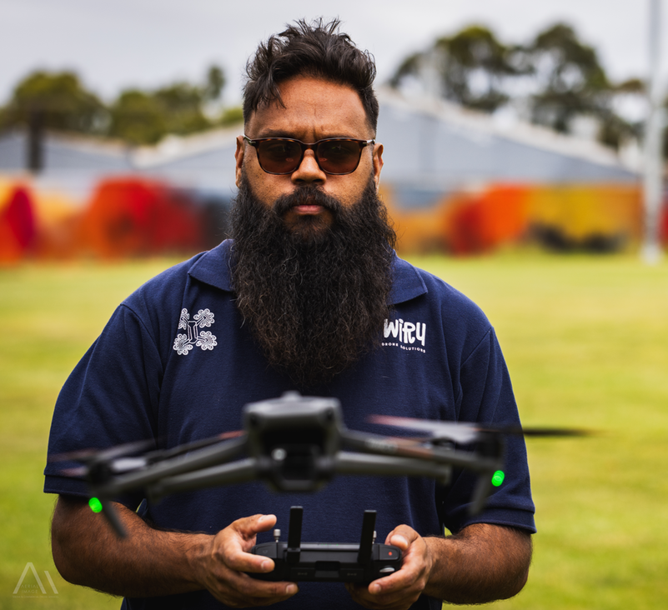
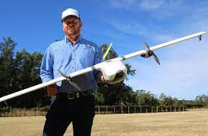
Meet Our Drone Technology Experts
Chris Warrior
Wiru Drone Solutions
Ben Watts
Bralca

Slide 6
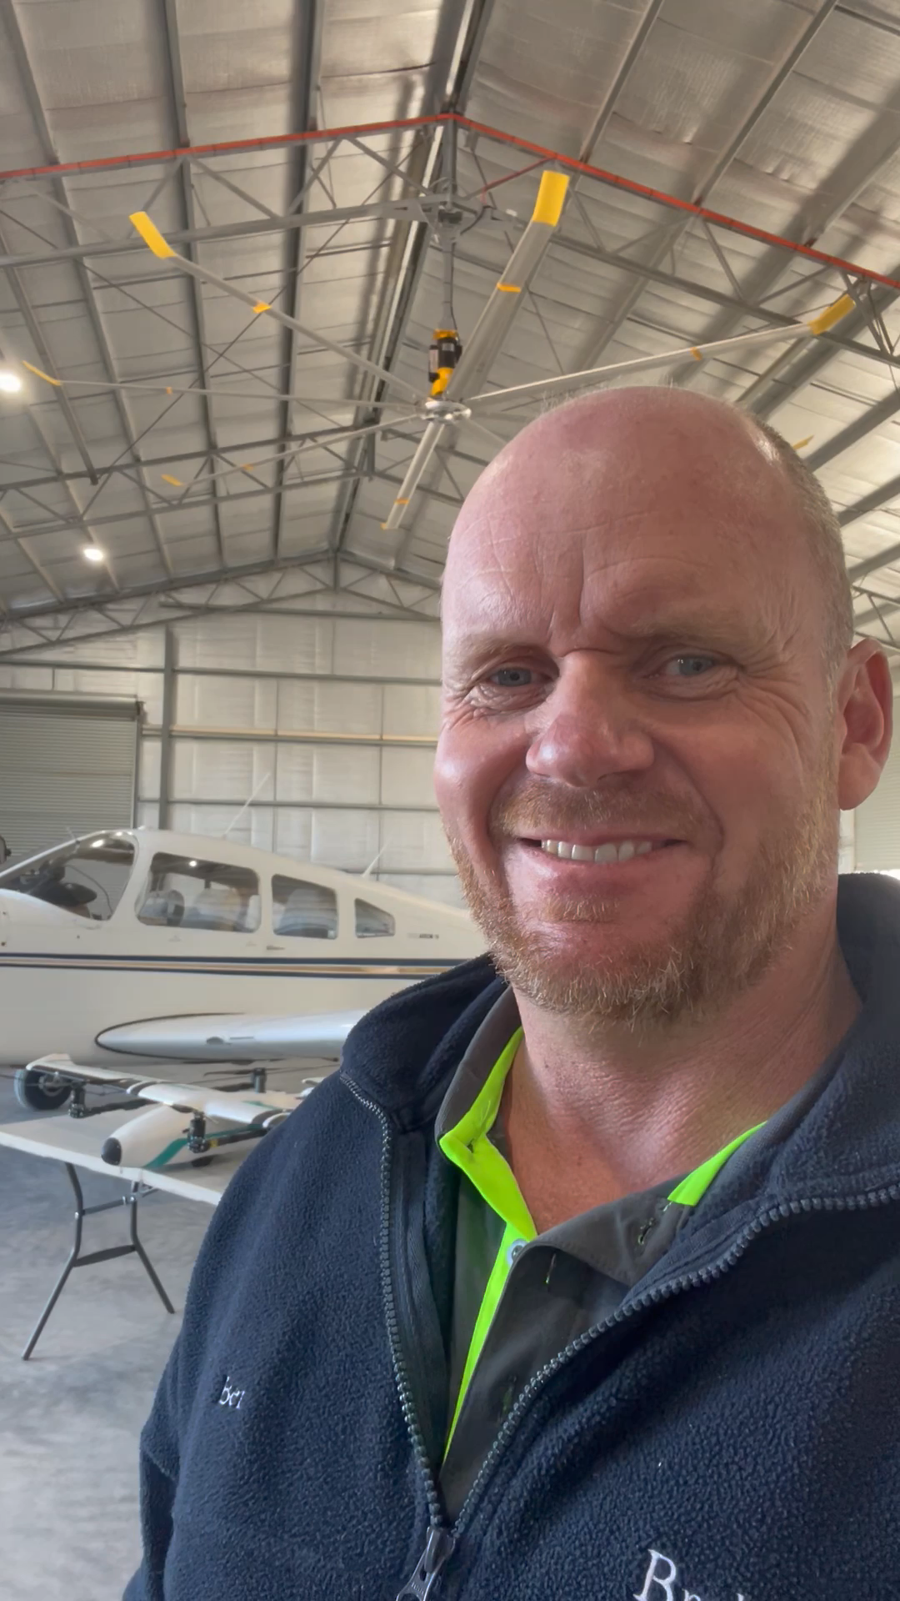

Slide 7
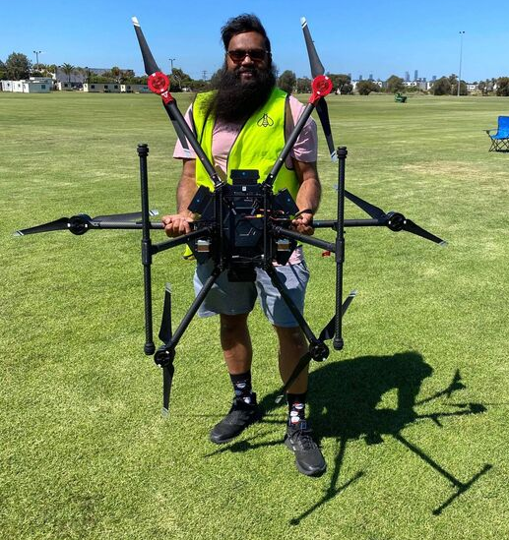
Chris Warrior
Wiru Drone Solutions is 100% Indigenous owned and operated by Chris Warrior a Kokatha/ Wiranga man.
Chris is passionate about providing pathways into drone operation and STEM for young Indigenous people. He offers
pathways, STEM and drone education workshops.
“My passion is capturing cultural heritage sites with 3D mapping on country and also teaching the next generation of Indigenous drone pilots to manage their own country with technology and data capture methodologies.” “I love capturing cultural heritage sites with the use of photogrammetry 3D mapping and how to better protect cultural heritage sites, especially when being on pastoral/farming properties. It is about sharing the land and preserving the heritage together and using drones to aid in data collection.”
Source: http://wirudronesolutions.com.au/about.html

Slide 8
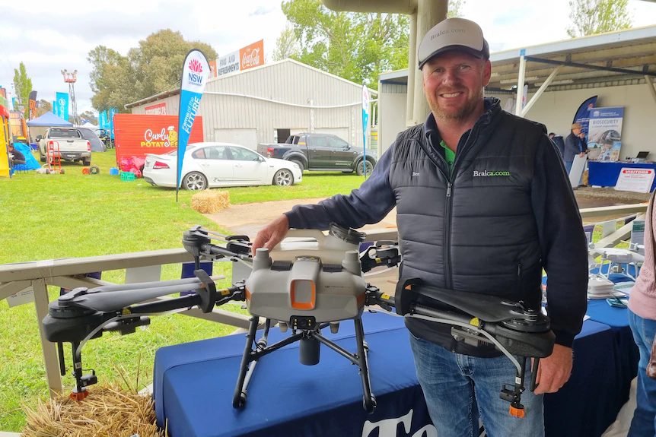
Ben Watts
Ben is a renowned keynote speaker for the Agricultural Industry having presented both nationally and internationally.
He brings a realistic and experience driven presentation that connects with both what is possible now and what the future looks like in the AgTech arena!
Ben is at the leading edge of Australian Agriculture and AgTech and brings a whole new dimension of engagement and opportunities for our emerging young drone pilots in Agriculture.
https://www.nbnnews.com.au/2022/12/08/farmers-learn-how-drones-can-benefit-their-farming-practices-in-the-northern-rivers/

Slide 9
The difference is YOU!
Local
Agriculture
National
Science
Global

Slide 10
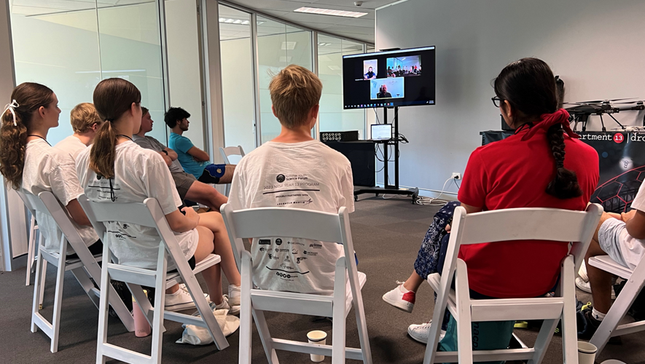
Agricultural Technology - Stage 4 & 5
AGLS-10 uses information and communication technologies to collect, organise and present information related to an agricultural enterprise
AG4-12 communicates experimental data using a range of information and communication technologies
AG5-11 designs, undertakes, analyses and evaluates experiments and investigates problems in agricultural contexts
AG5-12 collects and analyses agricultural data and communicates results using a range of technologies
ACARA
Identify the impact of a range of cultures, including those of Aboriginal and/or Torres Strait Islander Peoples, on Australian agricultural production, for example: (ACTDEK040) - Aboriginal land management
Research a range of current and future employment opportunities in agriculture, for example: – agricultural practices employing Aboriginal knowledge – operating unmanned aerial vehicles (UAV, Drones) – precision farming and Global Positioning System (GPS) technologies · evaluate the impact of current technologies on sustainability, for example: (ACTDEK041, ACTDEK044, ACTDEP051) – precision farming

Slide 11
Science - Stage 4 & 5
Earth & Space
LW2 Conserving and maintaining the quality and sustainability of the environment requires scientific understanding of interactions within, the cycling of matter and the flow of energy through ecosystems.
e. assess ways that Aboriginal and Torres Strait Islander peoples' cultural practices and knowledge of the environment contribute to the conservation and management of sustainable ecosystems
f. evaluate some examples in ecosystems, of strategies used to balance conserving, protecting and maintaining the quality and sustainability of the environment with human activities and needs
Additional content: Investigate how models can be used to predict the changes in populations due to environmental changes, eg the impact of fire or flooding

Slide 12
Thank you.
FARMER TIME - Stage 4 & 5
‘Exploring Drones In Agriculture’
National Science Week
12-20th August 2023
Term 3, Week 5
Contact Sharon: sharon.okane@piefa.edu.au
Sharon O’Kane
Project Officer – Storm & Flood Industry Recovery Program (SFIRP)
M: 0480 409 559
Register via the QR Code:

