Slide 1
Careers and opportunities in Agriculture

Slide 2
Careers and opportunities in agriculture
70% Increased global food and fibre demand by 2050
Data - 6 graduate level positions for every agriculture graduate student - CSU professor Jim Pratley, PIEFA conference 2023.
Longerenong Smart Farm Vic - 9-10 job offers before graduation - David Lamb, UNE, PIEFA conference 2023.

Slide 3
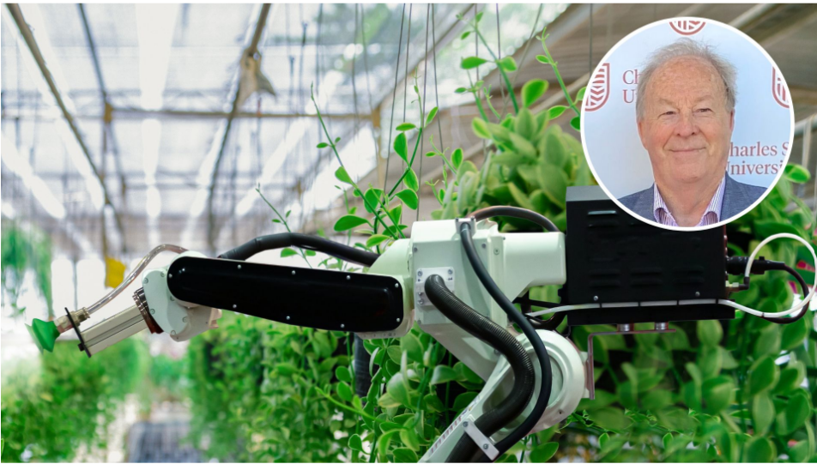
Careers and opportunities in agriculture
Workforce- 30% on farm, 45% off farm and 25% metropolitan - Scott Graham, PIEFA conference 2023.
Range of positions available (entry,
trade/certificate and graduate).
Range of sectors - Beef, Dairy, Horticulture and Aquaculture, education, Agribusiness, Agtech, Agronomy and Food Value Chains.

Slide 4
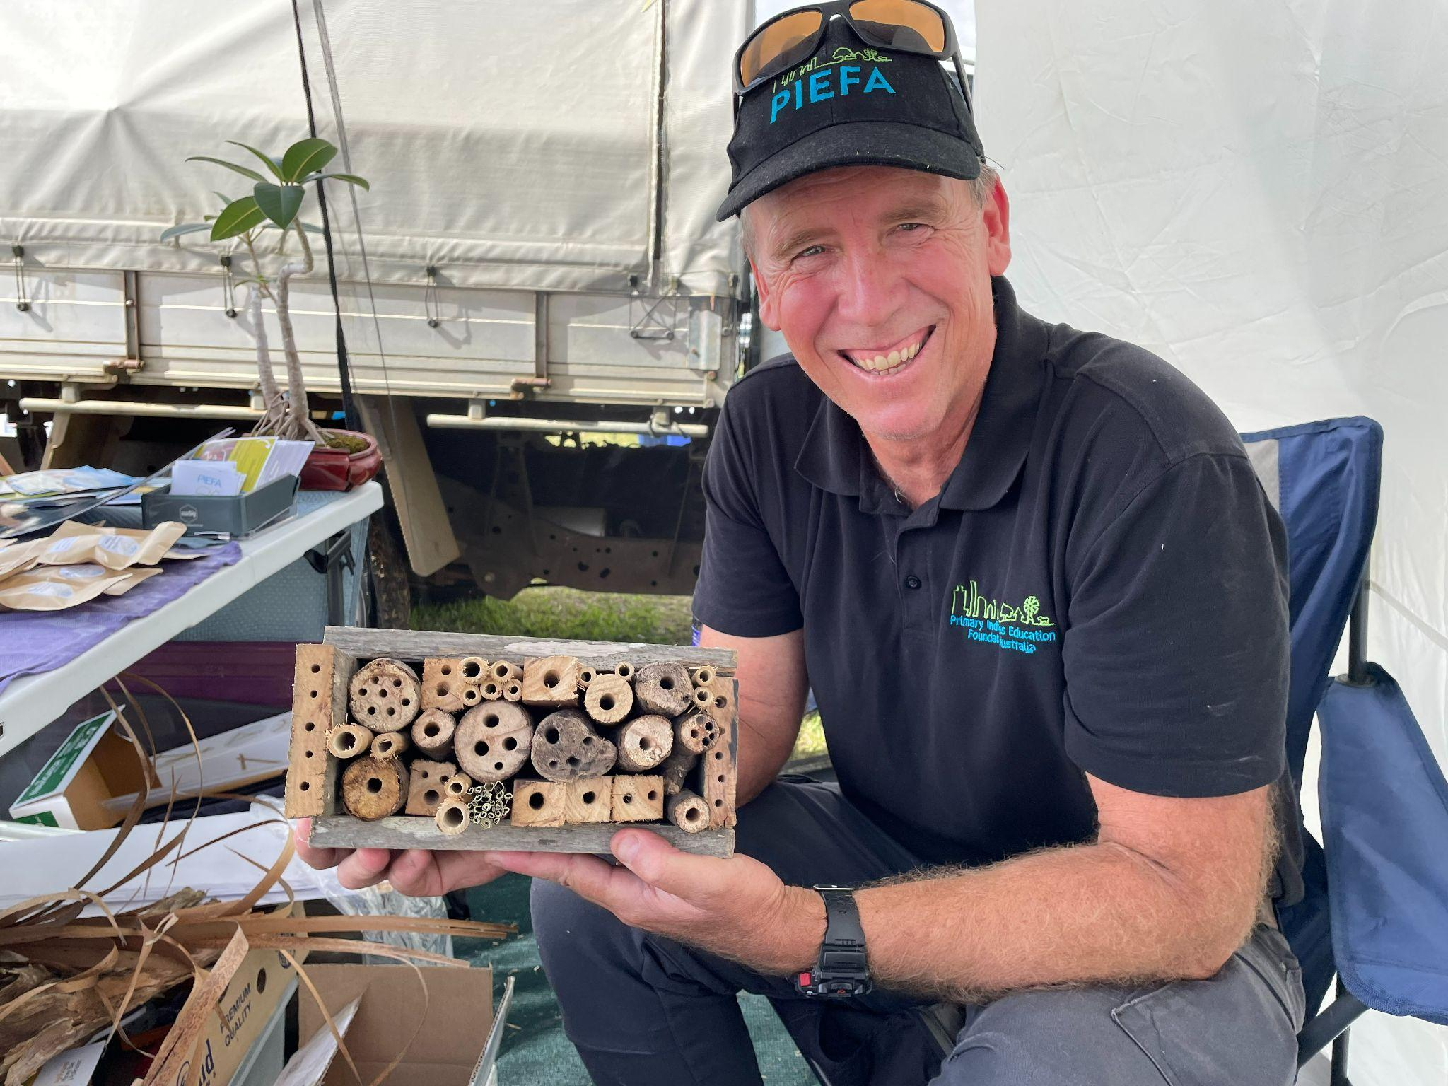
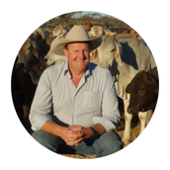
Key themes to consider
Skills needs - various operational, business, HR, R&D, agritech, regulation and compliance, QA, biosecurity and health, sustainability/carbon mitigation, comms and marketing and finally education - Rachel Rodney ANU PIEFA conference 2023.
Industry Issues - skills shortages, lack of workers, farm safety and unlocking the value of human capital - high death rate (3-8 times other industries - Troy Setter CPC PIEFA conference 2023).
Key attractors to industry - Youth want to “make a difference, improve environmental outcomes and be at the forefront for innovation” - Andrew Metcalf, PIEFA conference 2023.

Slide 5
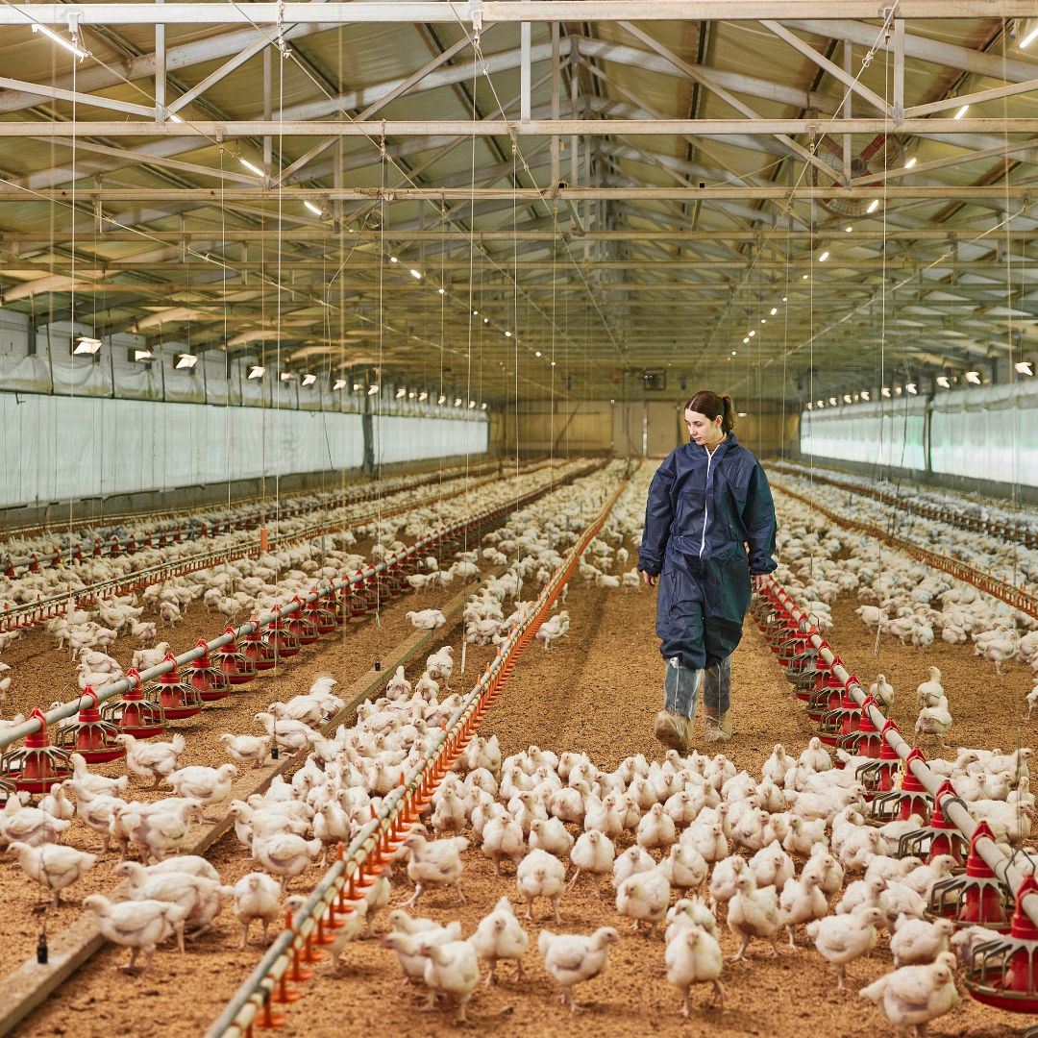
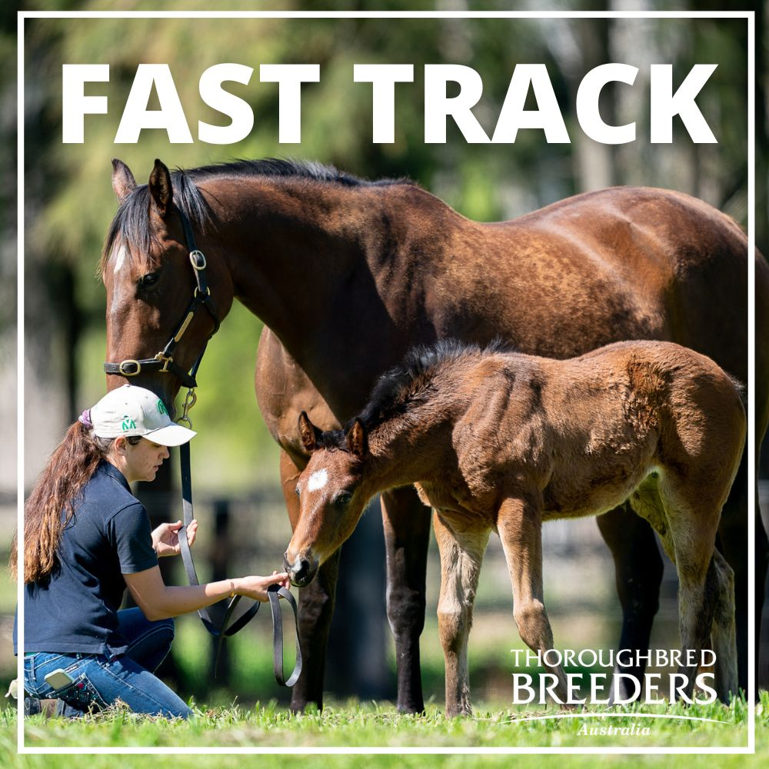
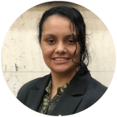
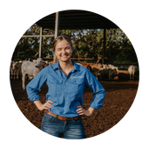
Key themes to consider
Range of training programs available - transferable skills, industry supported programs - PIEFA’s Agcareers Start, Agforce SIPP, Thoroughbred Breeders, AWI etc.
Cost of land a barrier to youth
Students have diverse backgrounds, skills and interests
Career pathways not clear unless looking back on the past - Gullara McInnes, Kari Moffat, PIEFA conference 2023.
.

Slide 6
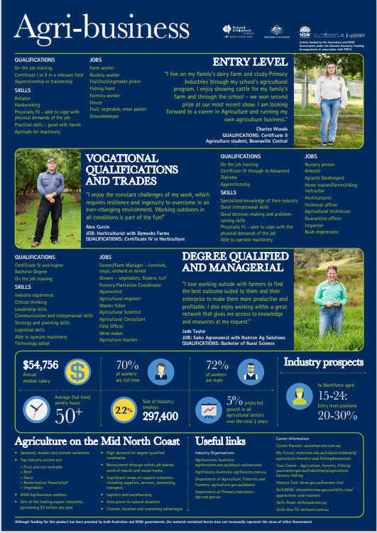
PIEFA resources for agriculture careers education
Future resources:
Subject selection to promote agriculture to students and parents - Scott Graham, Barker College, PIEFA conference 2023.

Slide 7
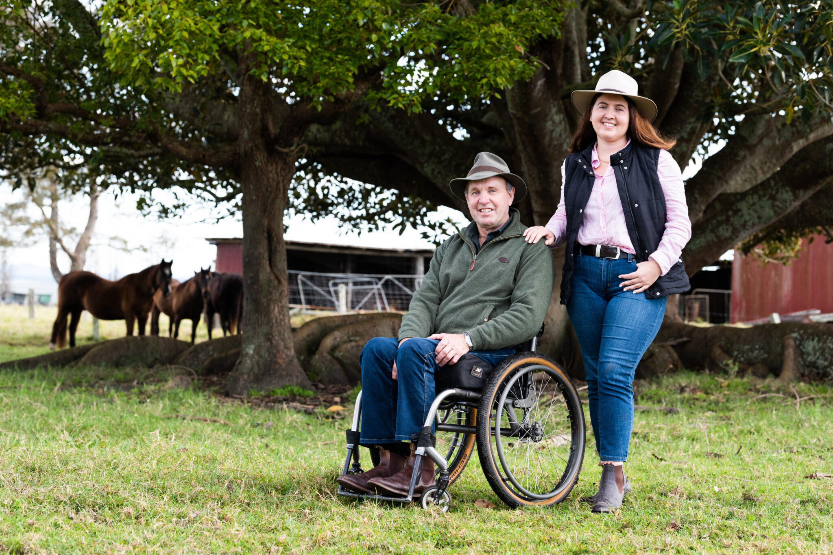
Ability Agriculture and Agcess websites: Josie and Glen Clarke
Inclusivity in the workplace and education:
Access for workers with disabilities
Provision of facilities to cater for individual needs adjustments, EEO principles and WHS compliance - Josie and Glen Clarke and the Gator.
https://abilityagriculture.com/

