Slide 2
Why we need to take action now...
It’s the right thing…
Customers and Governments are demanding action
We rely on clean & green claim for our products, we need to prove we are!
Our region has a strong social licence for environmental and social change and an existing clean green brand. If any region is to own the ‘Carbon Net Zero’ brand, it is us!

Slide 3
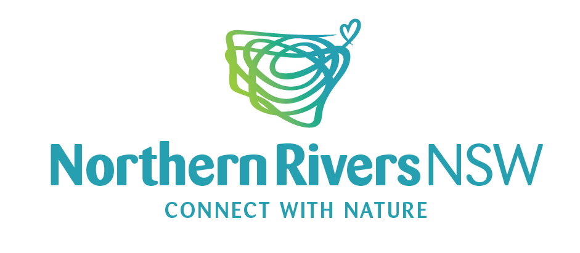
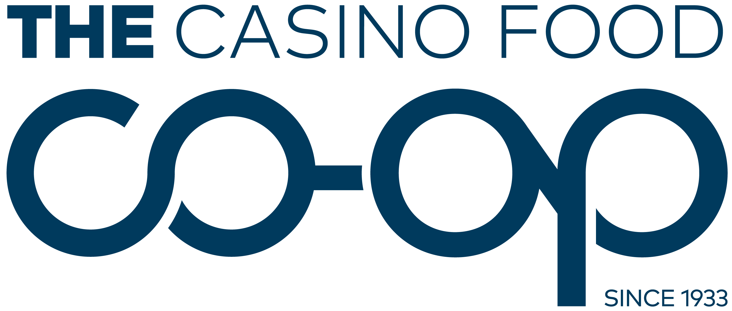
Project vision
An industry led collaboration to make Northern Rivers NSW one of the first carbon net zero regions in Australia.
Summary
Northern Rivers NSW Steering Committee, The Casino Food Co-op and Southern Cross University are collaborating to lead this exciting and ambitious project, united under the 'Northern Rivers NSW' brand.
The footprint spans seven local government areas between Tweed Heads and Grafton, with sectors including:
Agriculture
Energy
Waste
Transport.

Slide 4
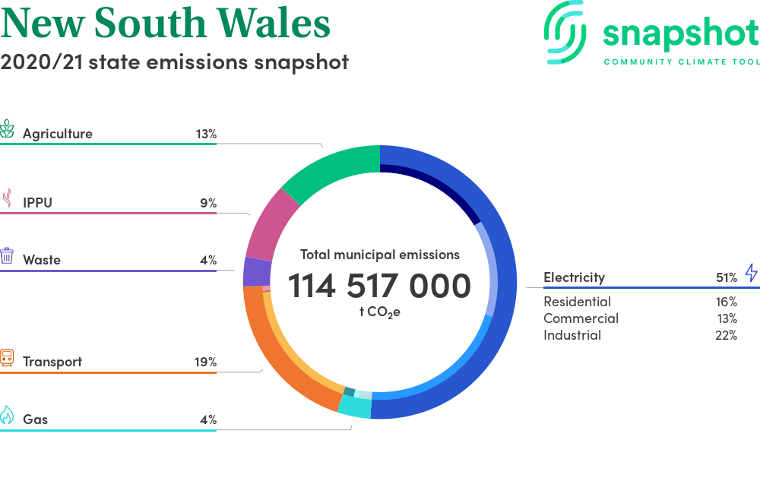
Northern Rivers – Total Emissions = 4,116,000 tCO2e or 3.5%

Slide 5
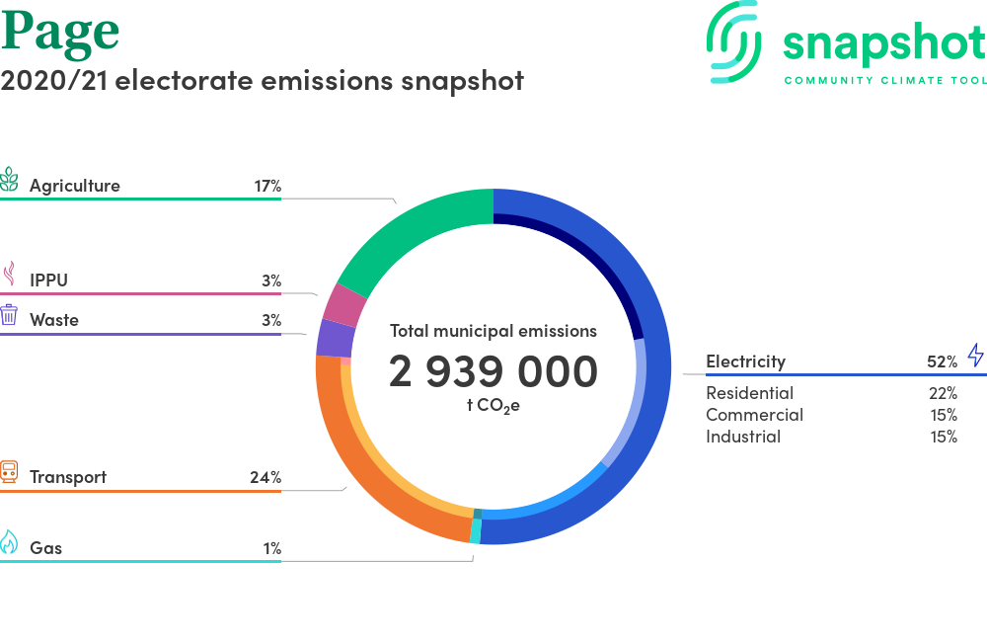
Councils: Kyogle, Richmond Valley, Clarence Valley and part of Ballina and Coffs Harbour

Slide 6
Agriculture 3%
Councils: Ballina, Byron and Tweed

Slide 7
Project benefits
Underpin/support brand claims “clean & green”
Income streams - carbon and biodiversity credits
Identify carbon emission projects underway and reduce our calculated net output
Emerging industries linked sustainability e.g regenerative agriculture, green power generation, waste utilization
Community driven, will foster pride in our local produce
More to learn….SCU collaboration

Slide 8
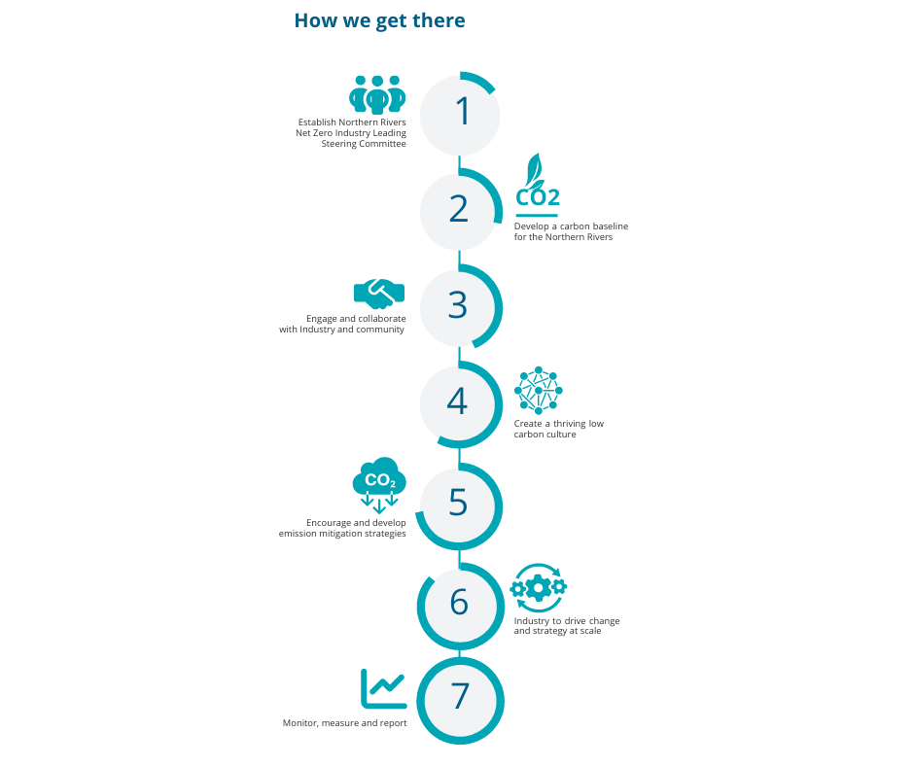

Slide 9
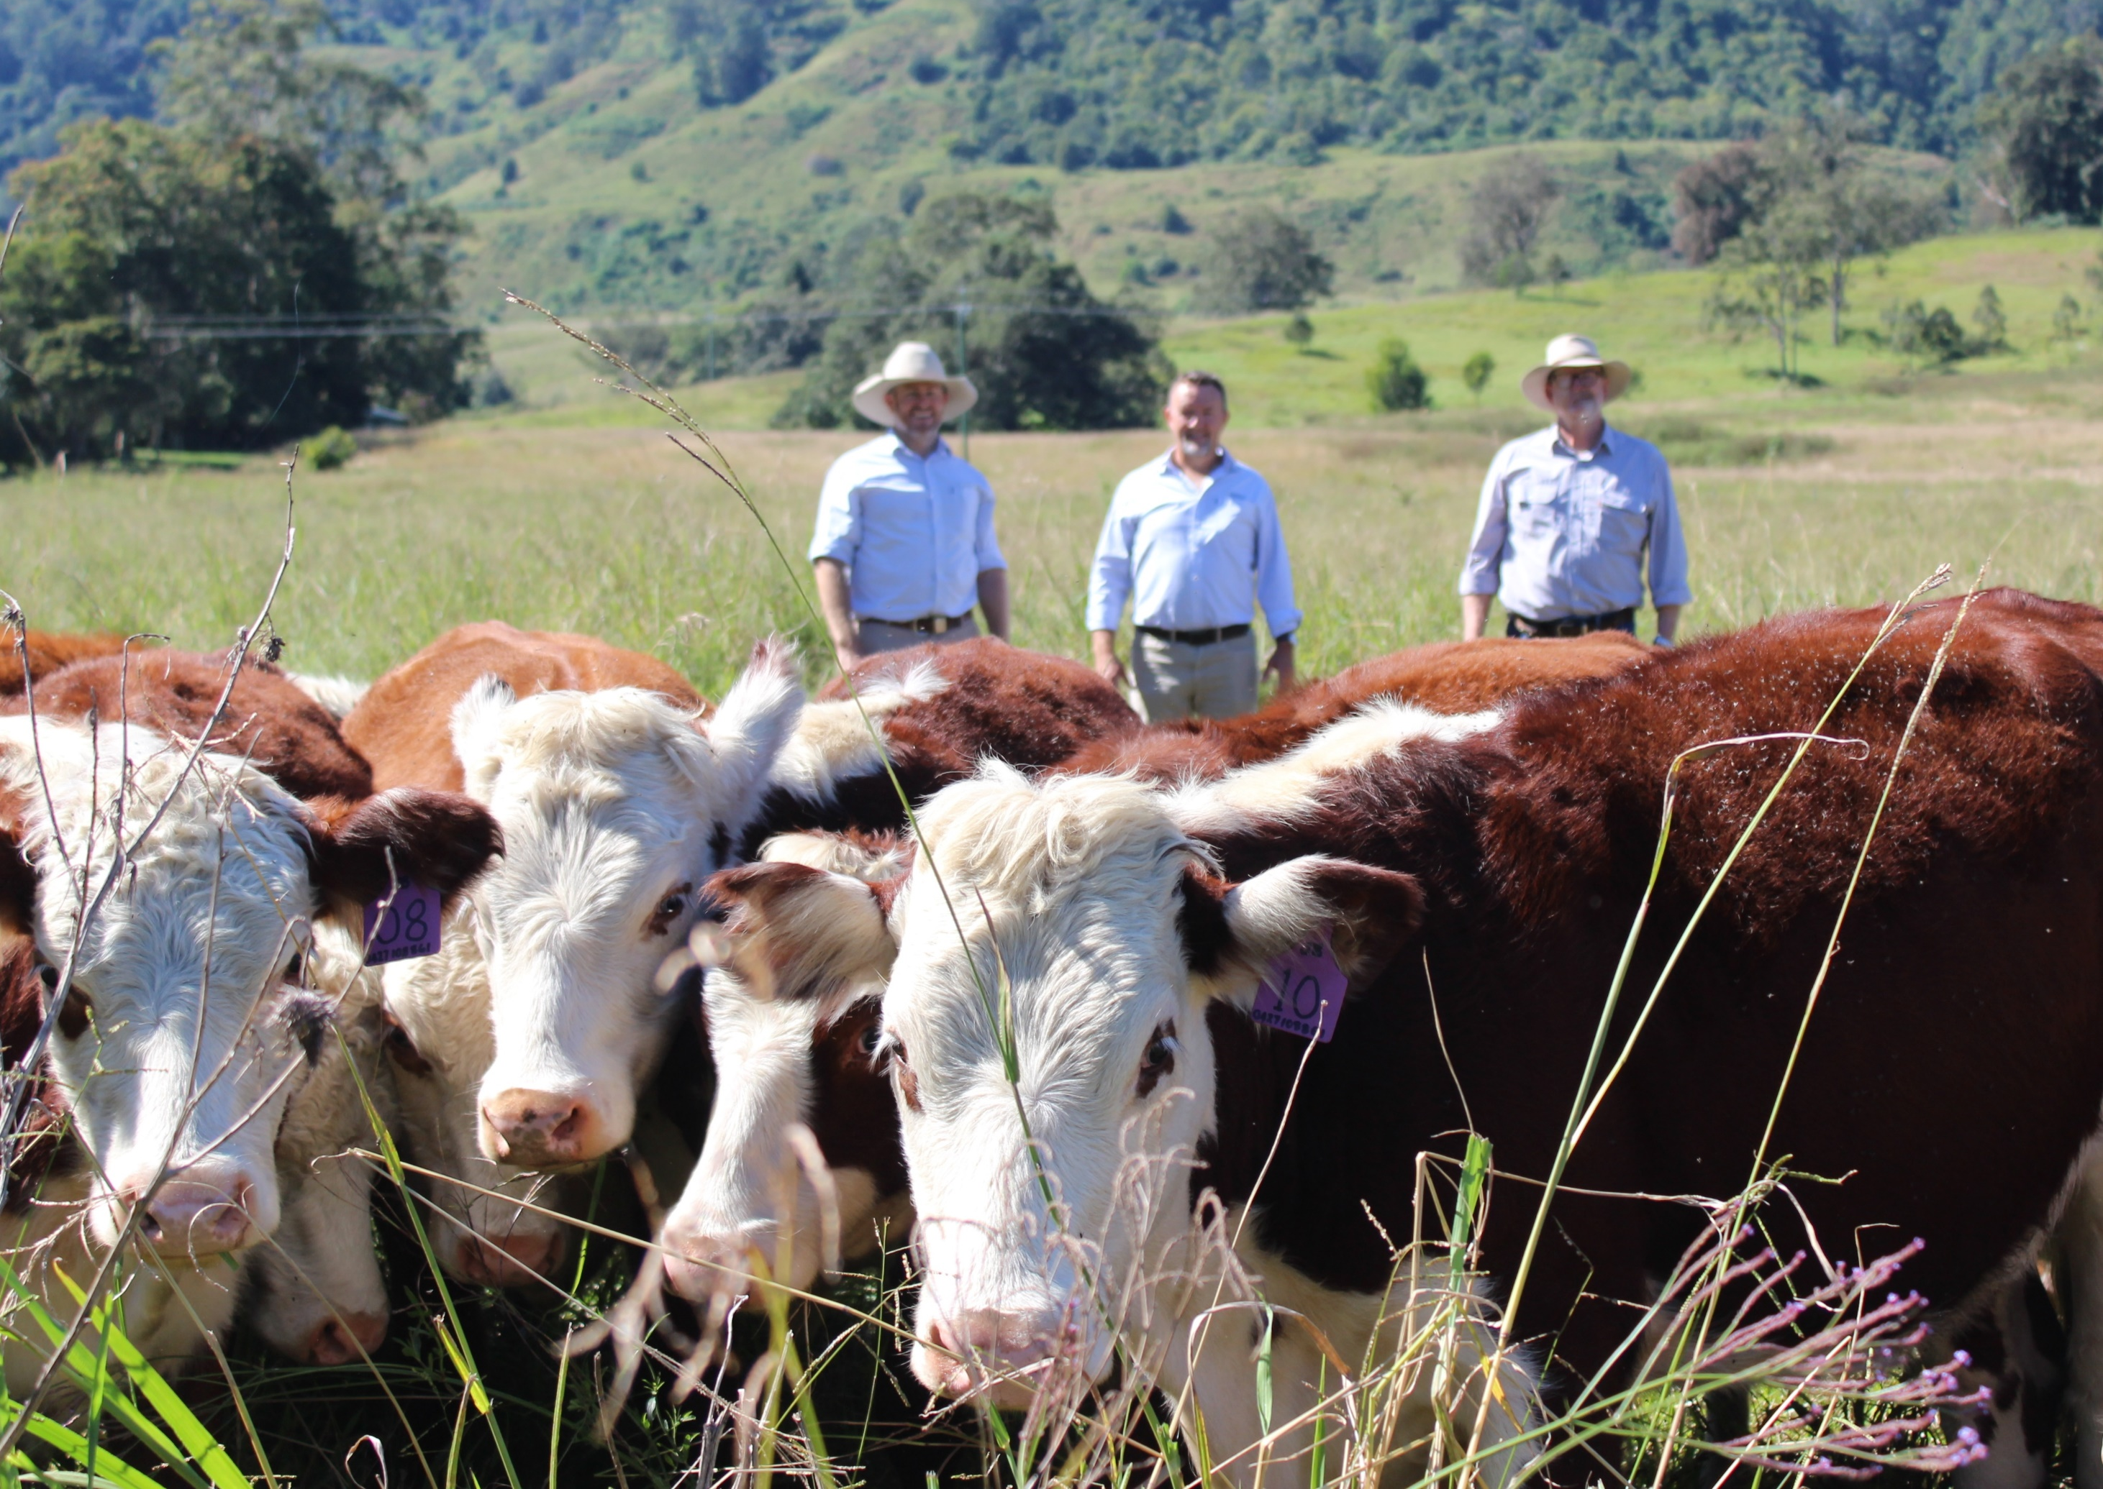
What are we doing?
Beef Industry – Project with MLA to research opportunity for small farm aggregation of carbon accounting – can it be done, what else do we need?
MLA CN30
Soil Club – better soils, productivity, carbon sink, river protection
River Crystal - Riparian Repair – river restoration / protection
Bio-hub – energy from waste-water & solid waste

Slide 10
Northern Rivers NET ZERO – Future Statement
https://bit.ly/northernriversnetzero

