Slide 1




INITIATIVE
This initiative focuses on supporting farm management practices to improve the health of our landscape and river's catchment area.
Water
Land
Climate

Slide 2


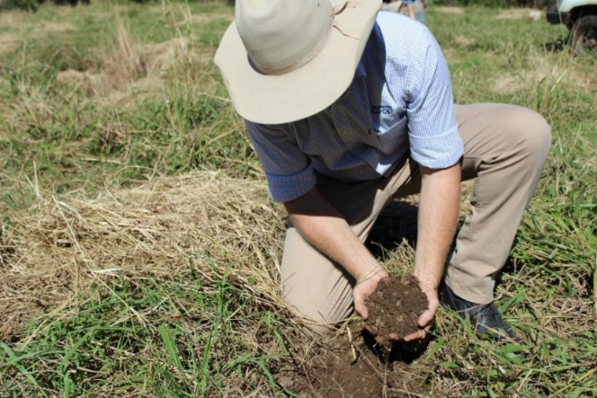
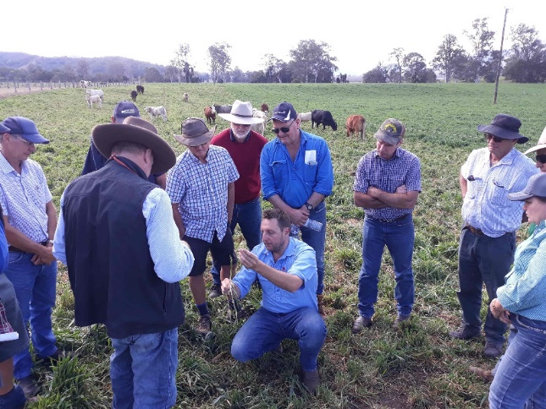
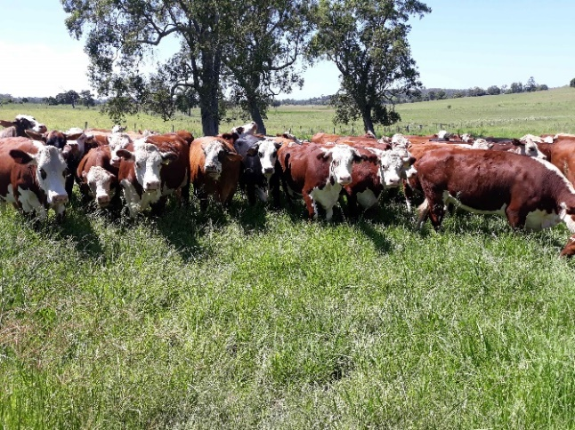
Our Ambitious Goal
Climate
CN30 - Red Meat Industry Carbon neutral by 2030.
We must lead – Industry leadership.
Co-op’s mission - Increase Carbon in agricultural soils to mitigate livestock emissions and improve productivity and sustainability in grazing systems.
Co-op pathway
  Optimize Livestock productivity.
    Calves DWG 0.95kg.
    Weaning rate 88%.
  Build Soil carbon
    Do the research, find farmers the answer.
    Drive approved practice change.

Slide 3

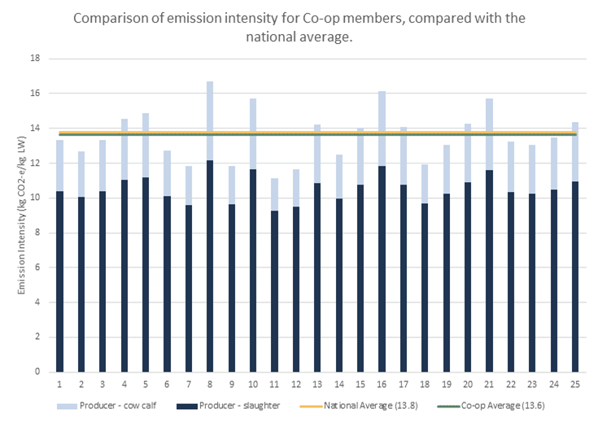

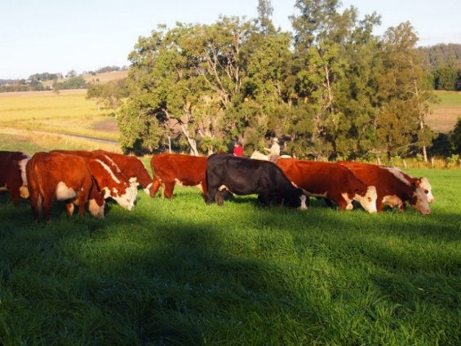
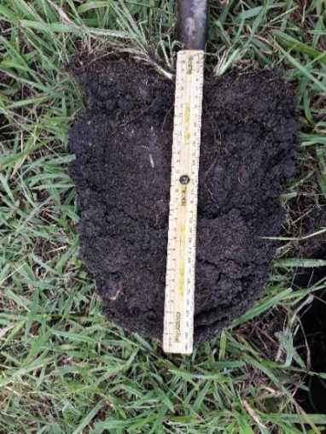
Co-op Member snapshot.
Climate

Slide 4


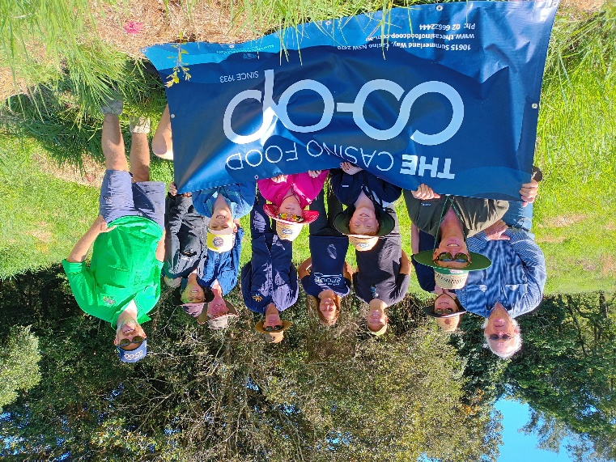
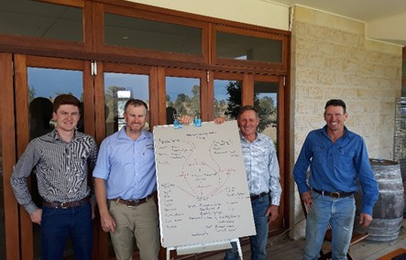
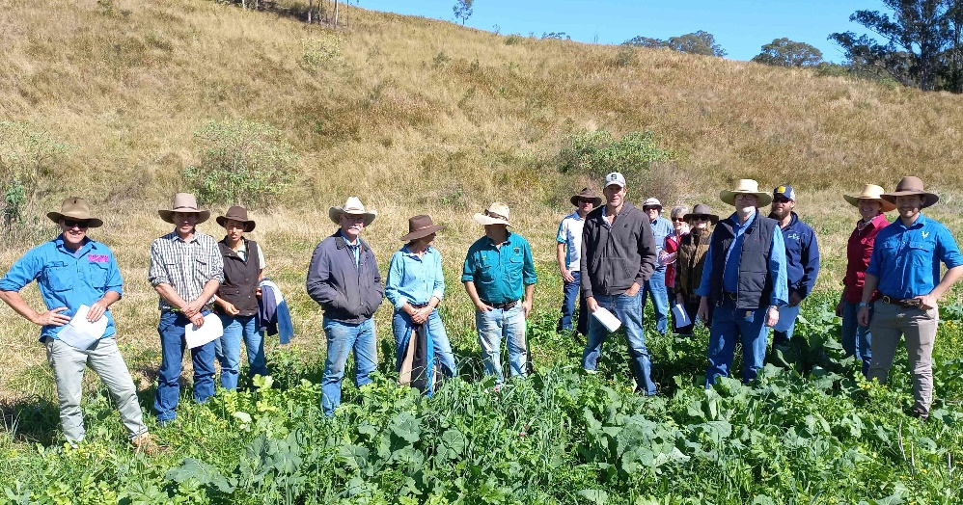
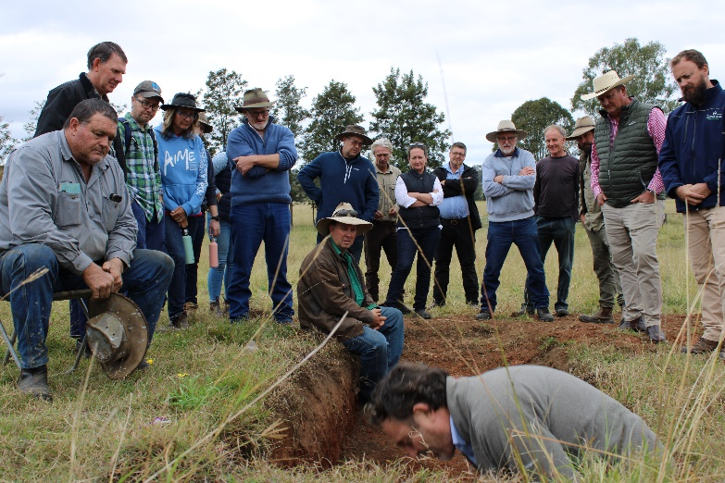
Farming with Confidence
We know our emissions footprint!
We know how to reduce it!
We know how to sequester it!

Slide 5

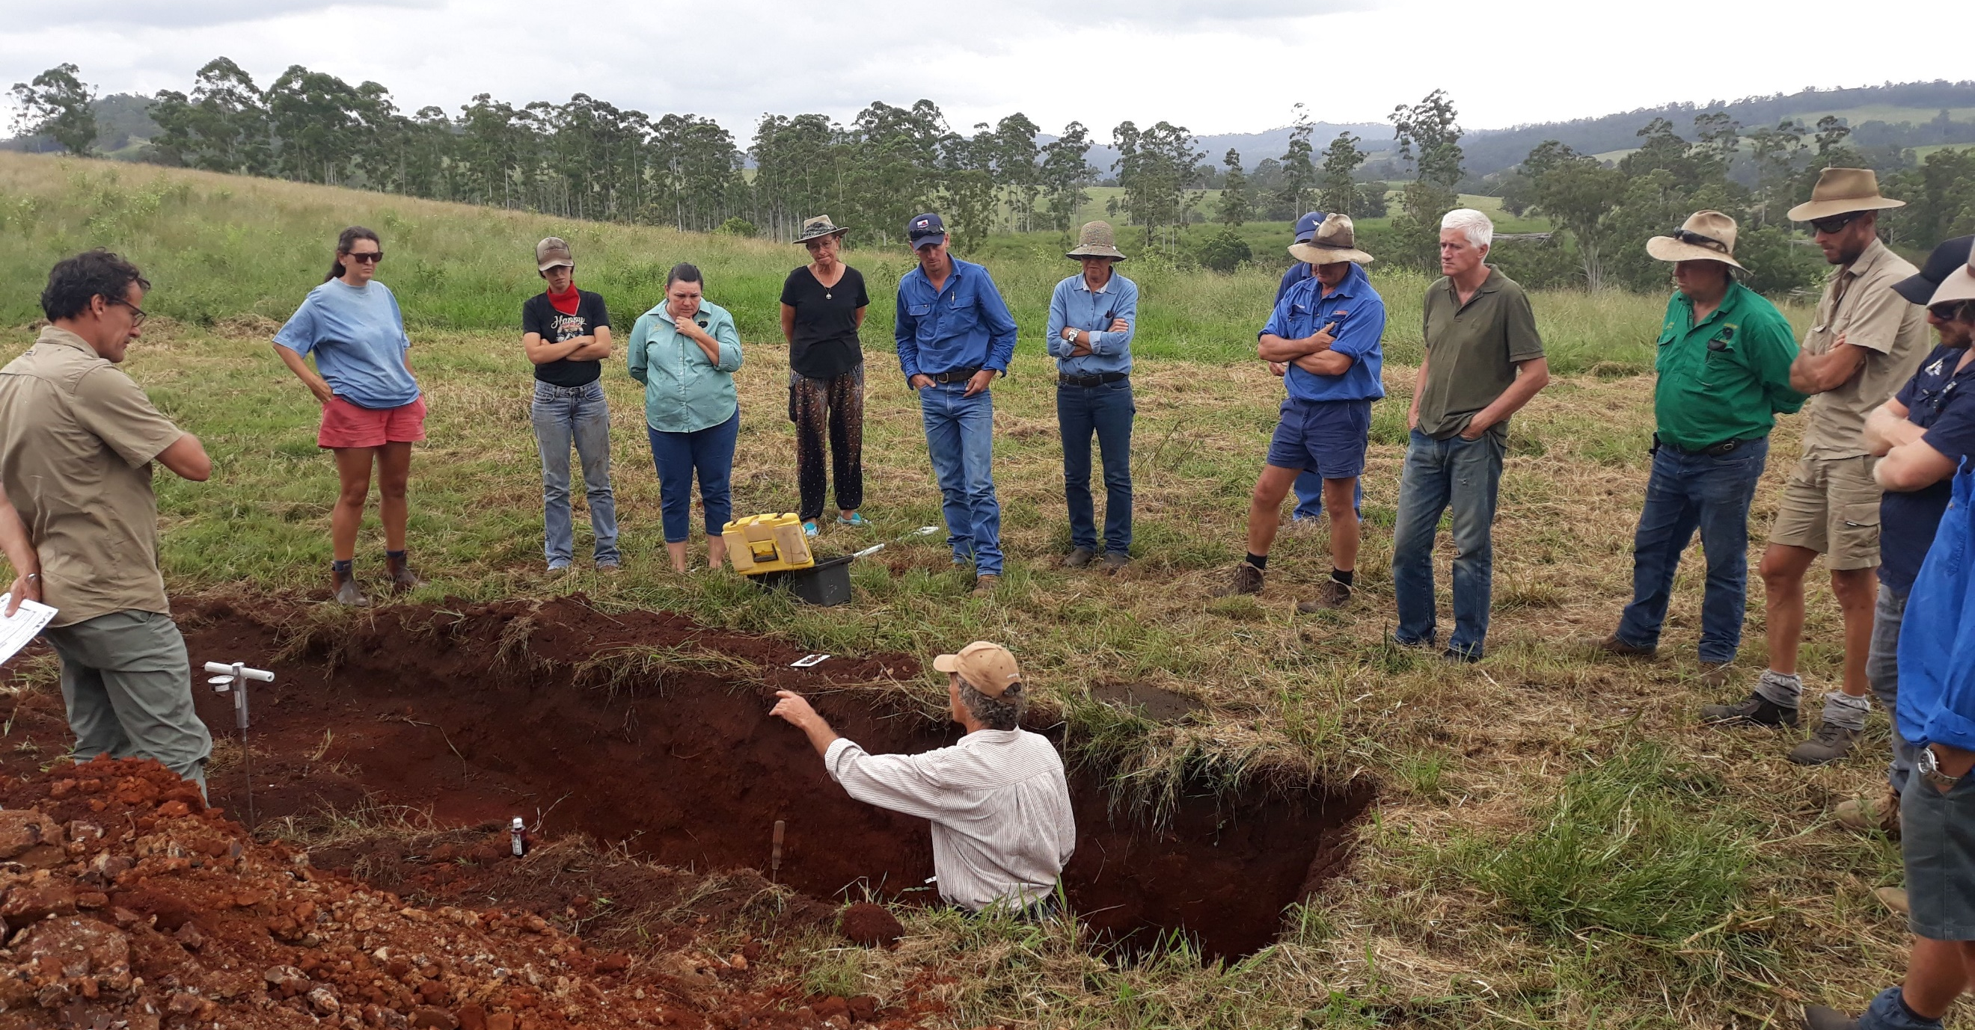
Healthy soils and functional landscapes

Slide 6
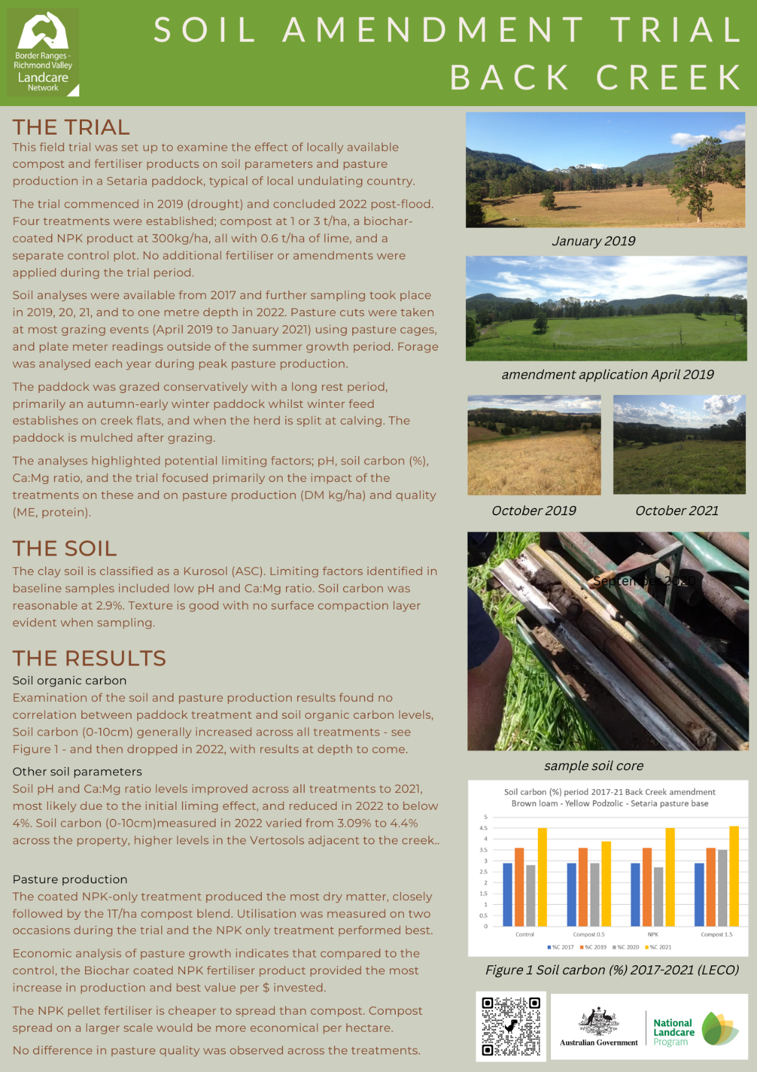
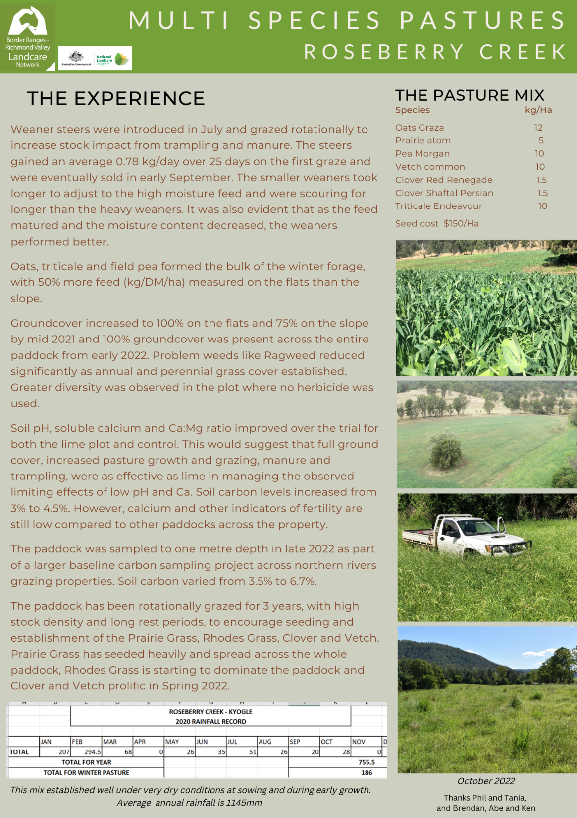
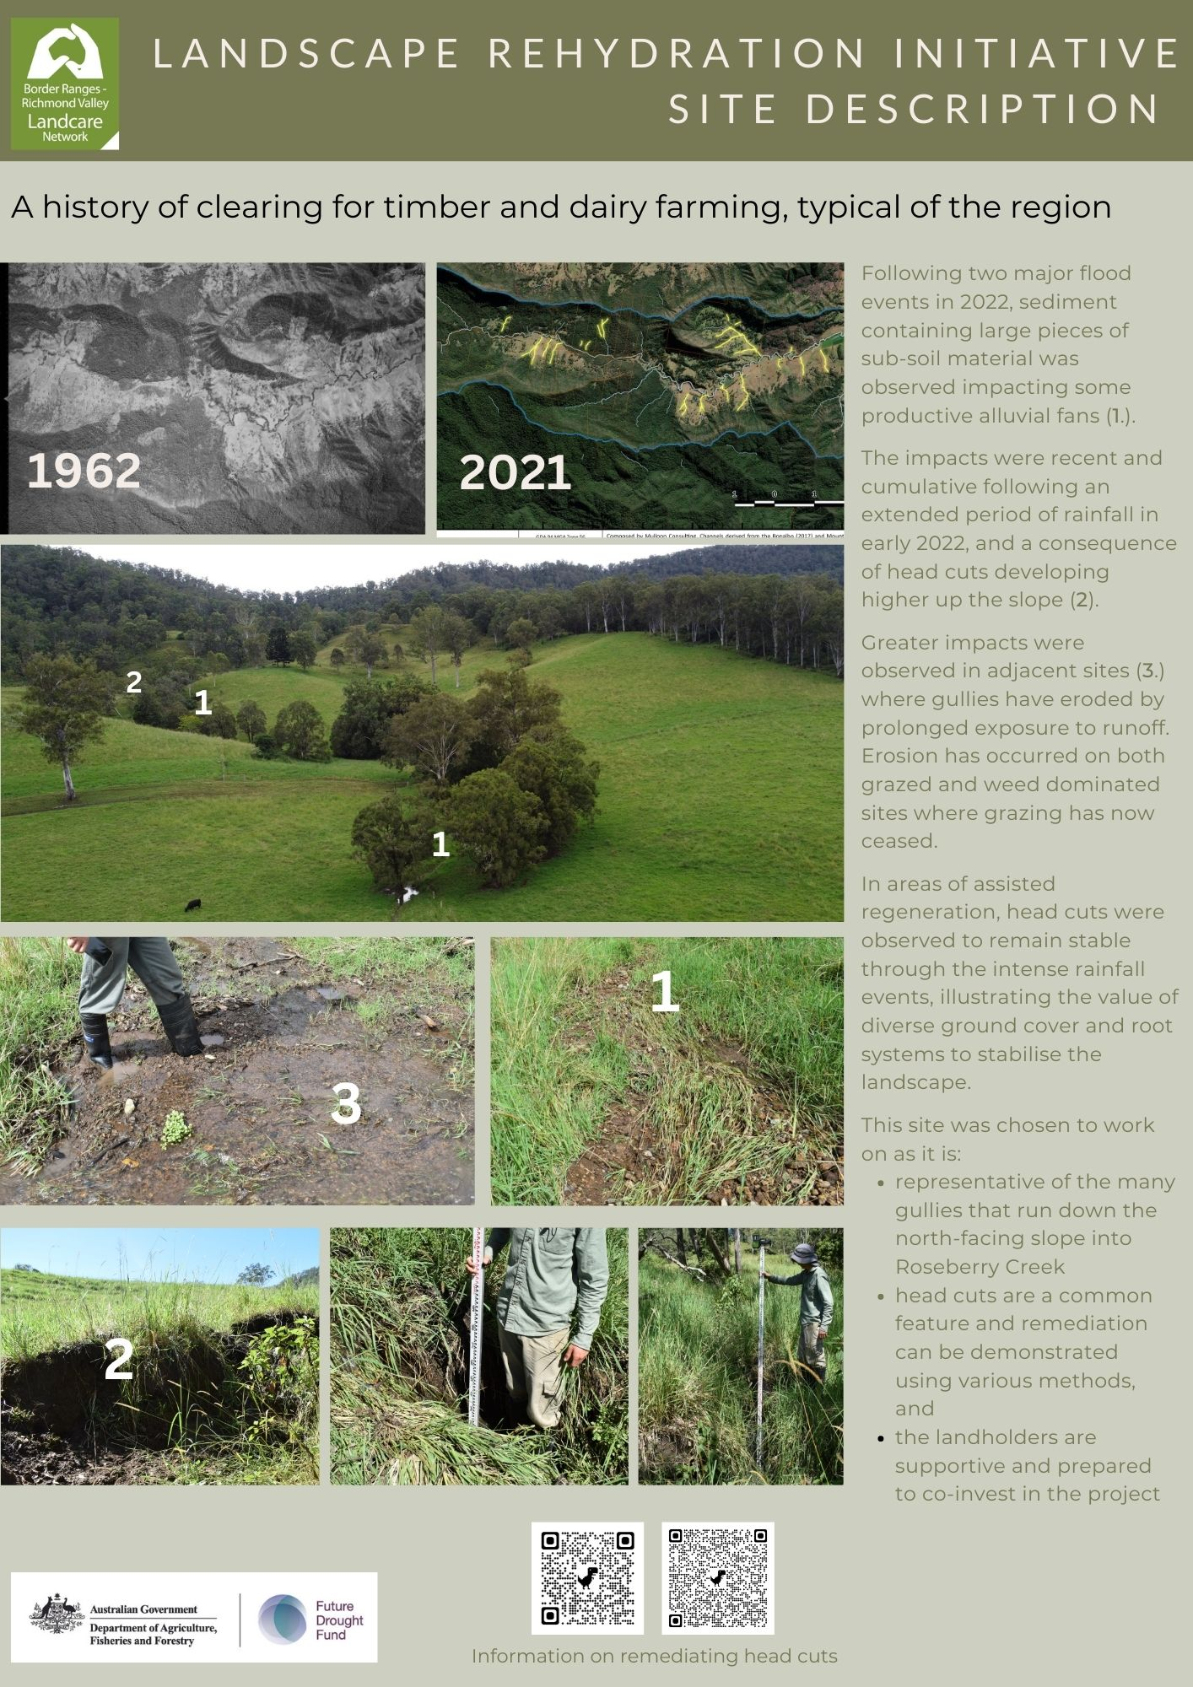
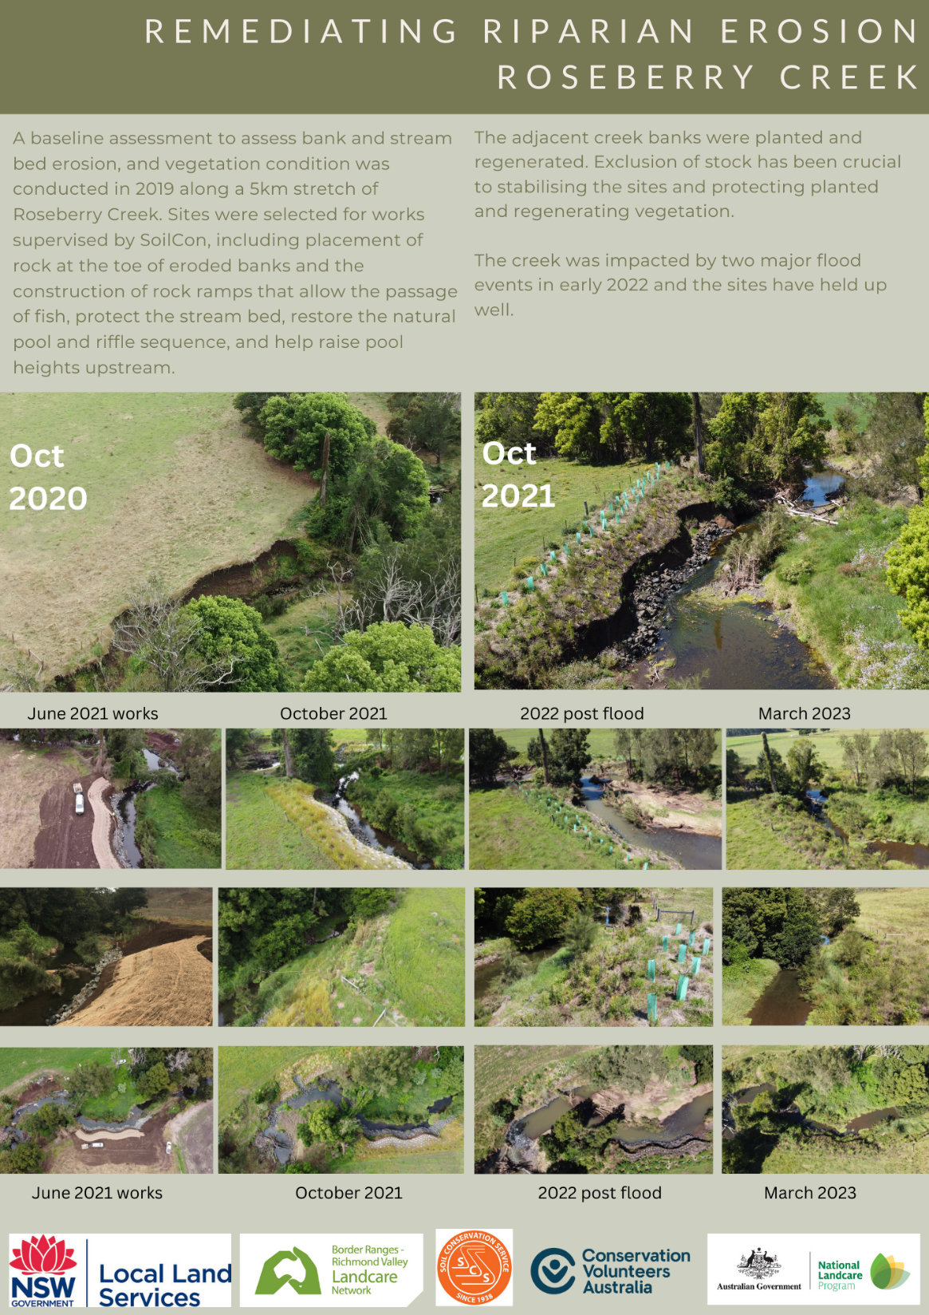
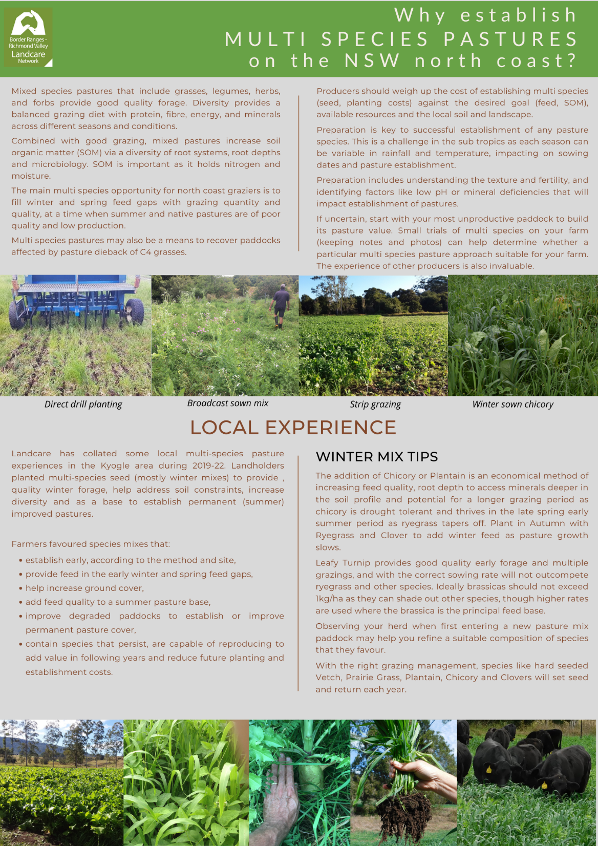

Slide 7
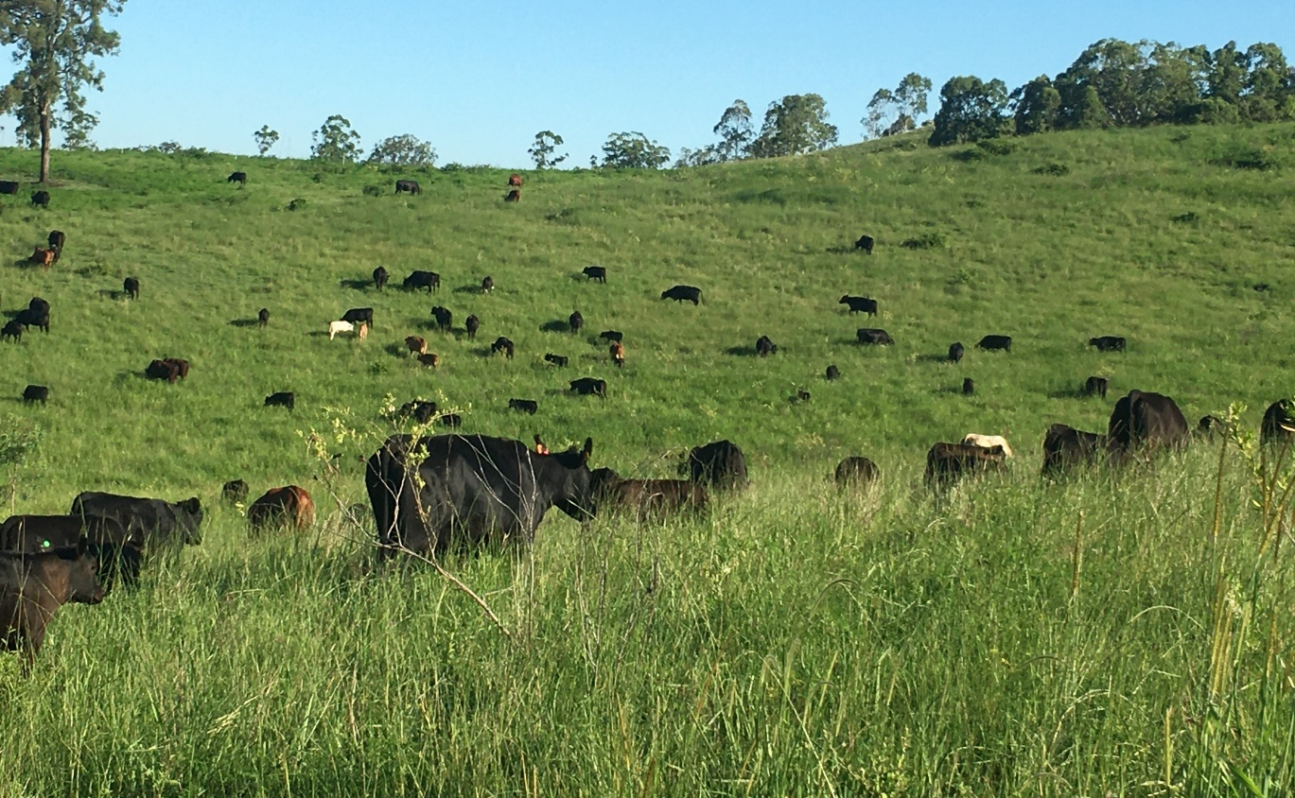
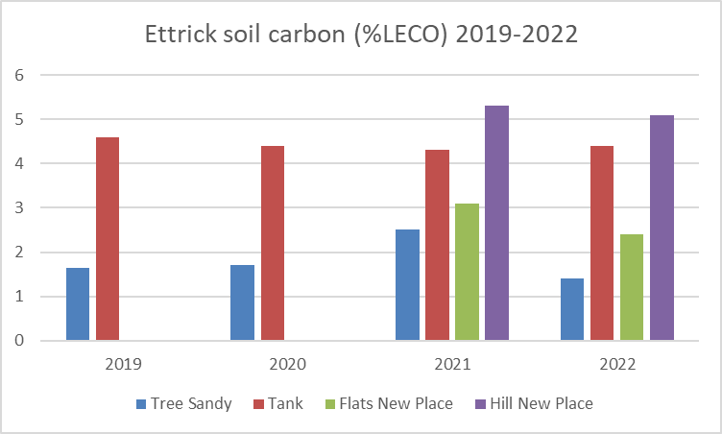
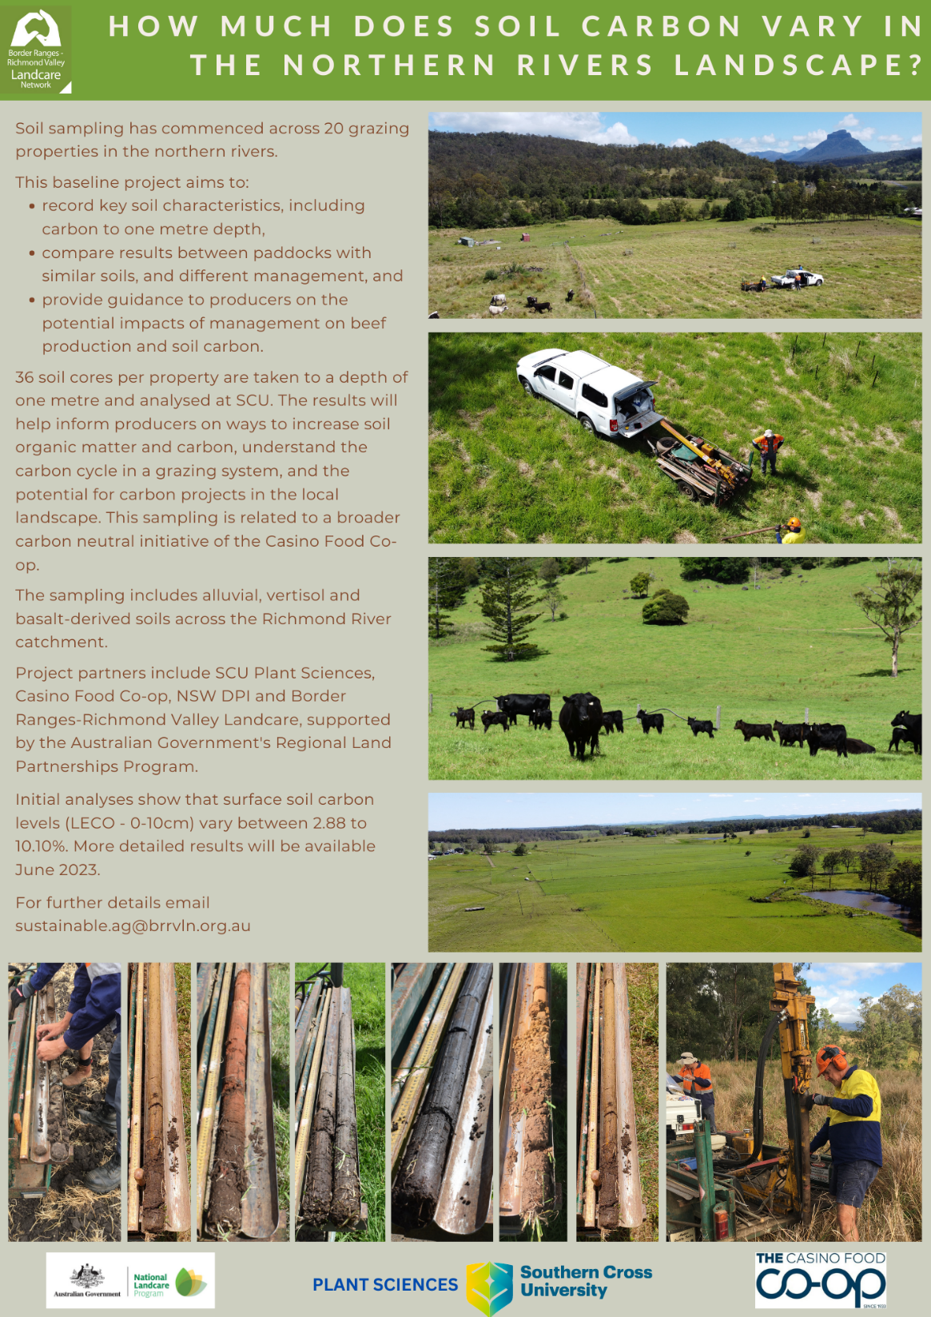
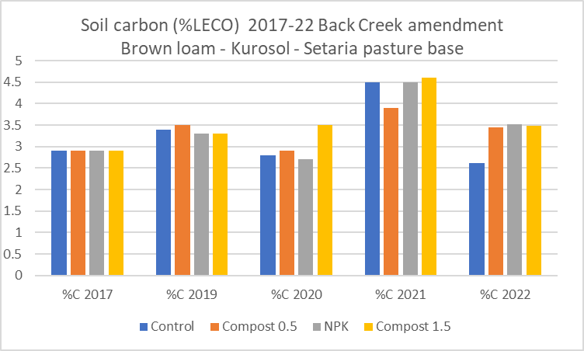
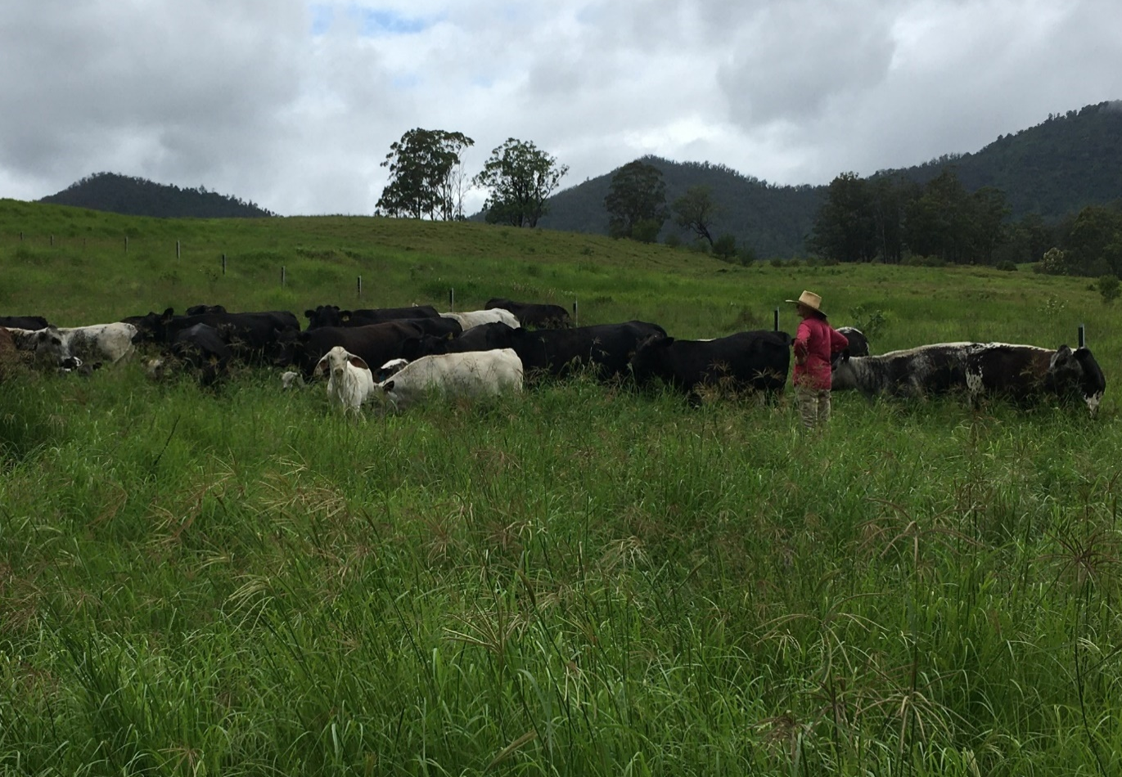
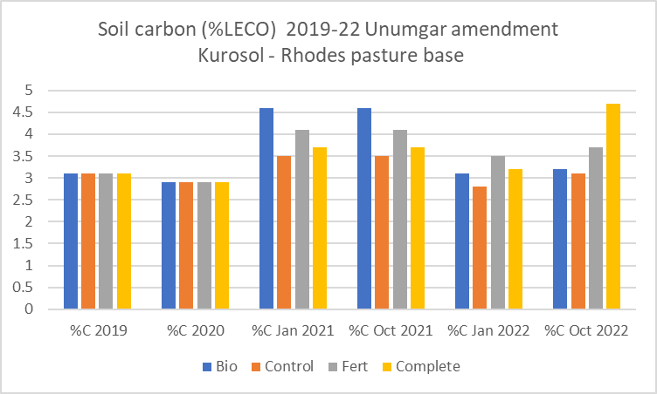

Slide 8
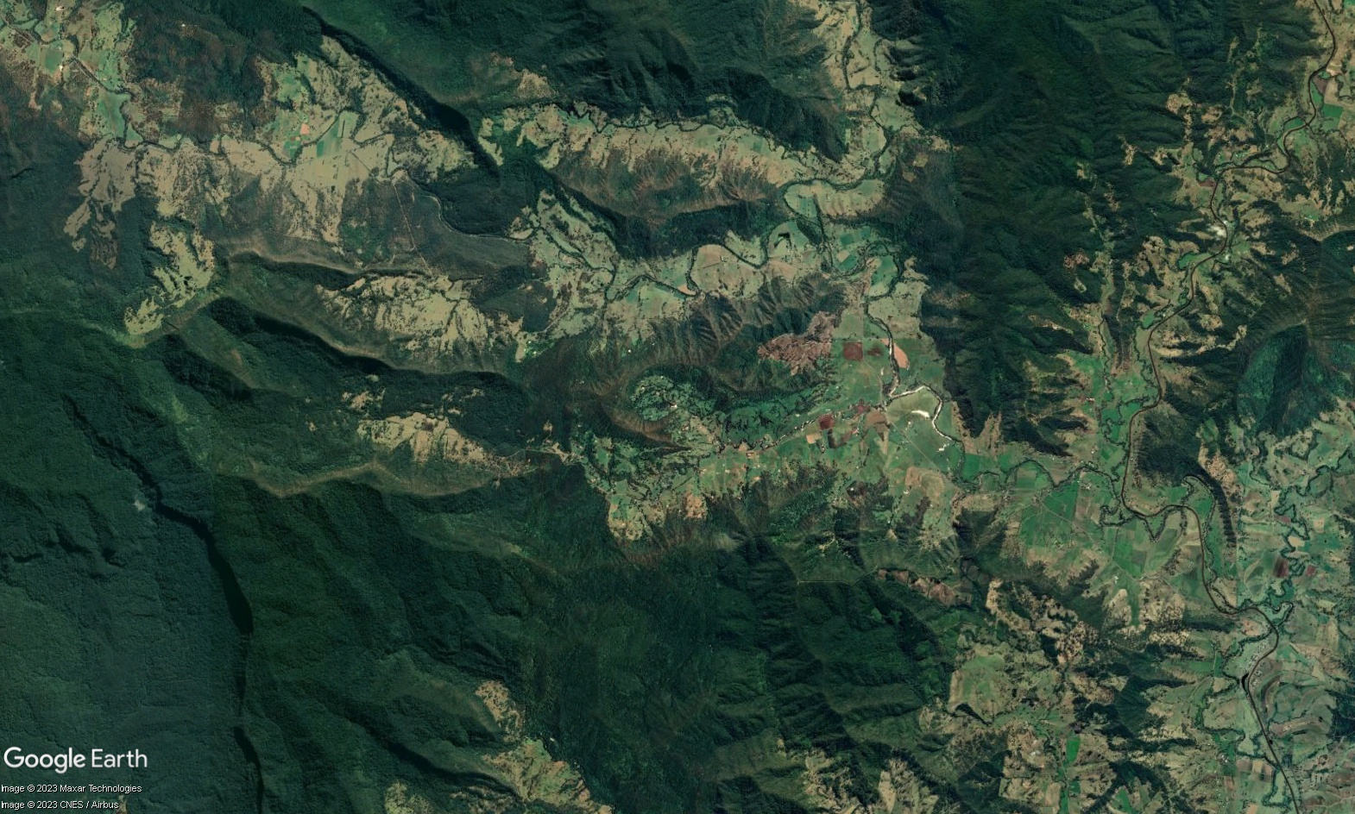
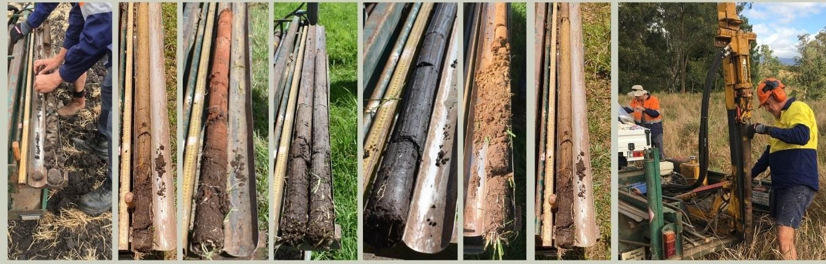
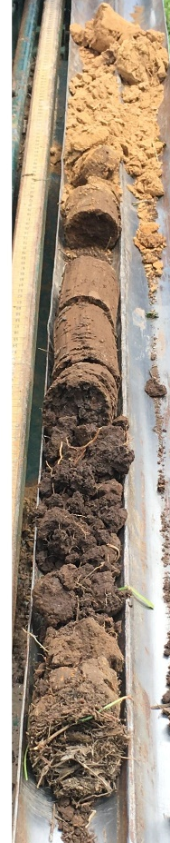

Slide 9
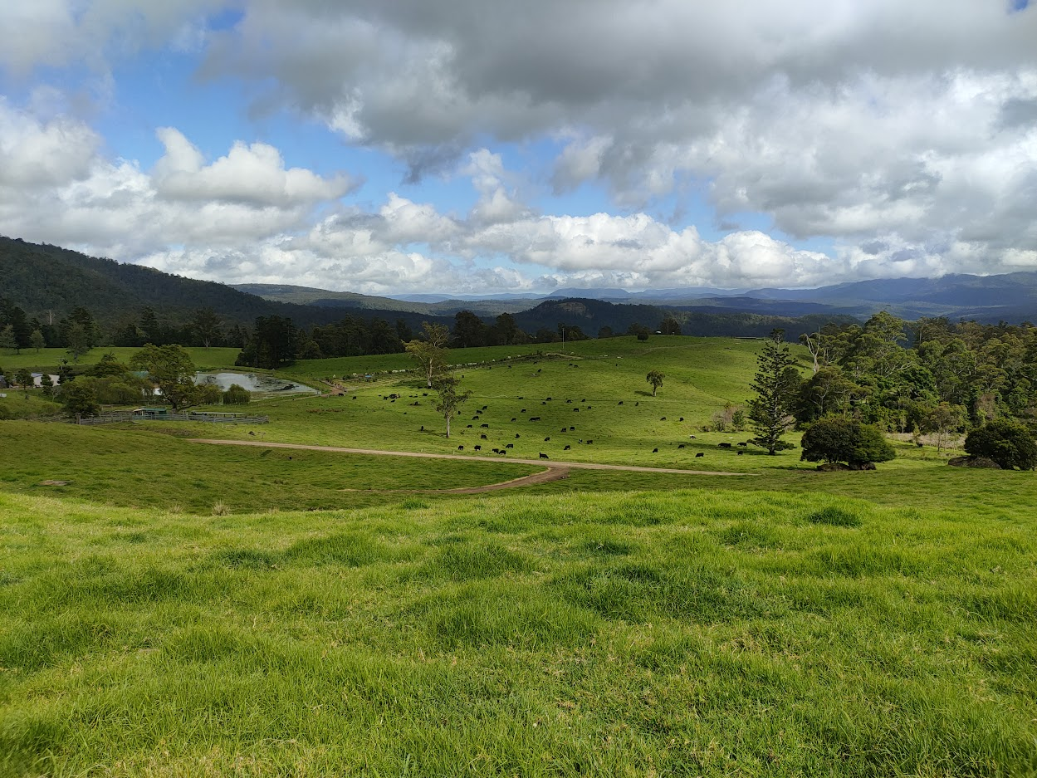
Soil Organic Carbon in Grazing Lands of the Northern Rivers
Dr. Abe Gibson
Research Fellow in Sustainable Grazing
Southern Cross University
abe.gibson@scu.edu.au

Slide 10
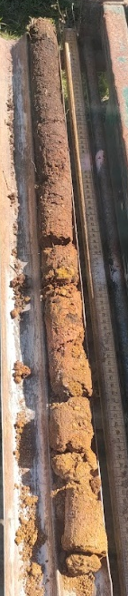
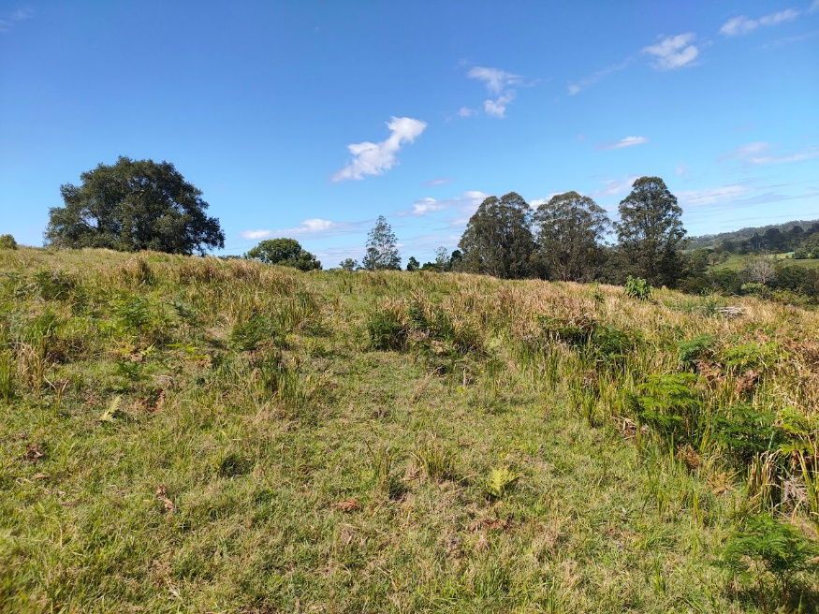
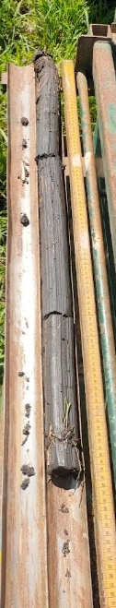
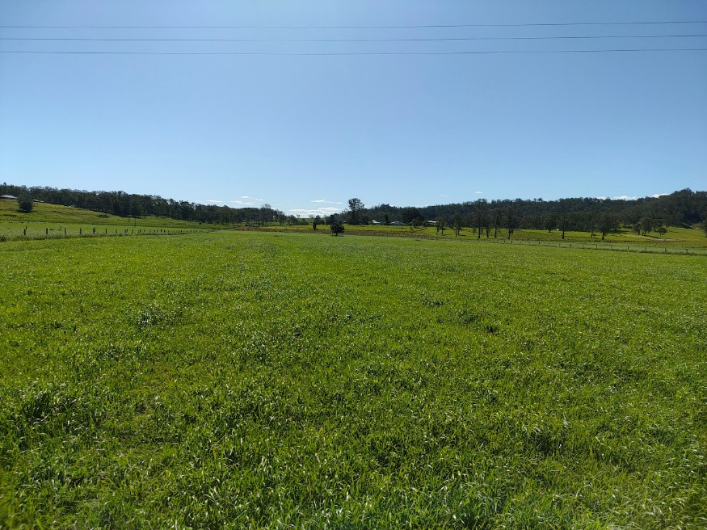
How Much Soil Carbon Do We Have?
Preliminary data ranges 3.9-7% in the top 10cm
Highest value of 12%
Lowest of 2.9%
Similar rainfall
Key differences are soil, management and topography

Slide 11
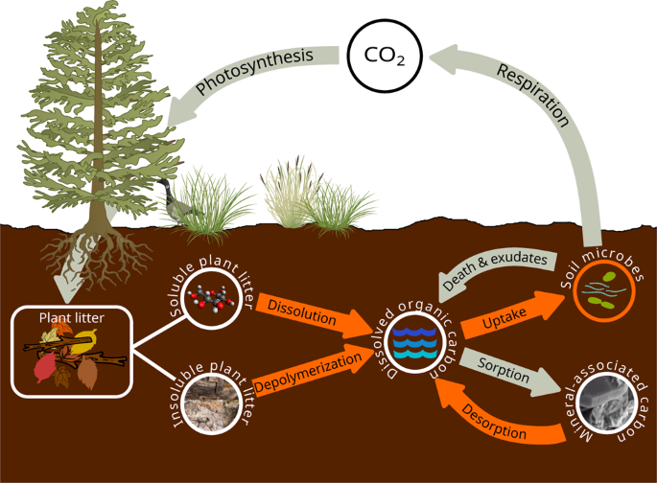
How Can We Build Soil Carbon?
Results so far:
  Grazing Management
  Pasture Management
  Soil Constraints
  Topography and Erosion
Subject of further research

Slide 12




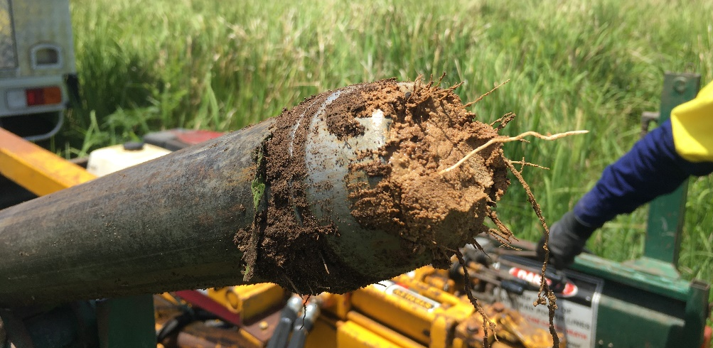
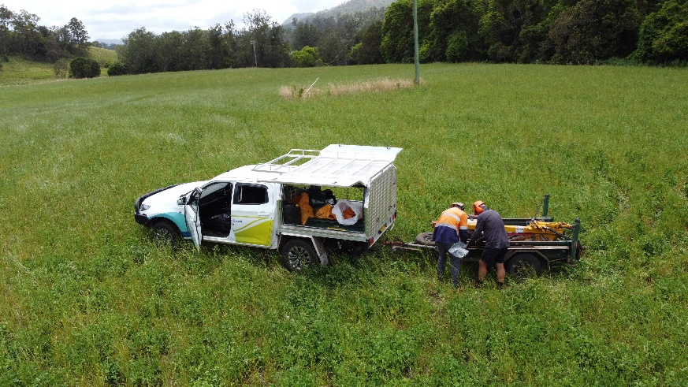
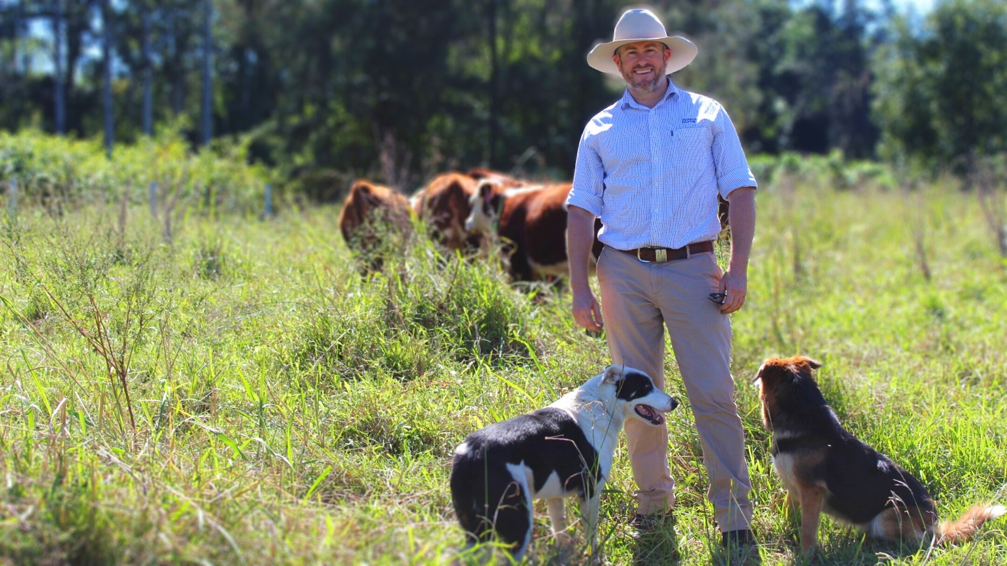
Thank you
Joe Leven and the Casino Food Co-Op
Gavin Tinning, Border Ranges Richmond Valley Landcare
Ken Lisha, Lukas Van Zwieten, Josh Rust, Scott Petty, NSW Department of Primary Industries
Stephen Wiedemann and Shane Bario, Integrity Ag and Environment
Department of Agriculture, Forestry and Fisheries and National Landcare Program
Terry Rose, Lee Kearney and Manisha Thapa, Southern Cross University
A massive thank you to the participating landholders for their time, insight and access to their properties. Individual results and consultation are coming!

