Slide 1

Lorraine Gordon
Director, The National Regenerative Ag Alliance &
Farming Together Program
Carbon & Cattle Farmer
13 March 2019
Notes:
I’m going to cover the following areas in my presentation:
My resilience journey in the last few of years – a journey of relationship breakdown, family health issues, drought, fires, floods, and Covid – 19 ramifications,
The meaning and unfolding of what resilience is,
The meaning and unfolding of regenerative agriculture is and is not,
Financial opportunities for farmers in enhancing their landscapes,
Emerging and interesting research areas including my own
All in 20 minutes!!!

Slide 2
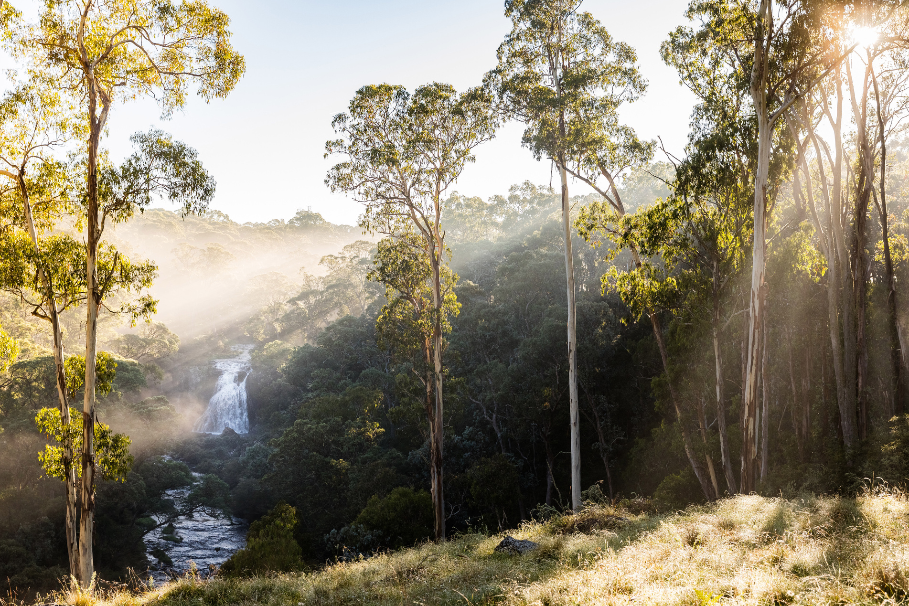
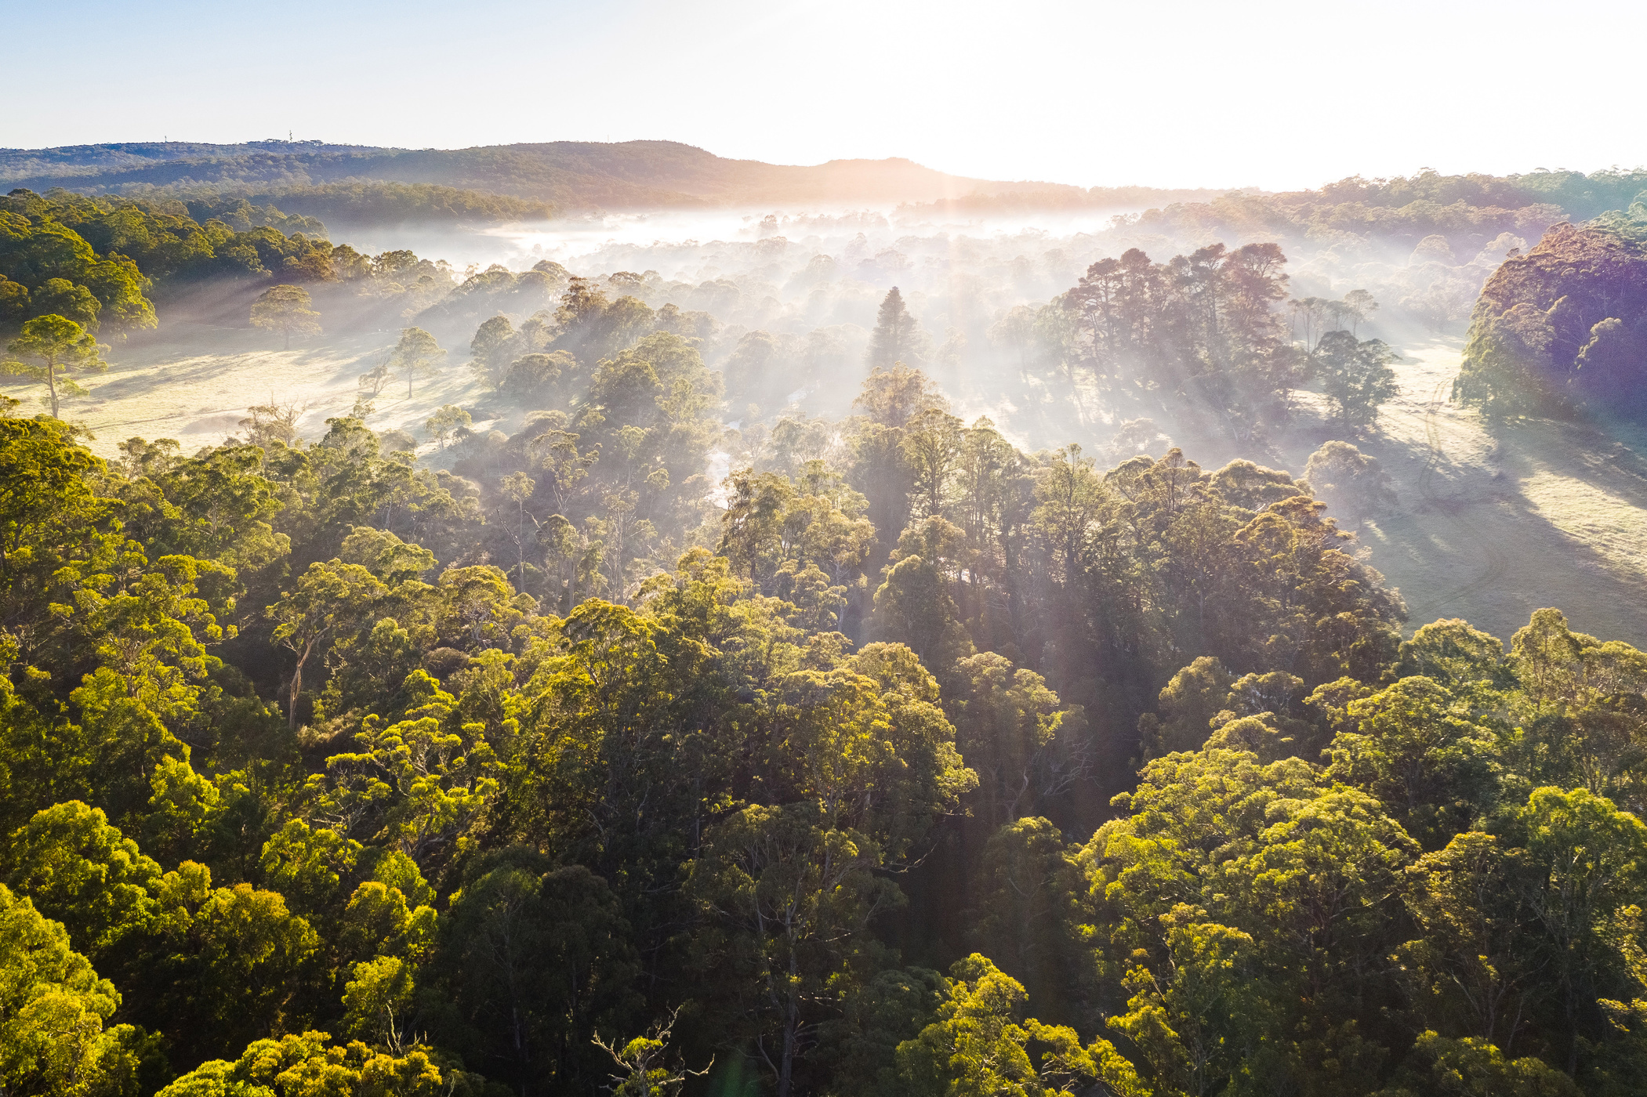
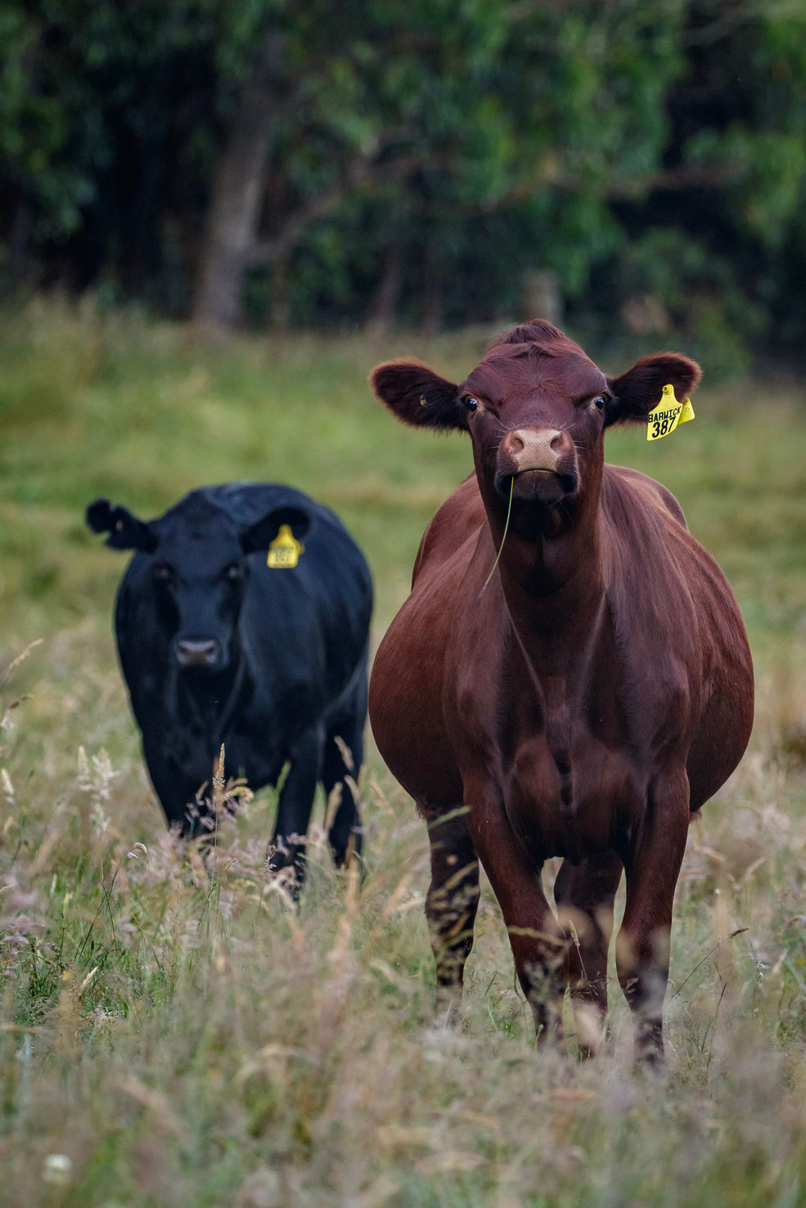
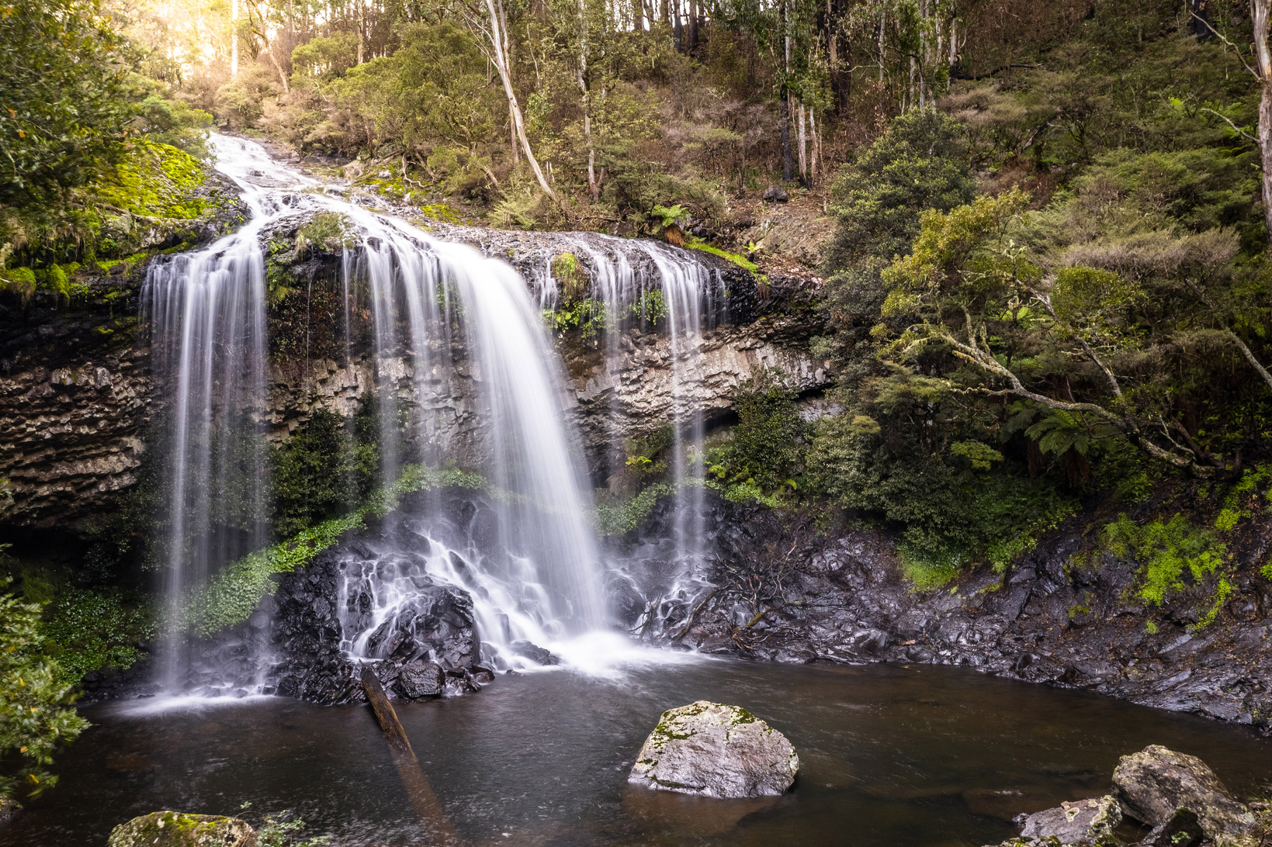
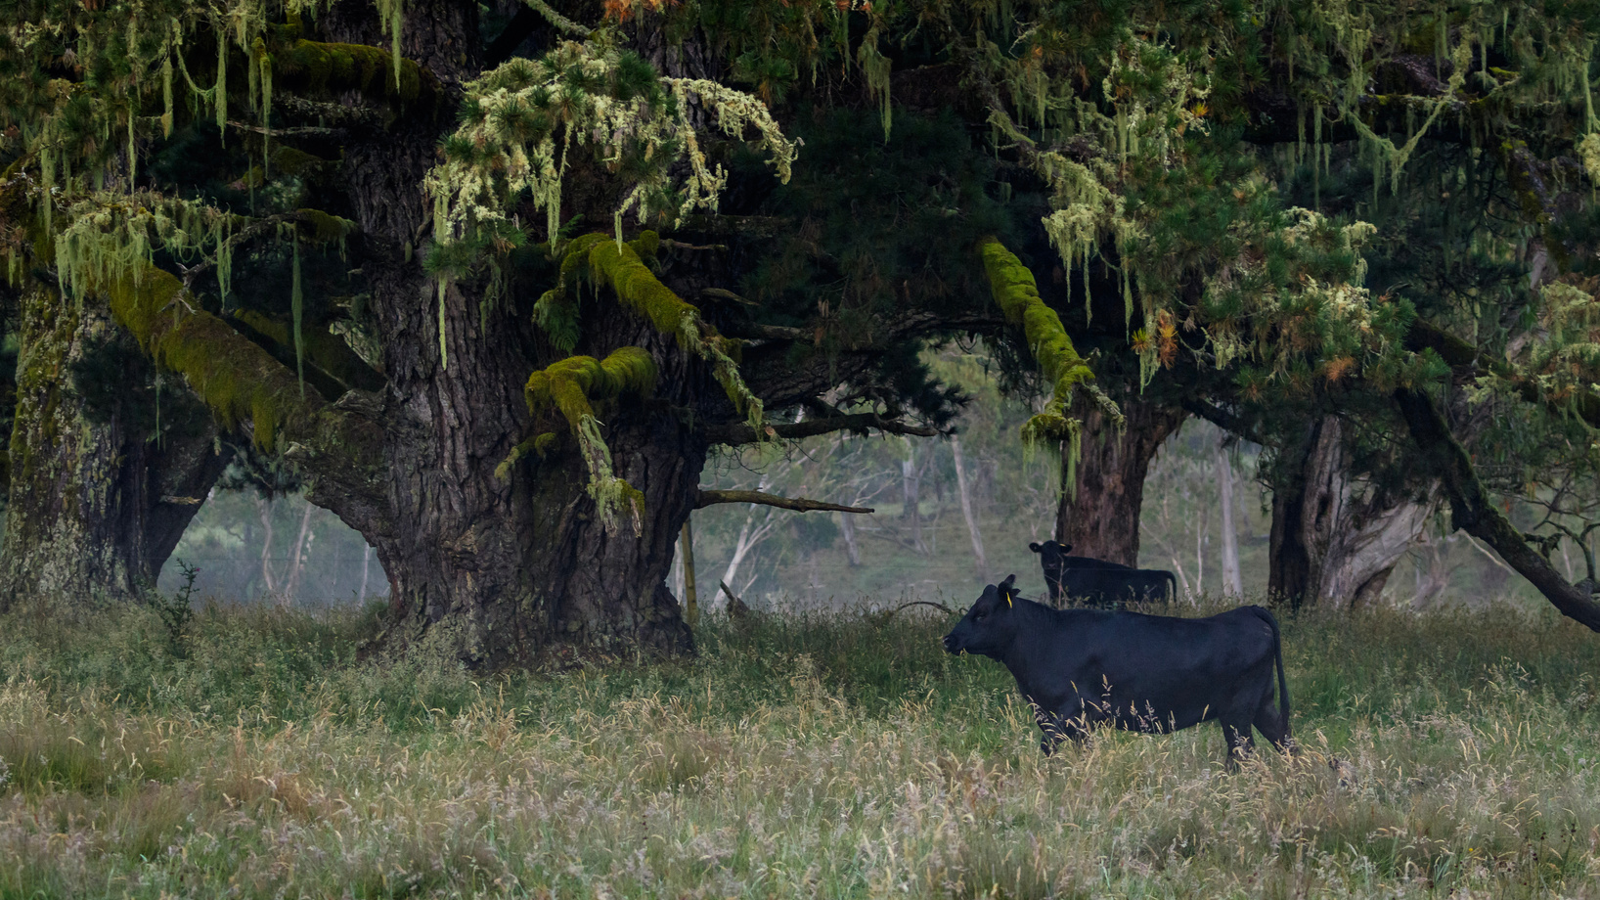
Notes:
My Country, my farm.

Slide 3
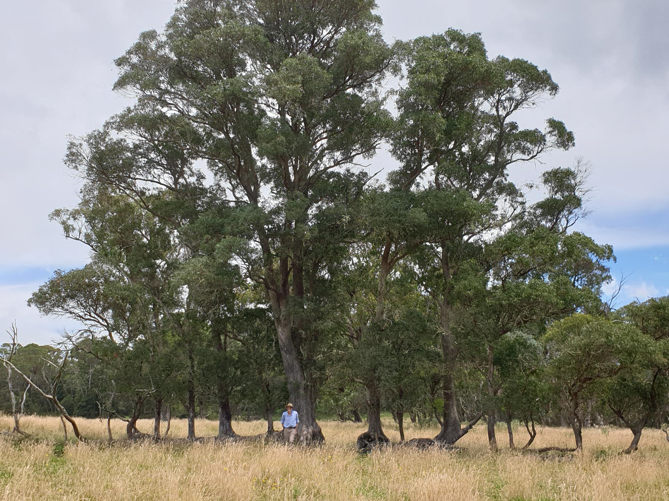
Notes:
When it comes to resilience, I have had a good does of it over the last 6 years!

Slide 4
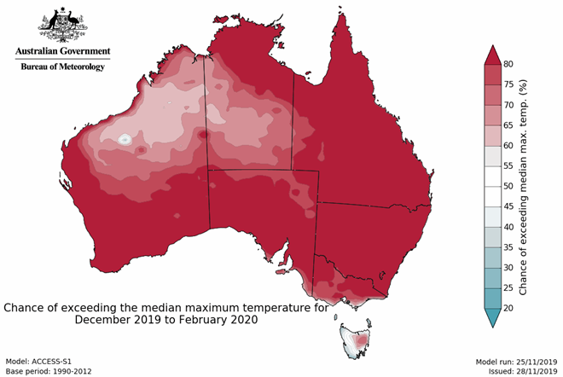
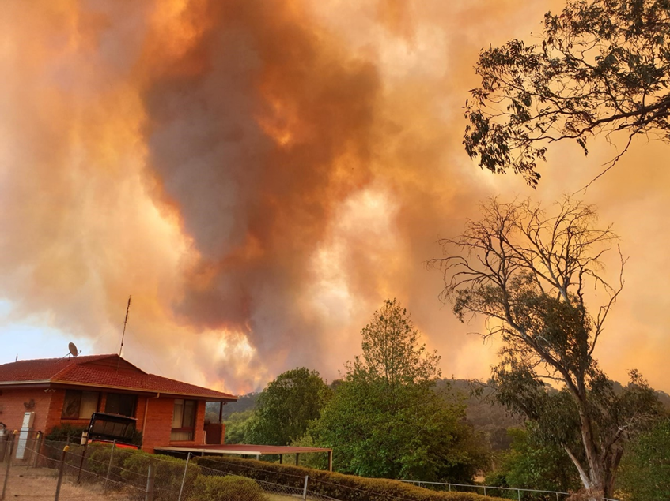

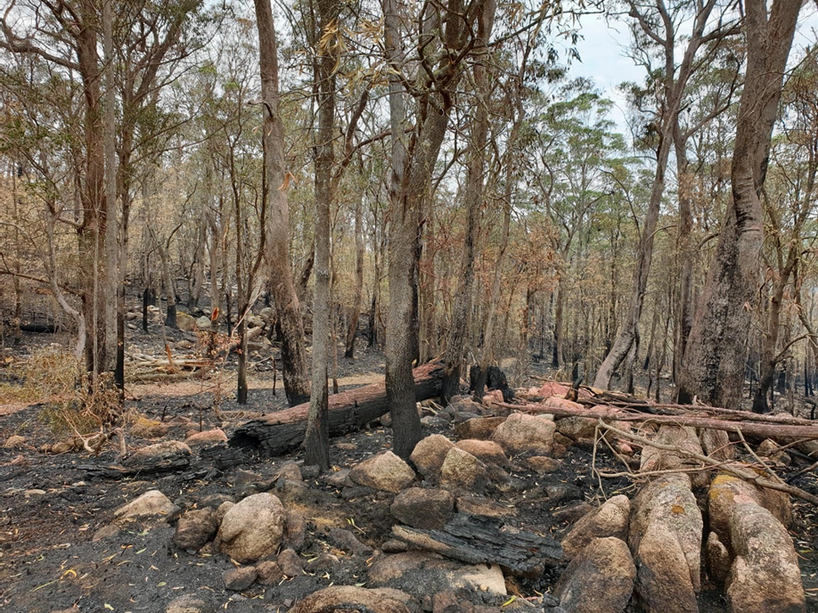
From drought to fires…..
Notes:
Again my story

Slide 5
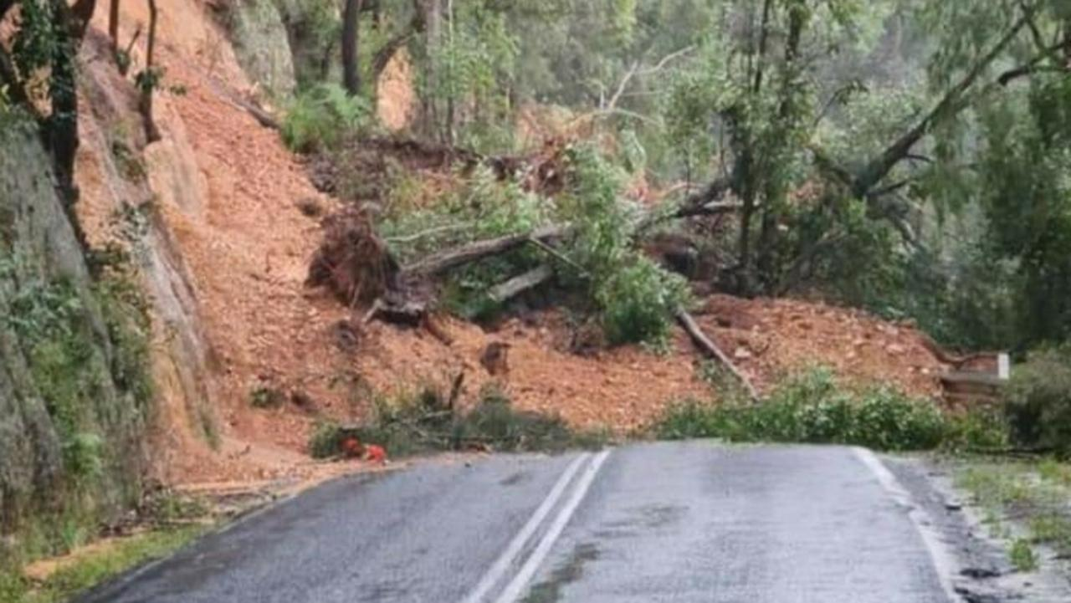
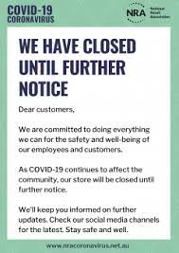
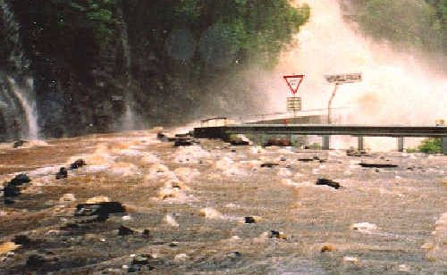
To COVID-19, floods and landslides……

Slide 6
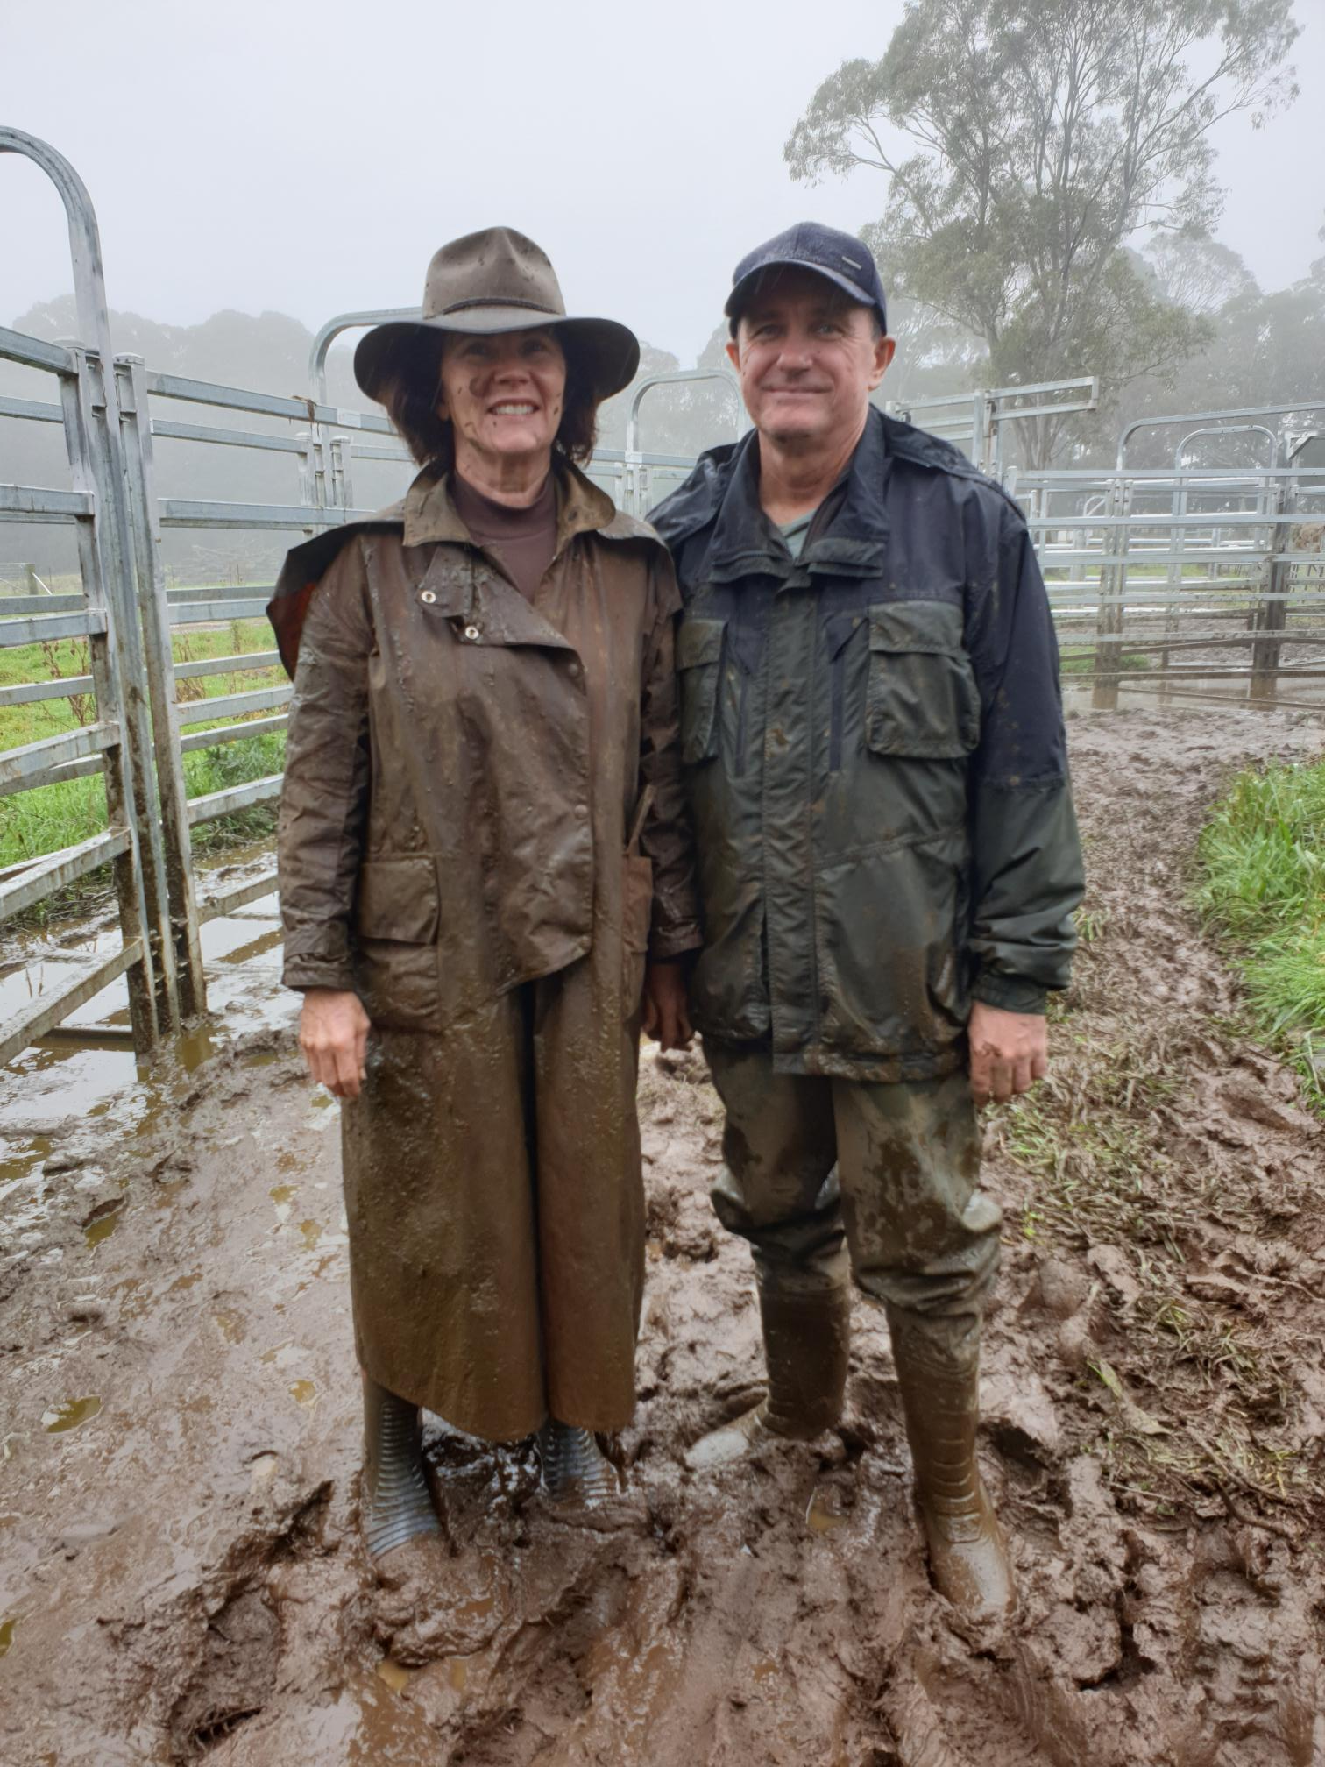
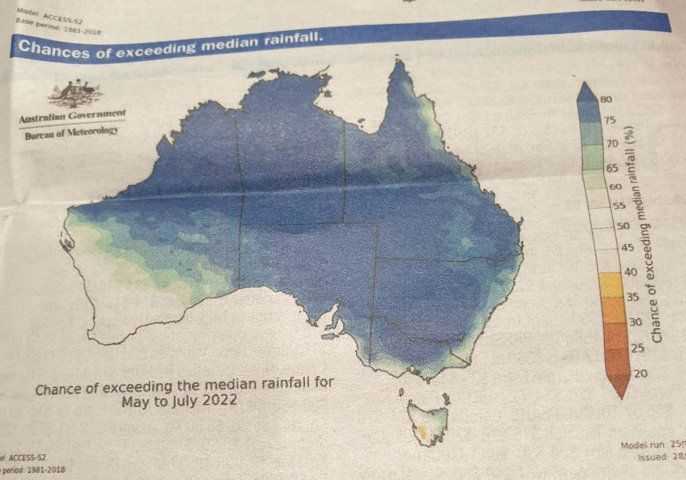
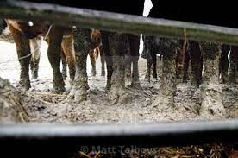
Then there’s the mud!
Notes:
Our cattle yards 2021

Slide 7
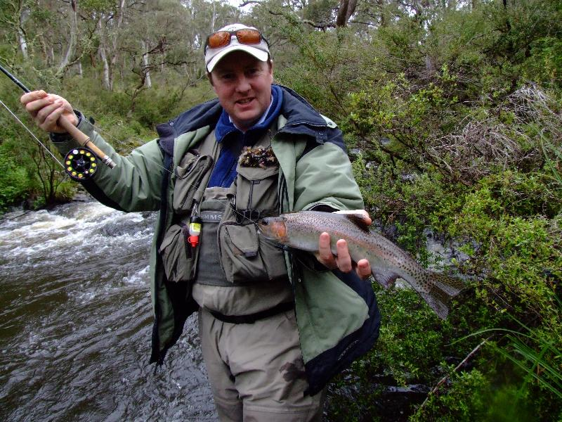
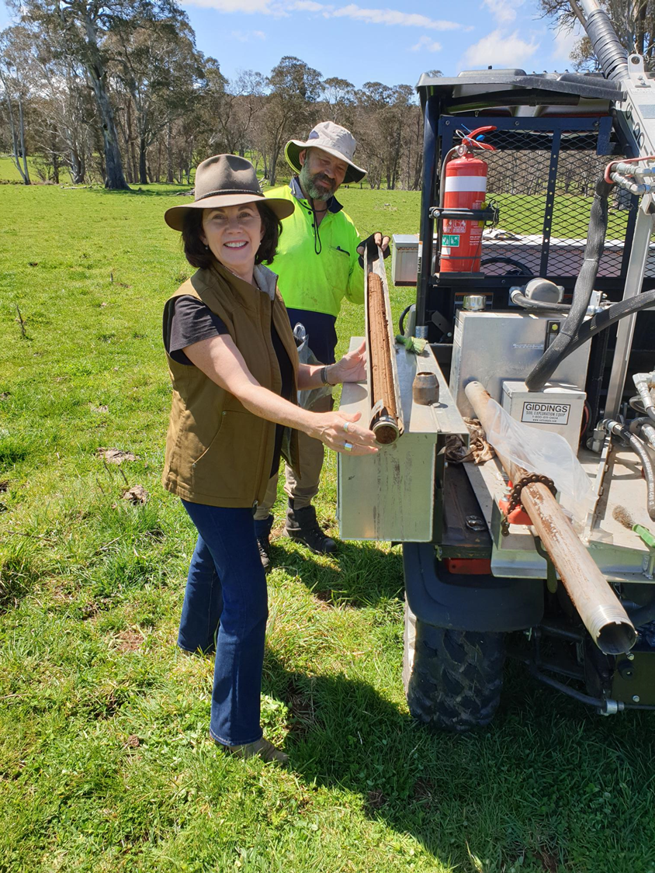
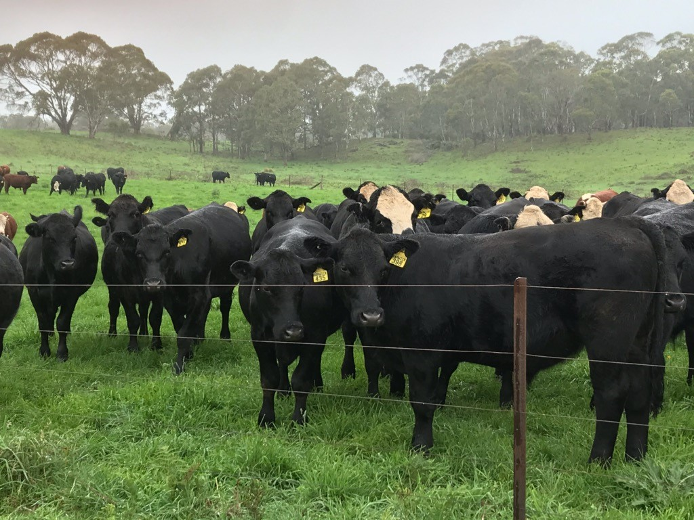

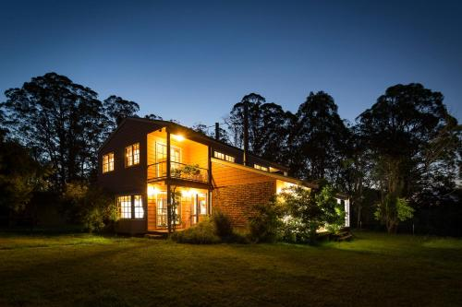

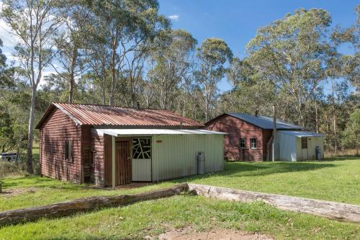
Integrating Enterprises

Slide 8
“I no longer consider myself
just a Cattle Farmer.
I am a Carbon Farmer that
happens to use cattle to
sequester carbon and
reduce CO2 emissions.”
Notes:
Lorraine Gordon 2022

Slide 9
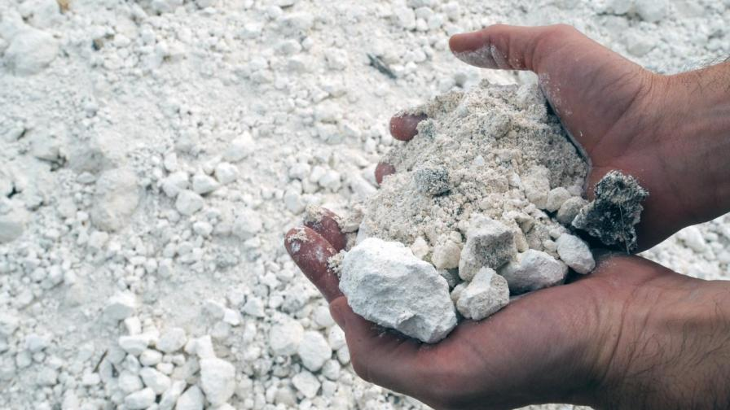
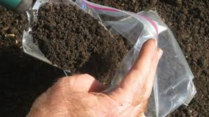
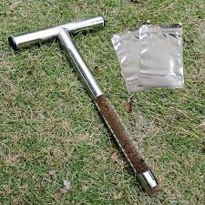
Correcting Mineral Deficiencies and Micronutrients
Notes:
For example adding Lime, Magnesium, Sulphur, Nitrogen, Phosphorus, Potassium, Manganese, Salt, Boron, Copper Sulphate, Zinc, Iron

Slide 10
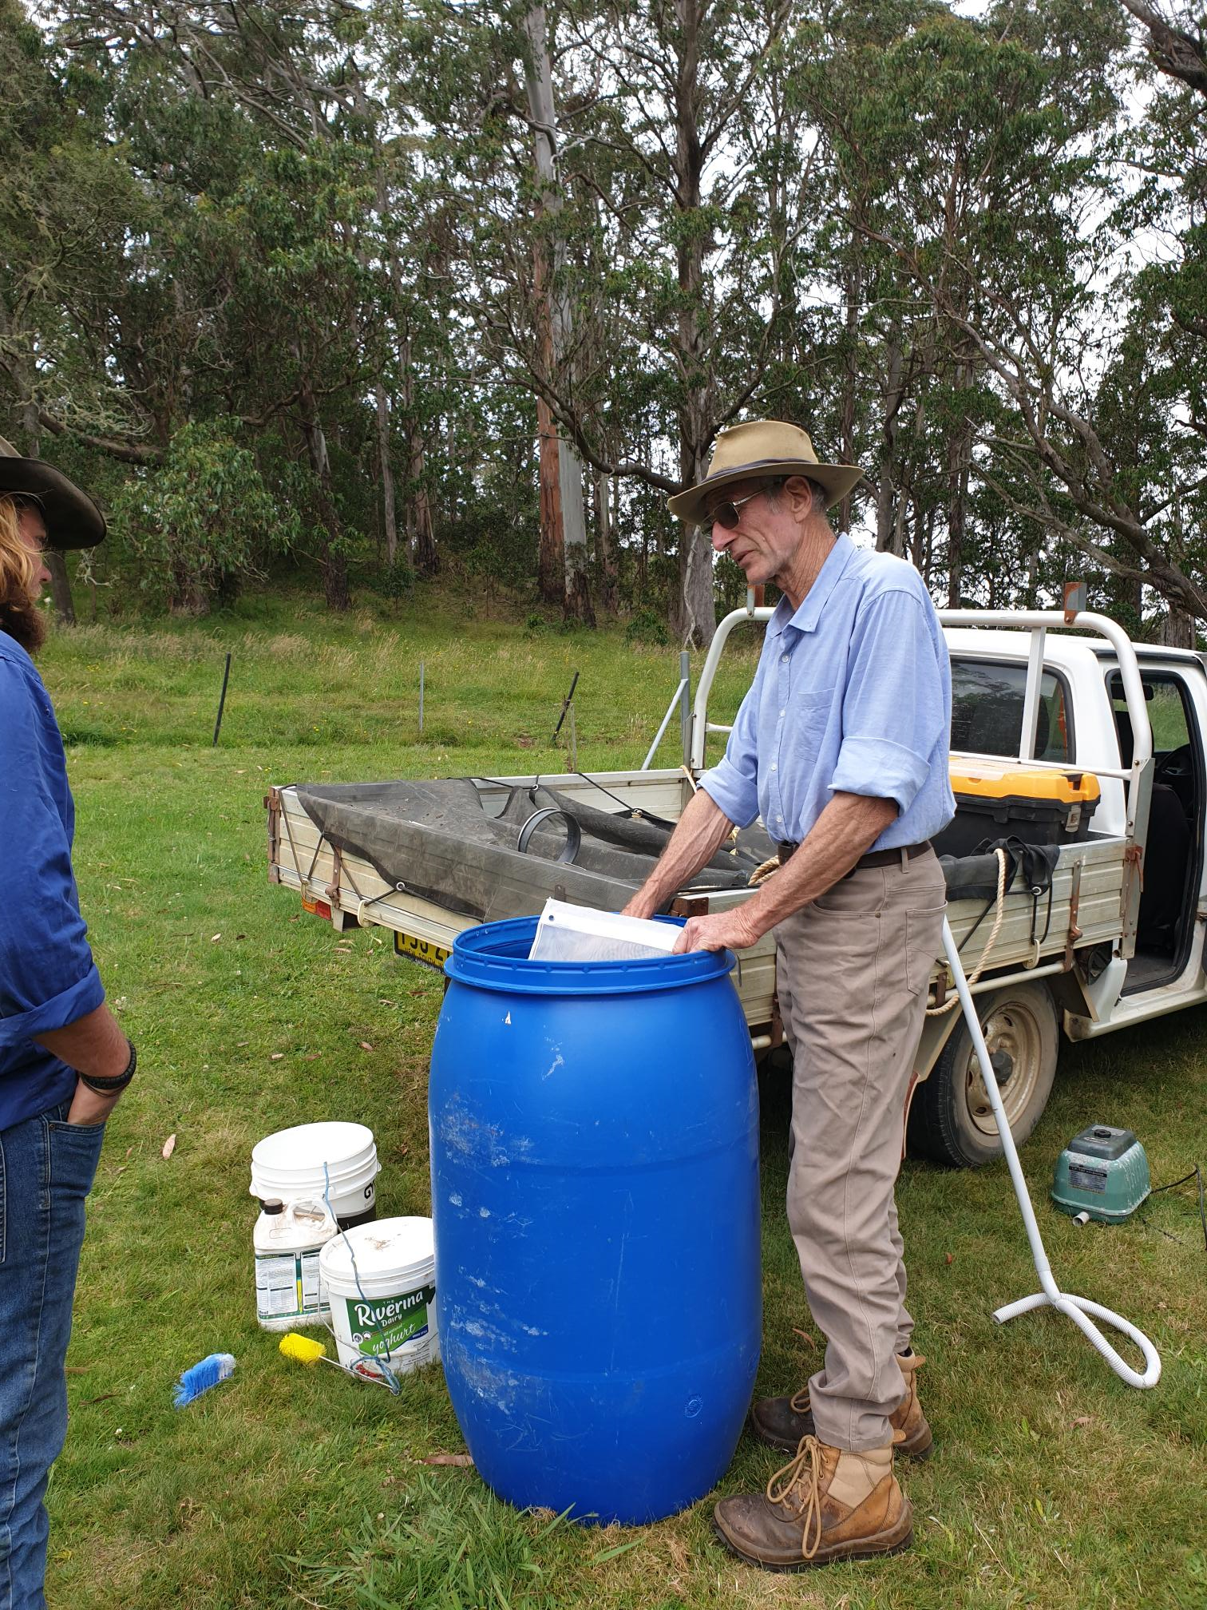
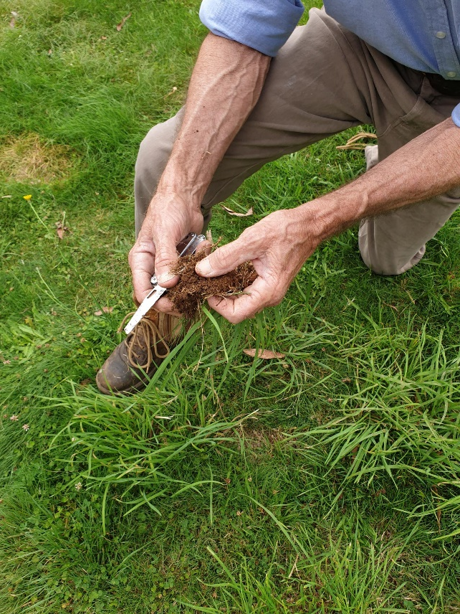
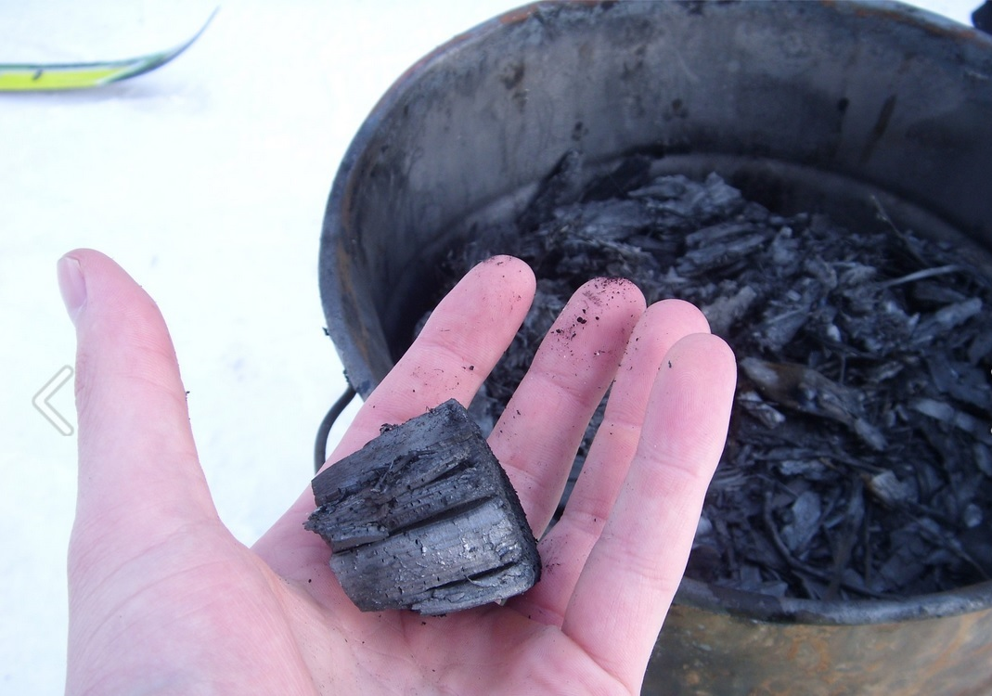
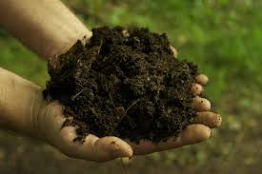
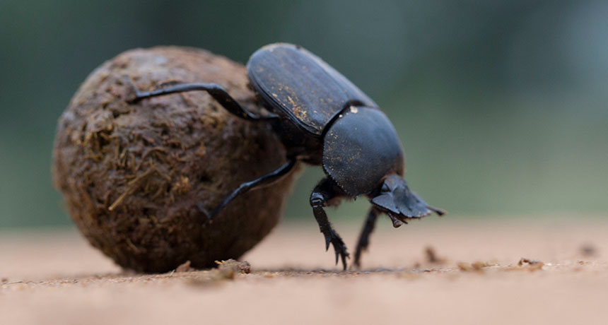
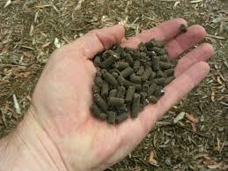
Environment -Composts/Biological Control/Reducing Chemical Inputs/Natural Nutrient Transfer

Slide 11
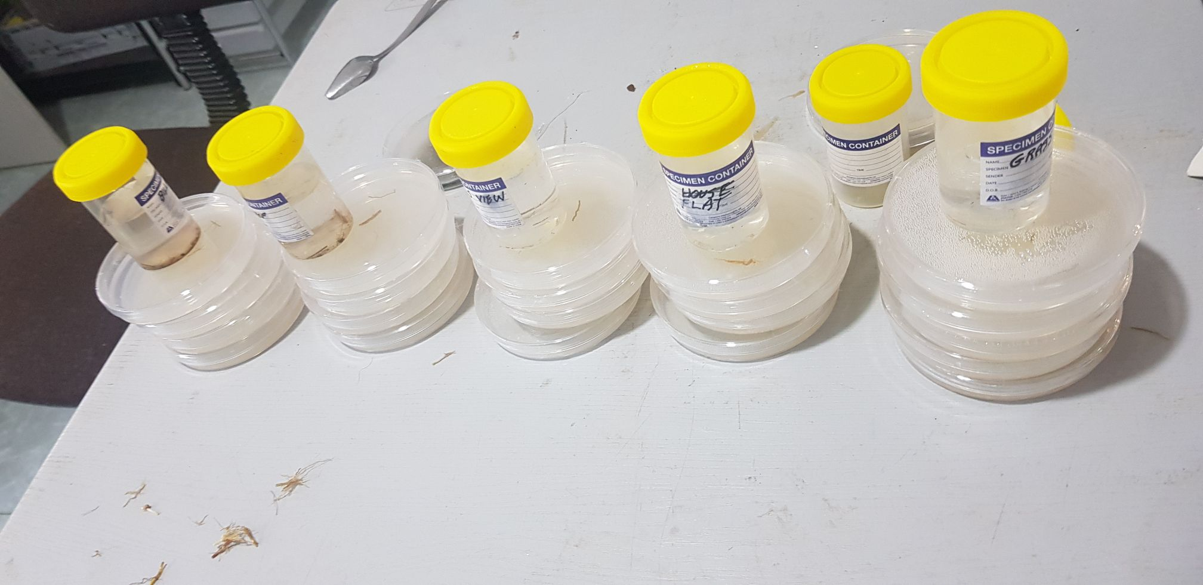
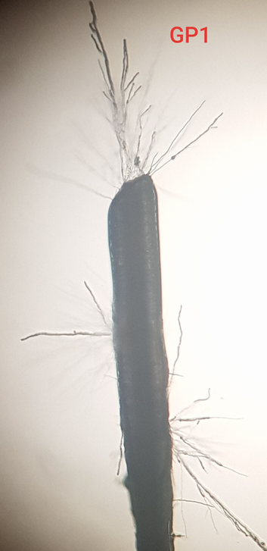
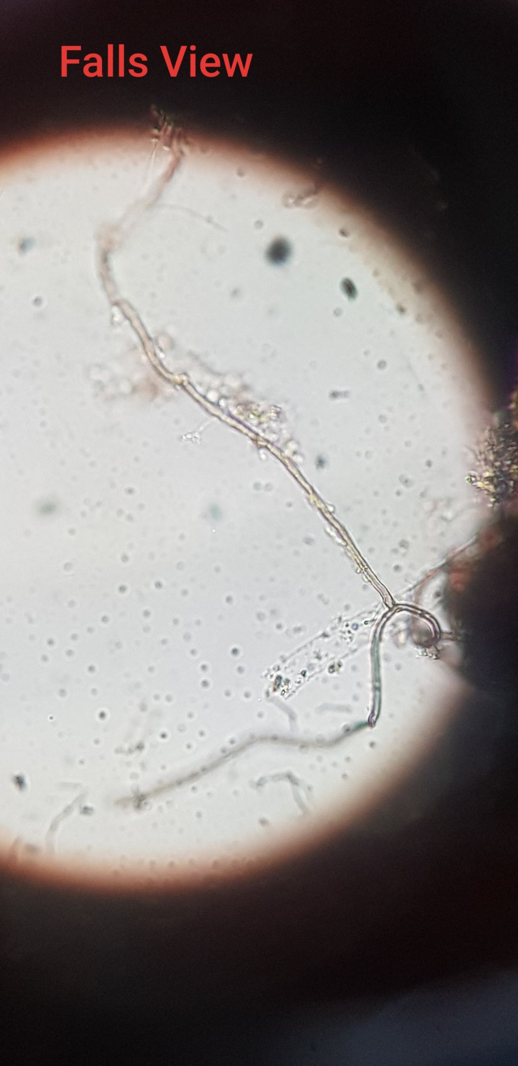
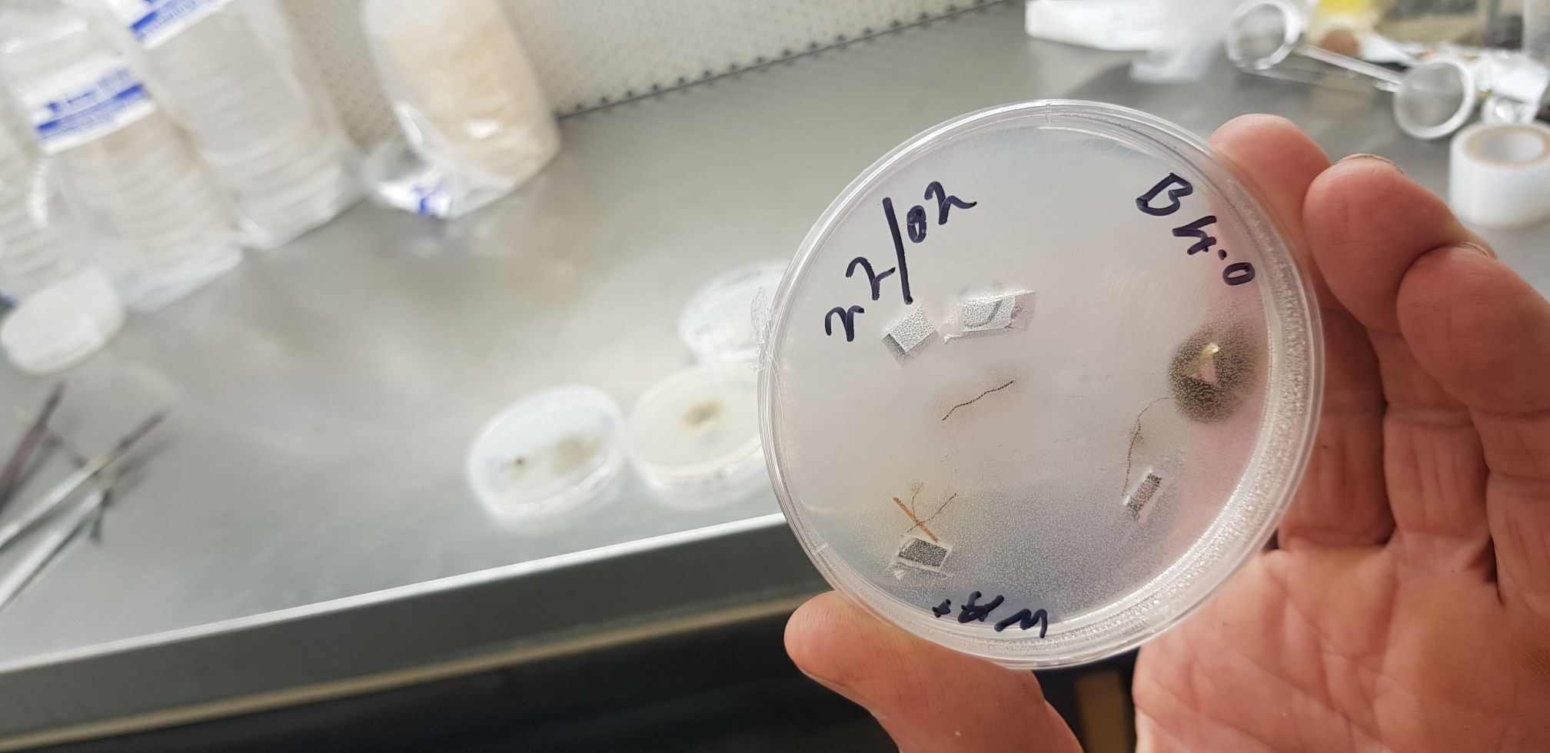
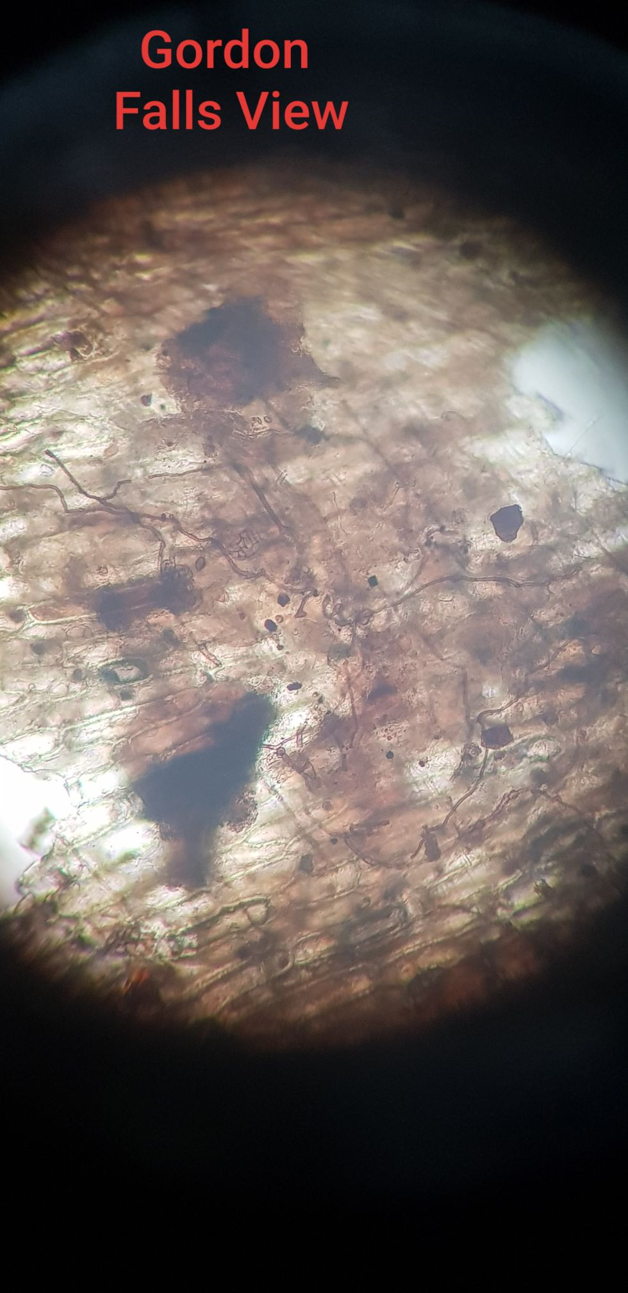
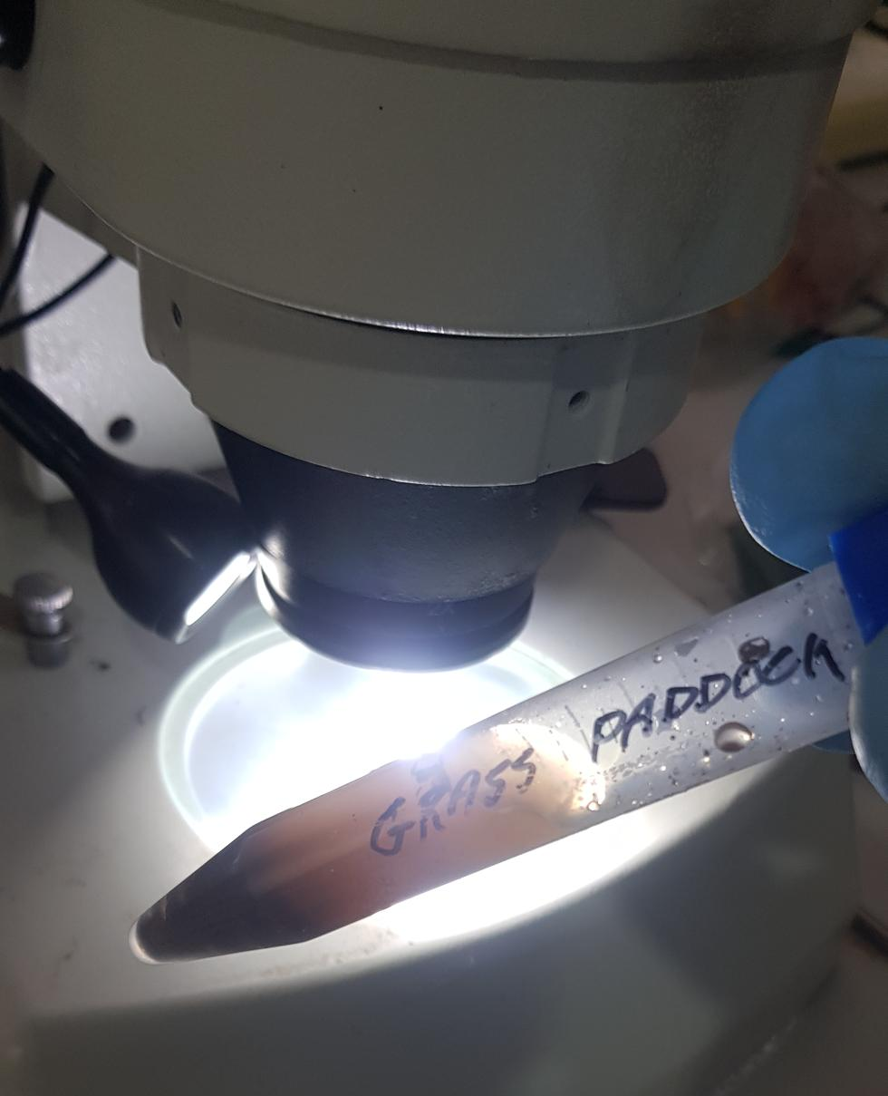
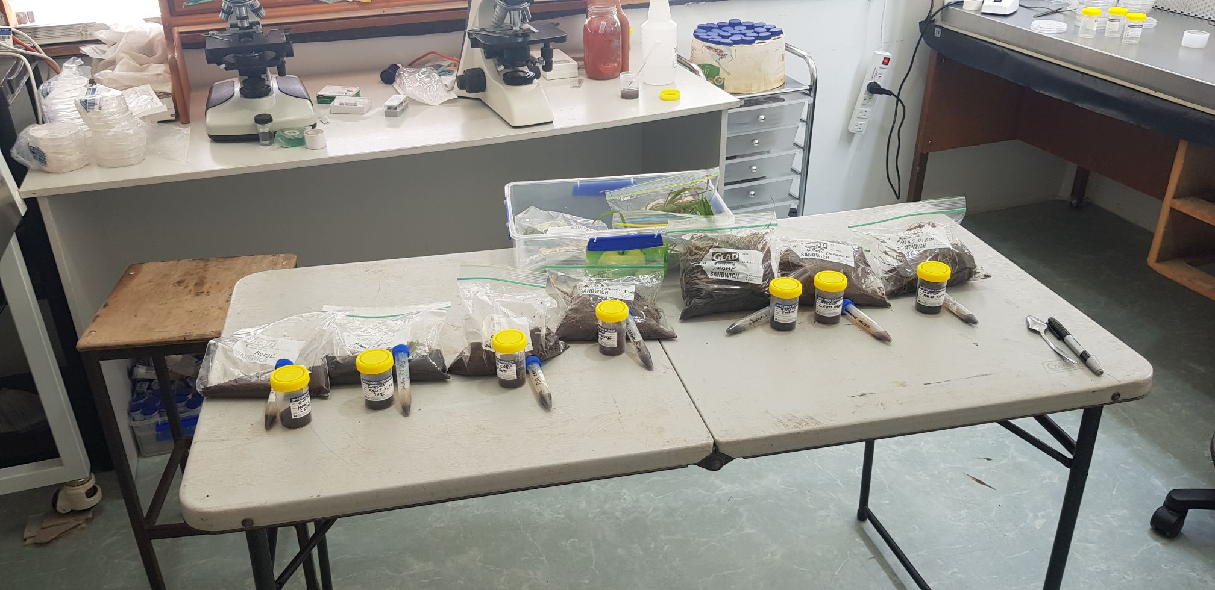

Slide 12
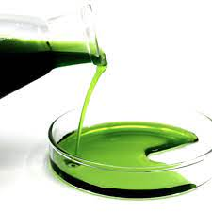

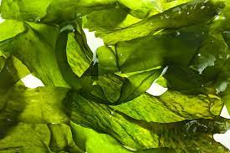
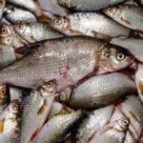

Slide 13
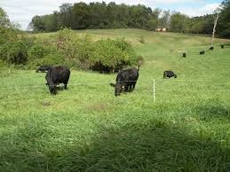
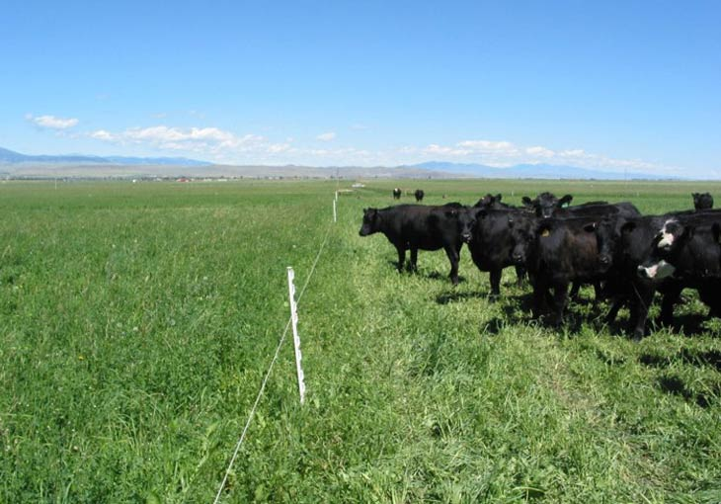
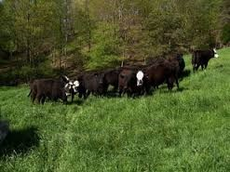
Time Controlled Planned Grazing / Cell Grazing/ Holistic Grazing
Notes:
There are subtleties between the various grazing practices which will be taught in the course, they are not all the same but very similar and all are based on adequate rest periods for the pastures to recover

Slide 14
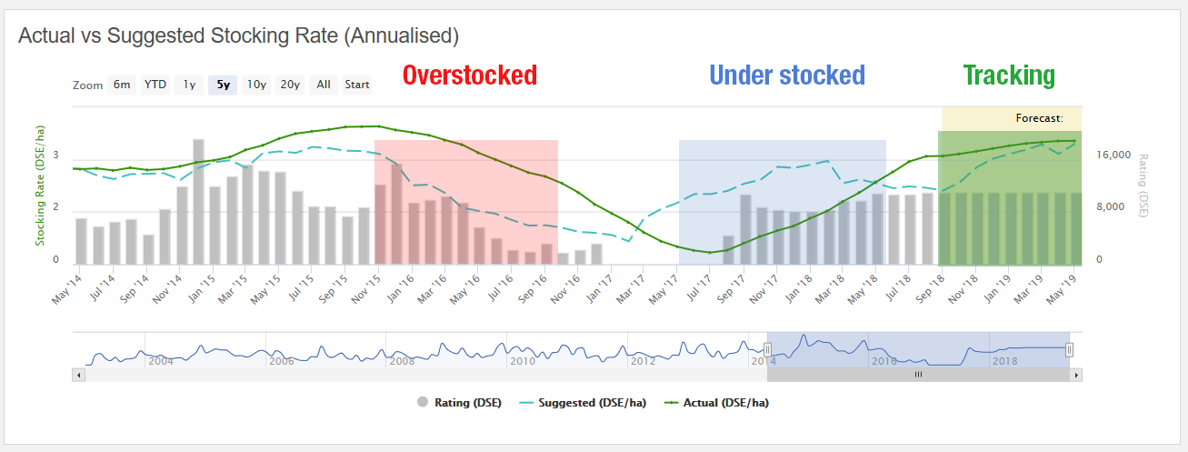

Slide 15
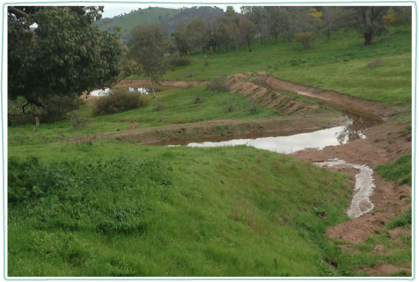
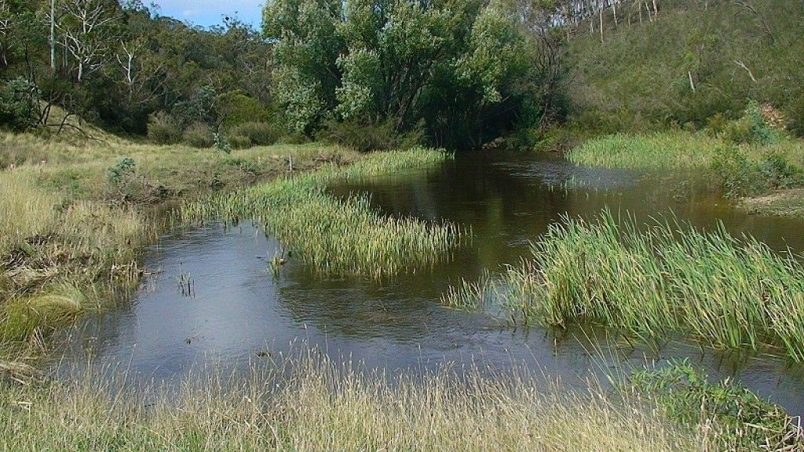
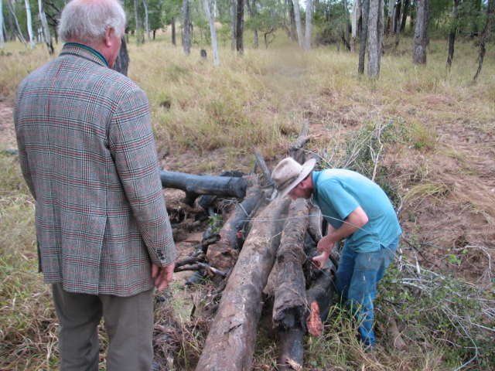
Leaky Weirs / Natural Sequence Farming/ Investing in Wetlands/
Building Natural Capital

Slide 17
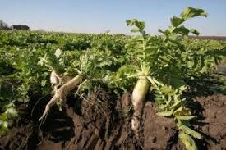
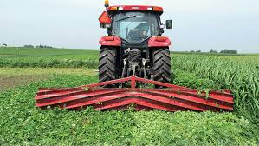
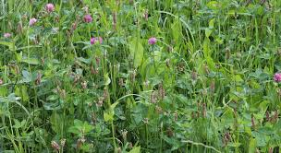
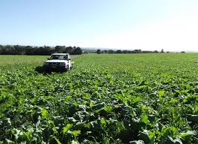


Multi Species Pasture Cropping, Cover Cropping, Green Manure, Under Sowing Legumes

Slide 18




Species Diversity

Slide 19


Notes:
We have already talked about some of the things we are doing on our farm in detail.

Slide 20
Potential income Carbon Sequestration
Disclaimer: Note, this is an example only……
400 ha used for project (assume remaining land excluded due to woodland, buildings, dams, riparian areas etc)
Aim for an average net gain of 1% SOC for top 30cm = 45 T of additional organic carbon per ha or 165 T of CO2 per ha or 124 Australia Carbon Credit Units (ACCU’s)
Total for 400ha = 49,600 ACCU’s
In 5 years if price is $38/ACCU = $1,884,800 (based on current price)
Notes:
Re-do this slide

Slide 21


Livestock and Emissions
16 % of global emissions are from Agriculture
81% of those are from livestock
48% of which is beef
Campaigners are moving to next target from fossil fuels to livestock!
European Union already have carbon dioxide emissions tariffs on imports
Carbon neutral Brazilian Beef
NZ will have farm levy by Jan 25
MLA carbon neutral targets - that means us
IPPC report advocating diet as the solution - “eat less red meat”
ABARES Insights 2022
State of the Climate 2022 CSIRO and Bureau of Meteorology

Slide 22
Multi Nationals are leading the way in measuring and offsetting emissions, whilst Government lags
Fonterra
Uni Lever
Nestle
Mars
Kellogg
Pfizer
Wilmar
Olam
Mondelez
FAIRR Initiative
Coller Foundation Ltd
(70 Trillion membership company)
https://www.fairr.org/index
View Company Rankings
Measures ESG Factors
Has a Protein Producer Index
Includes:
AACo
JBS

Slide 23



What’s coming
Macroalgae(Seaweed) Dictyota (brown) Asparagopsis (red) most promising however CO2 emissions from producing, harvesting, drying and transporting?
Vaccines & chemical inhibitors - early life programming–suppress the growth of methanogens but acceptable to consumers?
Phytocompounds - essential oils, tannins, saponins, flavonoids and organosulphur compounds. Garlic most promising….tannins in legumes, also help parasites and N utilisation.
Nutrition – lipids (fatty acids) and concentrates
Alternative sinks such as Nitrates – animal and environmental issues around excess nitrate
Combinations of strategies

Slide 24

What the farmer can do now about methane?
Measure your emissions – can’t mitigate what you don’t know you emitting!
Increasing production efficiency, replacing aged stock with young for efficiency. Fewer animals, turned off more quickly, less feed for a given amount of product
Animal breeding and genetics based on feed conversion and efficiency
Mixed legume based pastures – biodiversity makes sense
Plant trees
Holistic grazing systems reduce the use of synthetic fertilisers by more effective use of nitrogen-fixing plants and manure through animal impact

Slide 25

What else can farmers do to build Natural Capital ?
Sequester carbon, because you can!
Become carbon neutral by:
Planting trees
Soil carbon
Get paid for looking after your natural capital
Focus on:
Carbon sequestration,
Abatement,
Biodiversity,
Water quality,
Animal health
How:
Adopting Regenerative Agriculture Practices

Slide 27
What won’t build Natural Capital!
Paddocks of bare soil/lack of ground cover
Monocrops/lack of biodiversity
Spraying out paddocks prior to sowing new pastures or crops
Set stocking
Overuse of synthetic chemicals, fertilisers and pesticides
Over tillage/disturbance of soil
Gordon 2020

Slide 28




