Slide 1
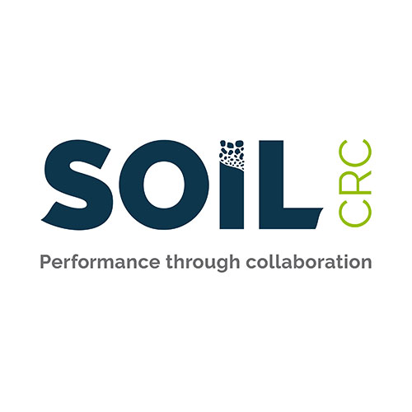
Building resilient and adaptive soils for climate mitigation/ adaptation
Lukas Van Zwieten

Slide 2
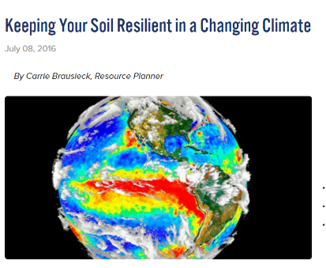
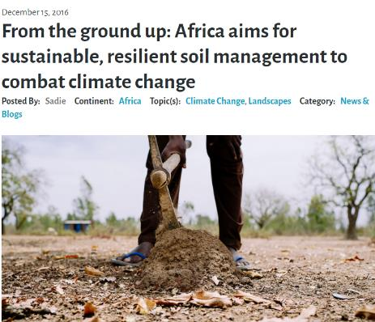
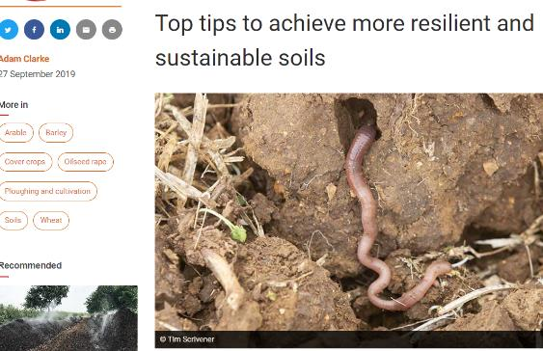
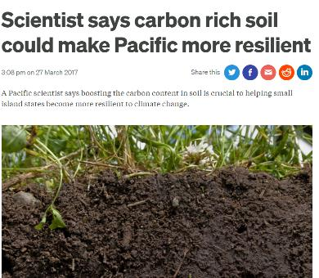
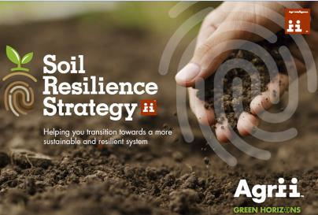
What is a resilient soil?
Notes:
Point out that the term resistant is commonly interchanged with sustainable,

Slide 3
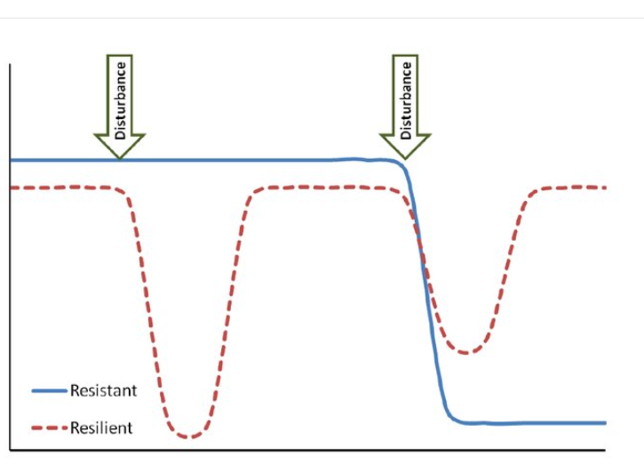
Resistance and Resilience:
Neither are a single point in time measure, and terms often used incorrectly
Resistance = The ability of maintain functional stability after a disturbance
Resilience = The speed/extent with which a system returns to its pre-disturbance level
Can soil ‘adapt’ to these disturbances?
(drought, flood, increasing temperature, chemicals, climate change- and higher CO₂ in atmosphere, heavier machinery etc)

Slide 4
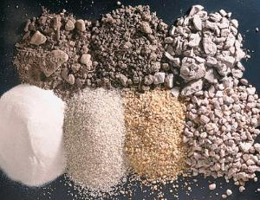
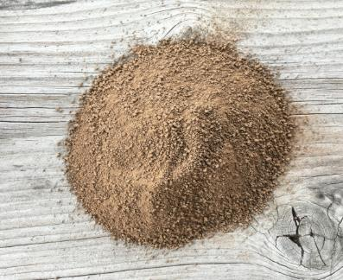
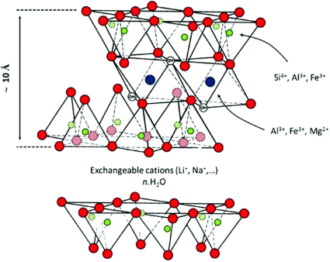
What’s in soil?
The Soil Mineral Fraction
Gravels and sands
Void
25%
Mineral
45%
Solution
25%
Silt- fine silica and feldspar
Organic
Clay
Notes:
Density on mineral matter is about 2.65 so half of the volume gives a bulk density of around 1.3. Squeeze the voids increases bulk density and lowers porosity and water retention
THE MINERAL fraction is mostly from weathered parent material. Note that the later part of the presentation will focus on soil organic matter, and its various functions.

Slide 5
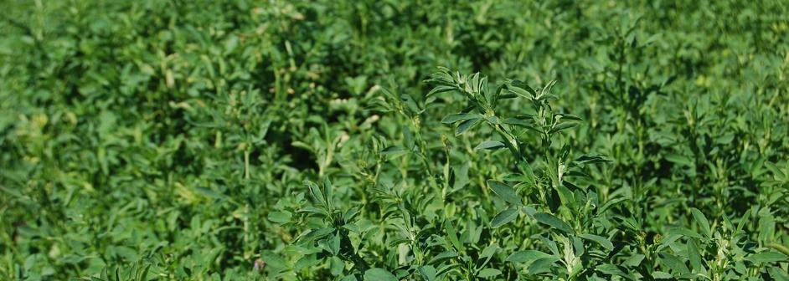
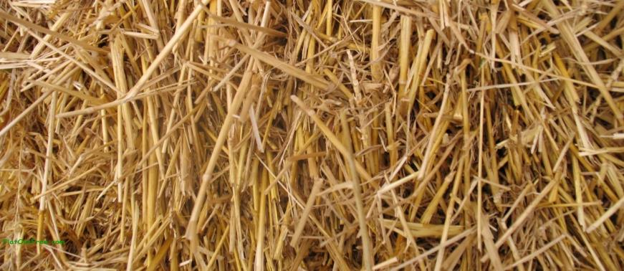
A closer look at organic C in soil
Carbon - main element in soil organic matter (58% by weight). This is what we measure.
Increasingly processed by microorganisms
Higher C:N:P
Less stable
Plant residues
Particulate Organic C (0.05-2mm)
Mineral Protected Organic C (humus) (below 0.05mm)
Charcoal
?
more stable
Fires, biochar
Legume C:N ranges 12- 40:1
C:P ranges 63- 640:1
Grass C:N 80:1
C:P 200:1
Notes:
SOM is physically and biochemically diverse.
SOM is divided into pools based on turnover time and resistance to decomposition.
Categorising SOM into pools helps to understand the mechanisms influencing stocks and fluxes.
The first division of soil C is that which has been biologically derived (SOC) and that which has not (SIC). SIC refers to lithogenic (primary) and pedogenic (secondary) carbonates. Soils in arid and semi-arid regions can contain 2 to 5 times more SIC than SOC in the surface 100cm. The focus of this research is on SOC and SOM. The second division of SOM is living OM and non-living OM.
The total C pool; also referred to as background C levels, is the total of the three conceptual pools.
As any one of these functional pools decrease, the remaining pools increase as a proportion of the total C pool.
SOC fractions vary in their sensitivity to land management. Often the total C pool is not responsive to changes in management in the short-term. Alternatively, more dynamic and labile SOM fractions are often monitored for early detection of SOC change.
Different measurable C fractions exist within each of the SOM components.
SOM can be categorised into three conceptual SOC pools: fast or active, slow and very slow (or passive or inert or recalcitrant) based on turnover rate.
The fast or active pool consists of
OM with rapid turnover rates, for example microbes, microbial products and fresh residue.
Materials generally have a short residence time; typically months.
Materials that are likely to oxidise and undergo change and respond quickly to agricultural management and other environmental variables.
Generally decreases with an increase in depth.
Major functions of the active pool are: a) substrate for soil organisms and b) binding, cementing and enmeshing aggregates.
SMBC: C held within the microbial biomass. SMBC is commonly greater under pastures than forests or crops.
Labile C: plant residues at various stages of decomposition. The chemical composition of labile C allows it to be readily oxidised by soil organisms. Labile C is comprised of carbohydrates, amino acids, peptides, amino sugars and some metal-organic complexes.
POC (<2000µm and 200-53µm fractionation) is made up of fragmented organic materials from a variety of sources. POC is not necessarily equivalent to labile C and includes a significant amount of lignin and other complex organic materials. It is small so has a high surface area and high accessibility.
The slow pool consists of
Relatively resistant plant materials for example lignin and stabilised plant and microbial products.
Moderate turnover time of sometimes years but more commonly decades to centuries.
Materials in the second stage of decomposition; the degradation of lignin molecules and aromatic C compounds.
Components are major contributors to the humic fraction of soil.
Humus: large, chemically diverse group of natural organic compounds formed from the decomposition of plant and animal residues. Some forms residence time in excess of centuries. Humic fractions generally have low carbohydrate contents and are instead phenolic-rich with a major proportion altered lignin.
Lignin: most resistant component of plant residue. Lignin lacks a defined primary structure; exhibiting complex and irregular ring polymetric structure. Therefore lignin is able to resist microbial attack by most soil organisms and contribute to the humic fraction of soil.
Alkyl-C: structures are predominantly polymethylene end products with decomposition dependant on CH2- chain structure; longer chains being less recalcitrant than branched structures. Preservation of plant derived polymers for example cutin and suberin.
The very slow consists of
Chemically stabilised OM that is either inaccessible or resistant to decomposition for example charcoal.
Turnover time of centuries to millennia.
Char is the carbonaceous material left after the incomplete combustion of organic matter. Charcoal primarily consists of elemental C with wide C/N ratios and high aromaticity; non-oxygenated condensed or cross-linked aromatic rings. Australian soils are reported to contain a significant proportion of char; up to 35% of the total SOC pool.
GP/MAS 13C NMR- nuclear magnetic resonance, magic angle spinning (MAS) is a technique used to perform experiments in solid-state NMR spectroscopy. Measures: lignin, char, humus, alkyl C and O-alkyl C

Slide 6
Why build Soil Organic Matter?
Reservoir of plant nutrients especially N, P, S
Source of charge density: CEC and AEC
Source of K_{OC} (lowers risk of chemical loss or uptake)
Store of plant available water
Provides energy and shelter for soil organisms
    -leading to aggregation and soil physical stabilisation
    -soil functions (mineralisation, disease resilience etc)
    -rhizodeposits control the rhizosphere processes
Buffers against environmental fluctuations
Promotes nutrient and water use efficiency
Important store of atmospheric C (globally, 2500 billion tonne in topsoil)
Notes:
SOM provides multiple functions and benefits for agricultural productivity and sustainability.
Through photosynthesis, C storage in soils provides a temporary sink of C that could otherwise be warming the atmosphere.
SOM positively correlates with CEC, nutrient availability, pH, soil aggregation, stability and water retention and negatively correlates with bulk density.
SOM provides nutrients, energy and shelter for soil organisms. Decomposition of SOM facilitates the production of microbial structural units, metabolites and stimulates nutrient immobilisation and mineralisation.
SOM forms and strengthens organic bonds between clay and sand particles and microaggregates. Improved soil structure increases: aeration, infiltration, storage and transmission of water and nutrients, resistance to wind and water erosion and promotes seed germination and root growth.

Slide 7
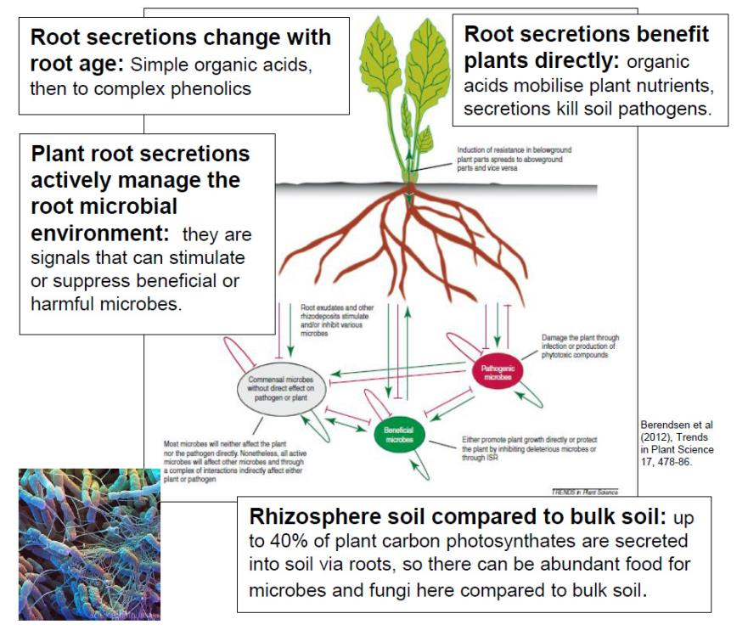
Plants and microbes co-design the rhizosphere
Jeewani et al 2019
Rhizosphere community is more preserved than bulk soil- across soil types and agro-ecological zones
Notes:
Note here how much of the products of photosynthesis go into the soil as root exudates to control/ manipulate the soil microbial community. Especially the rhizosphere

Slide 8
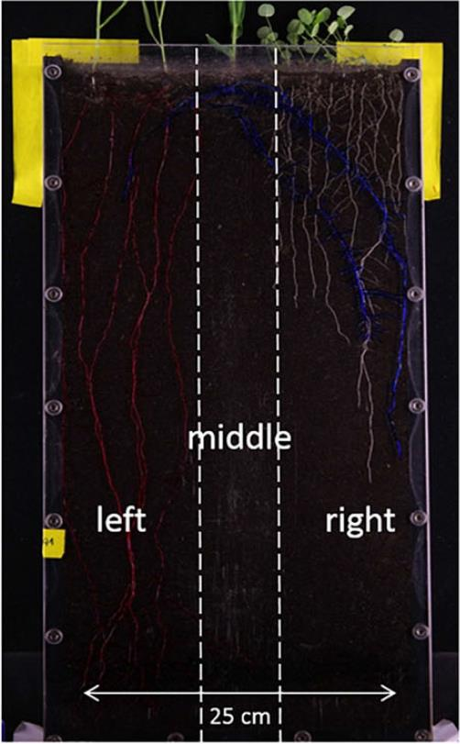
The plant-root neighborhood
Strategic companion planting for re-engineering soil/ root architecture
Current lack of understanding of mechanisms
Weidlich, E.W.A., Temperton, V.M. & Faget, M. Plant Soil (2017). https://doi.org/10.1007/s11104-017-3398-3

Slide 9
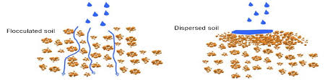
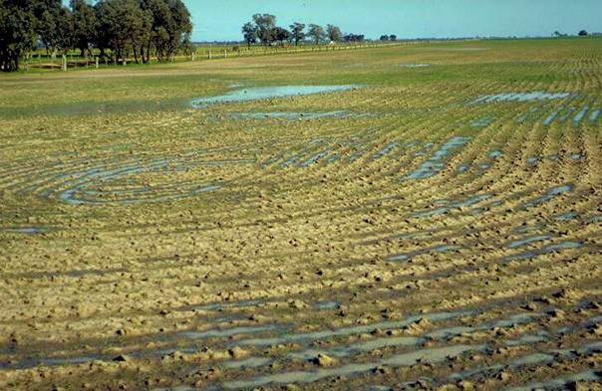
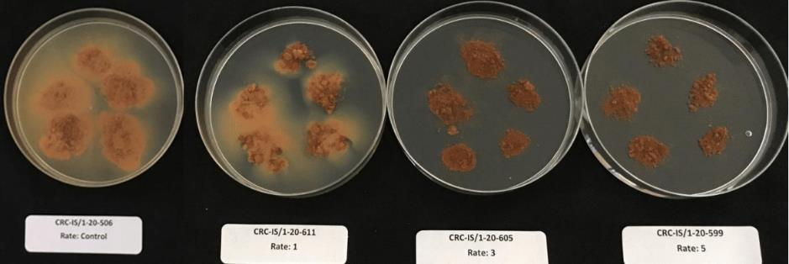
Constraints render soil less resilient- Dispersive soils
Photo; Johnston T. (2011), Soil Types and Structures Module. Vic DPI
Notes:
Not all dispersive soils are sodic- for example, high K+ (potassium) can also lead to dispersion. Dispersive soils are also a consideration where saline irrigation water is used.

Slide 10
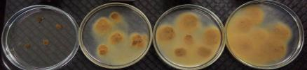
Sub-soil dispersion lowers the “bucket size”
Credit: Ehsan Tavakkoli, NSW DPI

Slide 11
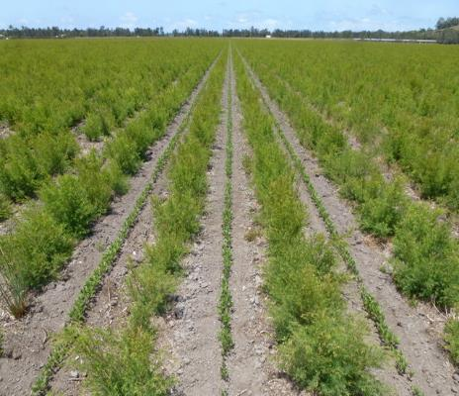
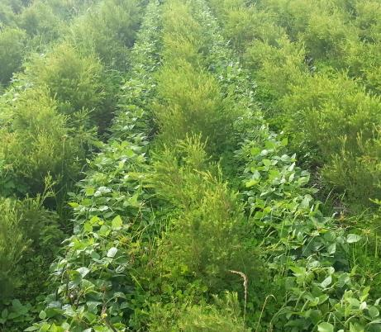
Using legume intercropping and species diversity to address constraints
Soil aggregate stability increased under greater plant species richness (Gould et al 2016)
Improved access to soil P resources (Journet et al., 2016)
Increased N availability and N transfer mechanisms (Rose TR et al (2016)
Manipulation of the rhizosphere ‘neighborhood’
Credit: Prof Terry Rose, SCU

Slide 12
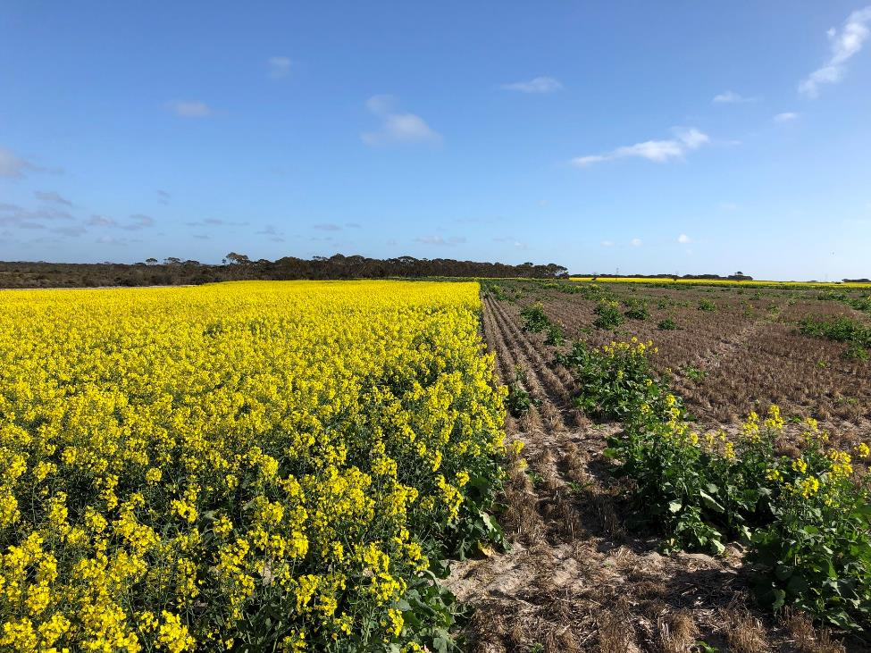
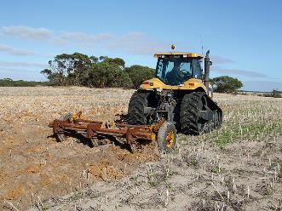
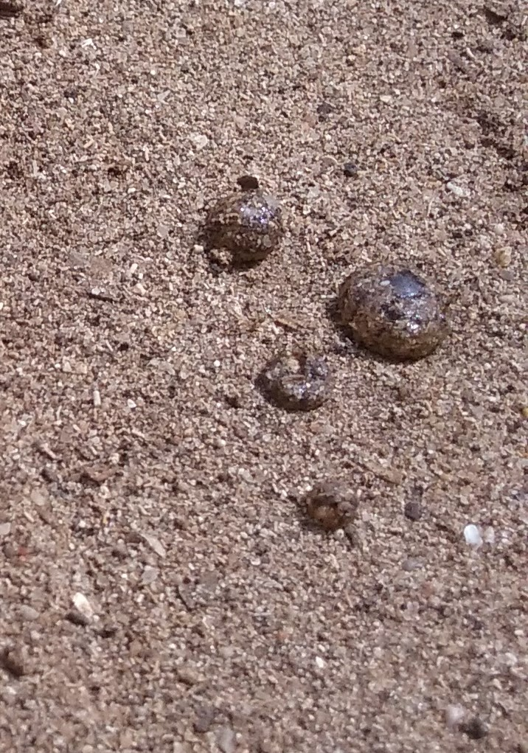
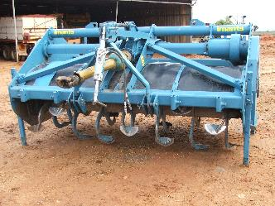
Example of successful amelioration
Soil delved and spaded to overcome non- wetting, Wittenoon hills WA.
Photo: Travis Stewart (Farmer).
Notes:
DELVING AND SPADING.

Slide 13
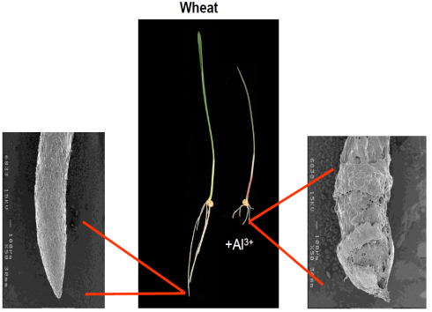
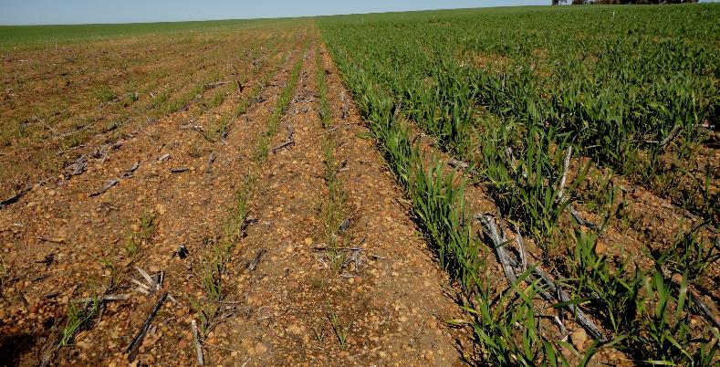
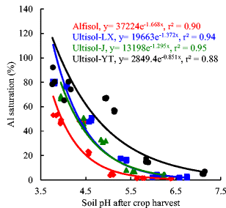
Another example- alleviating acid constraints
Baquy, et al. (2018) Critical pH and exchangeable Al of four acidic soils derived from different parent materials for maize crops. J Soils Sediments 18, 1490–1499

Slide 14
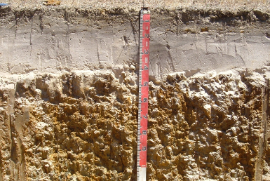
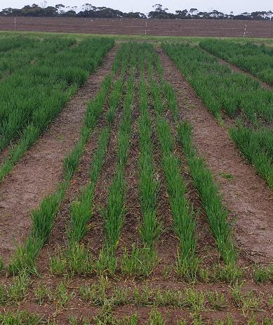
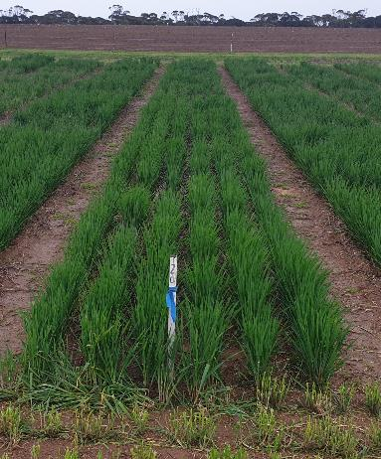
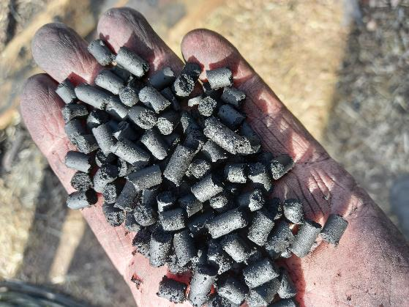
New products and soil management technologies
- addressing (very) high pH and P limitations in Calcarosol
Typical practice
Engineered biochar
Notes:
These biochar based soil amendments have been designed to lower the pH of calcareous soil and to slowly release P fertilizer to the plant, thus avoiding the binding of P fertilizer to Ca, which is not plant available.

Slide 15
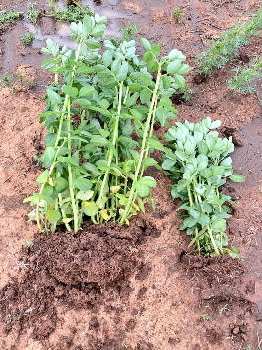
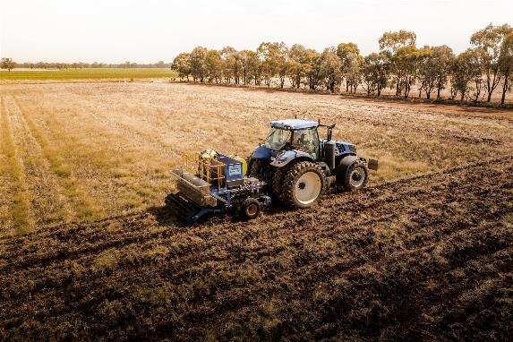
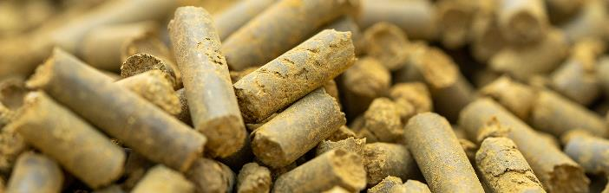
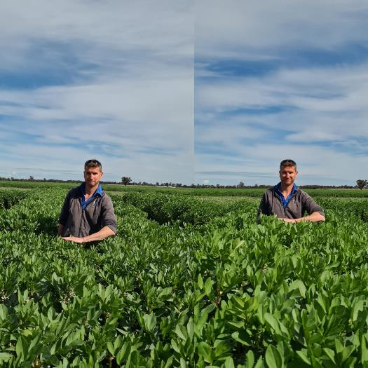
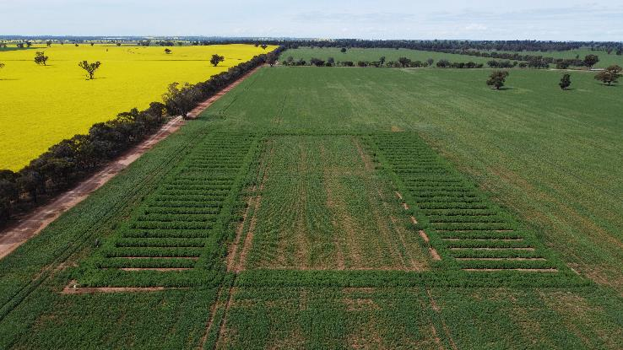
Engineered carbon-composites for addressing multiple constraints
https://soilcrc.com.au/innovative-amendments-trial/
Notes:
These high C amendments have been designed to stimulate soil structural improvement, in part through the development of fungal activity at depth, and via the production of protein based glues that bind soil. They can also be used to deliver nutrients to depth.

Slide 16
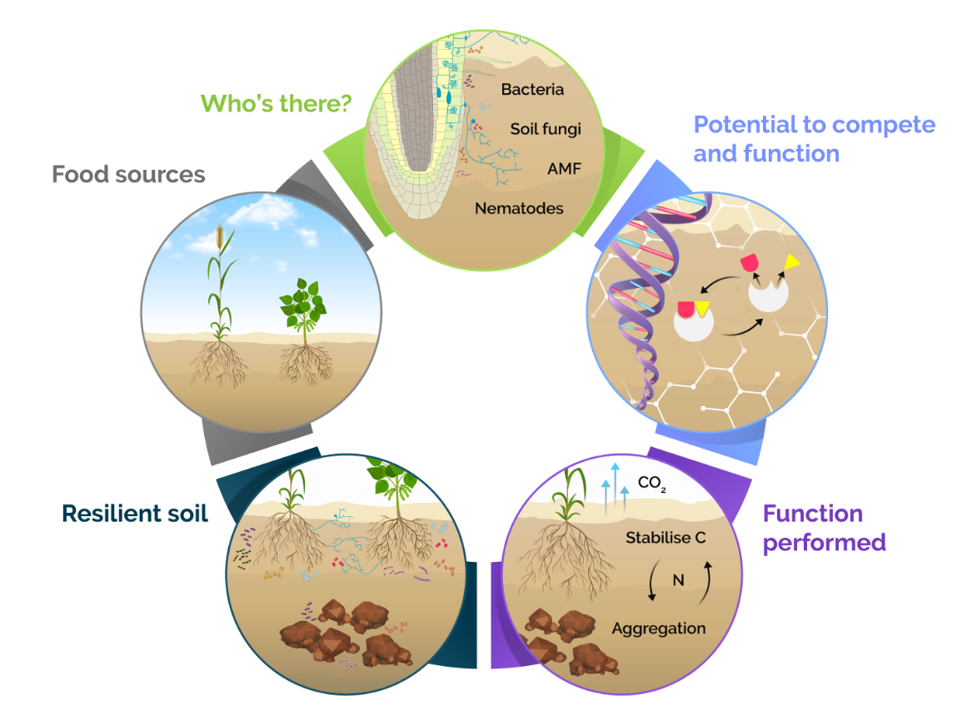
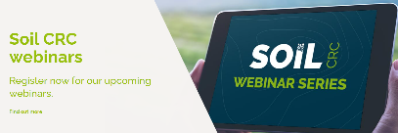
Applying the Soil Biology Assessment Framework
Notes:
There is recognition amongst farmers and scientists alike that soil biology is an important component in healthy soil. But selecting what to measure is confounding and analysing what the data really mean can be even more so. The webinar puts soil biology under the microscope and assessed key methods for measuring ‘who’s there’ and ‘what are they doing.’ The methodologies are being applied to Soil CRC field trials to help us understand changes to soil biological properties and how these may more broadly benefit soil health.
We have been developing a framework for the assessment of soil biology, and how soil biology testing can be used to improve soils as well as make agronomic decision.
1. On the left you can see where it all starts, and that is with the microbial food source. The food source is derived from products of photosynthesis, either as root exudates, litter, or soil organic matter that is processed products of photosynthesis.
2. Then comes “who’s there” and there are many new methodologies that have made this assessment easier. While it can be valuable to know who is there, this really is only a part of the picture when assessing soil biology, as there is significant functional redundancy in soil. By this I mean that if one particular genus or species is affected by a particular practice or event, there will usually be some other microorganism that steps up and completes the same function.
3. And that takes us to function. Here we can assess the potential of a soil to perform a particular function, this may be the ability to nitrify ammonium in soil or the ability to degrade complex C substrates. This can be measured by techniques such as assessing particular functional genes, or enzymes.
4. However the potential to undertake a function does not always relate to what has actually happened in soil, particularly when this is integrated over time where there may have been fluctuation in soil moisture content or temperature. This takes us to the assessment of the actual function that has been performed, that is independent upon who is there.
5. After we have understood who’s there, and what they can do, there is still a lingering question around what does it really all mean, and is the soil better or more resilient. There are some interesting new concepts on understanding soil resilience and then how a resilient soil can control the processing and quality of food sources, taking us back to 1. And so on goes the cycle.

Slide 17
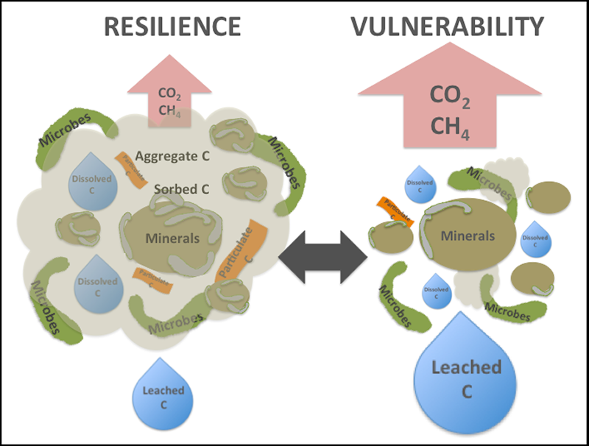
Wrapping up- What can be done to increase resilience?
Address constraints that limit root access to the water ‘bucket’ maximising photosynthesis (if possible)
Minimise erosion/ maximise ground cover
Cover cropping (if possible)
Intercropping- maximise diversification
Diversification of cropping rotation
Livestock in farming systems/ pasture leys
Perennial pastures
Organic amendments (if possible)
New technologies for increasing soil C storage
Second State of the Carbon Cycle Report (SOCCR-2), a special report of the U.S. Sustained National Climate Assessment scheduled for release in 2018.

