Slide 1
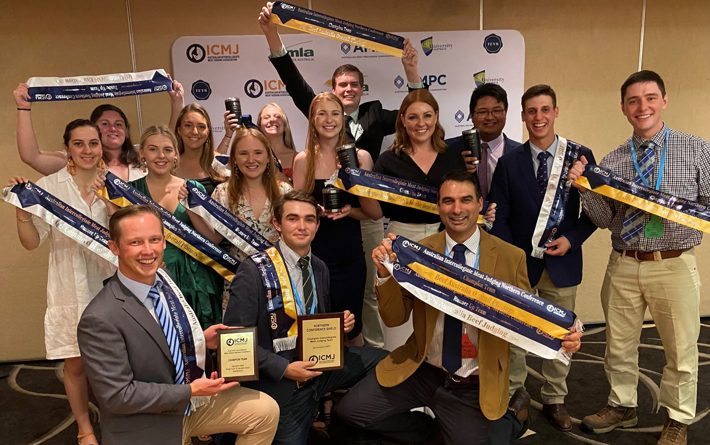
Rural Science and Agriculture @ UNE
Choosing the right course
Dr James Turnell
PIEFA Presentation 30 March 2023
Notes:
Importance of food production

Slide 2
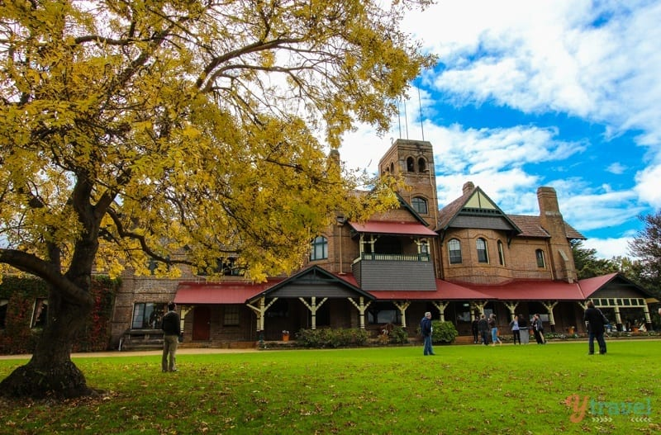
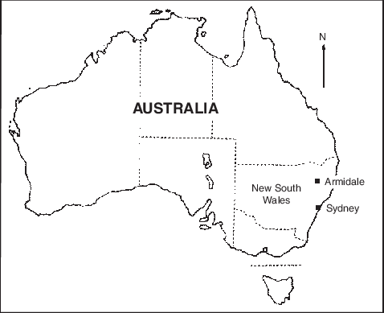
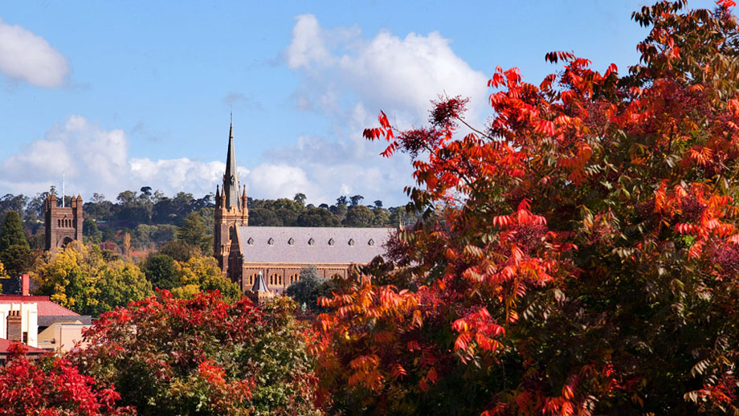
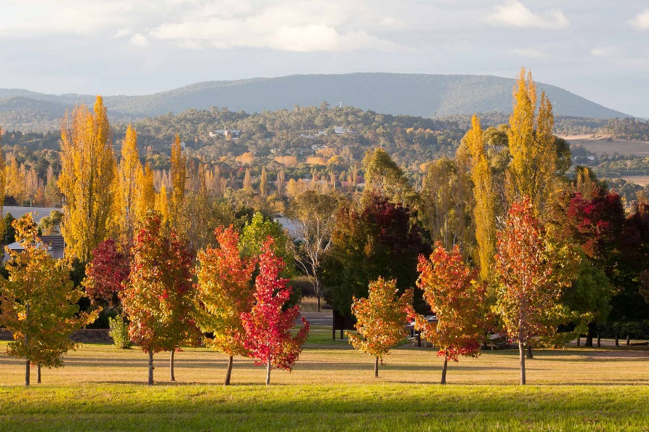
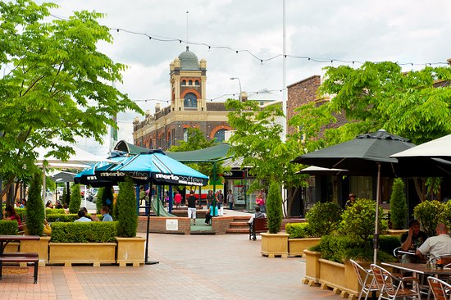
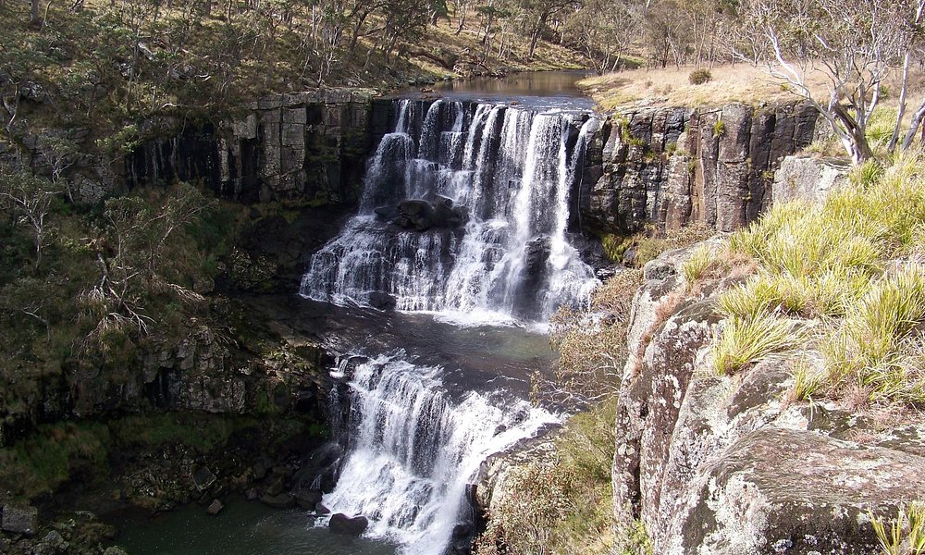

Slide 3
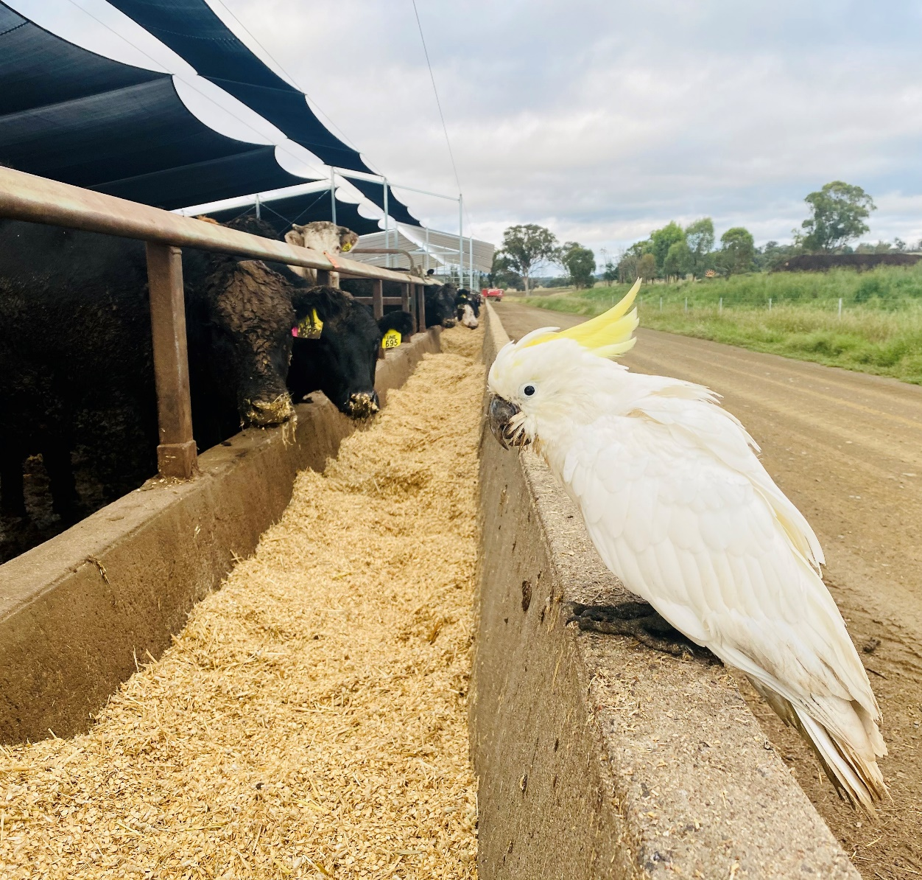
Ag Bachelor degrees @UNE
4 yr
Rural Science
Agricultural and Resource Economics
Agriculture/Business
Education (Secondary STEM - Agriculture)
3 yr
Animal Science
Agriculture
Agribusiness
1 yr
Diploma of Agricultural Studies
5 months
Undergraduate Certificate Agricultural Studies
5 yr
Agriculture/Law
>40 different elective units to choose from
Apply for UNE direct early entry open now – know the outcome by November 2023
Notes:
Dept Education - offers scholarships in high need areas – agriculture for high school teachers
Please highlight Early Entry – and if you discuss with teachers remind them to include student’s academic and extracurricular achievements including outside school such as Music, Queen Scout,

Slide 4
Notes:
Kirby 750 ha basalt, sedimentary and granite
Newholme 1790 ha mainly sedimentary and granite, include Mt Duval Nature Reserve
Tullimba 740 ha 1000 head Research Feedlot – 40km west @ Kingstown
Campus – 385 Ha

Slide 5
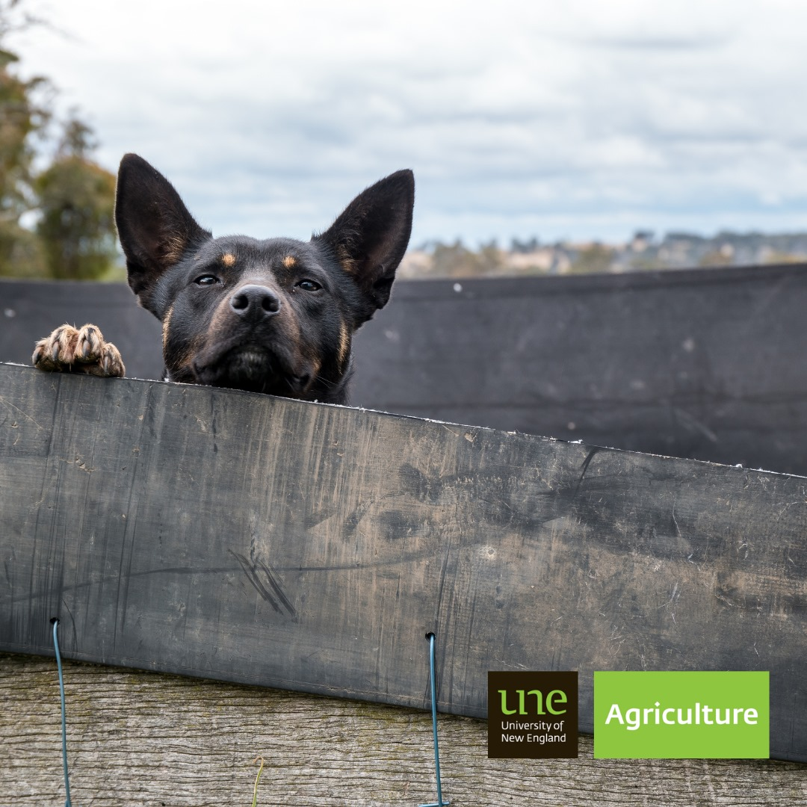
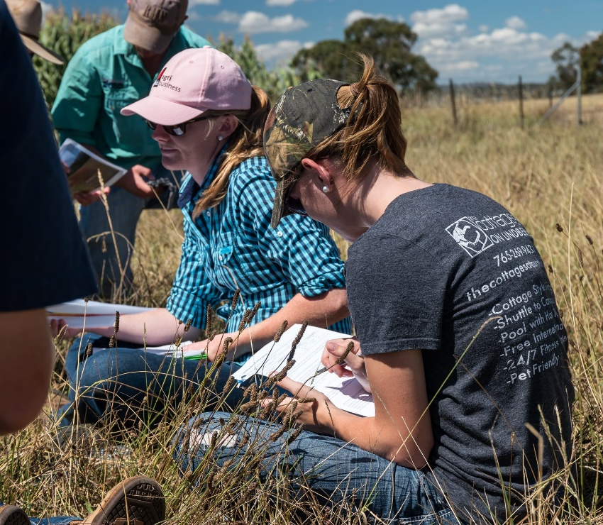
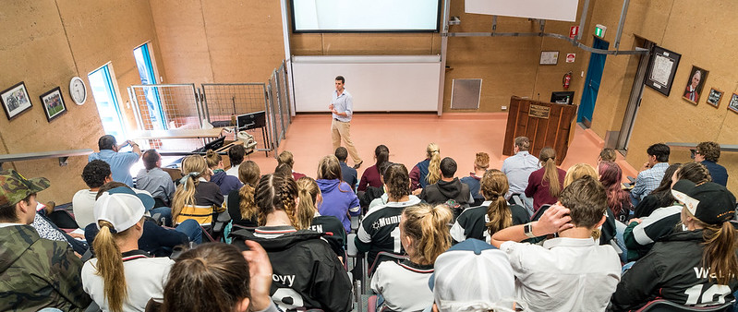
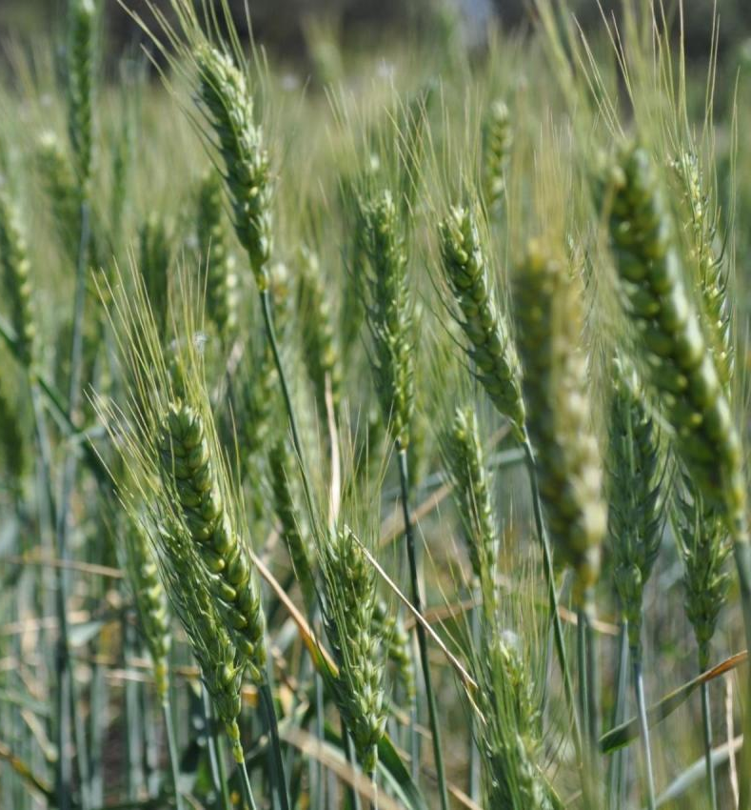
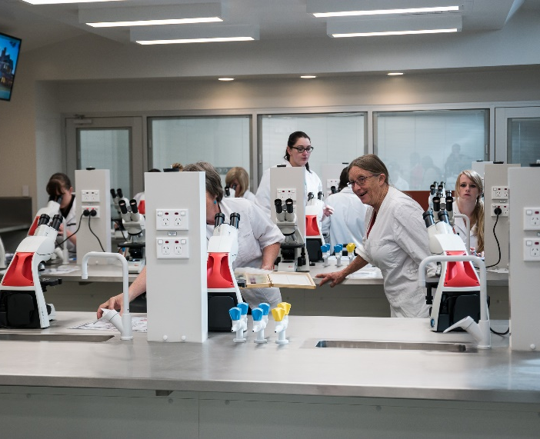
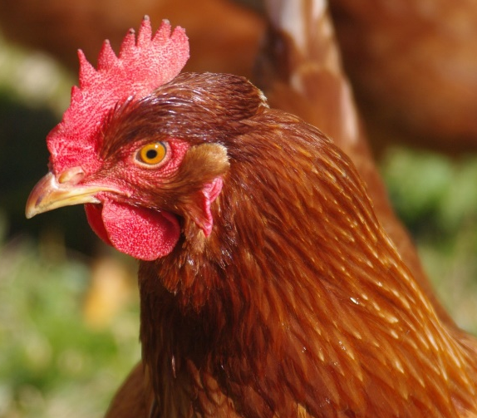
Notes:
Image - wheat, chickpeas, soils, farms on campus, new labs, chickens, sheep and wool, genetics,
At UNE we have a large number of subjects for students to select from and course structure that allows flexibility to choose elective units. – so students can specialise such as wool and sheep science, or choose a wide range o units that interest them from plants, animals, genetics, business, sustainability.

Slide 6
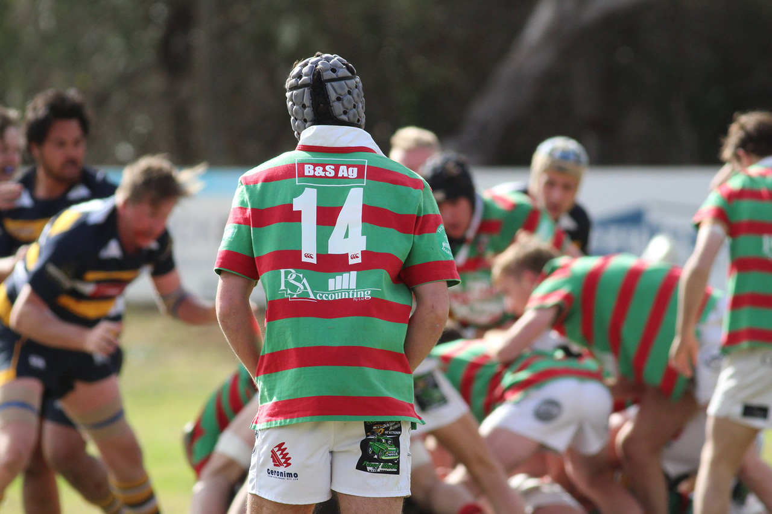
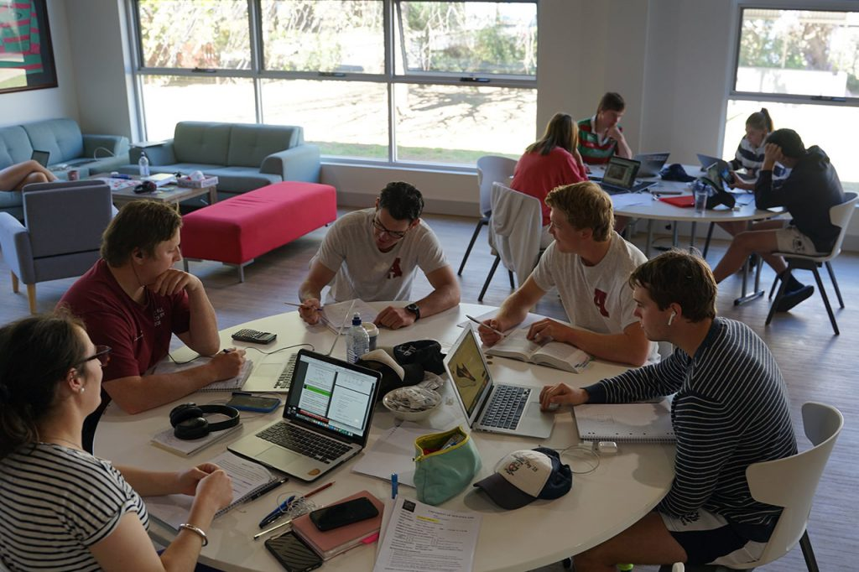
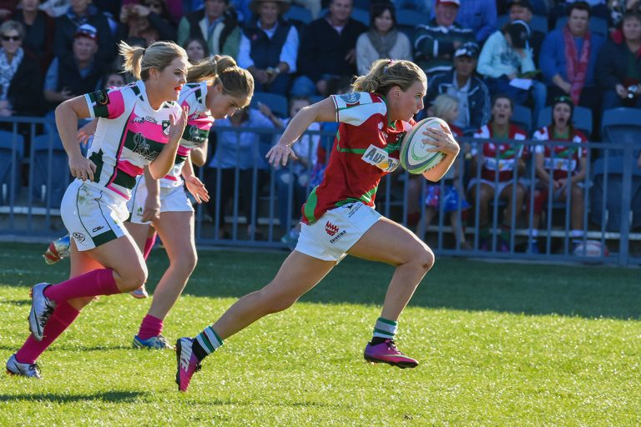
College
90% of UNE agriculture graduates said college benefited their study experience
‘It built a team environment giving you connections throughout the industry which has helped throughout uni and into the workforce’
Notes:
This stat was from Janelle’s project reviewing what past decade of students thought about living on campus.

Slide 7
Continue the conversation – @uneagriculture
Thank you for your time
Notes:
Diversity of jobs available

Slide 8
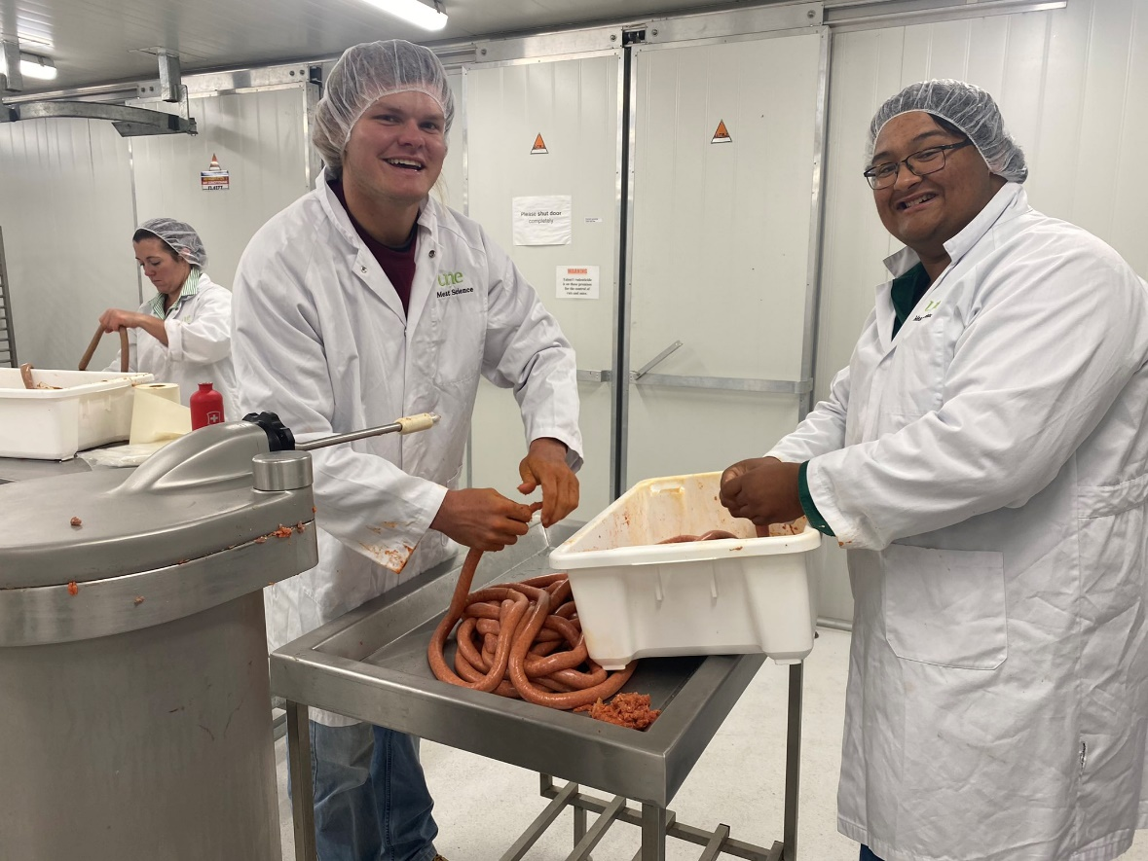
Meat418 student & the champion 2021 UNE ICMJ team

