Slide 1

Key Messages
Don’t listen to the parents
Agriculture is a noble job
It can pay well
NSW DPI is a great place to have a go

Slide 2




Sub Tropical Horticulture Industry Development Office
0.8 years with DPI

Slide 3
How did I get here?
Don’t listen to the parents and identifing what motivates me

Slide 4
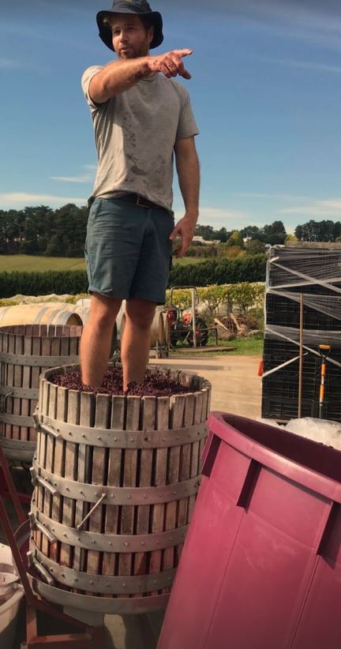

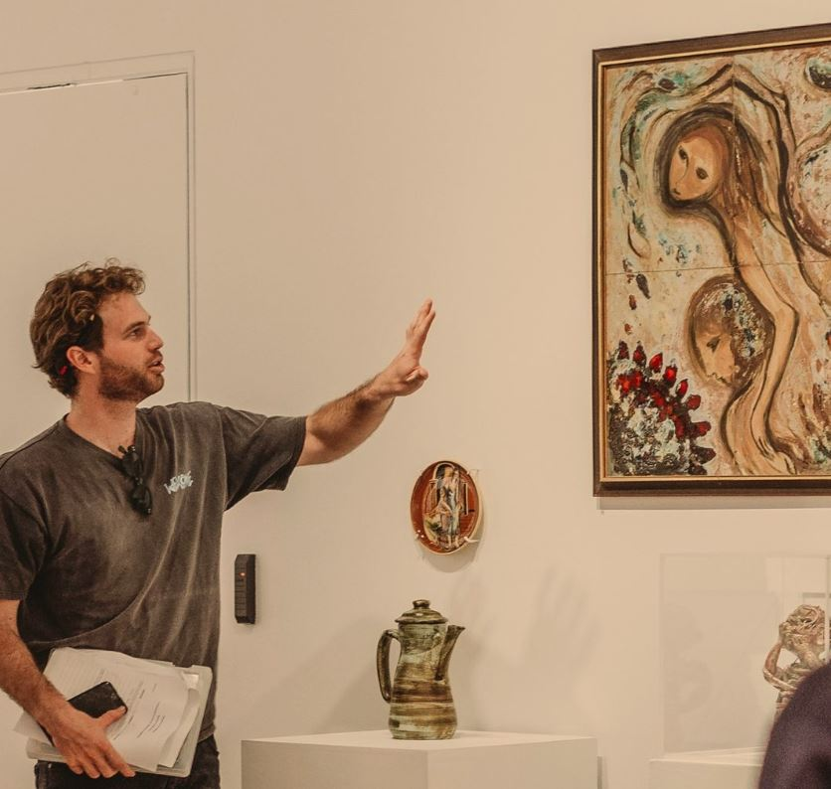
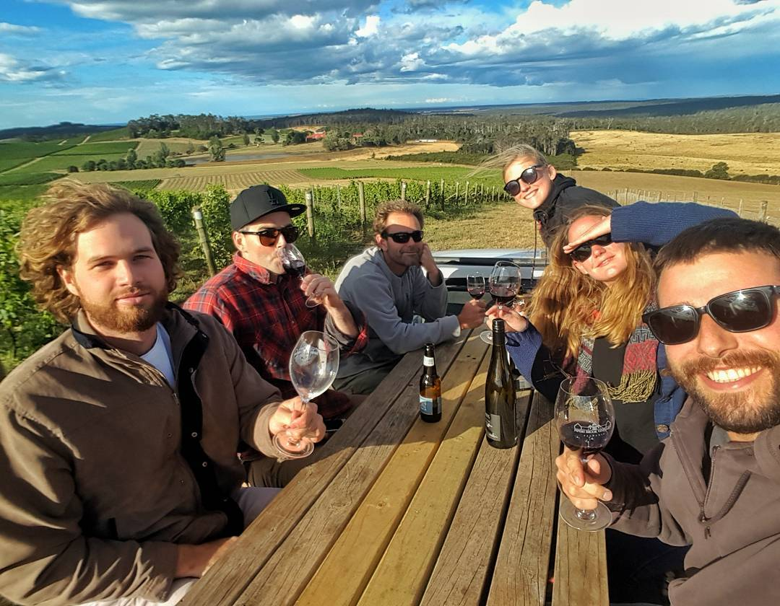
Dookie campus

Slide 5
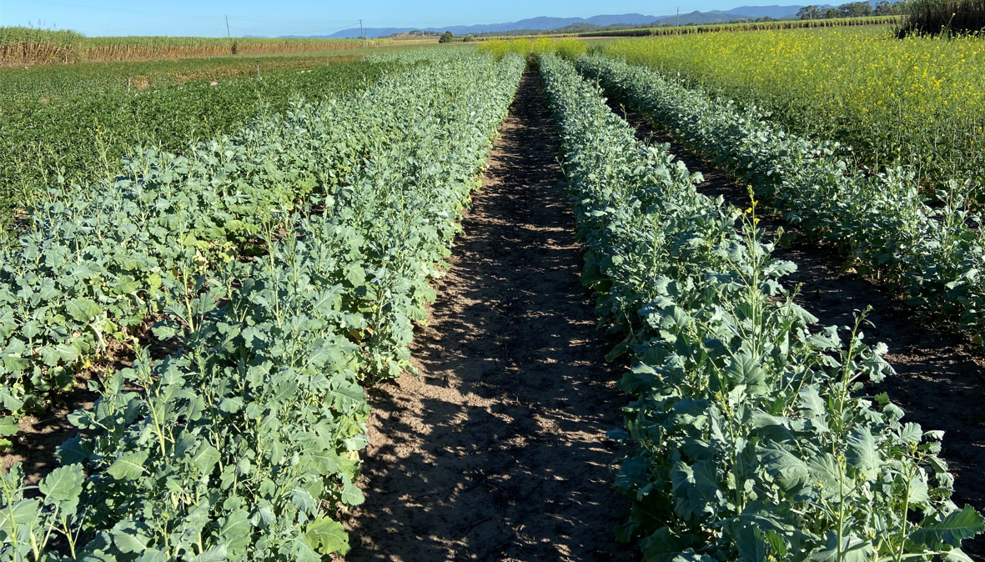
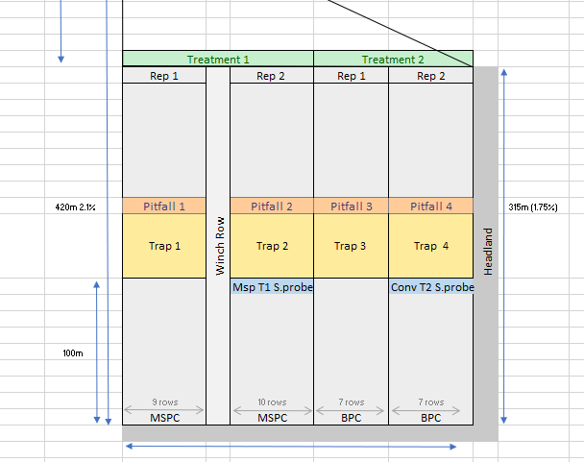
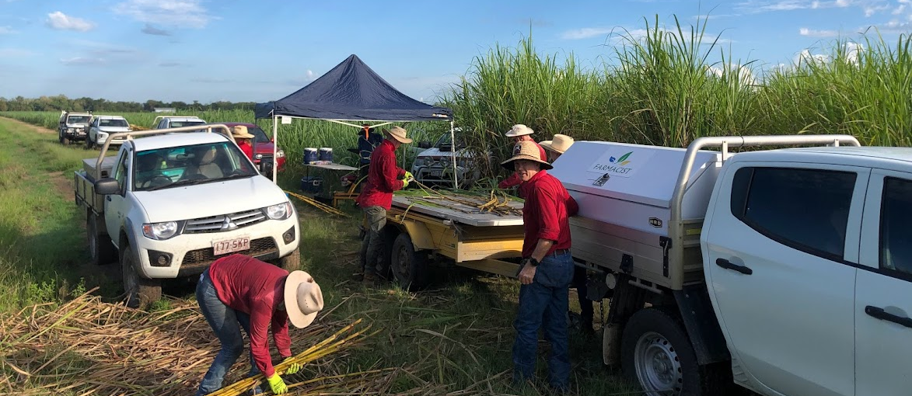

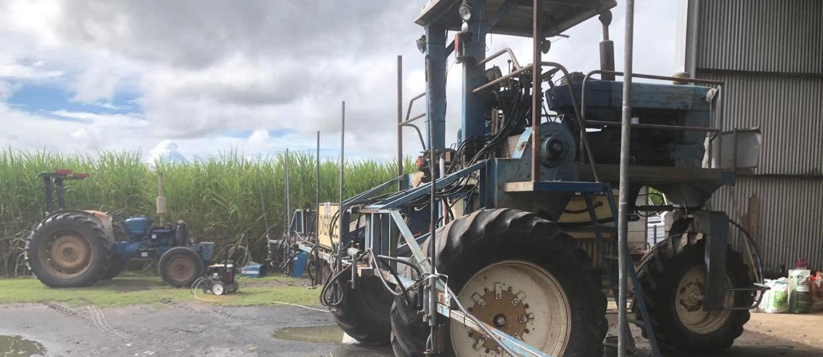
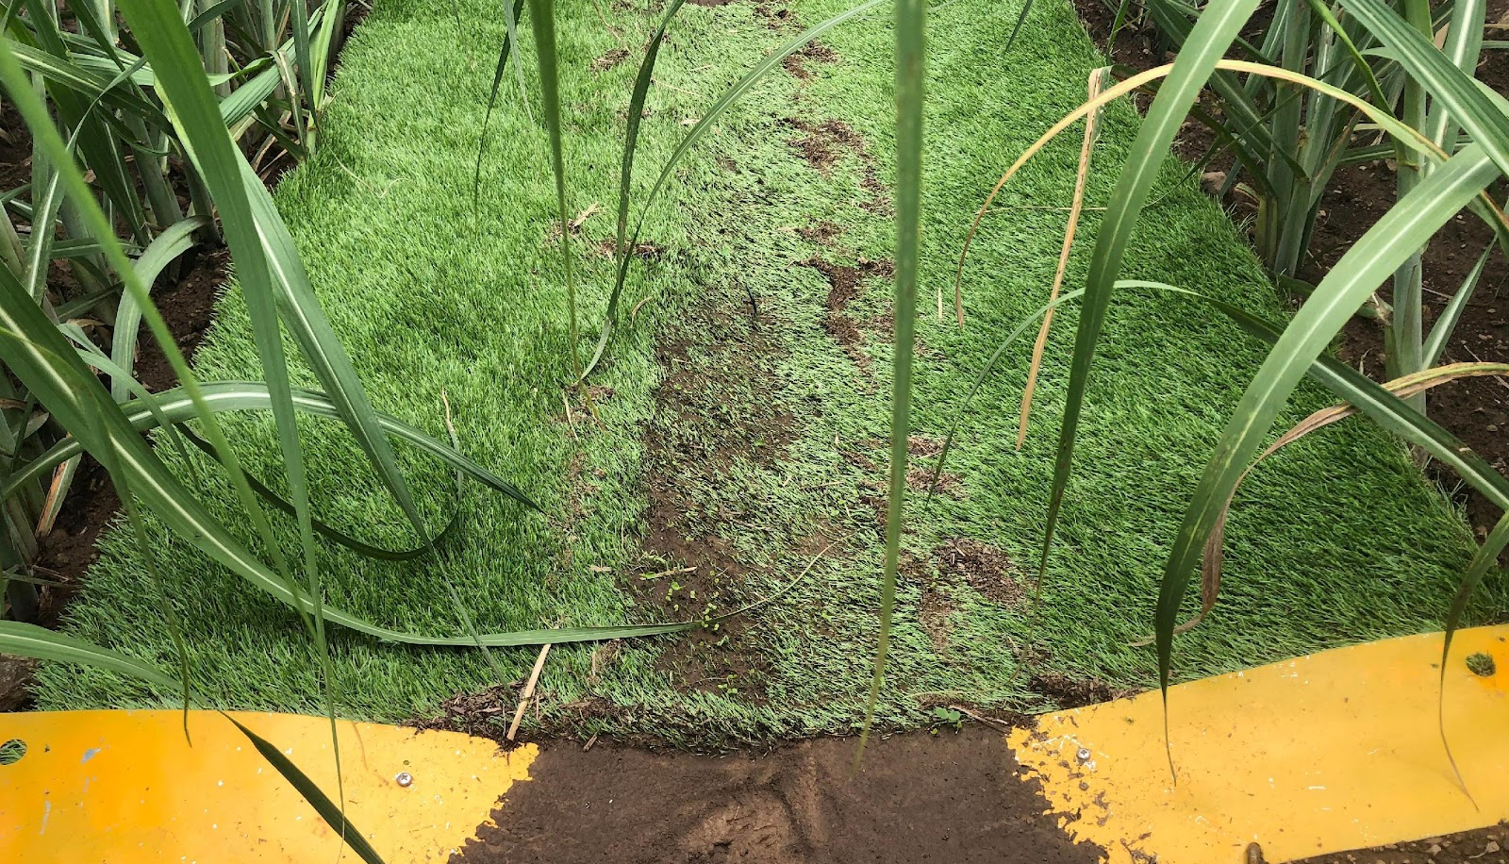


Slide 6
Why are these experiences meaningful for my current role?
Building agriculture within yourself – it’s a way of life! It’s all about understanding culture.

Slide 7
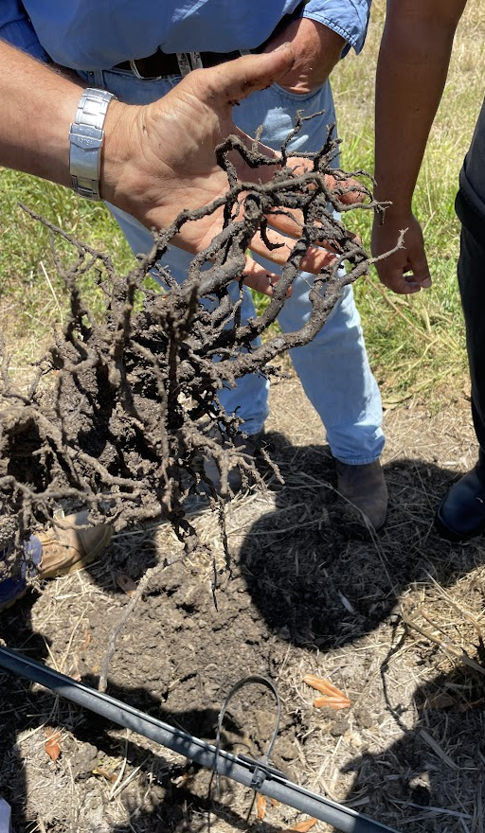
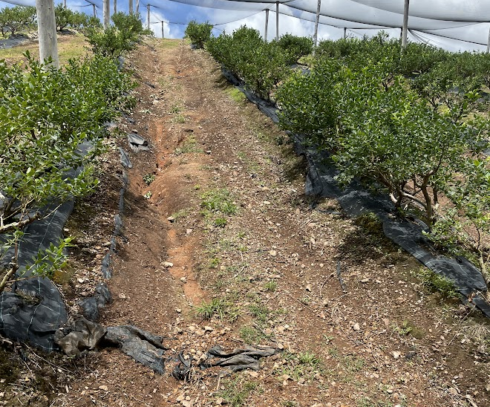
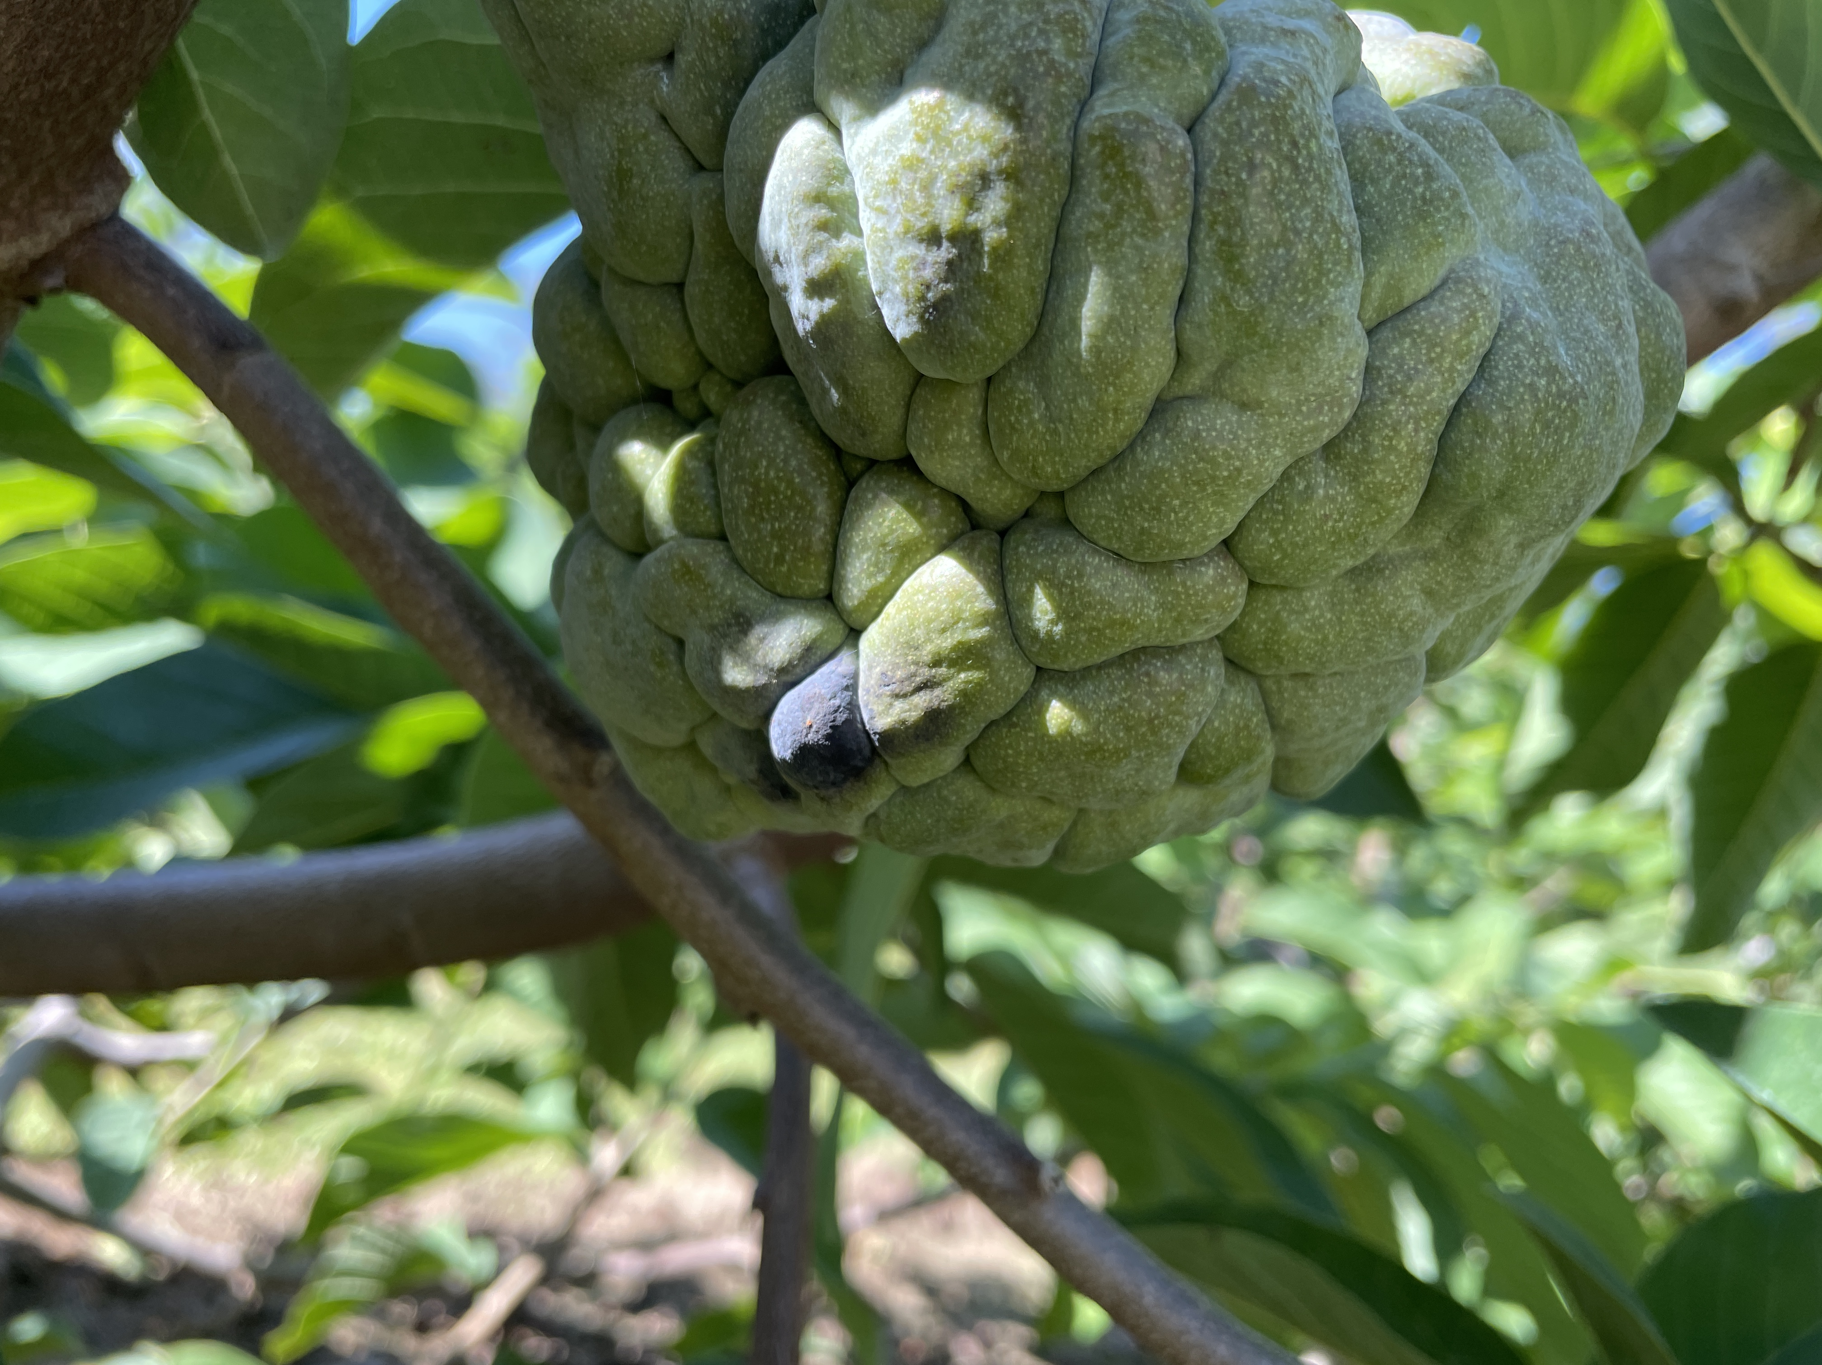
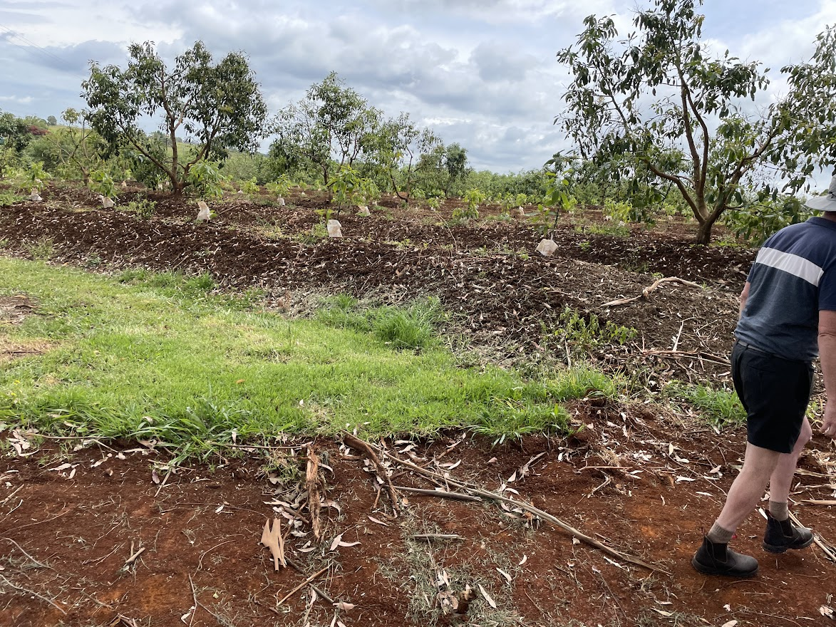
Clean Coastal Catchments
Nation Banana Extension and Development Building Flood Resilience
Supporting emerging markets
Developing a scientific writing profile

Slide 8
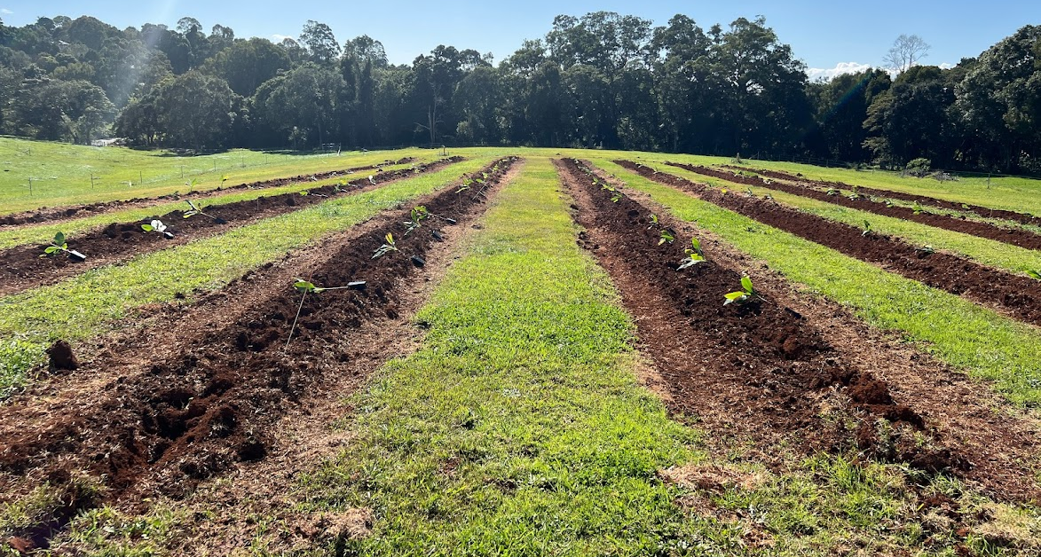
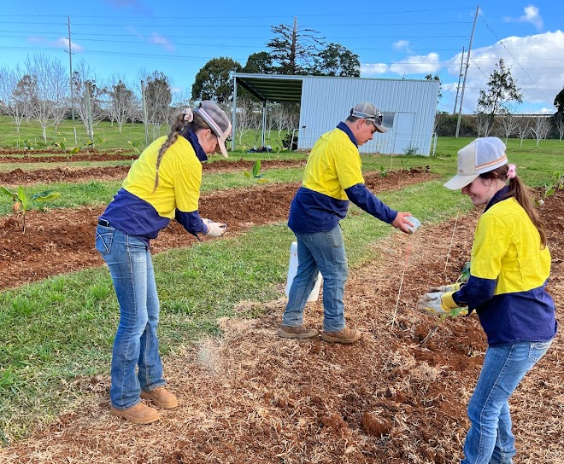
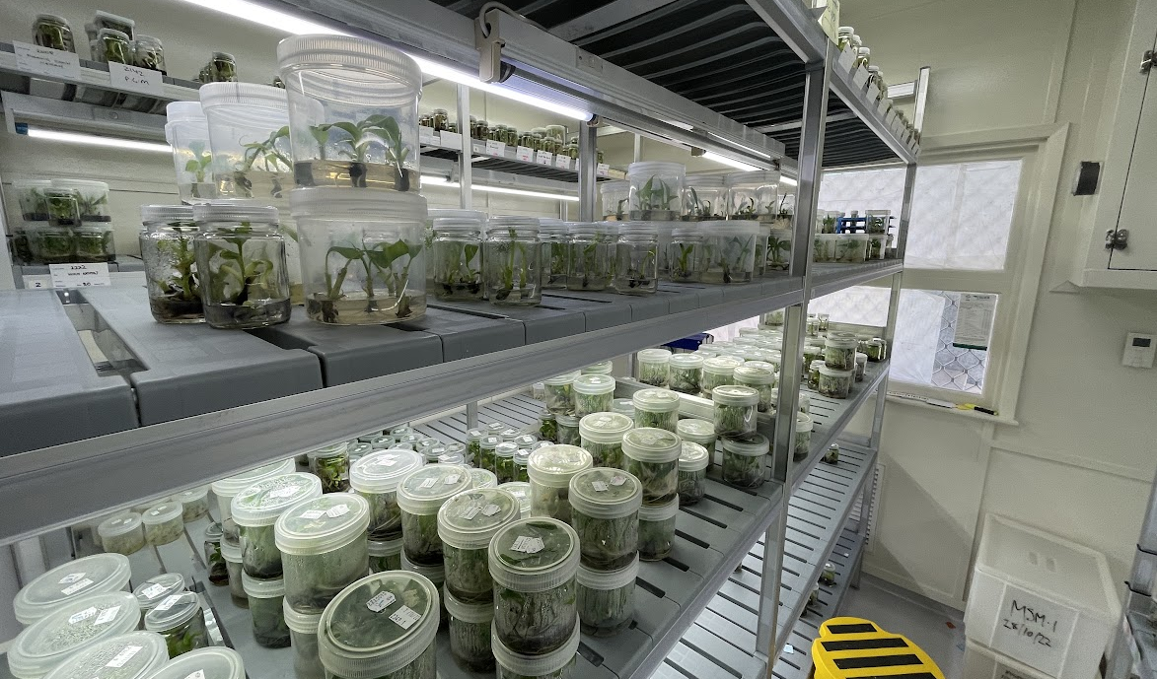
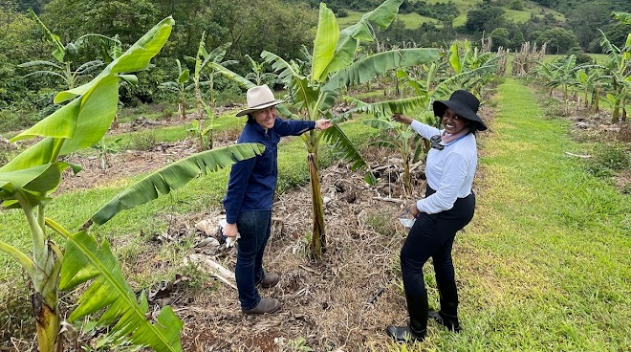

Slide 9
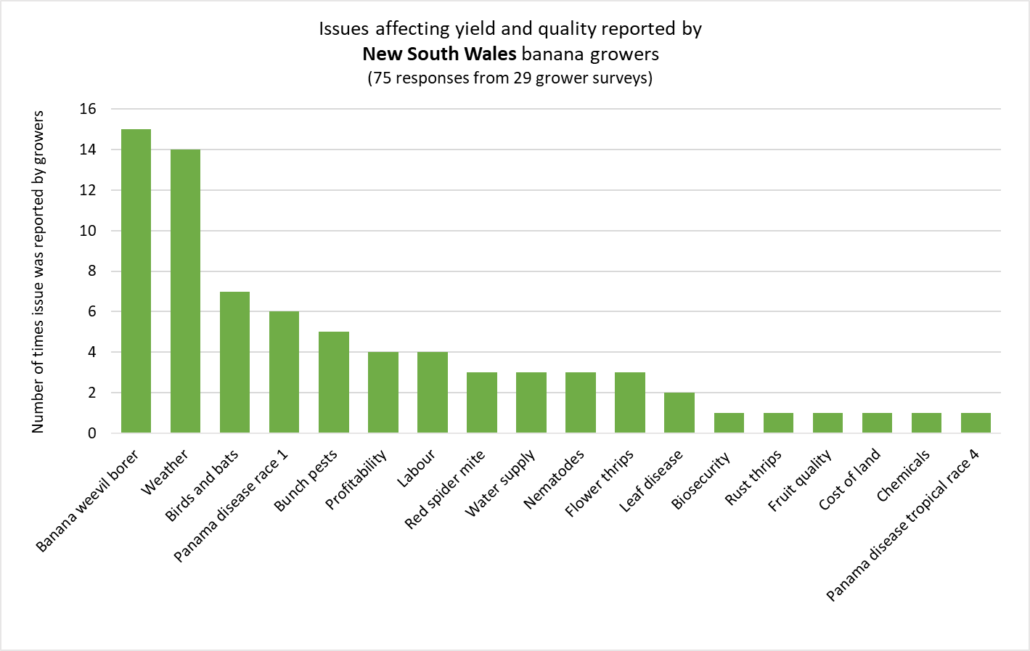
Why facts don’t change minds

Slide 10

Career pathways with DPI
Get on the I work for NSW website for all the information!
Research services
Research officer
Social science
Soil and plant science
Entomology
Professional officer
Extension and research
Industry development
Technical officer
Applied Science
Hands-on science
Farm management and research support
Executive opportunities and leadership development
I work for NSW App QR code

Slide 11

Questions?
I work for NSW App QR code

