Slide 1
The Australian Dairy Industry – Careers
Career Advisor Presentation
1

Slide 2




Reasons to Explore a Career in Dairy
STABILITY AND OPPORTUNITY
WORK WITH ANIMALS IN THE GREAT OUTDOORS
CONTRIBUTE TO A HEALTHIER WORLD
TURN YOUR DAIRY JOB INTO A DAIRY CAREER
A job on a dairy farm provides stability, a reliable source of income and a level of job security that not all industries can offer. It’s a career that will always be there.
Providing best care for animals is a key part of any role in the dairy industry. Technological advances continues to improve the treatment, care and health of dairy cows.
The dairy industry makes a positive contribution to local communities and is part of a collective effort to provide nutritious food for a healthier world.
Work in the dairy industry can lead to a rewarding career. Agriculture is one of the most rapidly changing fields of study, there is high demand for skills professionals.
2
Notes:
Australia’s dairy farmers are skilled, innovative professionals who are passionate about their industry.
They are committed to the health and wellbeing of their animals, land and communities.
The Dairy industry is progressive and technologically advanced with world leading practices.
There is no gender bias in the agricultural industry , both genders are widely represented.

Slide 3
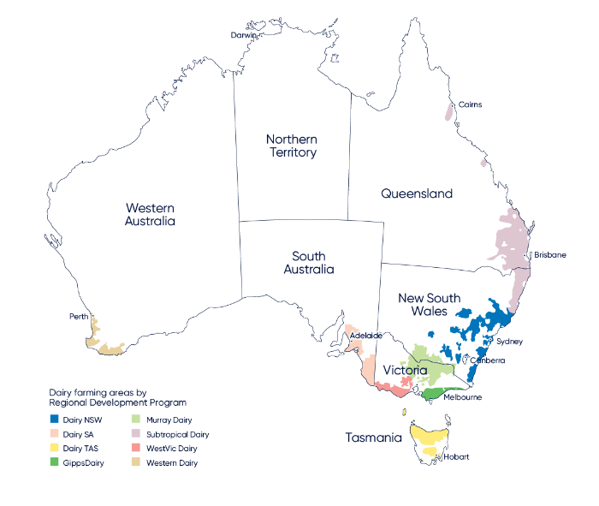
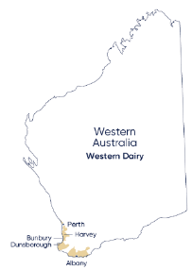
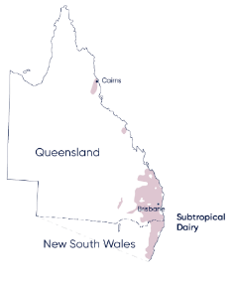
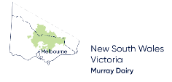


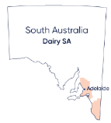
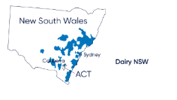

AUSTRALIAN FARMING AREAS
3
Notes:
8 Dairy Regions in Australia
Over 4500 dairy farms
History spanning over 200 years
Over 37,000 jobs nationally

Slide 4
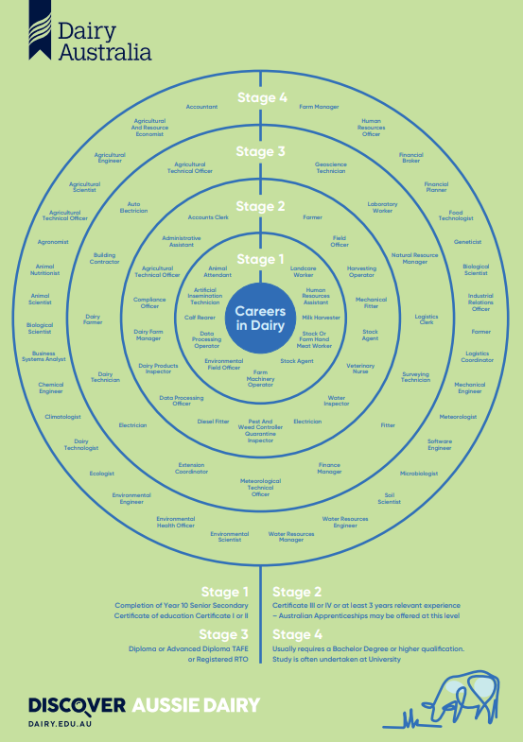
Career opportunities in the dairy industry
There's more to dairy that just milking cows.
Accredited training is available to prepare people and excel careers in the dairy industry.
A massive shortage of skilled professionals exists in a range of positions.
Agriculture is one of the most rapidly changing fields of study in the 21st century.
Entry level jobs
Milker, Farm Hand, Calf Rearer
Certificate II, III or IV
Agriculture, Agriculture Dairy Production
Diplomas
Traineeships
University Degrees
Agriculture, Agriculture Science, Agriculture Business, Veterinary Sciences
Trades
Diesel Mechanics, Plumbers, Fitters
Gap Year Program
AgSkills offers students the opportunity to take a gap year on a farm
Notes:
There are lots of jobs in diary both on farm and beyond the farm gate.
There are more jobs in agriculture than there are qualified applicants, currently (2022) there are 4-5 jobs for every agriculture graduate.
Agriculture is one of the most rapidly changing fields of study in the 21st century. As such, there is high demand for skilled professionals to develop ethical and sustainable food production systems, to support the world's growing populations. 40% of agriculture roles are in cities, so a career in agriculture can take you anywhere.

Slide 5
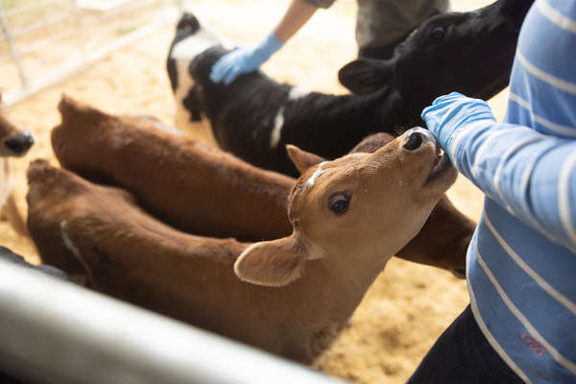
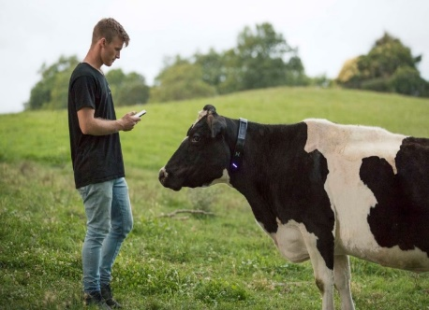
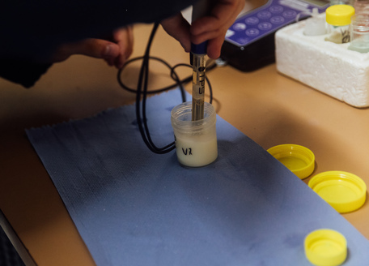
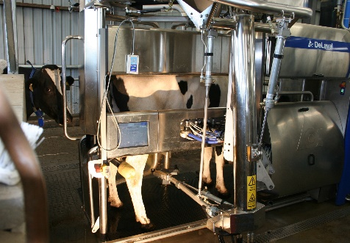
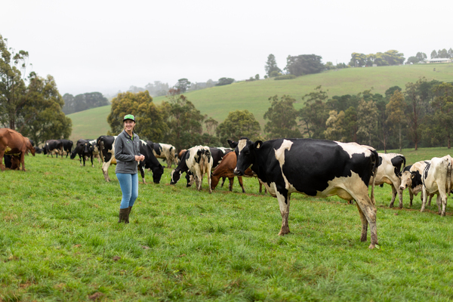
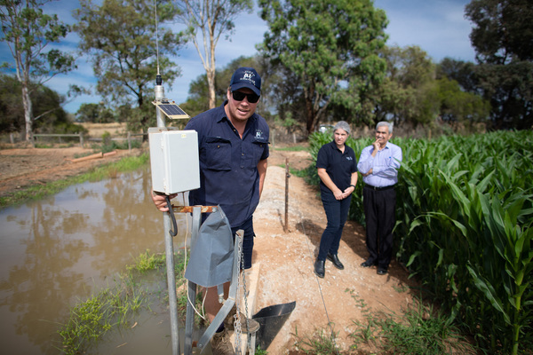
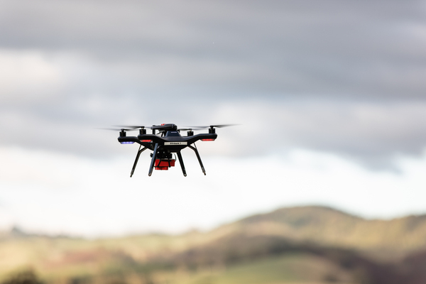
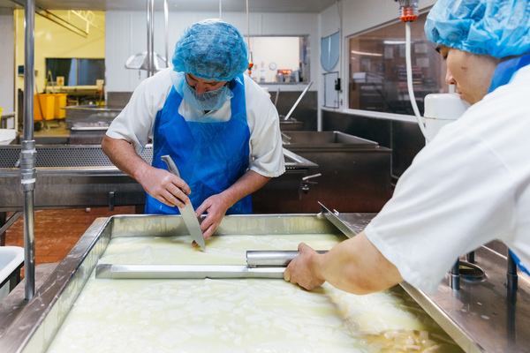
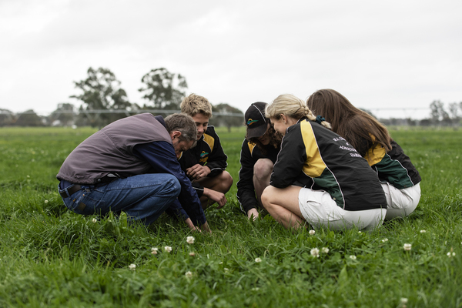
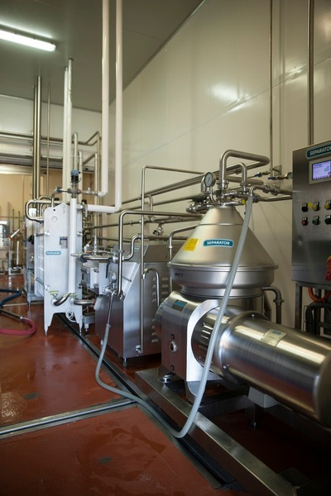
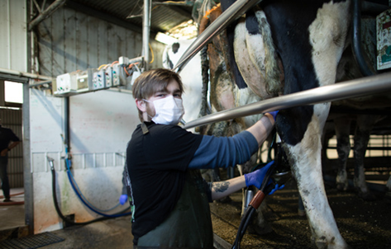
Just some of the careers opportunities in the Dairy Industry
Calf Rearing
Computer Technology
Science and Research
Robotic Dairies
Genetics and Biotechnology
Technology
Environmental Management
Food Technology and Manufacturing
Agronomy and Pasture Care
Engineering and Trades
Veterinary and Animal Nutritionist
Notes:
The opportunities in the dairy industry are vast.
Jobs range from entry level roles to highly sought after professionals.
Entry levels roles can progress from milkers and farm hands to herd and farm managers and onto lease farmers and farm owners for those interested in that career path.
Some examples of professional roles include:
Robotics professionals who develop and create robotic milking dairies.
Computer programmers who have created programs that monitor cow movement, eating patterns and when a cow in on heat.
Genetic professionals that work on creating embryos of cows that have optimum milk production levels and minimal health issues.

Slide 6
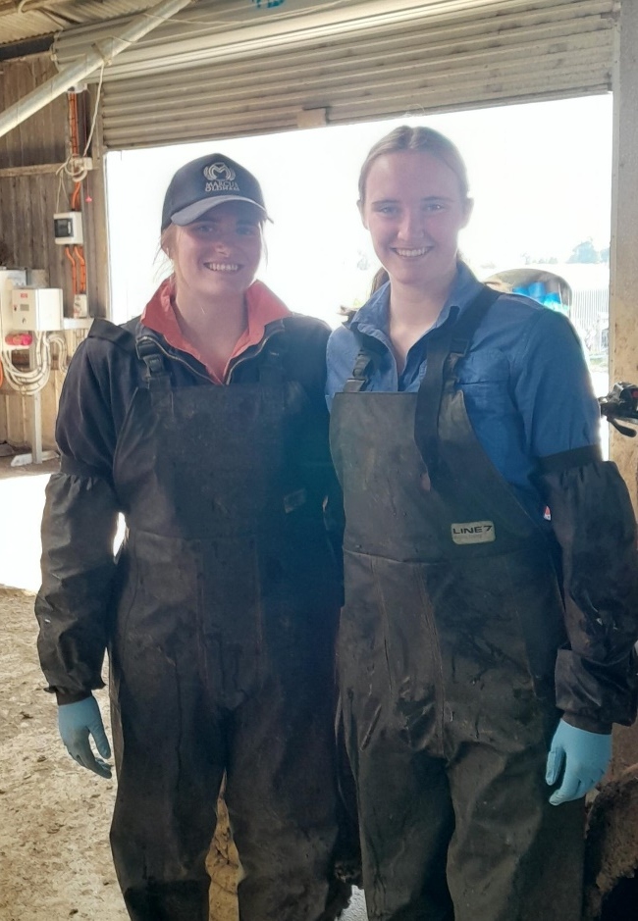
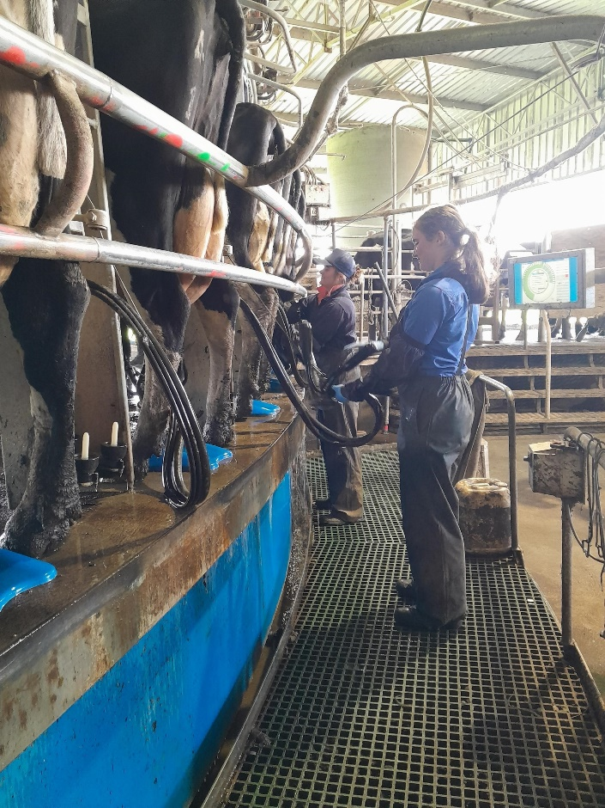
Meet Ella
Ella is a 17-year-old who has been working as a dairy farm hand and milker for the last couple of years.
Ella is currently in school and works casually after school and on weekends.
Ella was new to the dairy industry when she started and describes her experience on the farm as ‘rewarding and educational’.
She loves working with the cows and the team on the dairy. During school holidays she gets to help with calf rearing, animal health and tractor work.
Her experience as a casual farm hand and milker has made her realise that she wants to pursue a career in agriculture and intends to take on further study in the industry.

Slide 7
Questions to ask students
Are you interested in learning on the job?
Do you love the outdoors?
Are you interested in a career that is continually changing and advancing in technology?
Do you want to work in an industry that offers stability and opportunities for advancement?
Do you want to gain qualifications that will support a long-term career?
Are you interested in working with or providing care for animals?
7

Slide 8
NEXT STEPS
Ask your students
Share Information
View the Jobs Board
Register Interest
Keep you updated
Talk to students about career opportunities in the Agriculture industry
Provide information to students about careers in the dairy industry
Visit the Dairy Australia Jobs Board to see jobs currently available in dairy
If you have students interested in a career in dairy, register their interest
We can let you know about dairy job opportunities in your area
Contact Laura at Dairy NSW for more information
Career Advisors, Teachers, Students and Parents are welcome to contact Dairy NSW to get more information about currently jobs and future career opportunities in the dairy industry.
laura@dairynsw.com.au
0493452640
8

Slide 9
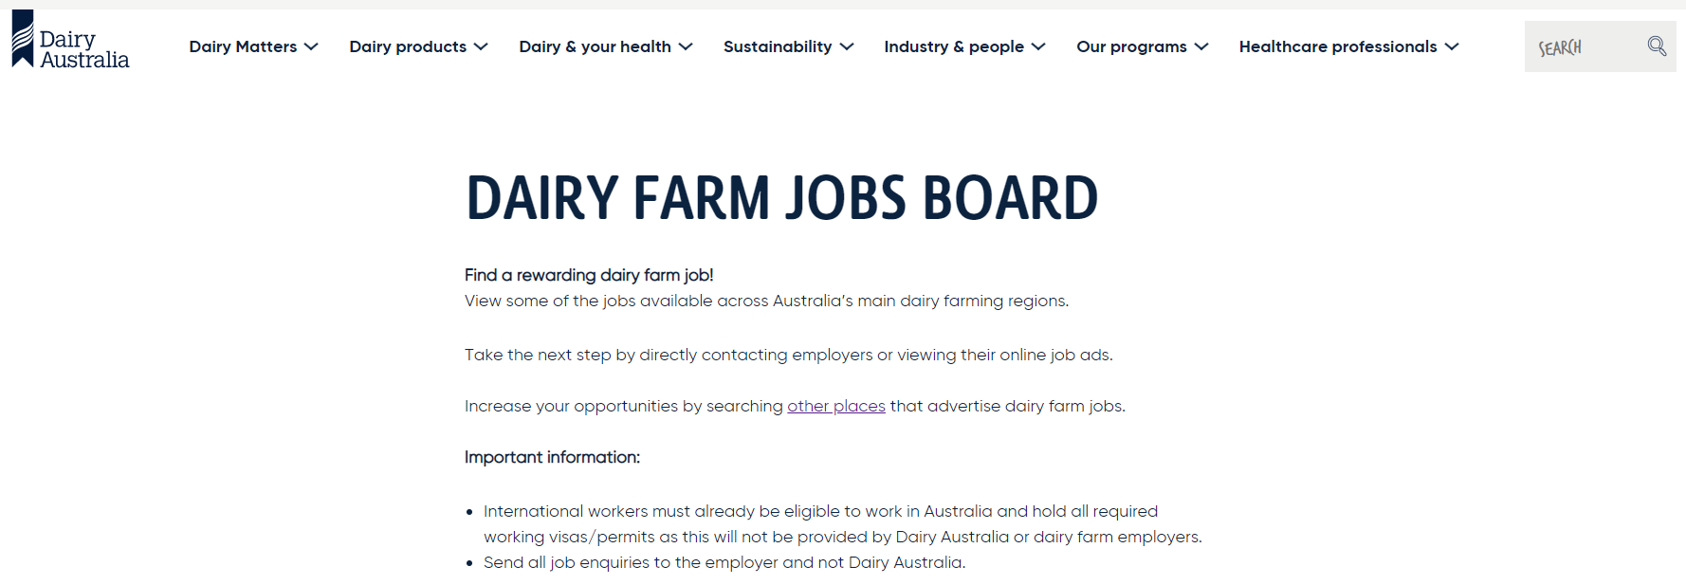
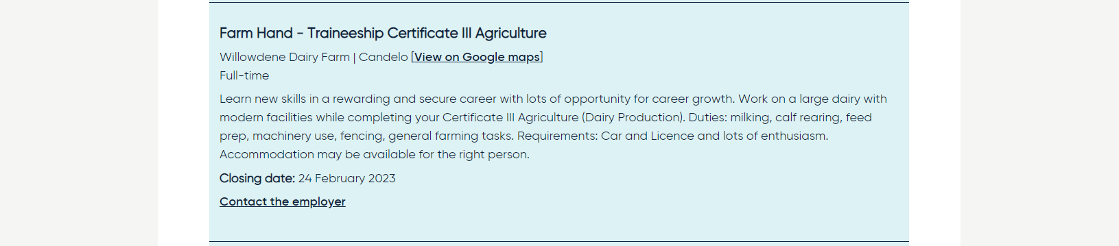
Dairy Jobs
9

Slide 10

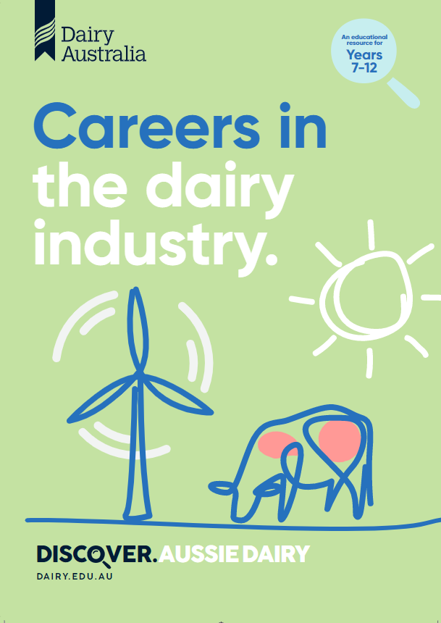
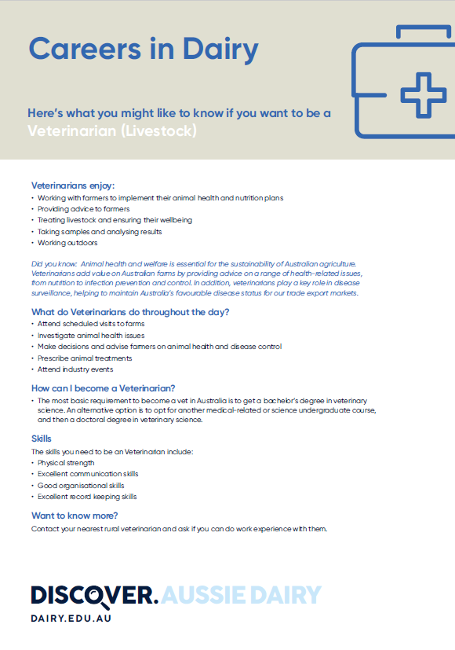
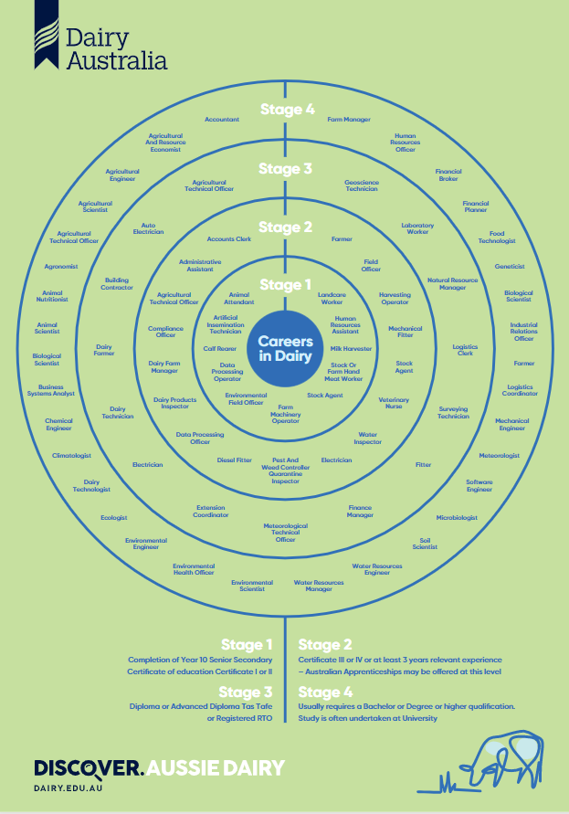
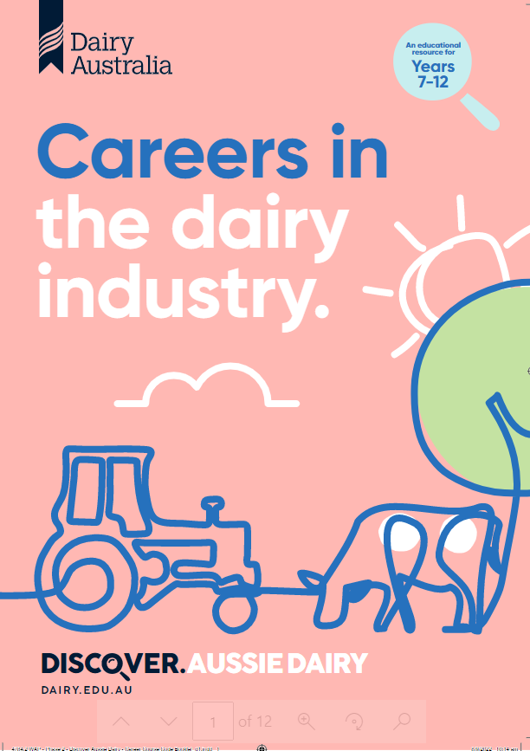
School Resources
Discover Dairy
www.dairy.edu.au
www.dairy.edu.au/dairy-careers/discover-dairy-careers-resources
Dairy Jobs Matter
www.dairy.com.au/dairy-matters/dairy-jobs-matter
Cows Create Careers
www.dairy.edu.au/dairy-careers/discover-a-careers-program-near-you
We are working to develop incursion projects with other stakeholders to engage school students in dairy farm experiences.

Slide 11
Questions?
11

