Slide 1
A.H.C
Agriculture
Horticulture
Conservation Land Management
Hands on & outdoors

Slide 2
Studying A.H.C
@ TAFE NSW Coffs harbour
education campus
Presented by
Tony Mcgowan

Slide 3
Study options @ school
School Based Apprentice/Traineeship - SBAT
Certificate II HORTICULTURE
Attend CHEC campus 1 day per week
Attend workplace 1 day per week
Employer sponsored

Slide 4
Study options @ school
School Based Apprentice/Traineeship - SBAT
Certificate III LANDSCAPE CONSTRUCTION*
Attend CHEC campus 1 day per week/2 YEARS
Attend workplace 1 day per week
Employer sponsored
*WILL ONLY COMPLETE STAGE 1 OVER THE 2 YEARS

Slide 5
Study options @ school
E-vet
Certificate II Horticulture - 4 units over 1 year
Counts towards ATAR (student choice)
Attend campus 1 day/week (usually Wednesday)
Work placement – 70 hours

Slide 6
Study options @ school
E-vet - Launchpad
Conservation Ecosystem Management - 2 units over 2 year
Counts towards ATAR (student choice)
Attend online class 3 hours per week day/week
Plus attend fieldtrips currently 8 days over the 2 years
Work placement – 70 hours
School based traineeships available

Slide 7
When I leave school? I am interested in……… Maintaining, developing, growing gardens designing garden SPACES Study horticulture certificate ii or iii

Slide 8
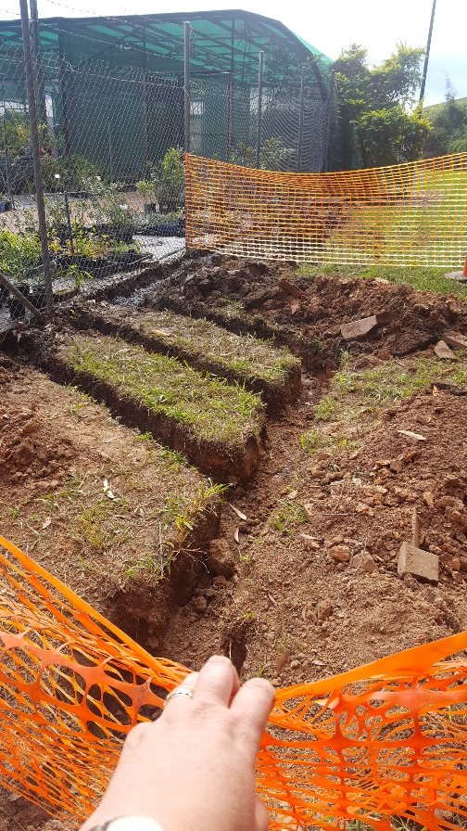
When I leave school? I am interested in……… building beautiful gardens designing garden spaces Study landscape construction certificate iii

Slide 9
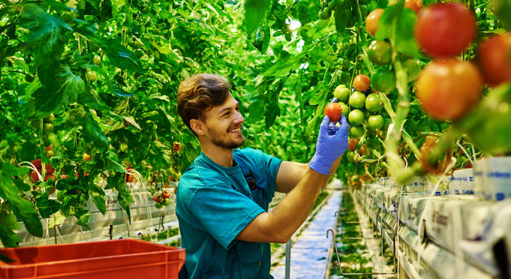
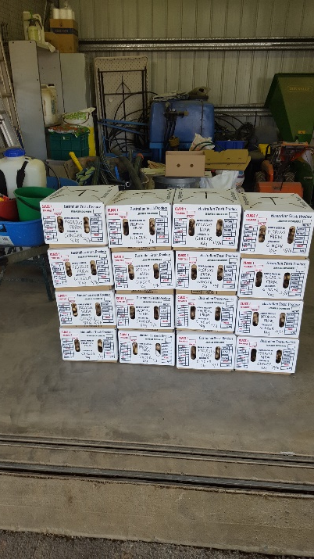
When I leave school? I am interested in……… growing food or flower crops organic food production Study production horticulture certificate iii

Slide 10
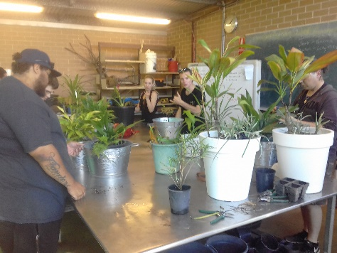
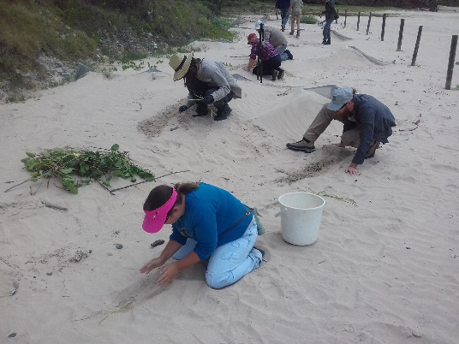
When I leave school? I am interested in……… caring for the land and fauna nurturing bush Study conservation ecosystem management certificate iii

Slide 11
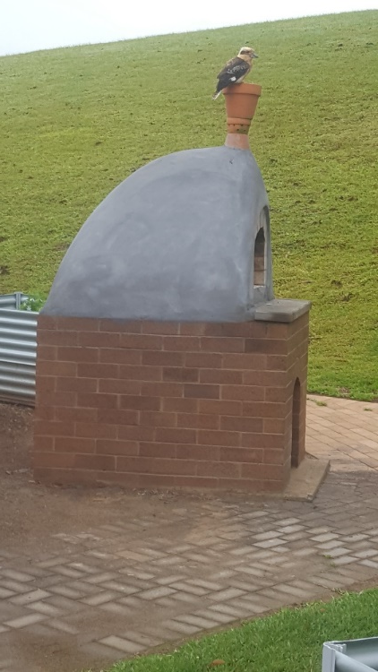
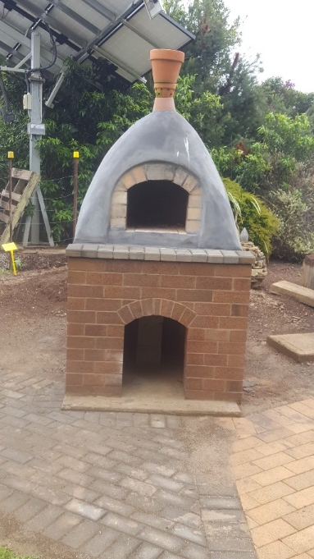
Student activities
CHEC pizza oven refurbishment unit construct landscape features using brick and block structure
After
Before/during

Slide 12
Student activities
Construct landscape features using concrete

Slide 13
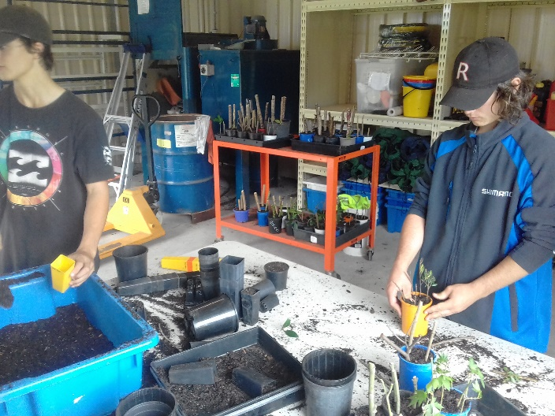
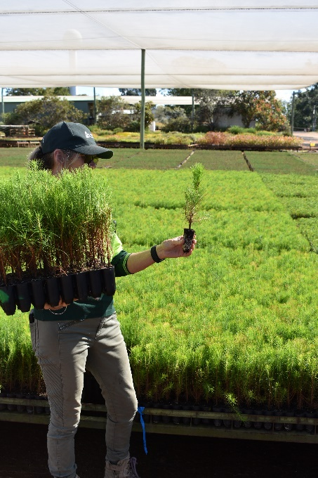
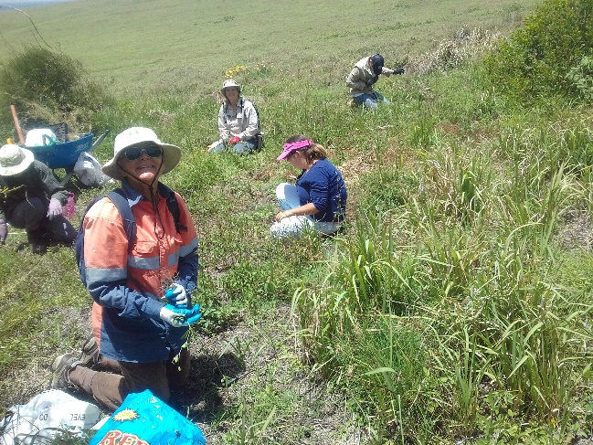
Student activities

Slide 14
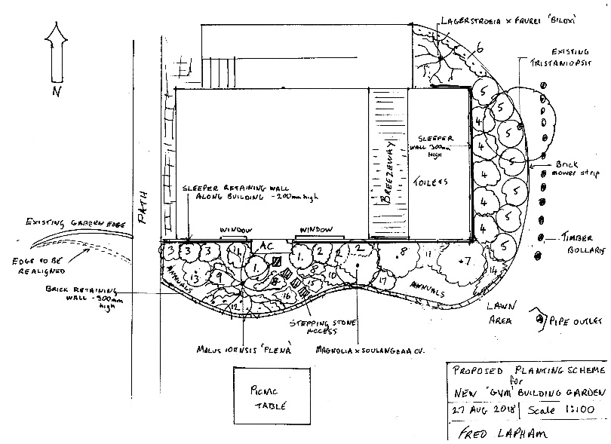
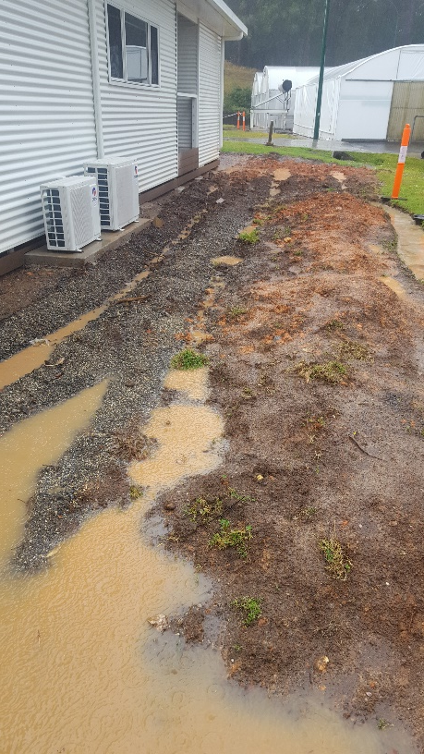
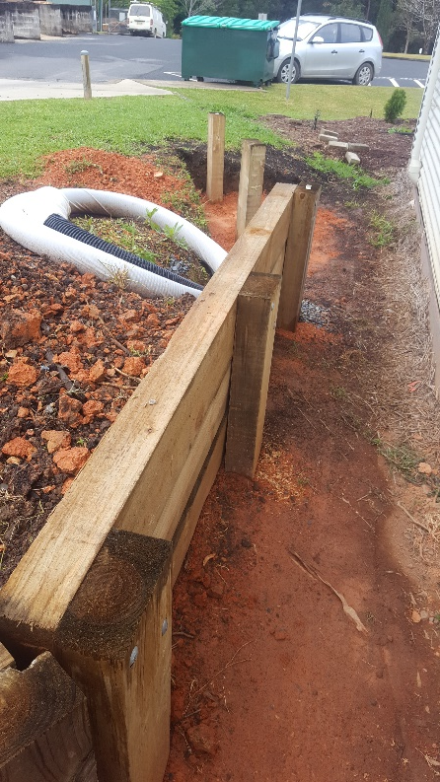
Student activities
A site and a plan

Slide 15
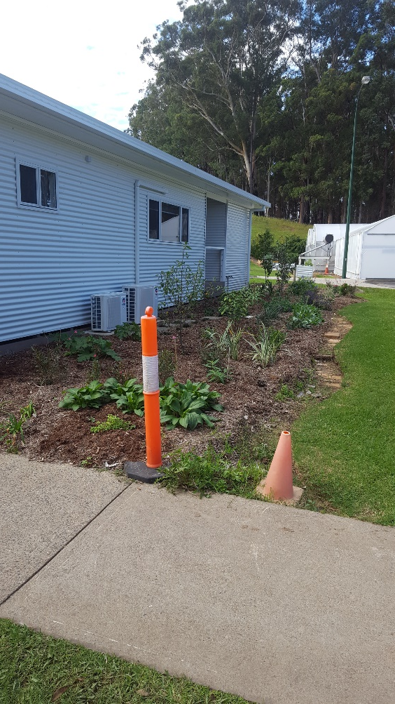
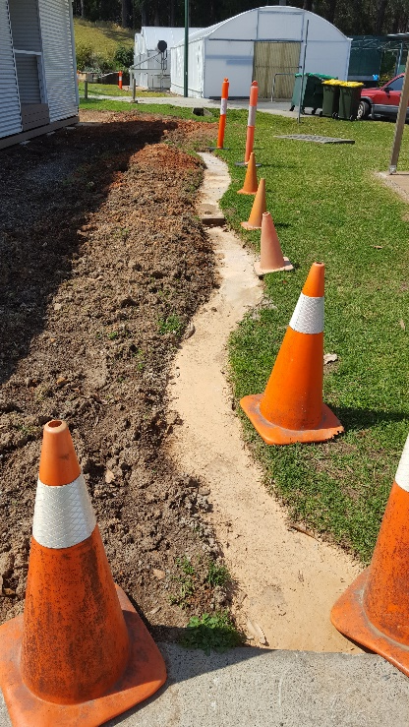
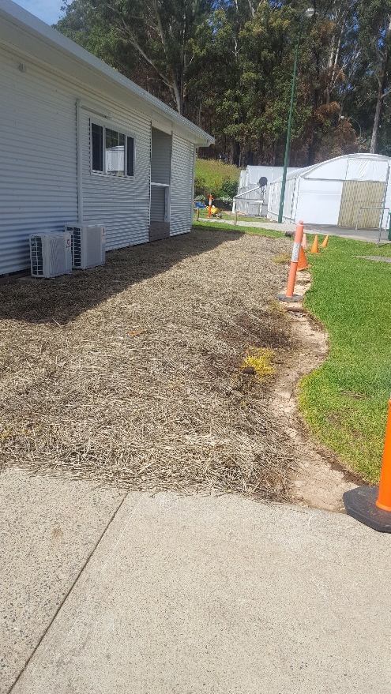
Student activities

Slide 16
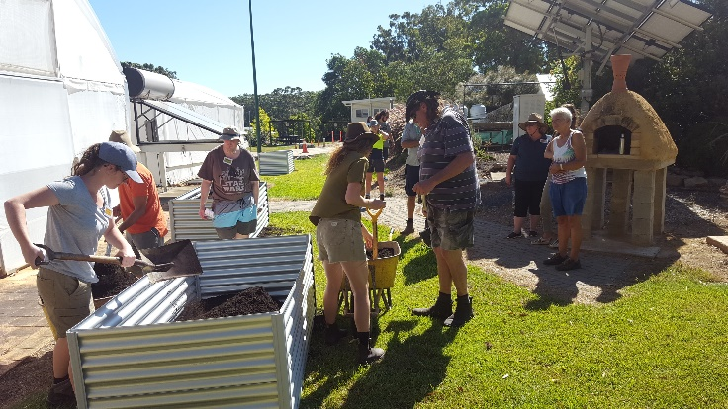
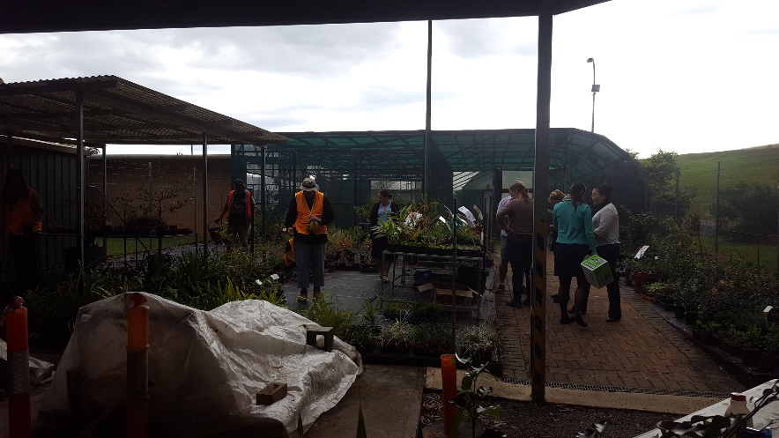
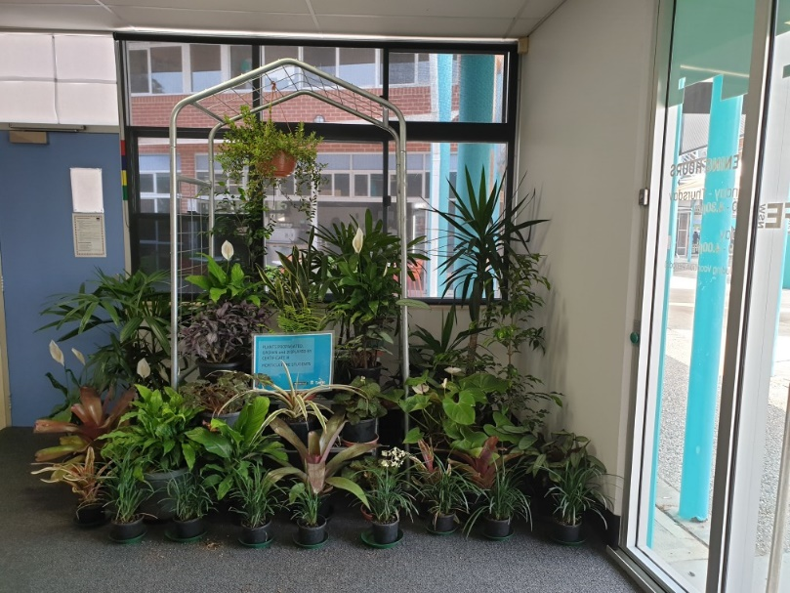
Student activities

Slide 17
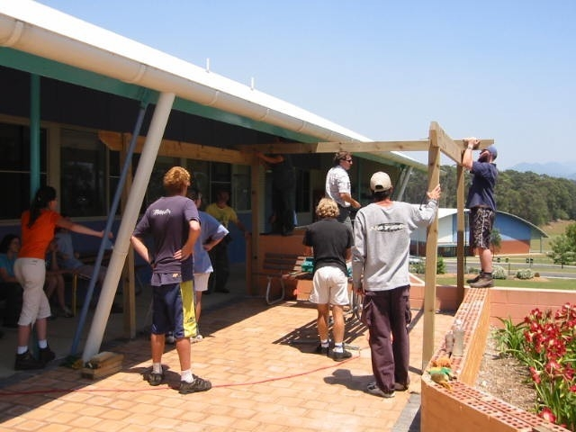
Student Practical Work

Slide 18
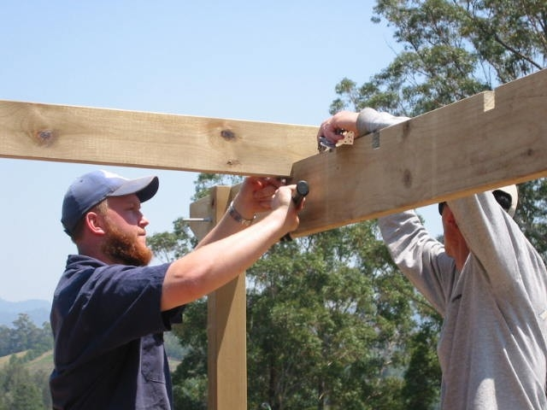
Pergola Construction

Slide 19
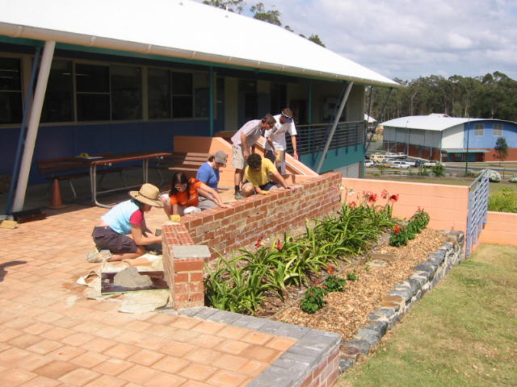
Horticulture - Landscape

Slide 20
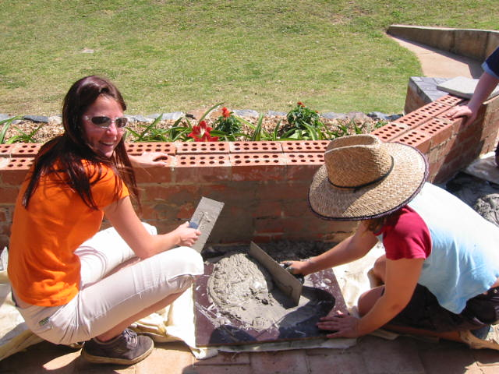
Horticulture - Landscape

Slide 21
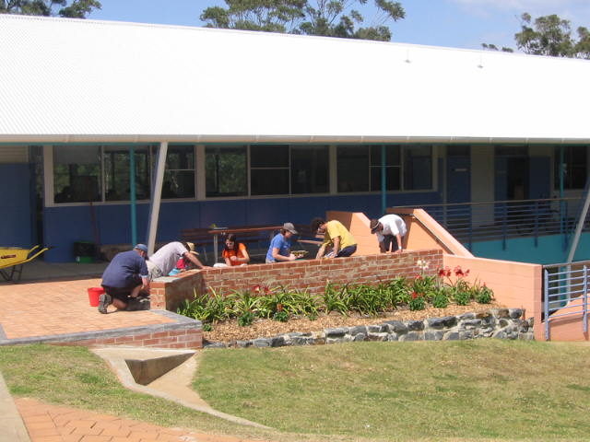
Masonary

Slide 22
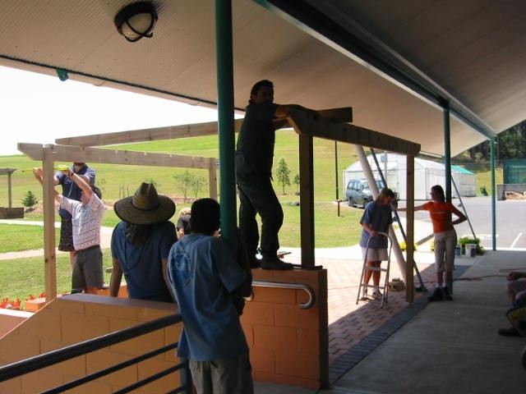
Paving

Slide 23
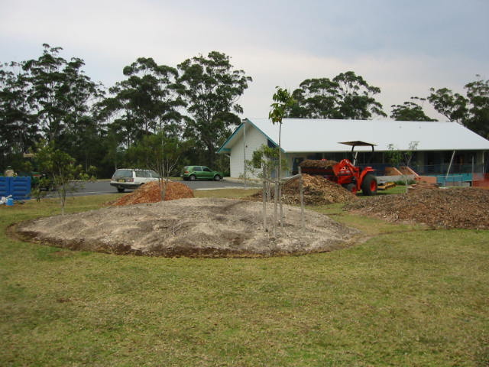
Garden bed construction

Slide 24
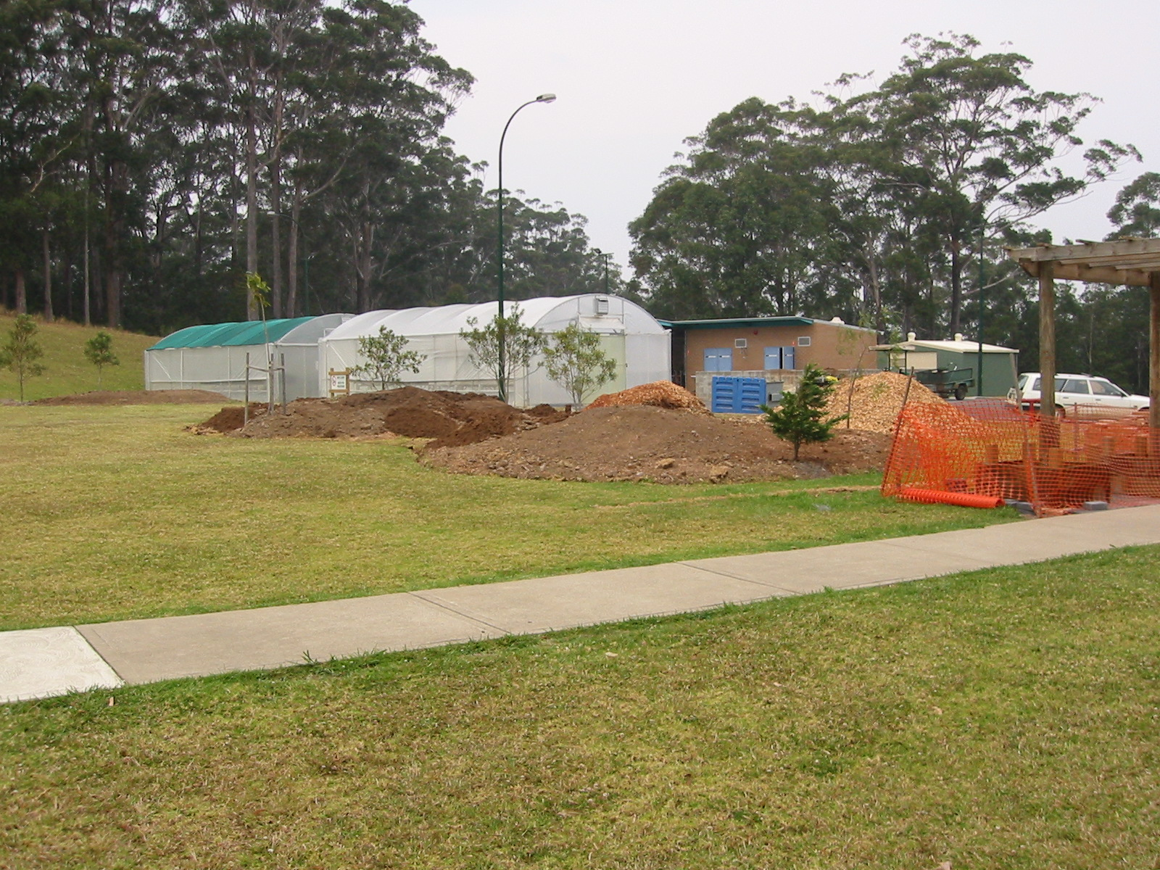
Garden bed construction

Slide 25
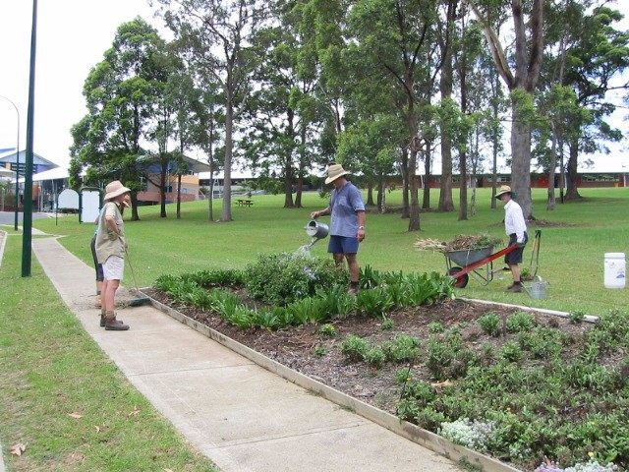
Garden Maintenance

Slide 26
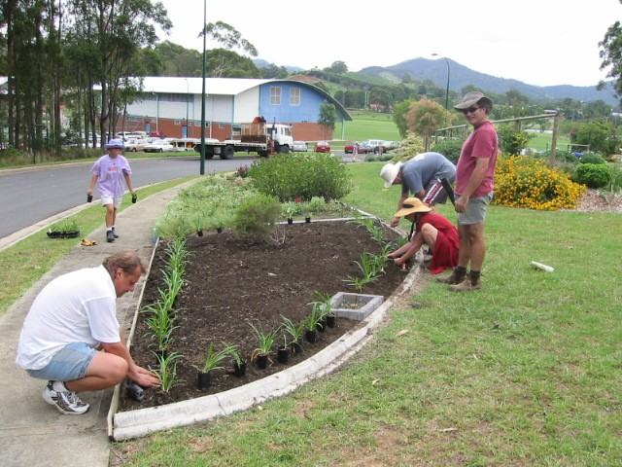
Planting Skills

Slide 27
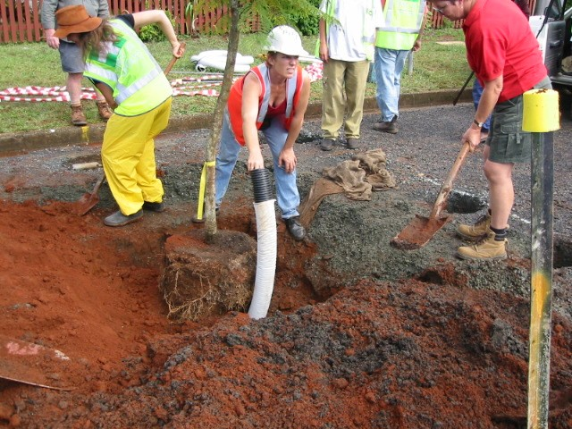
Street planting

Slide 28
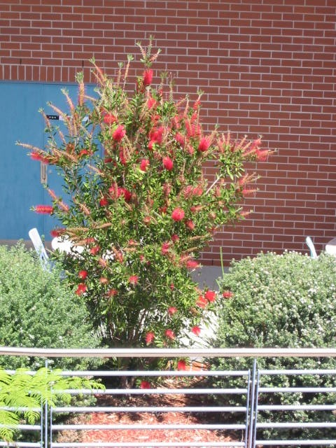
Plant recognition

Slide 29
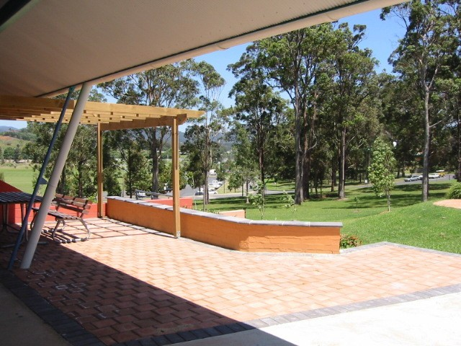
Paving

Slide 30
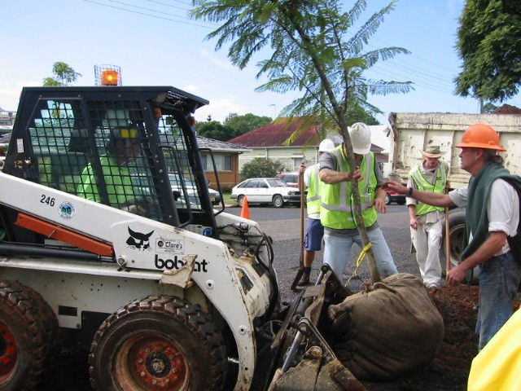
Planting

Slide 31
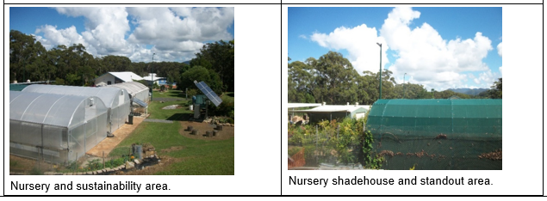
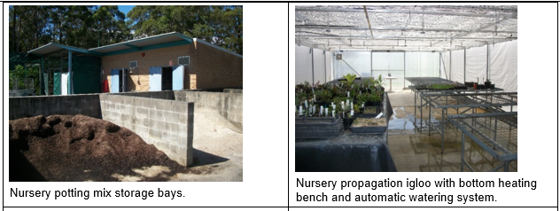
A.h.c. Facilities
Nursery

Slide 32
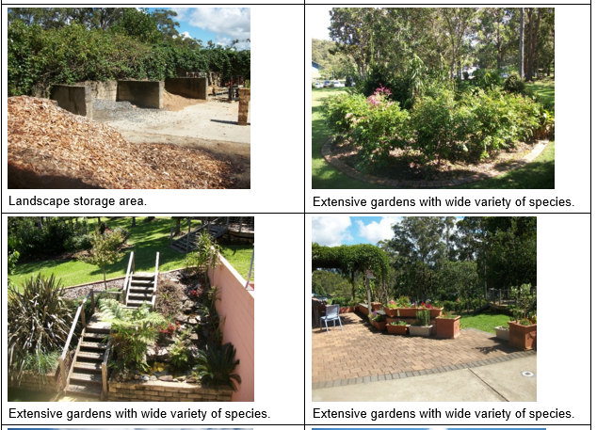
A.h.c. Facilities

Slide 33
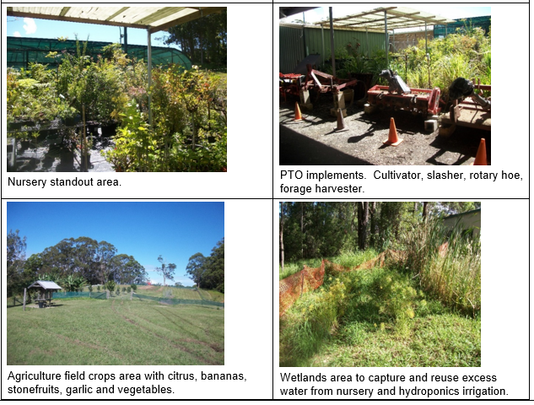
A.h.c. Facilities

Slide 34
My students aren’t sure what to study
Encourage/support them to join a Youth engagement Strategy (YES program)
Usually offered in term 2 and term 4 each year
1 day per week for 6-8 weeks, free.
Students try activities related to area of interest such as horticulture , landscape , food and crop growing or a combination of them all

Slide 35
What will I study @ TAFe?
Production Horticulture units
Chemical handling
Post harvest crop operations & Quality Assurance (QA)
Pests, plants & diseases
Working effectively in the industry & WHS
Planting horticultural crops
Observing weather
Soils and growing media
Treating weeds
Biosecurity

Slide 36
Course we offer – full qualifications*
Certificate II conservation Ecosystem Mangement
Certificate II HORTICULTURE
Certificate III HORTICULTURE
Certificate III Production Horticulture
Certificate III Landscape Construction
Certificate III Parks and Gardens
Certificate III Conservation Land Management
* Minimum required student numbers achieved

Slide 37
Where do our students go once they complete a qualification

Slide 38
Employment opportunities
Self employment – landscape, garden maintenance
Local Government
Landscape contractors
Nurseries
Bush Regeneration contractors
Blueberry and other food producers

Slide 39
Thanks for listening
Any questions
To contact us call Agriculture,
Horticulture, Conservation Land
Management section @ Coffs Harbour
Education Campus (CHEC) on 66593139

Slide 40
Questions

