Slide 1

LEARNING JOURNAL

Slide 2
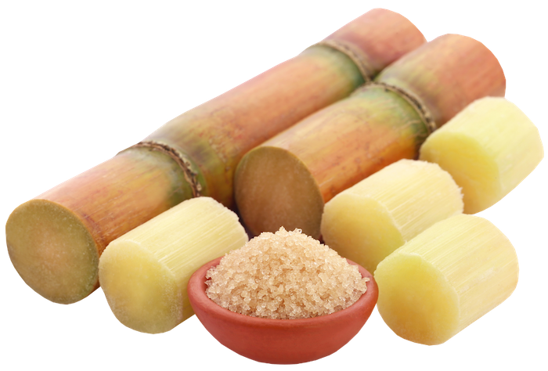
This Journal belongs to:
[insert name]

Slide 3
LESSON 1
Activity 1A
Answer the following question. Show your working.
1. If the average cane field is 1,000,000 m2, approximately how much raw sugar could be grown based on the information above?
Activity 1B
Answer these questions about the video: “Sugarcane - Paddock to Plate”.
Where is sugar made in the plant?
What do growers plant to grow sugarcane?
What 3 things does it need to grow?
What is 1 stool of sugarcane?
When the cane is harvested, what is it cut into?

Slide 4
6. What months are harvest time?
7. Why do you need to get harvested cane to the mill as quickly as possible?
8. Where do the billets go once they've been dropped at the receiving station?
9. What is used to fuel the mills boiler furnaces?
10. How are the sugar crystals separated from the molasses?
11. During refining, what is added to remove impurities?

Slide 5
LESSON 2
Activity 2A
Using paper, make an actual height illustration of a fully grown sugarcane stool.
Stick it on your wall and take a full length photo of you standing next to it to illustrate the difference in heights.
Include the photos here:

Slide 6
Activity 2B
1. Using this website, https://railwayvideos.club/cane-trains/ complete the following tasks:
Which train do you like the design of and why?
Using a map of Queensland, mark where each of the towns and/or mills mentioned on the page are located. Make sure you label them clearly.

Slide 7
LESSON 3
Activity 3A
Find 1 recipe that you would like to try or have eaten that contains molasses.
Write out the recipe here.

Slide 8
Activity 3B
Visit a grocery store or complete this task online.
Find & photograph/collect images of as many molasses brands as possible.
Add them here:

Slide 9
Activity 3C
Answer the following questions:
What is the history of the word: bagasse?
What is the equivalent energy value of 1 ton of dry bagasse when used as fuel?
Roughly what is the percentage of cellulose in bagasse?
What other products can be made from bagasse?
How are bagasse food packaging products made?

Slide 10
LESSON 4
Activity 4A
1. Are the following sugar myths true or false? Why?
2. You should start at this link: sugar.org.au
Natural sweeteners are much healthier for you than sugar.
Sugar is as addictive as drugs.
Sugar causes cavities in your teeth
We need to eliminate sugar from our diet.

Slide 11
Activity 4B
Using the link below as a guide, collect photos of popular types of sugars from around the world. Try to find sugar varieties that you’re not familiar with.
https://www.thekitchn.com/a-complete-visual-guide-to-sugar-ingredient-intelligence-213715
Add the information you find into a table below.
Include the sugar’s name, photo, where it’s popular and a short description.
Name | Photo | Where? | Description

Slide 12
LESSON 5
Activity 5A
1. Watch the following videos then answer the following questions.
https://www.abc.net.au/gardening/factsheets/mulch/9430092
Making sugarcane mulch: https://youtu.be/am1M0Ou0TO8
2. Add your answers to your Learning Journal.
What is sugarcane mulch?
How is it made?
How much waste does it save?
What value to the industry?
How can we use it around our homes?

Slide 13
Activity 5B
1. Watch this video and solve the following problems: Sugarcane Mulch in Your Garden - How to Use it and Application Rates
2. Based on the video, work out how many bags of sugarcane mulch you would need to buy to cover the following gardens.
A square garden with one side of 33m
A circular garden with a radius of 13m
A rectangular garden with length of 15m and a width of 12m

Slide 14
Activity 5C
Watch the following experiment.
Try the experiment yourself and see if your results match those in the video. Maybe try using different coloured balloons.
Take photos of the different stages and record your results below.
When you’ve finished your experiment, make sure you dispose of the liquid in your bottles carefully.
Warning: Do not drink or taste it

Slide 15
Activity 5D
Using PowerPoint or Slides, reproduce the diagram above using images from magazines, photos or from online. Include a short description of each step of the process.
This link will help you: https://www.qld.gov.au/transport/safety/road-safety/e10-fuel/environment
Add below.

Slide 16
Activity 5E
Using the Petrol Spy app (https://petrolspy.com.au), choose a city near you and compare the prices of E10, 94 and 98 petrol at ten different petrol stations across all parts of the city.
Save the data in a spreadsheet.
Graph your resulting data to group the E10 data, 94 data, 98 data together.
Which fuel was the cheapest? Buy how much on average?
Add your graph below.

Slide 17
Activity 5F
1. Read the article “Bush businesses take up call to boost hand sanitiser supplies” about how a local business was using local sugarcane to make sanitiser during the early days of the COVID pandemic.
PDF
2. Answer the following questions.
Who are Husk Distillers and where are they based?
What did they use as a base for the production of liquid sanitiser?
Why did they decide to produce sanitiser instead of their usual products?
What fragrance did they use?
What is the name of the company founder?
Aside from the production of sanitiser for the community, what benefits were there for the business?

Slide 18
Activity 5G
1. Using a real shop or online, list the ingredients to five different brands of hand sanitiser.
2. If your online shop doesn’t show the ingredients, do a Google search for the “brand name label” and read the image.
3. (https://shop.coles.com.au/a/national/product/dettol-instant-hand-sanitiser-pump)
How many contain ethyl alcohols?
What do the sanitisers have in common?
What is different about each?

Slide 19
LESSON 6
Activity 6A
1. Watch these two videos and take notes about the farming methods, machines used, and what has changed / improved over time.
Watch Video 1: https://youtu.be/KqX4K1E8NOM - Old footage
Watch Video 2: https://youtu.be/cIbRdZ9x7Q4 - Cropping technology over time
2. Write a brief report that discusses the differences between early farming machinery and the technology that growers have access to now. You must cover these topics: efficiency, results, time savings, and improved crop growth.

Slide 20
Activity 6B
1. Watch the following three videos.
Watch https://youtu.be/FLh4wWw76kc - Soil moisture probes
Watch https://youtu.be/Xtux9OqUmP8 - GPS controlled traffic systems
Watch https://youtu.be/6qBimHNDiMs - Drone use
2. In the three videos, we saw some technology that growers are using to manage, improve & grow better cane. Imagine you had a complete robotics and AI lab available to you and all of its scientists.
Design the ultimate “robot cane grower” that could be used by growers within the next five years. Here is a list of sensors that you would have access to https://en.wikipedia.org/wiki/List_of_sensors
Draw a technical diagram of your robot explaining all its features.
List and explain what your robot does, how it does it and how that will help farmers become more efficient & produce a more sustainable and high yield crop. You can present your information as a:
        - detailed report (min 500 words),
        - or a multimedia presentation,
        - or animation
3. Add your information below & on a new page.

Slide 21
Extension Activity
If you have access to 3D CAD and 3D printers, create a three-dimensional model of your “robot cane farmer”. Model it using 3D CAD then slice it to send to your 3D printer.

Slide 22
End of Unit - Reflection
Congratulations on completing the lessons on horticulture in Australia. Hopefully you are more aware now of the very diverse industry that impacts so many people around Australia and the world, and can see how it is a constantly evolving industry looking to make the processes more efficient to benefit the environment, the people and the economy.
Please place a mark on the scale below to answer the questions.
How much did I know about protected cropping before this unit?
1________________________10
How much do I understand now?
1________________________10
How important will protected cropping be to food security in the future?
1________________________10
Should this be protected cropping or protected horticulture?
1________________________10

