Slide 1
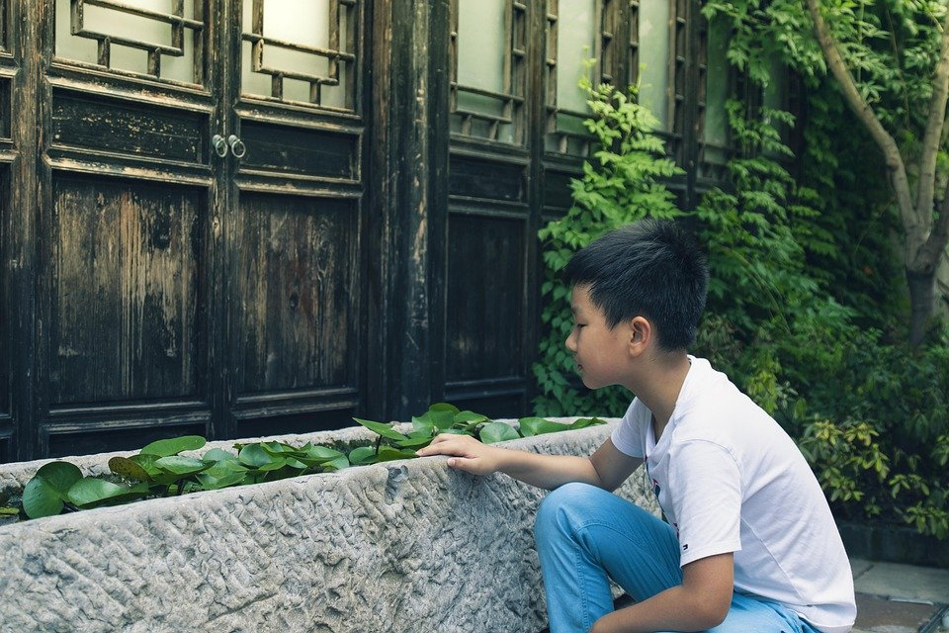
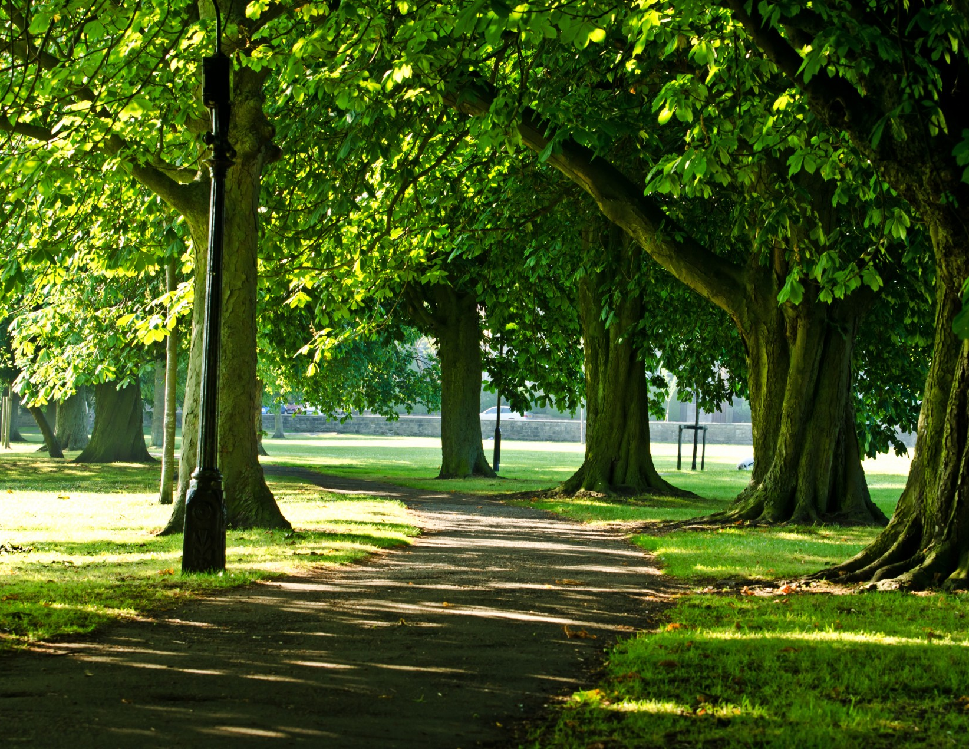
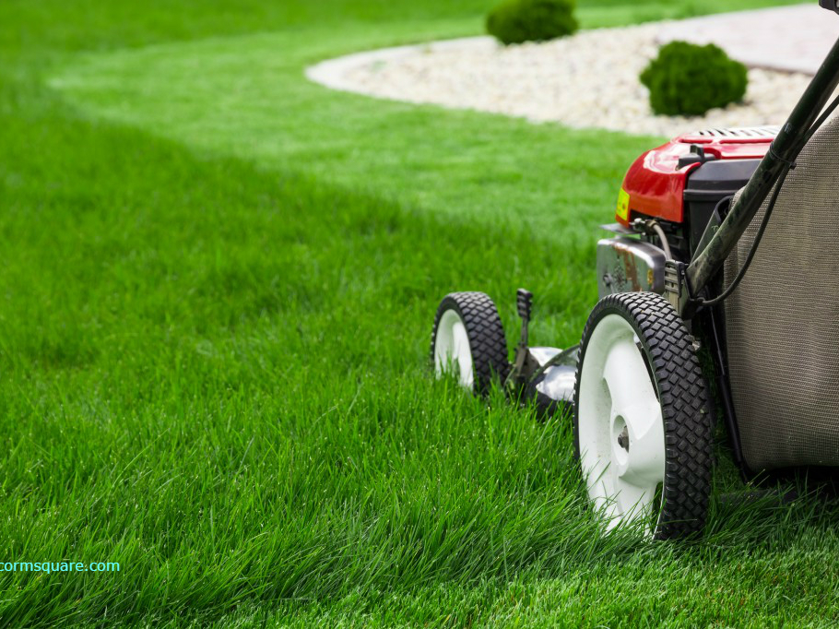
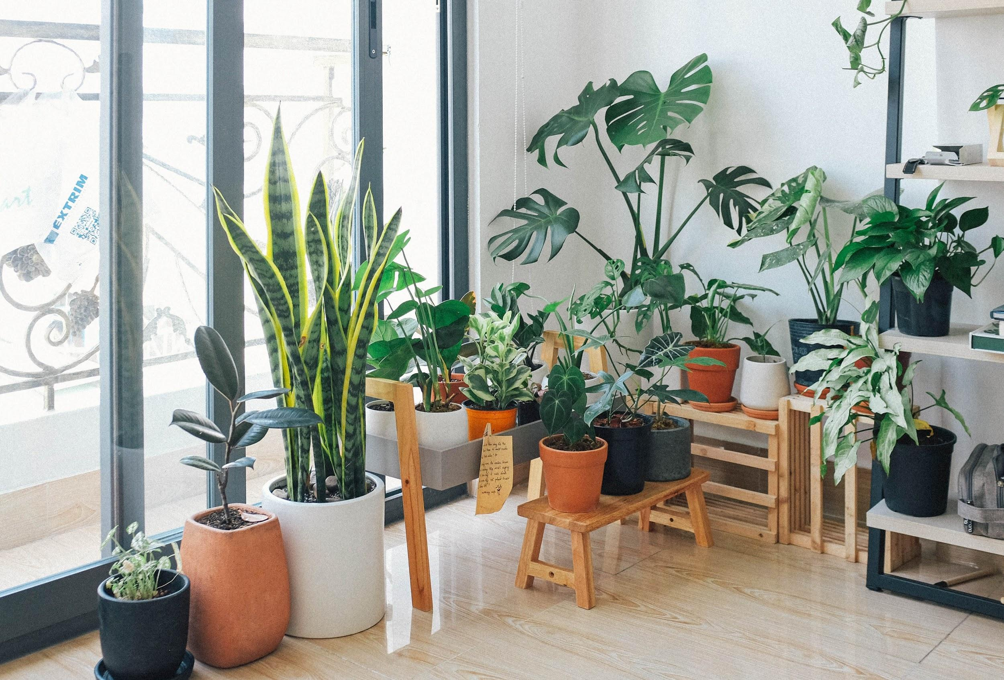
Learning
Journal
GREEN YOUR SCENE
Stage 4

Slide 2
This Journal belongs to:
[insert name]

Slide 3
Lesson 1
Lesson 1: How can plants improve our health?
Respond to t
Lesson 1 research task
What are some things you could do to help keep your playground cool in summer?
Research studies have worked out that there are two big benefits to having plants in our lives. What are they?
List your plants and grasses here.
Go outside and into a garden either at home, in a park or at school. How does being outside make you feel? List your feelings here.
1.
2.
3.
Do you think that being outside and around plants is positive for your mental health? Why?
Draw your map in this space
Draw a picture to help to demonstrate how plants can improve air quality

Slide 4
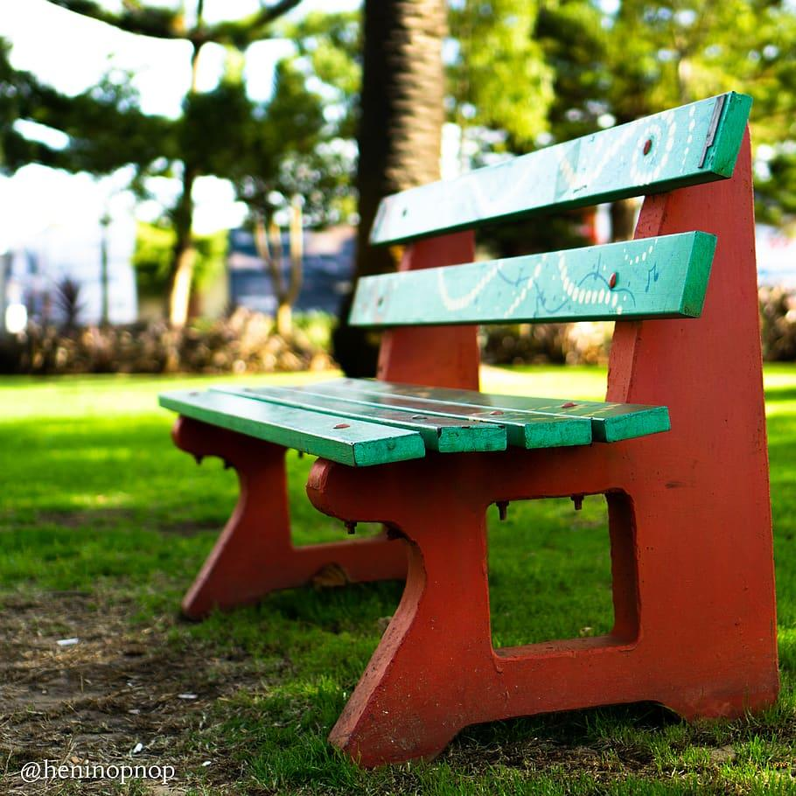

Lesson 2: Community Green Spaces
Park Profile
Use Google Maps to identify the community green spaces within your area.
You may find examples of parks, reserves, gardens, school grounds, and more.
How many in your list have you visited?
Lesson 2
Choose a park in your local area (preferably one you have visited).
Complete a profile of this park below:
Name of park
What are the main activities people engage in at this park?
Who are the main users of this park?
What facilities does this park offer?
If you could change/add anything to this park, what would it be, and why?
Community green spaces in my area

Slide 5
Lesson 3: Backyard Living
Greening your Scene at home
Backyard, balcony and rooftop garden design.
Think about your house. How much space do you have? What would your dream garden have in it? Fill out the table below to help you to work out what you need to make your dream garden become a reality!
Growing fruit and vegetables can be done in large and small garden spaces and are a fantastic addition to any backyard or balcony.
Use the Yearly Seasonal Gardening Australia Vegetable Garden by Temperate (Regional) Zone link to help you complete the table below.
Lesson 3
What I want | Details
Family essentials e.g. clothes line, shed
Fruit and Vegetables
Flowering plants, trees, shrubs and turf | Use this link to help with ideas Plant Finder - Gardening Australia
Extras and ‘dream’ elements
Fruit and vegetables I love to eat
e.g. potatoes
Do they grow where I live?
e.g. Yes! They grow where I live all year round.

Slide 6
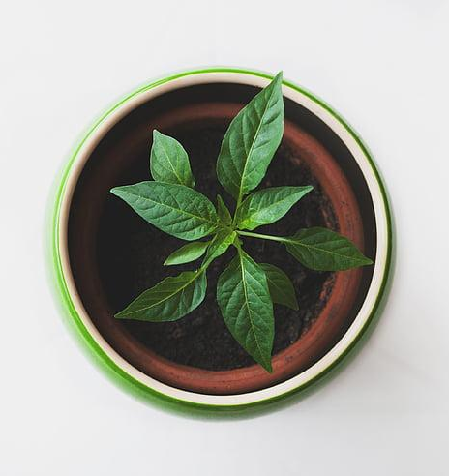
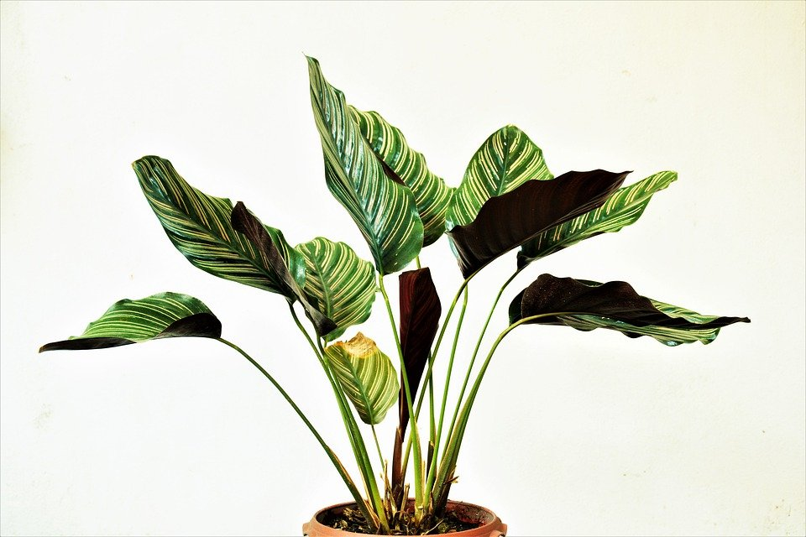

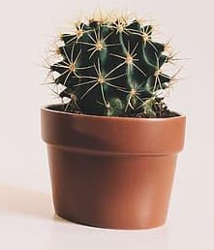
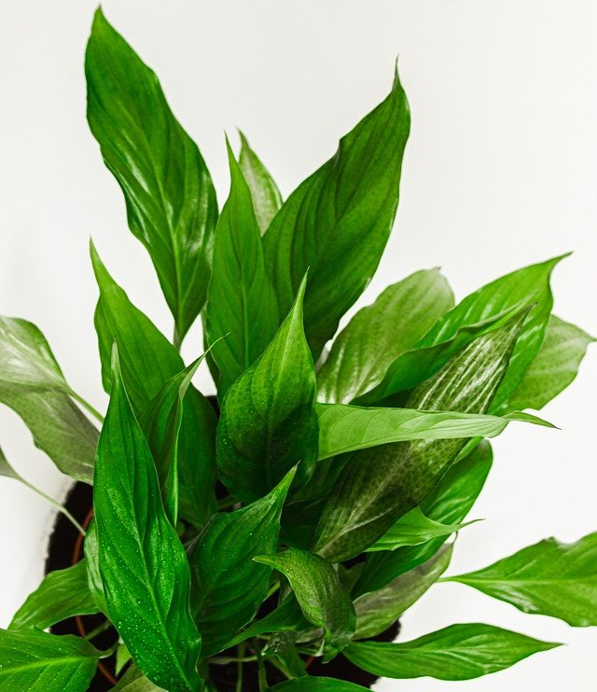
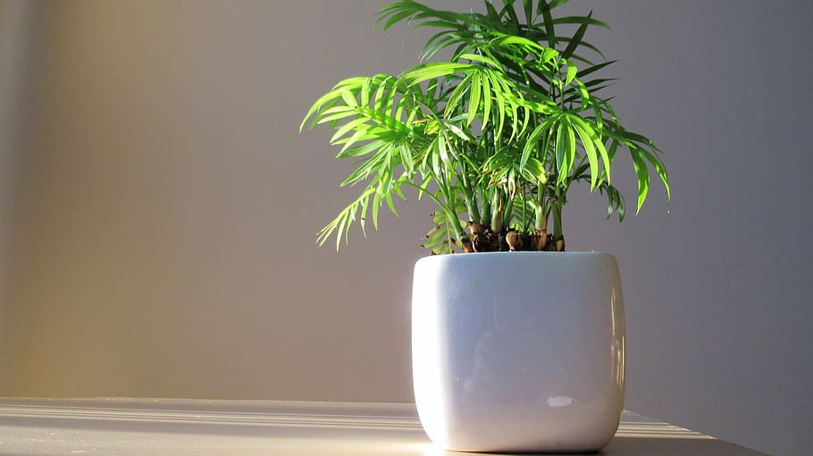
Lesson 4: Bringing the garden indoors
Which plants from the Plant-Life Balance app did you include in your design?
Design task:
Green Your Scene… indoors!
Follow the design task instructions in Lesson 4 to use the Plant-Life Balance app. Insert the image of your new, green indoor space below:
Lesson 4
List the reasons that you think including plants in this indoor space might be of benefit to its users:
Where is your indoor space located? What is it generally used for?

Slide 7
Lesson 5: Garden Design- It’s time to Green your Scene!
 | Description | Why?
Materials List the materials you would need for your design. Why have your chosen these materials? What will they be used for?
Plants List the plants you would include in your garden. Why have your chosen these plants?
Extras Are there any original features in the space that should remain or additional features you would like to add? Why?
Design Brief
Using the table below plan your design. Give details about each of the categories and why you have made these choices.
 | Description | Why?
Site Describe the site you have chosen for your design. Why have your chosen this site?
Users Who are the main users of the site you have chosen? Why do they use this space?
Needs of users What requirements do the users have for this space? Why are these requirements important?
5

