Slide 1
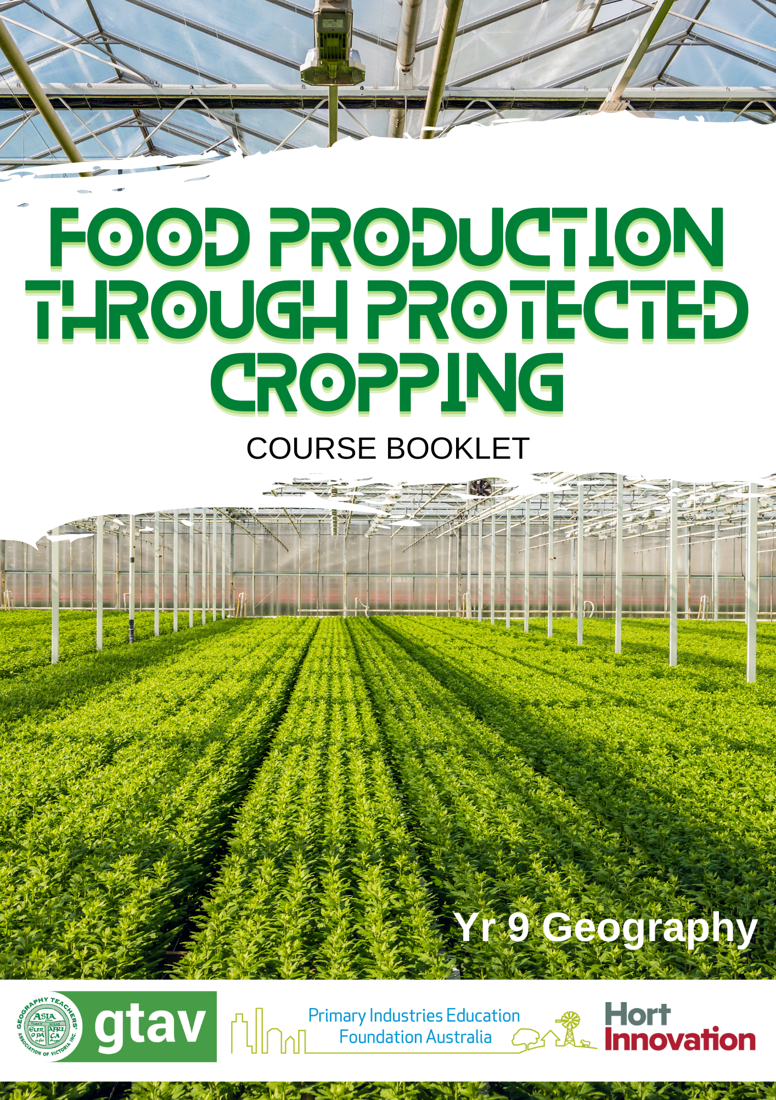

Slide 2
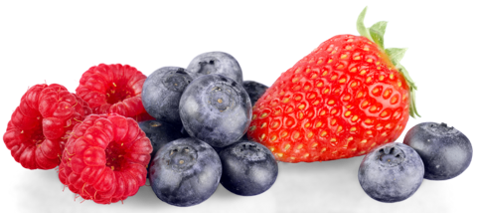
This Journal belongs to:
[insert name]

Slide 3
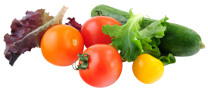
LESSON 1
Activity 1A
Describe all the things you can see along the street to your right
(“virtually walk” along the road).
Landscape:
Buildings:
Vegetation:
Number of people:
Equipment:

Slide 4

2) Answer these questions:
Using the scale on the map, how large do you think the greenhouses are?
b) Approximately how far is the greenhouse from Adelaide?
What would be some of the positives and negatives of having a
greenhouse so far away from a city?
Positives | Negatives
3) Read the article:
a)What makes Australia an ideal location for high tech greenhouses?
b)Where would a lot of the Australian produce be sold?
c)What challenges would face farmers in this style of industry?

Slide 5
Activity 1B
1) Match up the types of farming with location and produce. Use the clues to help you fill in the table from the words in the word box.
Type of Food Production | Where | Produce | Description
Horticulture | Australia
Shifting Cultivation |  | Guava
Pastoral Nomadism
Livestock Ranching |  |  | Cattle ranchers raise cattle over large areas of land. They are based in one location, but the animals will move around within the large space.
Monoculture |  | Palms

Slide 6
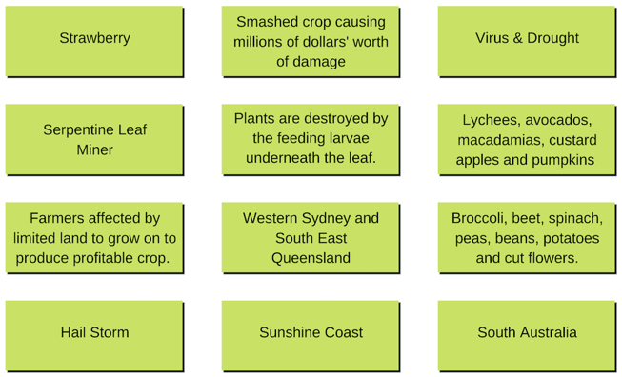
Activity 1C
Match up 4 boxes to complete stories of 3 challenges facing different Australia farmers .

Slide 7
Activity 1D
Complete the table to show your answers.
The Problem – Summarise | Suggested Solution
Answer the following questions:
Why might some farmers with a frost problem not use the helicopter method? What issues are there that might put off farmers? Try and list at least 3.
To what extent would the French method of a solar power shading covers be considered sustainable?
One article refers to wildlife friendly netting. What makes netting wildlife friendly and how do you test to see that it is?

Slide 8
Extension Activity
Read through the word list below. Work out what the words mean. In your own words, write your definitions into the area below.
Horticulture:
Protected Cropping:
Shifting Cultivation:
Livestock Ranching:
Pastoral Nomadism:
Monoculture:
Agri Tourism:

Slide 9
LESSON 2
Activity 2A
Answer the following questions:
1. Who eats blueberries?
2. What did the plant and farm look like?
3. What challenges do you think he was talking about?
4. Where is his blueberry farm?
Activity 2B
Mark on the blank Australian map where these are located using either an atlas or an online map. Make sure the BOLTSS mapping format is implemented (Border, Orientation, Legend, Title, Scale, Source).
Locations:
Atherton, Queensland – April - September
Bundaberg/Munduberra Queensland - May - October
Coffs Harbour/Northern Rivers New South Wales – June - February
Tumbarumba New South Wales – January - March
Victoria – December - February
Tasmania – January - April
Margaret River, Western Australia – November - March
Geraldton West, Western Australia – June - November
SE South Australia – December – March

Slide 10
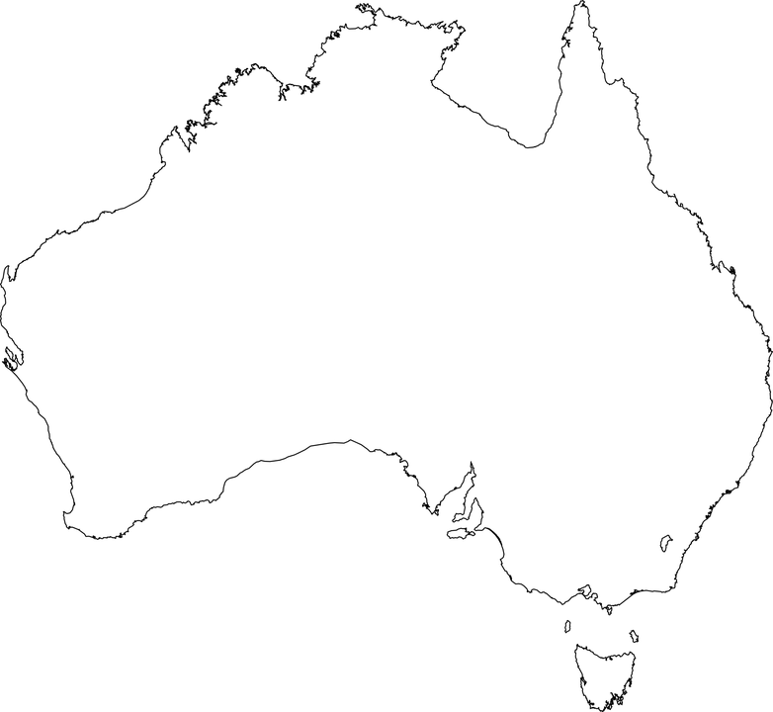
Blank Map to Use:
Having marked these on the map you can see that blueberries have a big spread across the country.
1. Suggest a reason why they are grown at different months of the year at different locations?
2. Why might the spread of blueberry harvest be good for the consumers of blueberries in Australia? Think about cost, availability and carbon footprint.

Slide 11
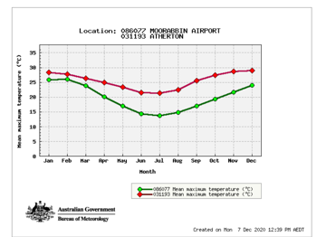
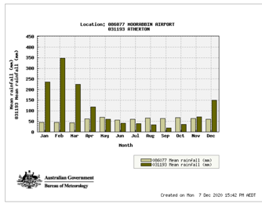
Activity 2C
Look at the map of locations you have created then use the link to the Bureau of Meteorology to complete the table below.
List all the types of climates that Blueberries are grown in.
To what extent is location of blueberry farms and climate spatially associated?
What other factors would be important for a location of a Blueberry farm?
2. Look at the two graphs below comparing Moorabbin Airport, Victoria and Atherton, Queensland climate data, (http://www.bom.gov.au/climate/data/). Use this data to answer the following question.
Based on Qn 2B, what are the best temperatures and amounts of rainfall for blueberries to grow?

Slide 12
Activity 2D
1. Using the table showing the values of blueberry production in Australia, create a bar graph to show the growth of the industry. Year on the X axis and Value on the Y axis.
Growing Year (Financial Year) | 2011/12 | 2012/13 | 2013/14 | 2014/15 | 2015/16 | 2016/17 | 2017/18
Local Value of Production ($Million) | 50 | 95 | 120 | 145 | 148 | 148 | 244
1. Describe the change in value of blueberry production referring to the graph created.
What is the overall pattern – change in value $
In what years is there most growth or loss?
2. Why might the value and production rates change from year to year?

Slide 13
Activity 2E
1. Watch this video and summarise the challenges faced with the growth of blueberries and the solutions to these problems
Challenges
Solutions
2. Using the links, read the article and watch the videos within it to outline the challenges faced and the solution to this problem in both Australia and America to deal with pests humanely and efficiently.
Challenges
Solutions

Slide 14
3. Netting is often used to keep birds away from the blueberries. What would be some advantages and disadvantages of this compared to the method outlined in the previous question?
4. Ever wondered how blueberries are harvested? As blueberries are grown on a bush and are easily bruised, there are a range of different ways that farmers can pick them. Research how manual vs machine picking differs and fill in the table below to list the positive and negative aspects of each.
Manual Harvesting (Hand) | Machine Harvesting (Automated)
Pros Cons | Pros Cons

Slide 15
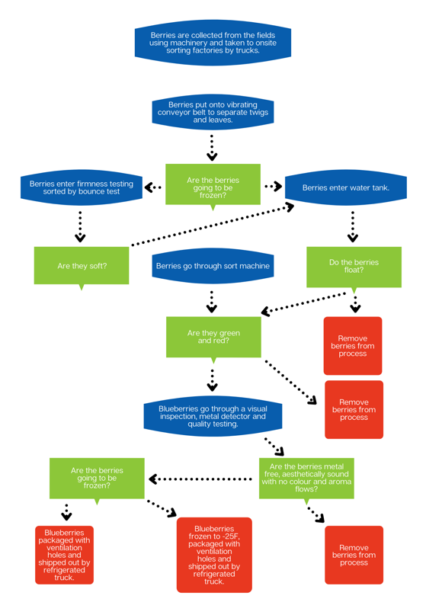
Activity 2F
Watch the video and complete the missing information on the flow chart. Each of the Green diamonds is a decision box with a yes/no question. Fill out Yes or No in the correct place on each of the black arrows coming from the diamond.

Slide 16
LESSON 3
Activity 3A
Use the information in the table to produce a bar graph to show the value of the export industry from 2009 – 2015.
Year | 2009/2010 | 2010/2011 | 2011/2012 | 2012/2013 | 2013/2014 | 2014/2015
Value (approx.) | $200,000 | $250,000 | $240,000 | $350,000 | $360,000 | $330,000
Value
Year

Slide 17
2. Describe the change in value of cucumber production referring to the graph created.
What is the overall pattern – change in value $
What year is there most growth?
What year is there the most loss?
3. Look at the list of statements below and describe how they might link to the changes you can see in the graph. Is there any evidence of these?
Land has been over worked and less nutrients in the soil.
More machinery used has reduced the need for workers on farms.
Farms have increased in size and smaller farms can’t compete.
Climate change has reduced yield of crops
Farmers have more land to use and have become less intensive with the use of the land.
Diseases and /or pests have decreased the yield.
4. Below data showing the yields of a cucumber crop over a two-year period. Work out the percentage change in crop yield using the data and the formula given.
Formula
A – B = X A = Yield 2008/9 = 26,156 Kg
X / A = Y B = Yield 2013/4 = 19,227 Kg
Y x 100 = % Change
Your Answer:

Slide 18
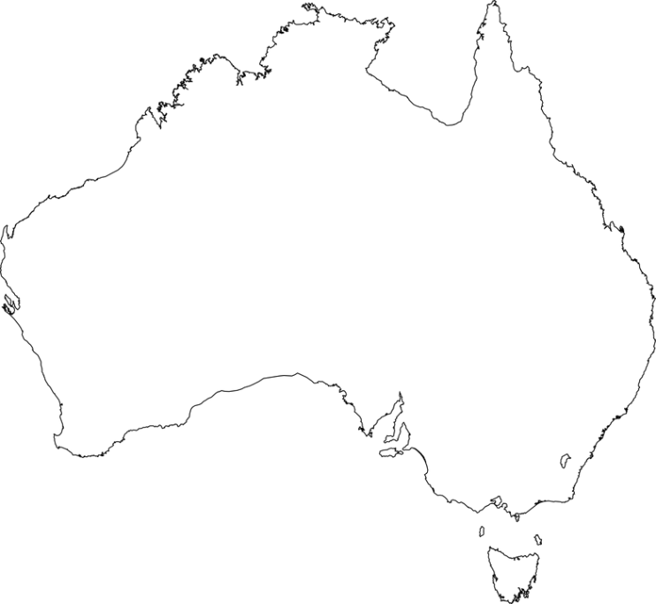
Activity 3B
1. Add the locations listed below onto the blank Australian map and make sure the BOLTSS mapping format is implemented (Border, Orientation, Legend, Title, Scale, Source).
Queensland: Bowen, Burdekin, Bundaberg, Lockyer Valley
South Australia: North Adelaide Plains, Riverland.
New South Wales: Greater Sydney Basin (Central Coast to Bargo, with epicentre in Western Liverpool),
Mid North Coast (including Coffs Harbour, Wardell and Woolgoolga Far west NSW centred in Gol Gol (adjacent to Sunraysia district of Vic
Victoria: Sunraysia, Melbourne Metro.
Western Australia: Geraldton, Metro outer areas.
Northern Territory: Humpty Doo.

Slide 19
Activity 3C
Answer the questions about the video.
1. Why do you think they have to suit up in the greenhouse?
2. What advantages are mentioned with regard to using a greenhouse and not an open field?
3. What natural ways are used to reduce flies and mosquitoes?
4. What would be a benefit of growing multiple varieties of cucumbers?
5. Reflect on the video:
Did the process seem to use a lot of people in the system?
What did the greenhouse look like?
What were the crops being grown in?
What would be the main costs of a farming system like this?

Slide 20
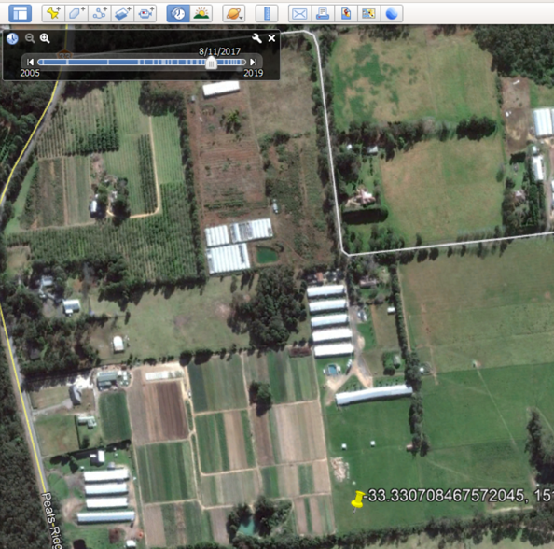
Activity 3C
6. You can find the location of the farm by searching the following G.P.S coordinates:
-33.32980717855362, 151.23758133316568
Search for this in Google Earth Pro.
Use the historical image icon to look back at the different stages of the farm’s growth. Use the measuring tools to look at the size of the structures and the distance to nearby markets/settlements for labour.

Slide 21
Activity 3C continued:
Answer these questions about the satellite image:
List any observations you make from comparing the images. Zoom out and look at the region surrounding the farm. Consider new structures, irrigation, land use around structures, distance from towns, size of farm.
Look at the following link of the new glasshouse featured in the video. Read through the website and list the technology used within the glasshouse to control growth conditions. https://familyfreshfarms.com.au/the-glasshouse/
Choose one of these features and explain how it controls the growing condition.
Can you work out from the image gallery where the new glasshouse is located on the farm? https://familyfreshfarms.com.au/gallery/

Slide 22

LESSON 4
Activity 4A
1. Watch the 2 videos about drones. Both videos show how drones are being used in agriculture to improve farming efficiency.
2. Fill in the benefits within the appropriate part of the Venn diagram. If you can think of additional impacts not mentioned on the video, then you should add these as well.
Social Impacts – Try and look at how people are impacted by the drone’s use.
Economic Impacts – Listen out for how this may impact the amount of money either spent or made on the use of the drones.
Environmental Impacts – How do you think the environment of the farmland as well as the surrounding area was impacted? This could be both positive and negative.

Slide 23
Activity 4B
Read the article and watch the video about modern approaches to hydroponics in an urban environment
2. Answer the following questions based on the article.
  What was the land used for previously and what benefits does this bring by changing its use?
  What was a key goal of the founding members of Thomas and Myers? Why did they see a need to set
  up this enterprise?
  What part of the system is highlighting as a high economic cost?
  Why might some environmentalists have an issue with the project?
  What environmental benefits does is mention as part of the “sustainable approach”?
  What are the social impacts of the project within the local community?
  In the first photo of the article there is a picture of the vertical garden with the salad plants stacked on top of each other. What is a benefit of doing this?

Slide 24
Activity 4C
1. Using the information you collect, write a 500-word report that discusses your chosen problem. You should include the positive and negative aspects when presenting your ideas.
Problems Facing Australia | Possible Solutions
Climate Change causing extreme weather events making crop growth difficult, (droughts, flooding, cyclones, bushfires) | Drone use on farms
Population Growth leading to a shortage of food. | Hydroponics
Land Degradation due to intense farming reducing fertility of land and crop yields. | Organic Farming
Cheaper Imports from other countries means demand for Australian grown crops is too low. | Urban Farms
Alien Invasion from pests, diseases and weeds makes farming inefficient. | Satellite
Shortage of labour as more people move to cities to work. Farms will no longer have the workforce to produce the crops. | Robots, GM Crops
b) Based on your chosen problem, answer these questions:
How do you think we should address the problem you have chosen?
How effective do you think this will be?
Advantages and disadvantages
How effective will this be in Australia
Could this be used worldwide?
Challenges faced by this.

Slide 25
Activity 4C continued:
c) Complete the table below by adding possible solutions.
Problems Facing Australia | Possible Solutions
Climate Change causing extreme weather events making crop growth difficult, (droughts, flooding, cyclones, bushfires)
Population Growth leading to a shortage of food.
Land Degradation due to intense farming reducing fertility of land and crop yields.
Cheaper Imports from other countries means demand for Australian grown crops is too low.
Alien Invasion from pests, diseases and weeds makes farming inefficient.
Shortage of labour as more people move to cities to work. Farms will no longer have the workforce to produce the crops.

Slide 26
Report
Paste your report below:

Slide 27
Report
Paste your report below:

Slide 28
End of Unit - Reflection
Congratulations on completing the lessons on horticulture in Australia. Hopefully you are more aware now of the very diverse industry that impacts so many people around Australia and the world, and can see how it is a constantly evolving industry looking to make the processes more efficient to benefit the environment, the people and the economy.
Please place a mark on the scale below to answer the questions.
How much did I know about protected cropping before this unit?
1________________________10
How much do I understand now?
1________________________10
How important will protected cropping be to food security in the future?
1________________________10
Should this be protected cropping or protected horticulture?
1________________________10

